Slide 1
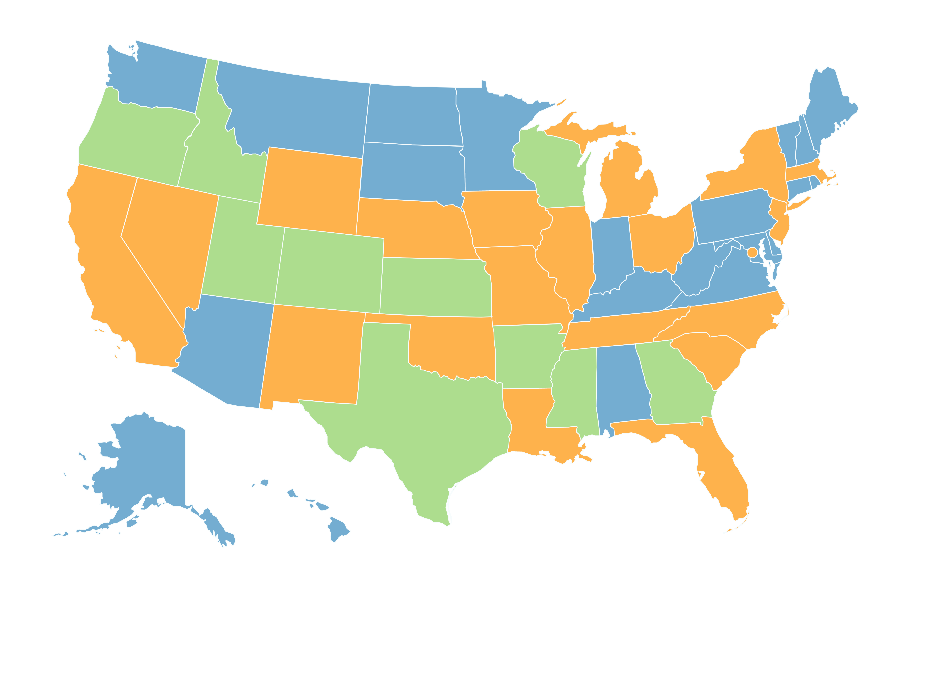



The Post-Heller Fate of “Campus Carry”:
Policy & Prohibition in New Hampshire and Beyond
University System of New Hampshire v. Bradley Jardis, et al. (2012): A NH Superior Court held that the state’s public universities have ”broad authority” to develop policies, including firearms prohibitions. The ruling distinguished between towns and school districts, where such prohibition would be preempted by state law*, and USNH, a creature of the state but not its alter ego.
Oregon Firearms Educational Foundation v. Board of Higher Education (2011): Oregon Court of Appeals struck down Oregon University System’s firearms prohibition, created through the Board’s “quasi-legislative ‘lawmaking’ authority.” The court concluded that the policy must be pre-empted as “an exercise of an ‘authority to regulate’ firearms” exceeding the Board’s authority to do so.
Glass et al. v. Paxton et al. (2018): The Court of Appeals for the 5th US District rejected arguments made by professors at University of Texas – Austin. In upholding a state law allowing campus carry, the court determined that self-censorship amounting to a ”subjective chill” cannot be viewed as a violation of 1st Amendment free speech rights; that arguments against an individual rights-interpretation of 2nd Amendment are “foreclosed by Heller”; and that equal protections granted by the 14th Amendment do not apply because “professors are not members of a protected class.”
District of Columbia v. Heller (2008): The US Supreme Court struck down a DC handgun ban, and redefined the 2nd Amendment “right to keep and bear arms” as an individual right unconnected to militia service. McDonald v. Chicago (2010) extended that individual right to people who meet licensing and permitting requirements in every state in the country.
“Campus Carry” by State
Guns allowed by law (10 states)
Guns banned by law (19 states + DC)
Institutional/system choice (21 states)
Jacob A. Bennett | Ph.D. candidate, Education Dept., Leadership & Policy Studies jacob.bennett@unh.edu | @ProfBennyBull
*NH House Bill 101, introduced in 2019, would allow “a school district, school administrative unit, or chartered public school to adopt and enforce a policy regulating firearms, firearms components, ammunition, firearms supplies, or knives within its jurisdiction.”

