Slide 1


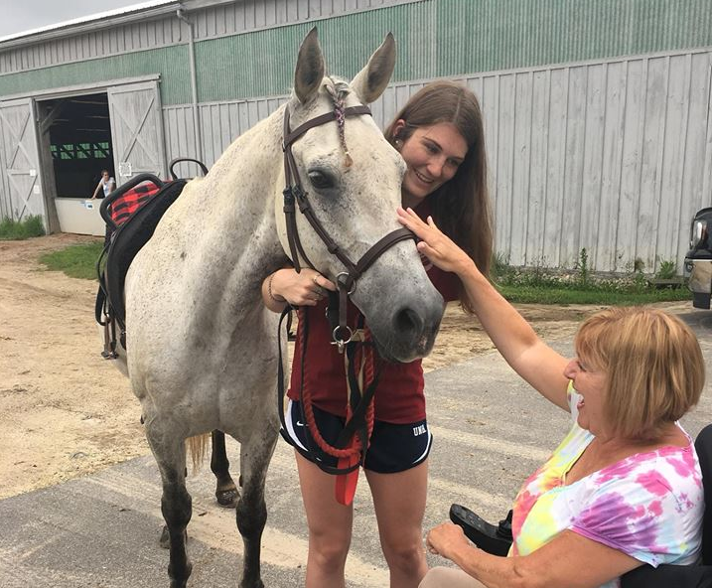
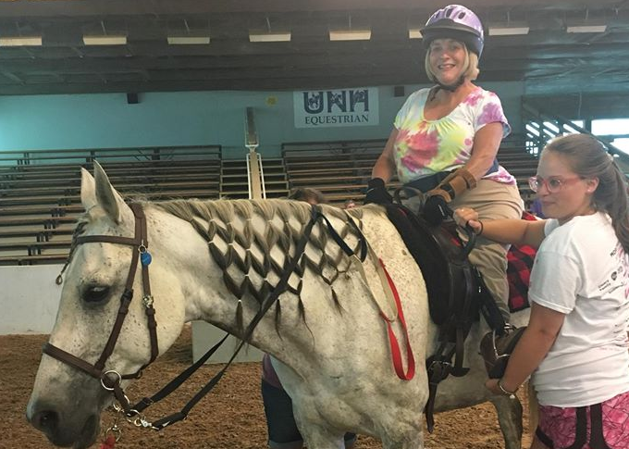
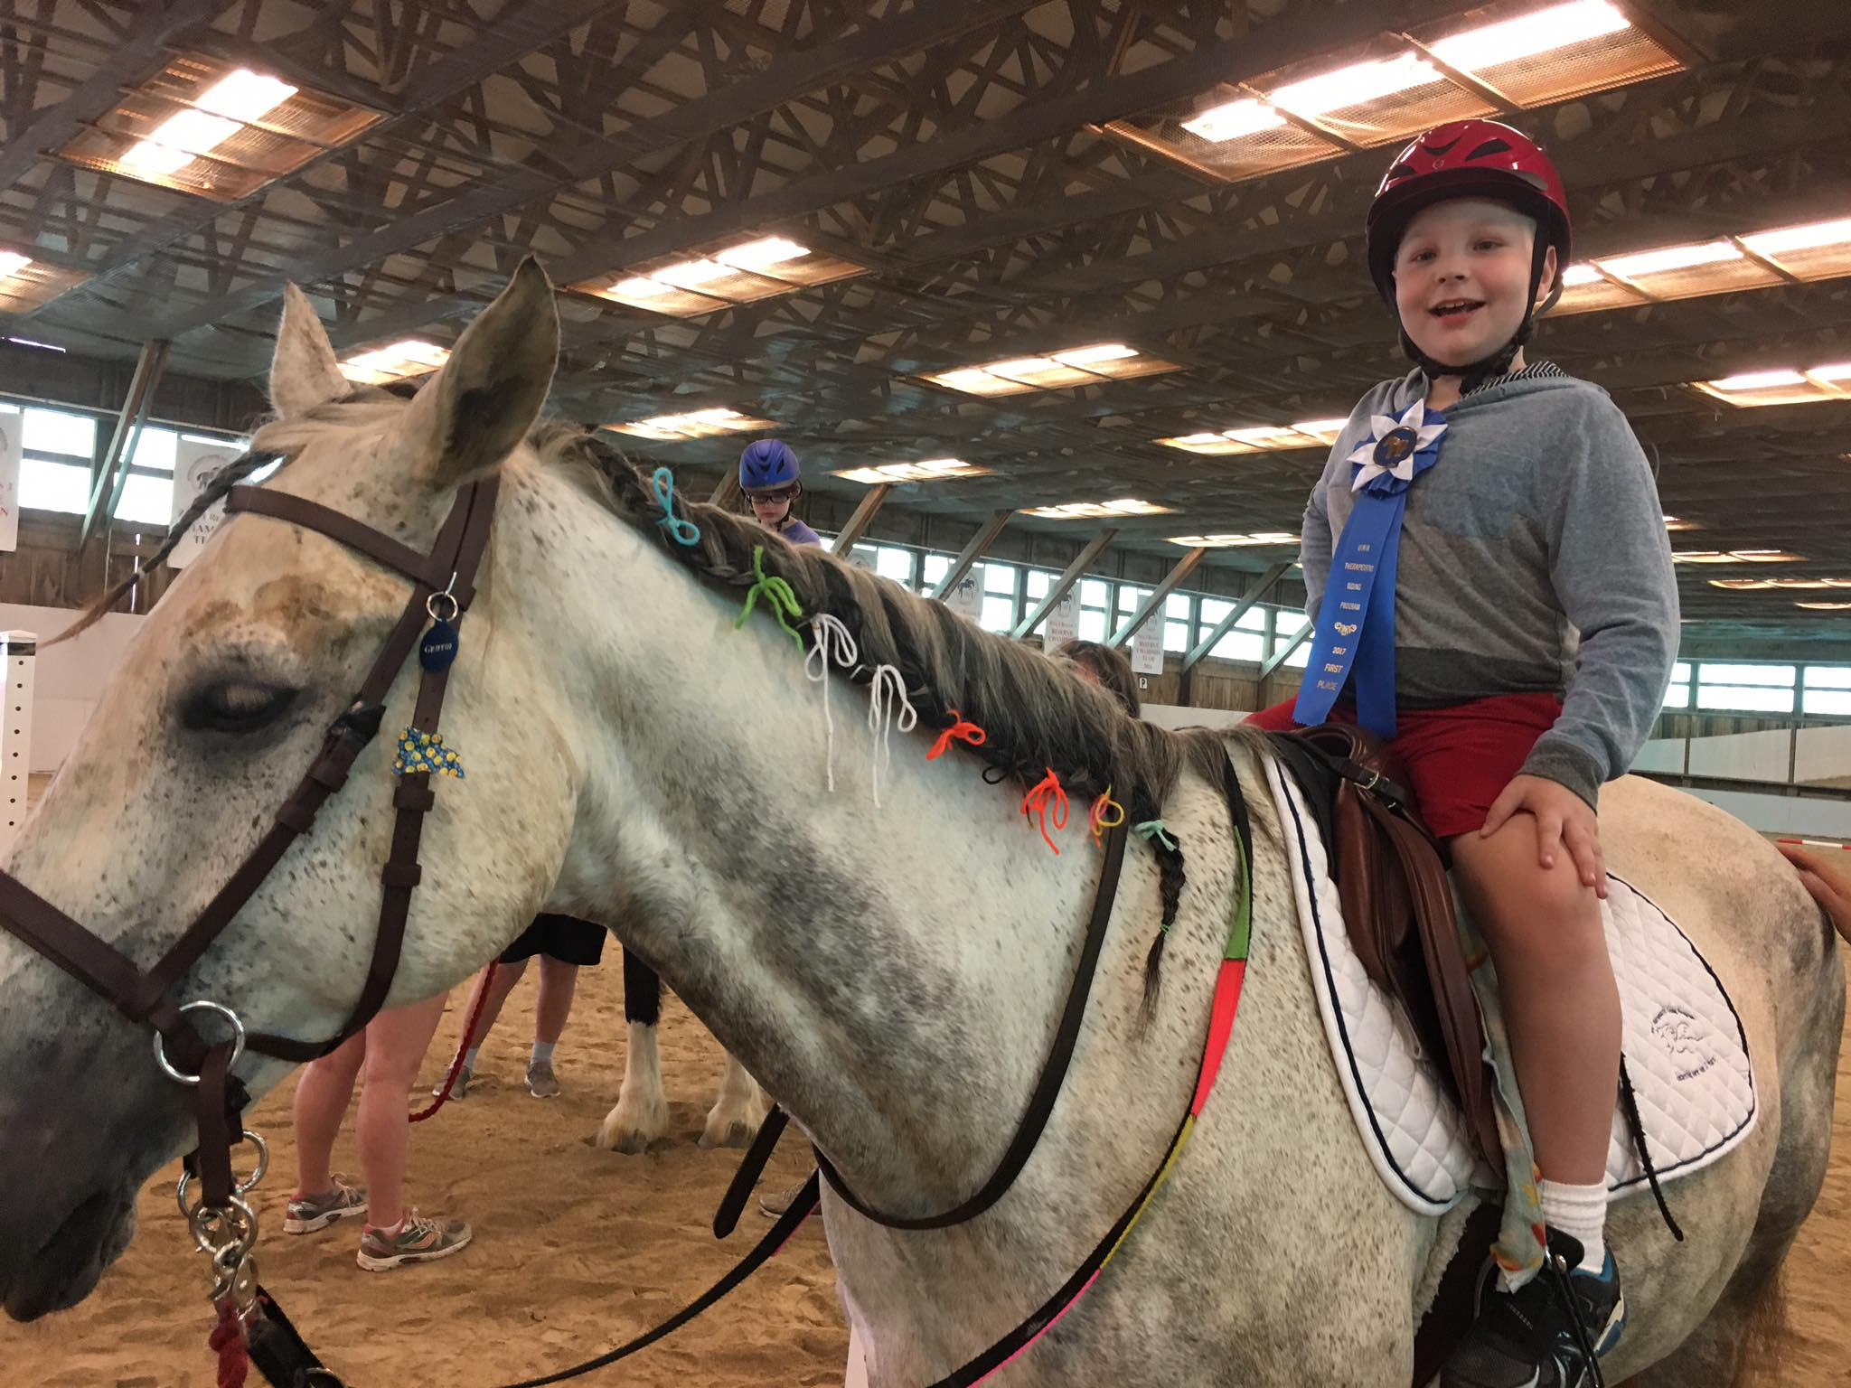
The Magic of Horses:
A Phenomenological Study Exploring the Meaning of
Therapeutic Riding for Youth At-Risk
Lizzy Fowler, Patti Craig, Ph.D., CTRS/L, Cindy Burke, UNH Therapeutic Riding Program Director
Department of Recreation Management and Policy, University of New Hampshire
Introduction
Potential Outcomes and Benefits
Youth
At-Risk
A child or adolescent under the age of 18 who has a greater probability of having poor life outcomes due to certain life experiences (Kominski et al., 2001).
Therapeutic Riding
Equine-Assisted Activities and Therapies
Uses traditional riding disciplines and/or adapted riding activities to achieve therapeutic goals (NARHA, 2007).
Purpose
Understand the meaning of therapeutic riding for at-risk youth
Problem
Explore psychological influence of therapeutic riding (i.e., empathy, trust, & confidence)
Most research focuses on the physical benefits of therapeutic riding
Research of psychological benefits tend to be reported by instructors and/or parents, not by youth
Human Animal Bond Theory (Bachi et al., 2012)
Anticipated outcomes*
Understand the meaning of therapeutic riding for at-risk youth
Psychological well-being (i.e., empathy, trust, & confidence)
Possible Benefits*
Instructor knowledge
Rider/parent reflection and knowledge
Improved programing which enhances rider experience
Methods
Phenomenological research design: A descriptive, reflective and interpretive mode of inquiry that seeks to understand and describe the essence of a lived experience (Moustakas, 1984)
Three-part phenomenological interviewing strategy (Seidman, 2013)
Setting: UNH Therapeutic Riding Program
Participants: Convenience sample of 3-5 youth that meet inclusion criteria (i.e., family situation, disability)
Phenomenological Interview Method
* Data collection in progress
Part 1:
History
Demographics and brief description of current living situation.
What led the participants to therapeutic riding?
Part 2:
The Experience
What happens during a lesson?
Part 3:
Reflection
of Meaning
Expectations (of/from horses, volunteers, instructors, etc.)
Interactions (i.e., with horses, volunteers, instructors, etc.)
Feelings
Thoughts
Impact
Riding skills
References
.
Bachi, K., Terkel, J., & Teichman, M. (2012). Equine-facilitated psychotherapy for at-risk adolescents: The influence on self-image, self-control and trust. Clinical Child Psychology and Psychiatry, 17(2), 298-312. doi:10.1177/1359104511404177
Kominski, R., Jamieson, A., & Martinez, G. (2001). At-risk conditions of U.S. school-age children. Washington, DC: US Census Bureau. Retrieved from: http://www.census.gov/population/www/documentation/twps0052.html.
Moustakas, C. (1994). Phenomenological research methods. Thousand Oaks, CA: Sage
North American Riding for the Handicapped Association Standards and Accreditation Manual for NARHA Centers (2007). [Binder]. Denver, CO: Author.
Seidman, I. (2013). Interviewing as qualitative research: A guide for researchers in education & the social sciences, Fourth edition. New York, NY: Teachers College Press.

Slide 2

This poster template provided courtesy of
UNH ESRC Poster Printing Services
Trust us to make your poster look GREAT!
Website: http://posters.unh.edu
Poster Guide: http://goo.gl/1E7TJY
DELETE THIS SLIDE BEFORE PRINTING

