Slide 1


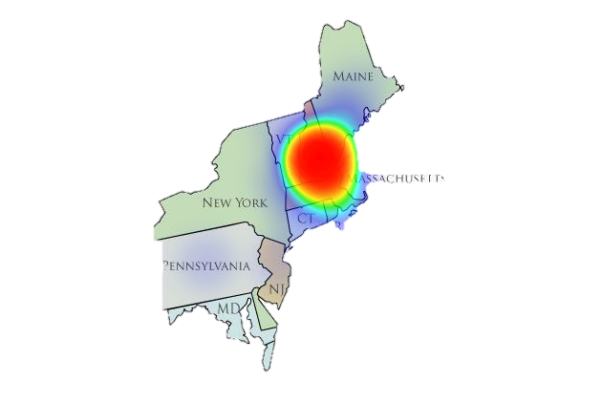
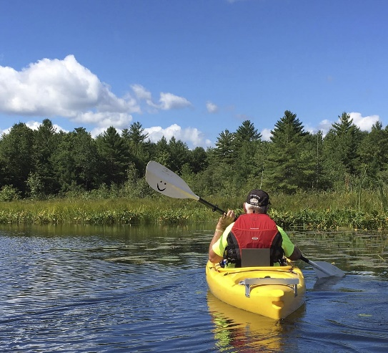
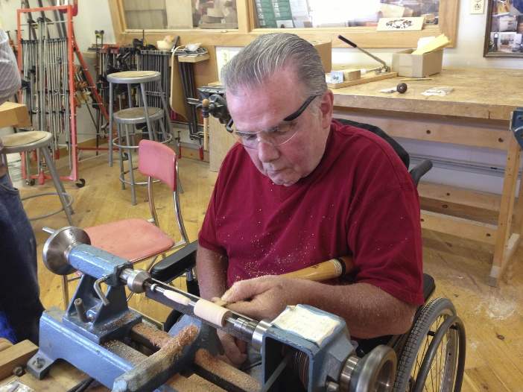
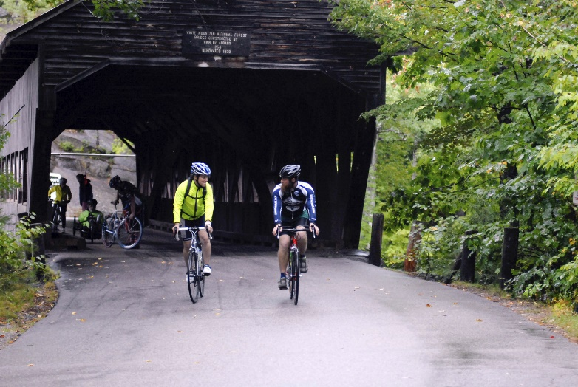
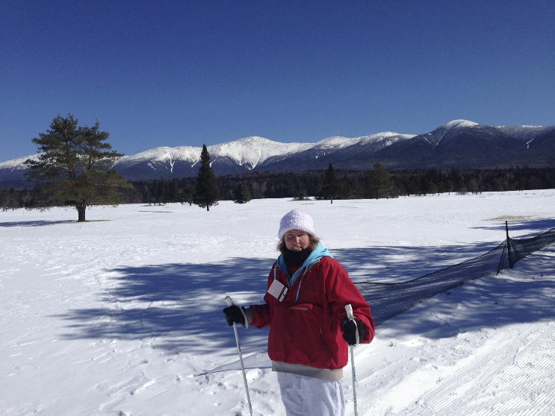
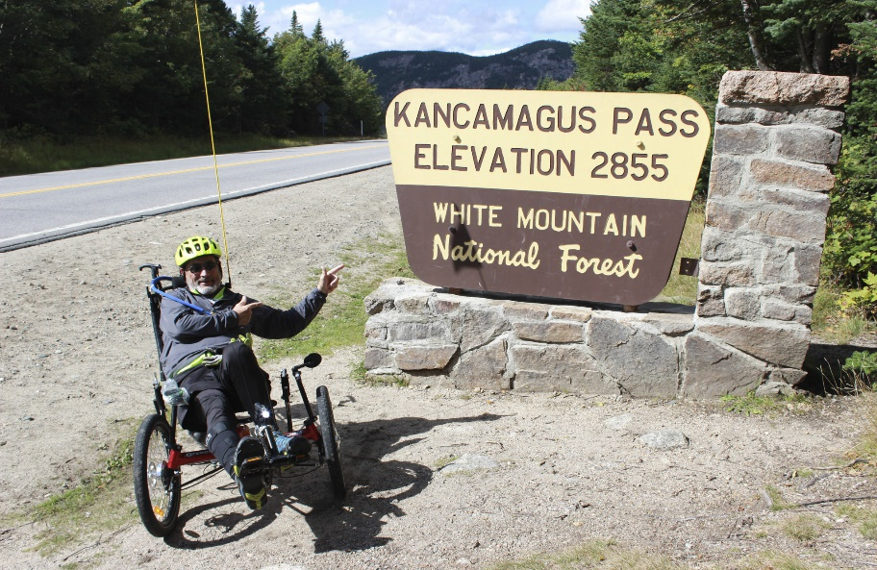
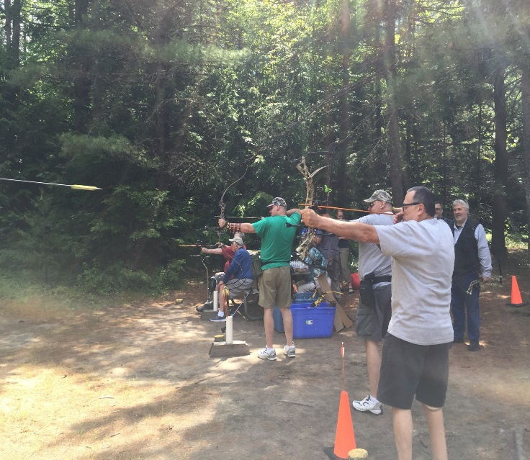
Constraints and Negotiations to Recreation Participation
Among Military Veterans with Disabilities
Elizabeth Attisano; Jessie Bennett, Ph.D. CTRS/L; Patricia Craig, Ph.D. CTRS/L; Dave Lee, CTRS/L
Department of Recreation Management and Policy, University of New Hampshire
Background
Purpose Statement
Anticipated Outcomes*
Veterans with disabilities are at risk of increased suicide rates compared to the civilian population (Nelson et al., 2017).
For Veterans who experience mental health disorders, their daily lives are often represented by choices made to reduce or simply endure symptoms instead of choices that support health and well-being (Price et al., 2015).
Therapeutic Recreation services have shown to be effective for Veterans of all ages and abilities.
This study was grounded in Leisure Constraints Theory (LCT) (Crawford et al., 1991).
  Negotiation strategies
Previous research has found Veterans are experiencing three different types of constraints that inhibit them from participating in recreation.
  Intrapersonal (e.g., self-esteem)
  Interpersonal (e.g., making friends)
  Structural (e.g., transportation)
The purpose of this study is to examine constraints and negotiations to recreation participation among Veterans with disabilities.
To determine what the key constraints are for Veterans.
  Intrapersonal
  Interpersonal
  Structural
To determine the key negotiation strategies for each of those constraints.
*Data collection in progress
Figure 1: Geographic Location of Respondents
Potential Benefits
Methods
The goal will be to fill gaps in the literature and provide new information to help recreational therapy programs reach and serve Veterans with disabilities in a more effective way.
To reduce constraints through programmatic facilitation techniques.
To develop skills for Veterans through interventions.
Online cross-sectional survey method.
Sample: Military Veterans with disabilities in the northeast region of the U.S.
Approximately 900 individuals received Qualtrics survey via the Northeast Passage listserv.
The constraints and negotiations were developed based on the principles of LCT and adapted to include Veteran-specific constraints and negotiation strategies.
The data will be analyzed using descriptive statistics.
Research Questions
What are the strongest constraints to recreation participation among Veterans?
What are the strongest negotiation strategies used by Veterans who experience constraints to recreation participation?
Amireault, S., & Godin, G. (2015)., Bennett, J. L., Piatt, J. A., & Van Puymbroeck, M. (2017), Bennett, J. L., Trauntvein, N., Craig, P., Jeralds, M., & Lee, D. (2015), Crawford, D. W., Jackson, E. L., & Godbey, G. (1991), Nelson, H. D., Denneson, L. M., Low, A. R., Bauer, B. W., O'Neil, M., Kansagara, D., & Teo, A. R. (2017), Price, W. D., Lundberg, N. R., Zabriskie, R. B., & Barney, K. W. (2015), & Ware, J. E. Jr., Kosinki, M., & Keller, S. (1996).
Notes:
Introduction/background – why are you doing this? What is the problem?
- recreation has show to be beneficial
- veterans aren’t attending, why?
Purpose – purpose statement

