Slide 1

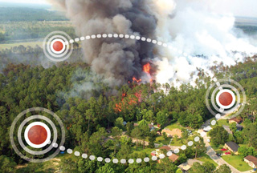
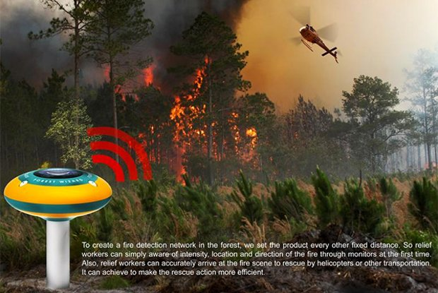
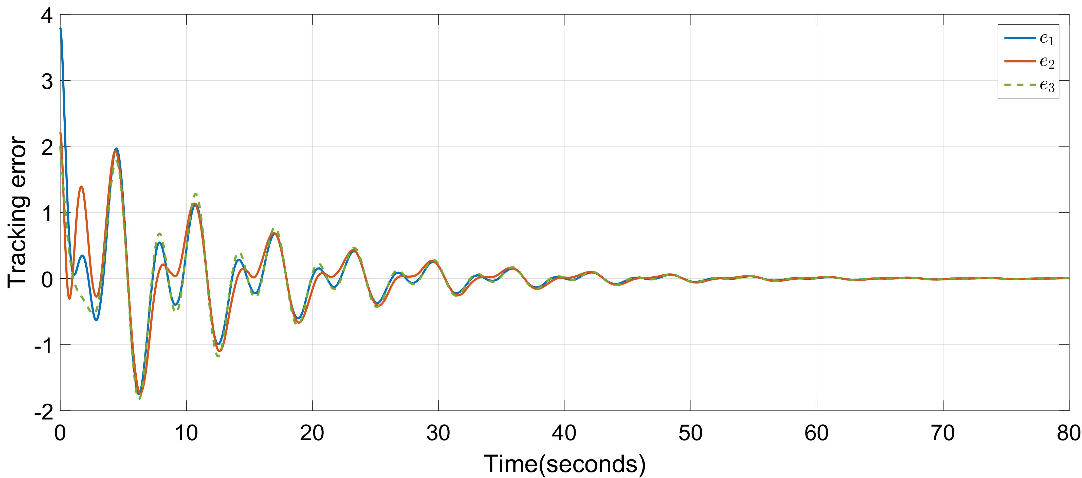
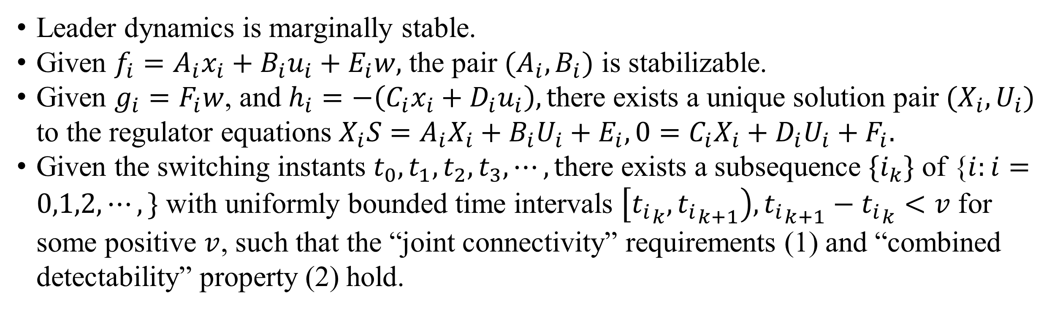
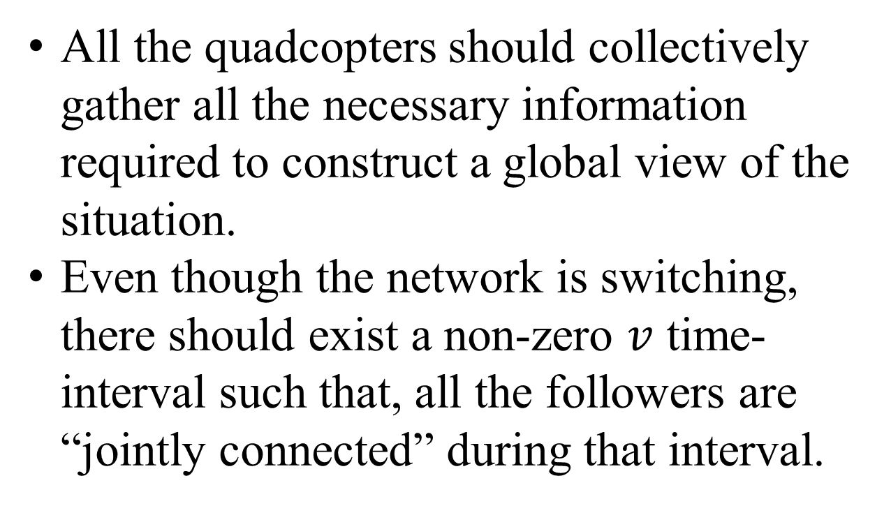
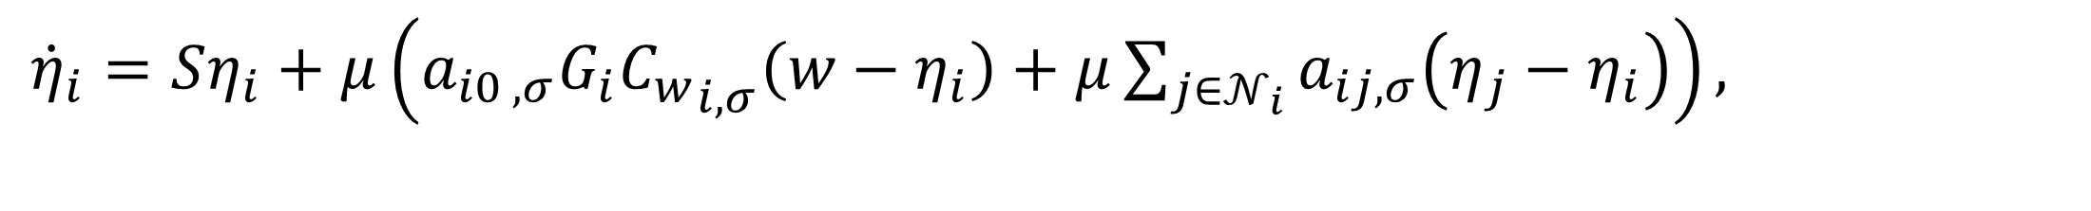
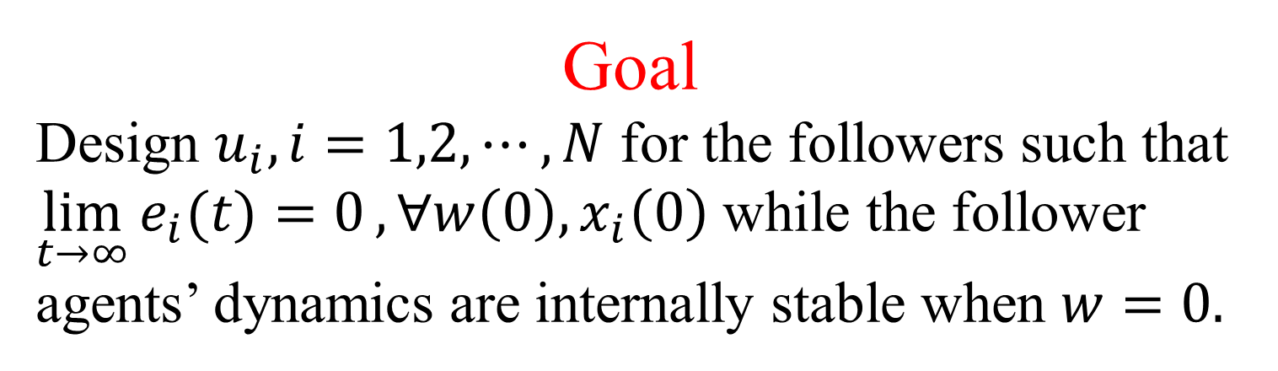
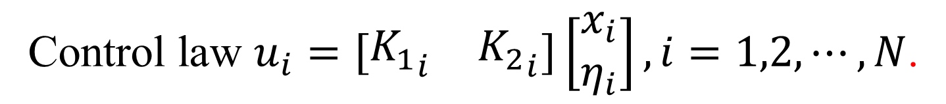
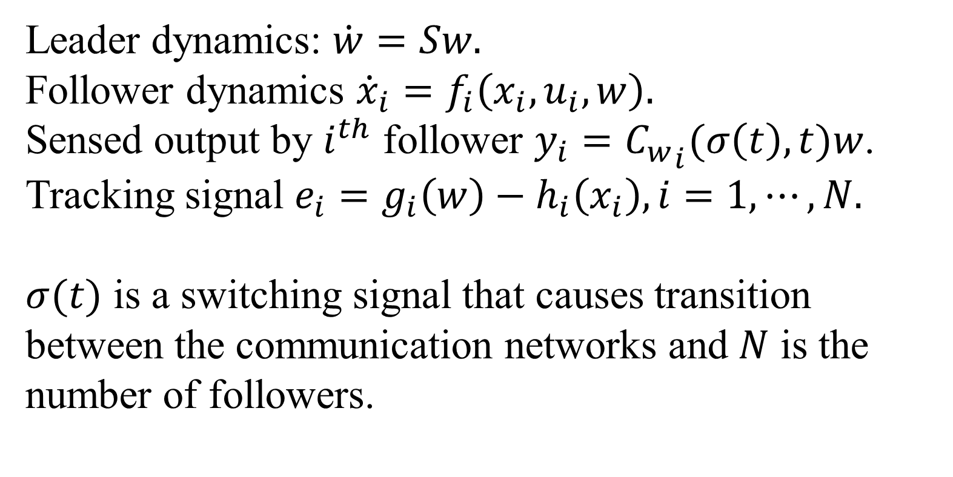
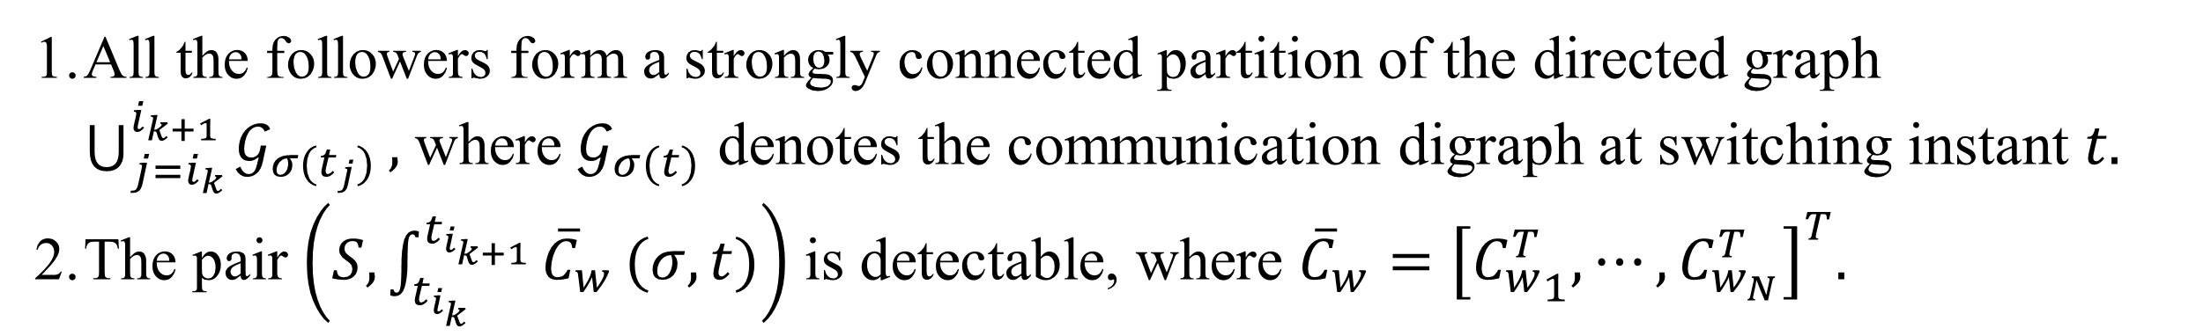
Cooperative Control of Multi-Agent Systems in Robotic Applications
Himadri Basu, Se Young Yoon
Mechatronics and Controls Lab, Department of Electrical and Computer Engineering, University of New Hampshire
Problem: Synchronize a group of autonomous dynamic systems under unreliable communication and limited access to the synchronization signals.
Challenges
Problem Assumptions
Communication among the firefighting quadcopters is limited by the obstacles such as trees, mountains etc.
Each of the quadcopters can capture only a small portion of the blaze owing to their limited field of view.
Leader dynamics is marginally stable.
Given $f_{i}=A_{i}x_{i}+B_{i}u_{i}+E_{i}w,$ the pair $(A_{i},B_{i})$ is stabilizable.
Given $g_{i}=F_{i}w$, and $h_{i}=−\left(C_{i}x_{i}+D_{i}u_{i}\right), t$here exists a unique solution pair $(X_{i},U_{i})$ to the regulator equations $X_{i}S=A_{i}X_{i}+B_{i}U_{i}+E_{i},0=C_{i}X_{i}+D_{i}U_{i}+F_{i}.$
Given the switching instants $t_{0},t_{1},t_{2},t_{3},⋯,t$here exists a subsequence $\{i_{k}\}$ of {$i:i=0,1,2,⋯,\}$ with uniformly bounded time intervals $\left[{t_{i}}_{k},{t_{i}}_{k+1}\right), {t_{i}}_{k+1}−{t_{i}}_{k}<v$ for some positive $v$, such that the “joint connectivity” requirements (1) and “combined detectability” property (2) hold.
Problem Formulation
Leader dynamics: $\dot{w}=Sw.$
Follower dynamics ${\dot{x}}_{i}=f_{i}\left(x_{i},u_{i},w\right).$
Sensed output by $i^{th}$ follower $y_{i}={C_{w}}_{i}(σ\left(t\right),t)w$. Tracking signal $e_{i}=g_{i}\left(w\right)−h_{i}\left(x_{i}\right), i=1,⋯,N.$
$σ(t)$ is a switching signal that causes transition between the communication networks and $N$ is the number of followers.
Leader: Dynamics of the fire outbreak
Follower: Quadcopters
Remedy
All the followers form a strongly connected partition of the directed graph $\bigcup_{j=i_{k}}^{i_{k+1}}{𝒢_{σ(t_{j})}},$ where $𝒢_{σ(t)}$ denotes the communication digraph at switching instant $t.$
The pair $\left(S,\int_{t_{i_{k}}}^{t_{i_{k+1}}}{{\overline{C}}_{w}}(σ,t)\right)$ is detectable, where ${\overline{C}}_{w}={\left[{C_{w}^{T}}_{1},⋯,C_{w_{N}}^{T}\right]}^{T}.$
All the quadcopters should collectively gather all the necessary information required to construct a global view of the situation.
Even though the network is switching, there should exist a non-zero $v$ time-interval such that, all the followers are “jointly connected” during that interval.
Goal
Design $u_{i}, i=1,2,⋯,N$ for the followers such that $\lim_{t→∞}{e_{i}(t)=0},∀w\left(0\right),x_{i}\left(0\right)$ while the follower agents’ dynamics are internally stable when $w=0.$
Distributed state estimation and control algorithm
Control law $u_{i}=\left[\begin{matrix}{K_{1}}_{i} & {K_{2}}_{i}\end{matrix}\right]\left[\begin{matrix}x_{i} \\ η_{i}\end{matrix}\right],i=1,2,⋯,N$.
${\dot{η}}_{i}=Sη_{i}+μ\left(a_{i0 ,σ}G_{i}{C_{w}}_{i,σ}\left(w−η_{i}\right)+μ\sum_{j∈𝒩_{i}}{a_{ij,σ}\left(η_{j}−η_{i}\right)}\right),$
Motivating Example: Extinguishing forest fire with multiple quadcopters
$η_{i}$ is an estimated leader state by follower $i$ and $j^{th}$ follower is in its neighborhood.
References
R. Seth, The Forest Fire Alarm, https://www.yankodesign.com/2014/07/07/the-forest-fire-alarm/, 2014.

