Slide 1

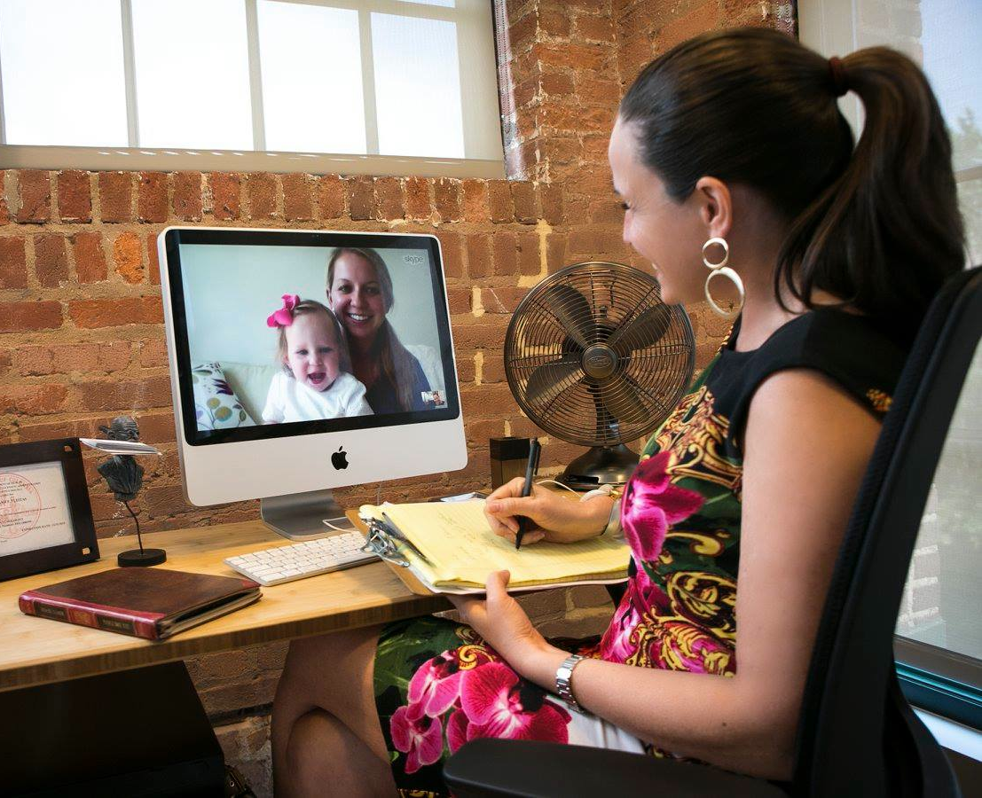

Perceptions of Telehealth in Occupational Therapy through
Level I Fieldwork
Courtney Bowman, OTS Carolyn D’Olympio, OTS Tracey Ellis, OTR/L MPH Kathryn Holloran, MA, BCBA Amy B. VanCamp, OTD, OTR/L
Telehealth as Fieldwork
Newest wave of healthcare services
True experience in interdisciplinary care
Removes geographic barriers for clients
More flexible care for clients, students, and practitioners
Increased accessibility and efficiency
Reduced travels costs
Access to variety of specialists and resources
BEFORE
STUDENT PERCEPTIONS
AFTER
How nervous we were
“Now I can navigate a telehealth database, send links for therapy sessions, and ensure electronic medical information is kept secure.”
“I’m not skilled with technology.”
“I’ve never used telehealth before.”
How prepared we felt
“I’m confident in using telehealth to provide occupational therapy services.”
“Will we learn as much as our peers who are in traditional fieldwork?”
How much we learned
“Modalities of telehealth, ethics, transdiciplinary care, consultative approaches, HIPAA adherence with electronic medical records, flexibility, scheduling, and billing.”
“Can we establish the same rapport with clients as we would in face to face care?”
Professional OT via telehealth
“Our clients share the comfortability and confidence of receiving our care. It feels as though we have known many of the teachers and families forever.”
evolving
learning
CREATIVITY
time zones
HIPAA
CULTURE
CONNECTION
variety
technology
international
communication
professional
rapport
ethics
therapy
problem solving
synchronous
CULTIVATION
EMR
etiquette
asynchronous
flexibility
modalities

