Slide 1


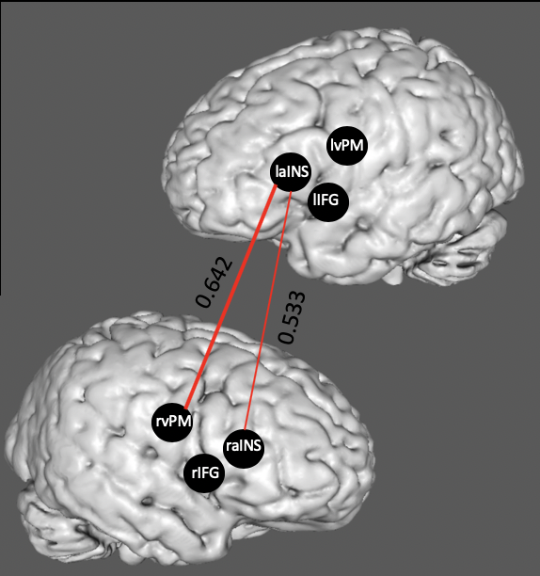
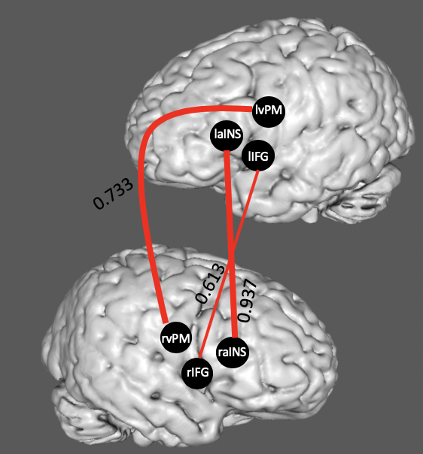
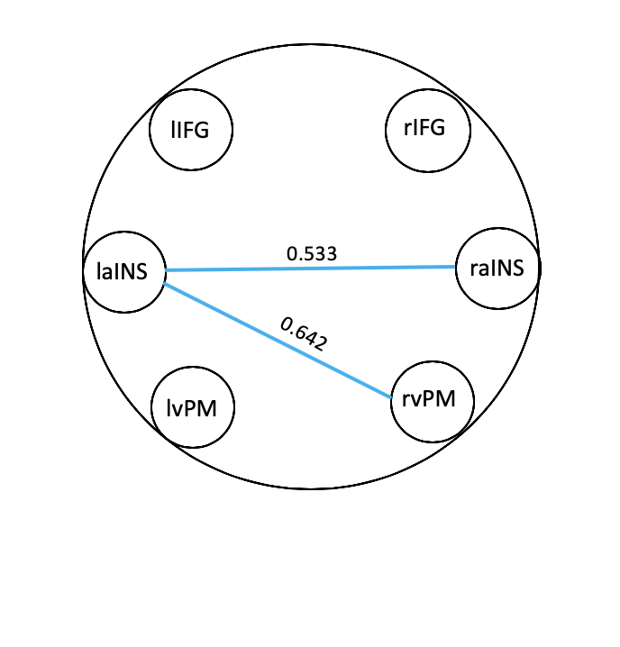
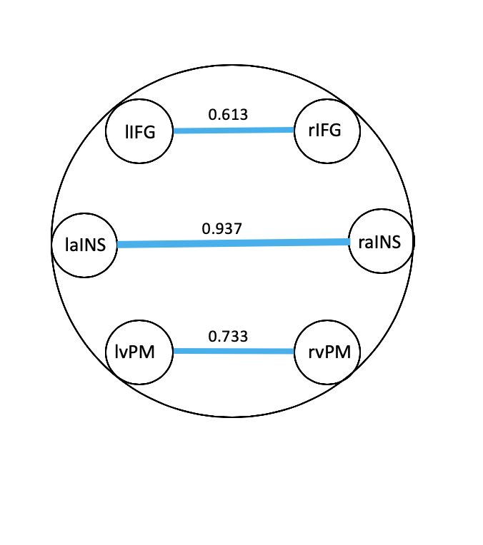
Resting State Functional Connectivity Analysis in Children with Childhood Apraxia of Speech Following the Treatment for Establishing Motor Program Organization (TEMPO)
Morgan F. James, Amy E. Ramage, PhD, Jenna L. Campbell, PhD, Kirrie J. Ballard, PhD, Donald A. Robin, PhD
Childhood Apraxia of Speech
Imaging Data Analysis
Childhood Apraxia of Speech (CAS) is a a motor programming disorder that disrupts spatial and temporal parameters for accurate production of speech sounds [1, 7]
Core Perceptual Features:
  Segmentation (longer than normal time between syllables)
  Lack of stress contrast (PApa pronounced papa)
  Distorted sounds
Regions of interest informed by: the Directions into Velocities of Articulators DIVA, meta-analyses [2, 8] and a resting state fMRI study investigating network connectivity in AOS, non-AOS and healthy control subjects [11]
Resting state fMRI (rsfMRI) allows for the investigation of the relationship of brain regions independent of task performance
Treatment for Establishing Motor Program Organization (TEMPO)
Region of Interest | MNI Coordinates
 | X | Y | Z
Left inferior frontal gyrus (BA44) (lIFG) | -50 | 10 | 5
Left inferior frontal gyrus (rIFG) | 50 | 10 | 5
Left anterior insula (laINS) | -32 | 15 | 2
Right anterior insula (raINS) | 32 | 15 | 2
Left ventral premotor cortex (BA6) (lvPM) | -58 | 1 | 23
Right ventral premotor cortex (rvPM) | 58 | 1 | 23
Pre-TEMPO
Post-TEMPO
Intervention explicitly targets each of the three features of CAS through repeated productions of multisyllabic nonwords (eg. TAgibu, buGIta)
  Twenty stimuli (10 SW and 10 WS) randomly selected per session.
Principles of Motor Learning and Experience-Dependent Neural Plasticity
TEMPO is structured using principles of motor learning (PML) that are known to promote long-term learning and generalization of speech [6]
    e.g. high repetitions, varied stimuli, random practice, specific feedback
PML engage experience-dependent neural plasticity- the ability of the brain to change and adapt in response to environmental cues, experience and behavior.
Hypotheses
Results
There will be an increase in functional connectivity between brain regions associated with speech production and childhood apraxia of speech
TEMPO was found to effectively treat the core features of CAS in this individual
Increased connectivity between all bilateral seeds was observed post-treatment compared to pre-treatment particularly lvPM--rvPM and laINS--raINS
Treatment Design
References
TEMPO Treatment Design
Treatment then consisted of 1-hour sessions, 4 days per week for 4 weeks.
3 baseline probes prior, 2 post-treatment probes, 1 3-month retention probe
Imaging sessions were conducted within one week of the start time of treatment and within one week once treatment ended.
Treatment Results
  Treatment results paralleled a group study (n=12) investigating TEMPO [9]
  The participant met all inclusion criteria proposed by the larger group study.
American Speech-Language-Hearing Association. (2007). Childhood apraxia of speech [Position statement]. Available from www. Asha.org/policy
Ballard, K. J., Tourville, J. A., Robin, D. A. (2014). Behavioral, computational, and neuroimaging studies of acquired apraxia of speech. Frontiers in Human Neuroscience, 8, 892. doi: 10.3389/fnhum.2014.00892
Duffy, J. R. (2013). Motor speech disorders: Substrates, differential diagnosis, and management. St. Louis, MO: Elsevier-Mosby.
Kent, R. D., & Read, C. (1992). The acoustic analysis of speech. San Diego, CA: Singular.
Kleim, J. A. & Jones, T. A. (2008). Principles of experience-dependent neural plasticity: Implications for rehabilitation after brain damage. Journal of Speech, Language, and Hearing research, 51, S225-S239.
Maas, E., Robin, D. A., Austermann Hula, S. N., Freedman, S. E., Wulf, G., Ballard, K. J., & Schmidt, R. A. (2008). Principles of motor learning in treatment of motor speech disorders. American Journal of Speech-Language Pathology, 17, 277-298. doi:10.1044/1058-0360(2008/025).
Maas, E., Robin, D. A., Wright, D. L., Ballard, K. J. (2008). Motor programming in apraxia of speech. Brain & Language, 106, 107-118.
McNeil, M. R., Robin, D. A., & Schmidt, R. A. (2009). Apraxia of speech: Definition and differential diagnosis. In M. R. McNeil (Ed.), Clinical management of sensorimotor speech disorders (pp. 249-268). New York, NY: Thieme.
Miller, H (2018). Improvements in Speech of Children with Apraxia: The Efficacy of a Treatment for Establishing Motor Program Organization (TEMPO). (Unpublished Master’s Thesis).
Murray, E., McCabe, P., Heard, P., & Ballard, K. J. (2015). Differential diagnosis of children with suspected childhood apraxia of speech. Journal of Speech, Language, and Hearing Research, 58, 43-60. doi:10.1044/2014_JSLHR-S-12-0358.
New, A.B., Robin, D., Parkinson, A., Eickhoff, C., Kathrin, R., Hoffstaedter, F., …, Eickhoff, S. (2015). The intrinsic resting state voice network in Parkinson’s disease: Intrinsic Voice Network in Parkinson’s Disease. Human Brain Mappings, 36(5). doi: 10.1002/hbm.22748
New, A. B., Robin, D., Parkinson, A., Duffy, J., McNeil, M., Piguet, O., …, Ballard, K. (2015). Altered Resting-State Network Connectivity in Stroke Patients with and without Apraxia of Speech. Neuroimage Clinical, 8, 429-439. doi: 10.1016/j.nicl.2015.03.013
Schmidt, R. & Lee, T. (2005) Motor control and learning: A behavioral emphasis (4th ed.). Champaign, IL: Human Kinetics.
Notes:
Connectivity refers to how regions of the brain talk to each other. Specifically, our primary hypothesis is that there will be increases in connectivity between L and R premotor cortices. It is also the case that other regions connection strength changes as a result of treatment
In this case, that experience is the principles of motor learning driven TEMPO treatment

Slide 2
Regions of interest for this study were informed through meta-analyses, as well as the Directions into Velocities of Articulators (DIVA) model of motor speech production and the New et al. 2015 resting state fMRI study investigating differences in network connectivity.
Resting state functional magnetic resonance imaging (rsfMRI) , allows for the investigation of the relationship of brain regions independent of task performance
Neural plasticity is the ability of the brain to change and adapt in response to environmental cues, experience and behavior. In this case, that experience is the principles of motor learning driven TEMPO treatment
Hypotheses
There will be increased in functional connectivity between brain regions associated with speech production and childhood apraxia of speech. Connectivity refers to how regions of the brain talk to each other. Specifically, our primary hypothesis is that there will be increases in connectivity between L and R premotor cortices. It is also the case that other regions connection strength changes as a result of treatment
Single-Subject Study Design
7 year old male, normal hearing, no orofacial structural abnormalities, muscle weakness or altered tone/reflex, native speaker of English, no other developmental, neurological, genetic or speech disorders, and a diagnosis of CAS made by expert consensus
Imaging data was collected on a 3-Tesla Siemens fMRI scanner. Analysis was completed using SPM12, and by extracting the time course for each ROI as the eigenvariate of the resting-state signal time-series of all grey-matter voxels located within 5mm of the respective peak coordinate
Treatment Outcomes
Treatment results paralleled a group study (n=12) investigating TEMPO (Miller et al., 2018), in which treated stimuli improved from baseline to post-treatment probe, and demonstrated maintenance at the 3-month retention probe

