Slide 1
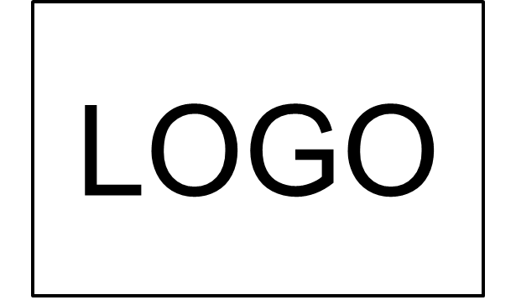
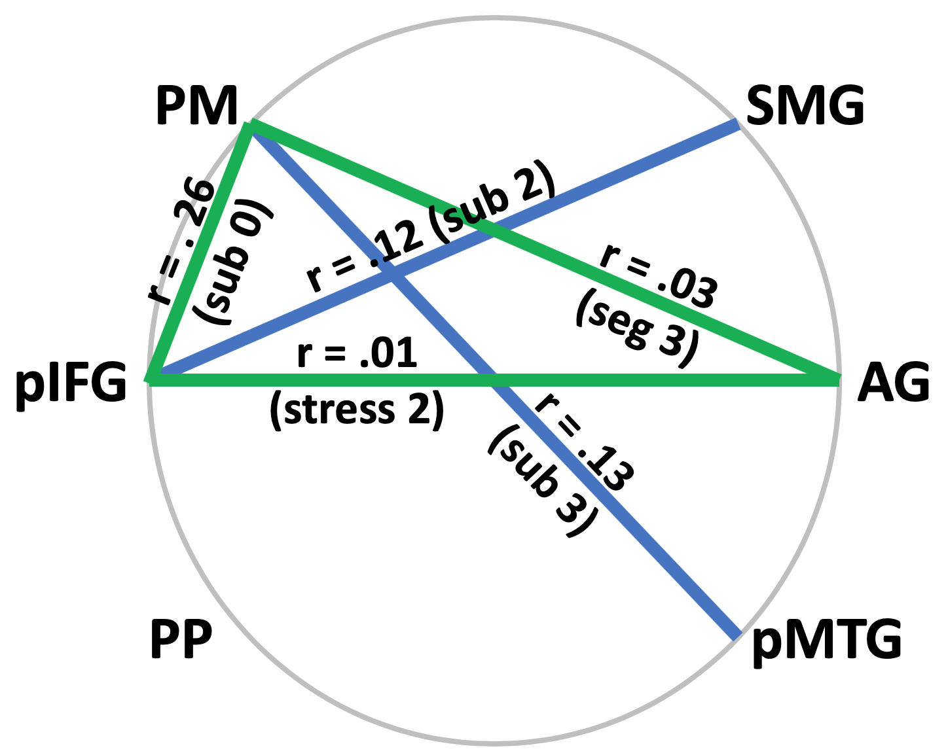
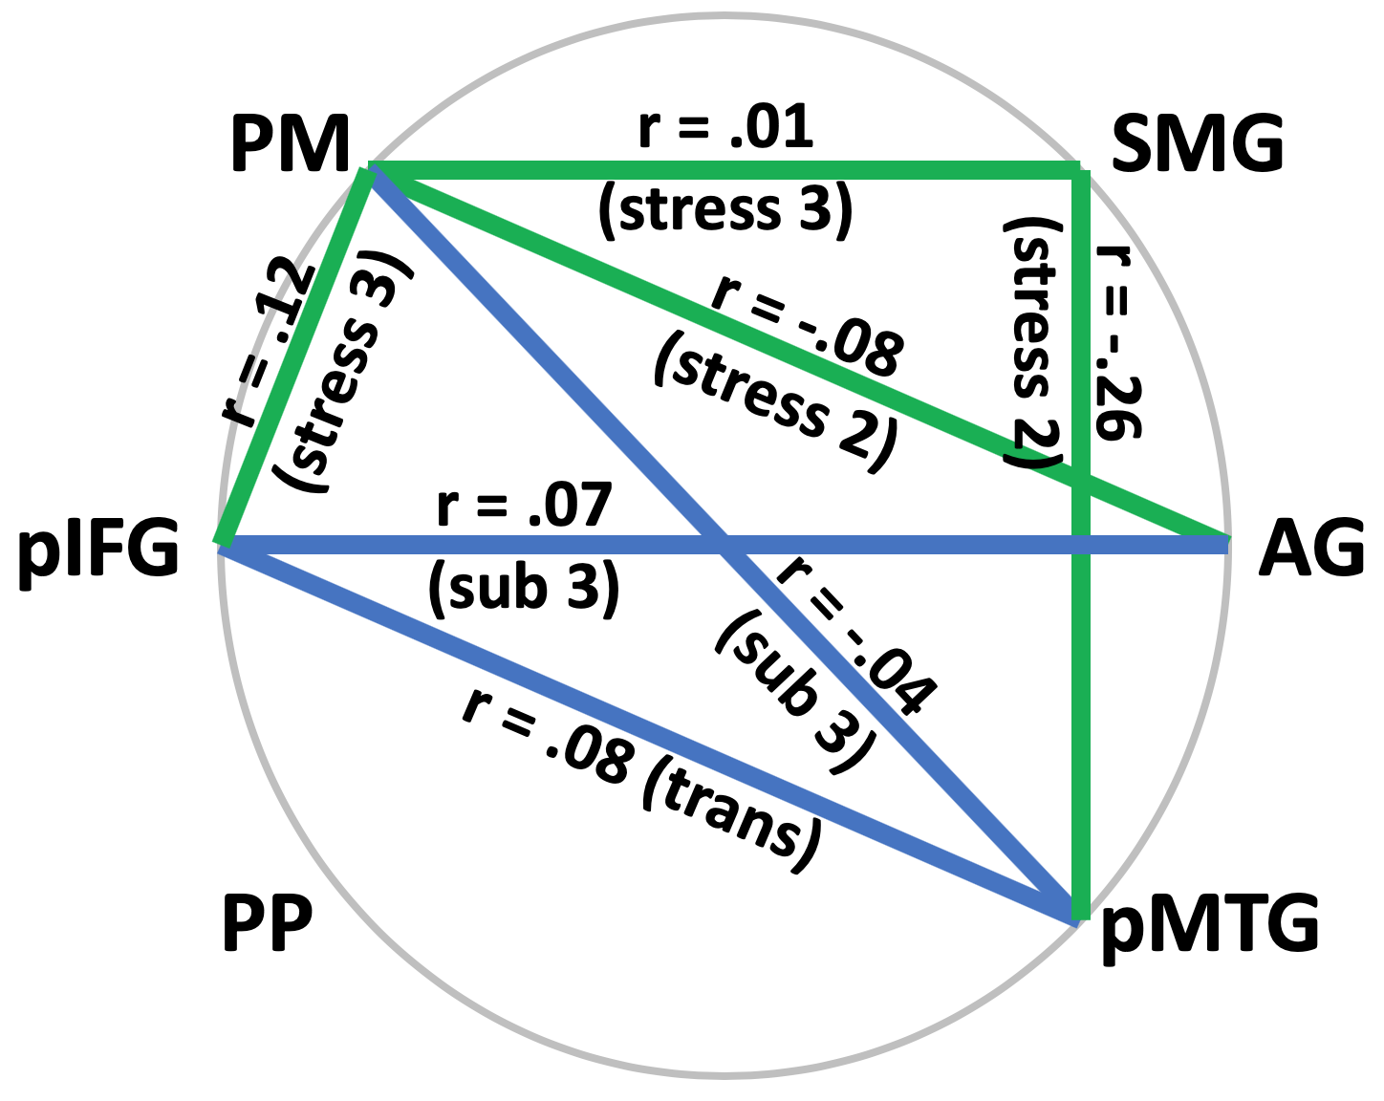
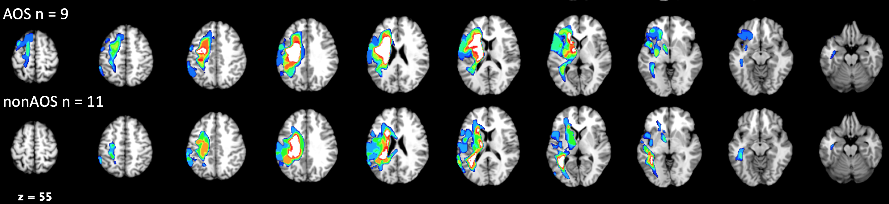
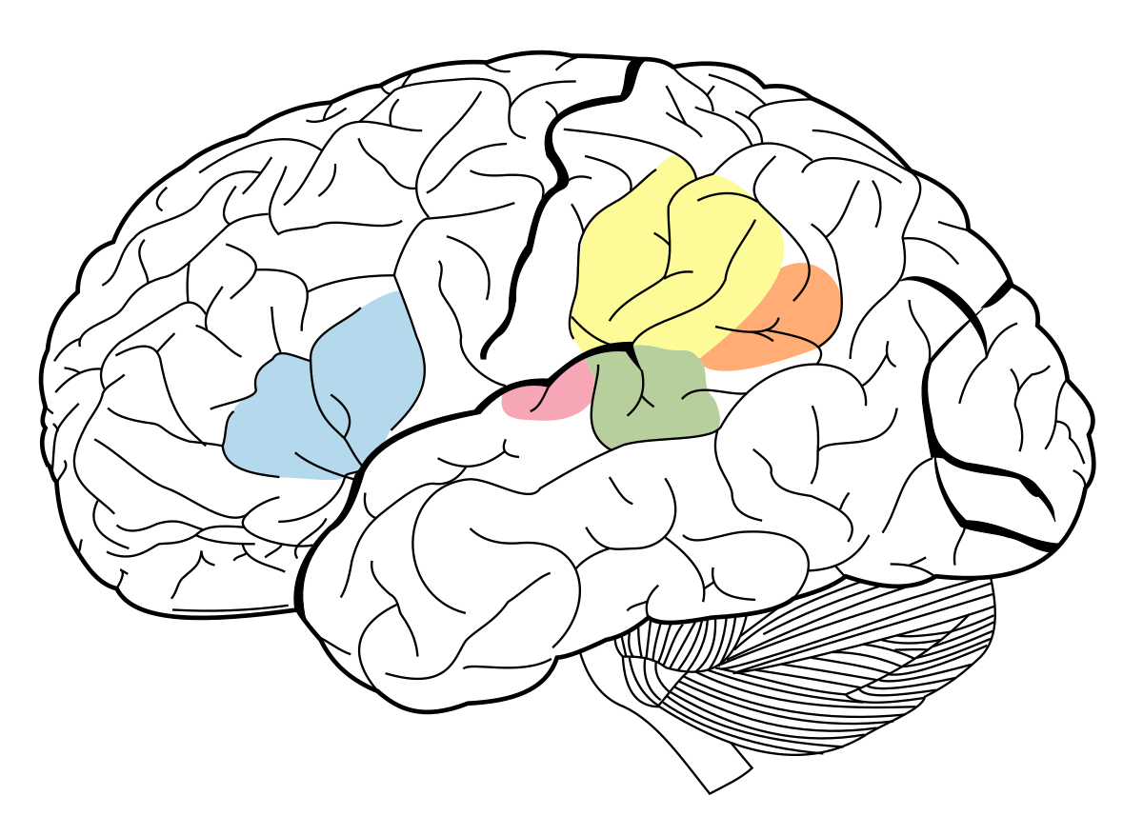
Resting-state fMRI of the Phonologic Network in Repetition
Mara E. Callahan¹, M.S. Candidate
Advisor: Amy E. Ramage¹, Ph.D.; Committee: Donald A. Robin¹, Ph.D., Kirrie J. Ballard², Ph.D.
Communication Sciences and Disorders at ¹UNH and ²University of Sydney
Background
Methods
Results
Participants
Aphasia is an acquired language disorder resulting from a stroke in the left hemisphere of the brain.
Verbal expression in aphasia may include speech sound errors that are due to either phonological or motor system impairments. [1,2]
Speech-Language Pathologists struggle with differential diagnoses between phonological [language] and motor programing [speech] deficits in word production. [1,2]
Phonological and motoric deficits are thought to arise from differing neural systems and to manifest from different levels of word processing. [3,4]
 | AOS | Non-AOS
n | 9 | 11
Age | 63.5 ± 12.1 | 61.9 ± 9.5
Gender (M:F) | 9:0 | 9:2
Phonological Severity | 3.11 ± 1.83 | 3.3 ± 1.35
AOS Severity * | 4.56 ± 1.59 | 1.18 ± .405
Months Post Onset Stroke* | 57.7 ± 83.0 | 24 ± 16.53
Western Aphasia Battery-Revised (WAB-R) – Aphasia Quotient* | 57.7 ± 24.2 | 75.02 ± 19
Raven’s Progressive Matrices | 26.9 ± 6.5 | 31.45 ± 3.4
PALPA Auditory Discrimination | 71.4% ± 26.5% | 91.7% ± 10.6%
 | Regression Equation
AOS Severity | Y = 13.5(Distortions) + .426; F_{1,18} = 21.597, p<.001
Dysarthria | Y = 6.3(Distortions) + 2.5(Moderate Segmentation) – 3.3(Inappropriate Stress) + .136 ; F_{3,16} = 9.745, p<.001
Nonverbal-Oral Apraxia | Y = 9.7(Distortions) + 1.67; F_{1,18} = 7.504, p<.001
WAB AQ | Y = -85.1(Severe Segmentation) – 94.4 (Substitutions) + 88.4; F_{2,17} = 12.18, p<.001
Table 3. Error types predict the severity of AOS, Dysarthria, Nonverbal-Oral AOS, and WAB AQ.
Table 1. * Indicates significant group differences, p < .05.
Lesion Overlap by Group
Specific Aims
  Reliably identify error types in verbal repetition data and their relation to diagnostic group.
  Identify differences in functional connectivity between brain regions of a phonological processing network in individuals with aphasia from that of healthy, age-matched controls.
  Examine differences in phonological network functional connectivity individuals with aphasia who demonstrate more phonological than AOS-type errors differs (Non-AOS) relative to those with AOS-type errors (AOS).
AOS
Non-AOS
Figure 1. Lesion Overlap Map. Blue = least overlap, White = most overlap
Figure 2. Significant correlations between errors types and functional connectivity between the regions of interest. Blue is associated with phonological errors and green is associated with motoric errors
Region | x | y | z
Frontal Lobe
Premotor Cortex | -58 | 1 | 23
Posterior Inferior Frontal Gyrus | -56 | 17 | 15
Temporal Lobe
Angular Gyrus | -48 | -68 | 28
Supramarginal Gyrus | -48 | -50 | 14
Planum Polare | -48 | -16 | 0
Posterior Middle Temporal Gyrus | -62 | -18 | -14
Conclusion
PM
SMG
AG
Experience and clearly defined criteria for differential diagnoses of AOS and phonological impairments are crucial for the identification and treatment of underlying deficits.
Errors predict symptom severity:
  An increased number of distortions is predictive of AOS, dysarthria, and nonverbal-oral apraxia severity.
  Moderate segmentation is predictive of dysarthria, but individuals who do not use inappropriate stress are less likely to be dysarthric.
  Lastly, patient’s who have fewer substitutions, even with severe segmentation, have higher WAB AQ scores.
Patterns observed in correlations between error production-FC include:
  All correlations between phonological errors and FC involved the pIFG-ROIs, where FC was weaker in the Non-AOS group.
  The significant correlations between motoric errors and FC were in connections that were stronger in the AOS than Non-AOS group.
pMTG
IFG
PP
Methods
Figure 1. Regions of Interest
This Photo by Unknown Author is licensed under CC BY-SA
Twenty left hemisphere stroke patients (11 Non-AOS, 9 AOS) and 18 healthy controls underwent a battery of assessments to diagnose and determine the severity of aphasia and AOS.
Six graduate student clinicians were trained in identification of phonologically versus motorically-based speech sound errors and rated the presence and severity of each in auditory repetition data.
Clinicians rated the stimuli of the Repetition Task from the Western Aphasia Battery – Revised (WAB-R).
  Motoric Features: distortions, stress, and segmentation.
  Phonological Features: transpositions and substitutions.
Structural and functional MRI data was acquired and functional connectivity (FC) assessed amongst regions of a phonological brain network (Table 4). [5]
Error types were correlated with FC to determine the components of the network relating to phonological relative to motoric errors. [5]
Error Detection and Types
 | Error Type | Inter-Rater Reliability | Error Frequency
 |  |  | AOS |  |  |  |  |  | Non-AOS
Motoric | Distortions* | κ = 0.857 | .24 ± .1 |  |  |  |  |  | .11 ± .1
 | Stress | κ = 0.775 | 1 |  | 2 |  | 3 |  | 1 |  | 2 |  | 3
 |  |  | .62 ± .3 |  | .29 ± .2 |  | .09 ± .1 |  | .78 ± .2 |  | .29 ± .2 |  | .05 ± .1
 | Segmentation | κ = 0.730 | 1 |  | 2 |  | 3 |  | 1 |  | 2 |  | 3
 |  |  | .52 ± .1 |  | .31 ± .1 |  | .18 ± .1 |  | .64 ± .2 |  | .25 ± .2 |  | .09 ± .1
Phonologic | Transpositions | κ = 0.994 | 0 |  |  |  |  |  | .02 ± .04
 | Substitutions | κ = 0.902 | 0 | 1 |  | 2 |  | 3 | 0 | 1 |  | 2 |  | 3
 |  |  | .73 ± .2 | .10 ± .1 |  | .04 ± .1 |  | .13 ± .1 | .81 ± .2 | .03 ± .0 |  | .06 ± .1 |  | .09 ± .1
References
Table 2. Inter-rater reliability was established using Cohen’s Kappa. Inter-rater agreement at/above K = .6 was difficult to achieve until the three of the clinicians were retrained using an agreed-upon rating system and reached agreement. The groups differed for frequency of distortions (F_{1,18} = 11, p = .004). Stress: 1=normal, 2=equal, 3=inappropriate; Segmentation: 1=smooth, 2=moderate 3=severe; Substitutions: 0=none, 1=voicing, 2=group switching, 3=true.
[1] Duffy, J. R. (2013). Motor Speech Disorders: Substrates, Differential Diagnosis, and Management(3rd ed.). St. Louis, MO: Elsevier.
[2] Hope, T. M., Prejawa, S., Jones, A P., Oberhuber, M., Seghier, M. L., Green, D. W., & Price, C. J. (2014). Dissecting the functional anatomy of auditory word repetition. Frontiers in Human Neuroscience, 8. doi:10.3389/fnhum.2014.00246
[3] Bock, K., and Levelt, W.J.M. (1994). Language production. Grammatical encoding. IN M.A. Gernsbacher (Ed.). Handbook of psycholinguistics (pp.741-779). New York: Academic Press
[4] Dell, G.S., Change, F., and Griffin, Z.M. (1999). Connectionist models of language production: lexical access and grammatical encoding. Cognitive Review. 23: 517- 542
[5] New, A. B., Robin, D. A., Parkinson, A. L., Duffy, J. R., McNeil, M. R., Piguet, O., & Ballard, K. J. (2015). Altered resting-state network connectivity in stroke patients with and without apraxia of speech. Neuroimage. Clinical, 8429-439. doi:10.1016/j.nicl.2015.03.013

