Slide 1

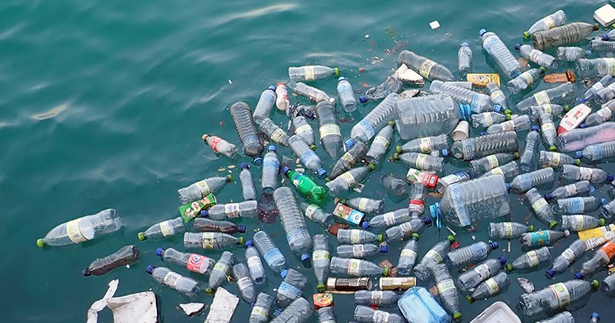
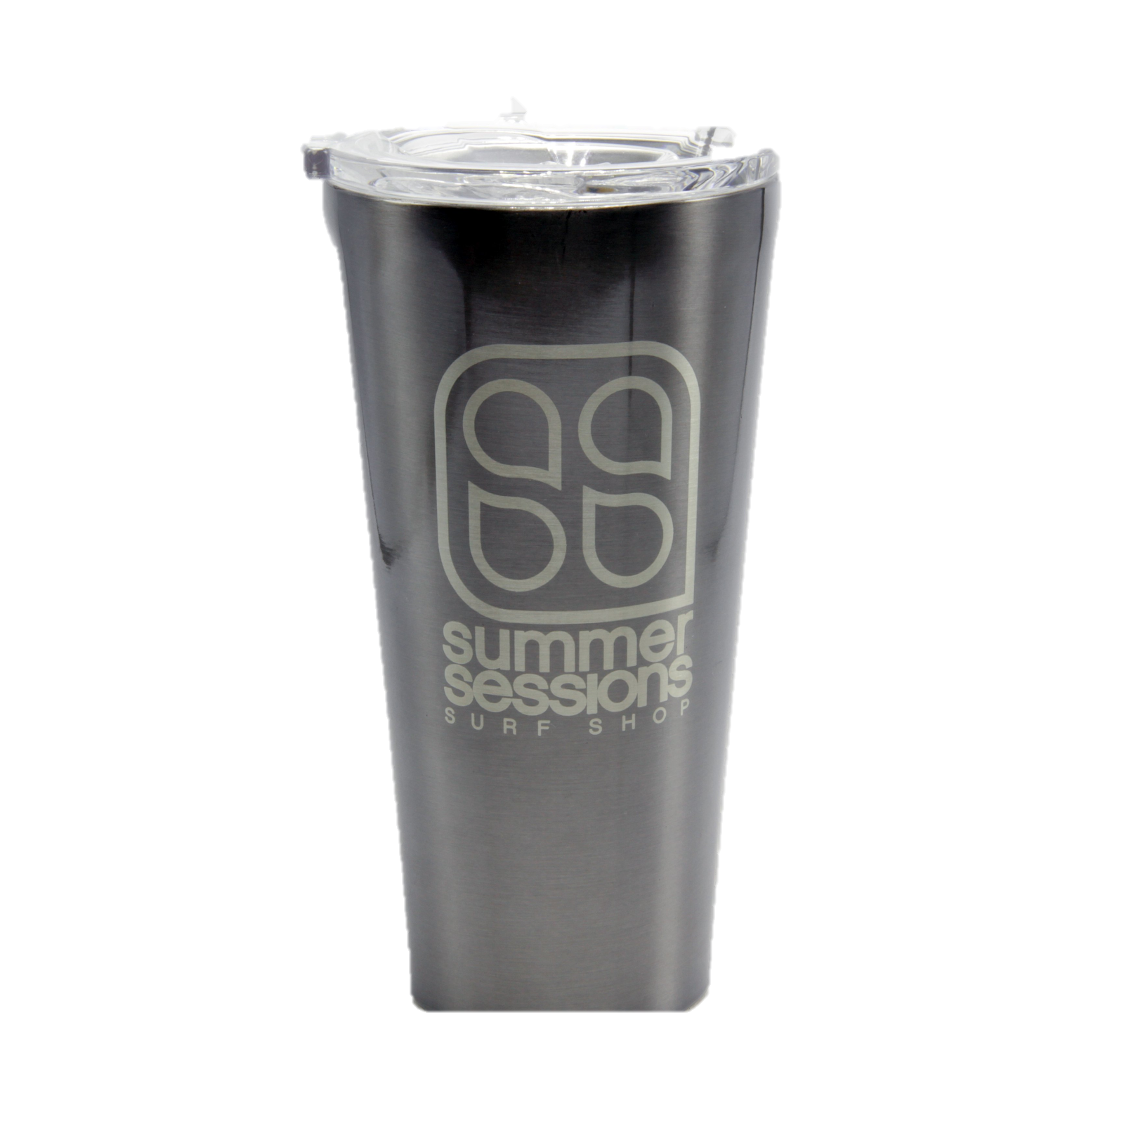


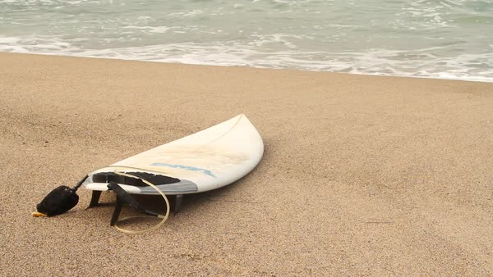
Company Background
Real World Problem
Being Addressed
Two Locations, one in Rye, NH other in Portsmouth, NH
Company offers surf equipment, apparel and accessories
Also offers surf camps and rentals on water equipment
Founded by Tyler and Ryan McGill.
38 billion water bottles end up being in landfills every year
Can take up to 1,000 years for plastic water bottles to decompose
Animals, wildlife and humans are all impacted by plastic
Matthew Morrison and Brandon Tweed
Solution
Project Goals
Stainless Steel Water Bottles provided by Summer Sessions
These Stainless Steel Water Bottles are easy to wash, have good insulation and save the environment
UNH has places to refill these bottles in every building on campus
A percent of each sale goes towards Plastic Oceans Charity
Raise awareness about plastic pollution while improving the sales of the SS water bottle.
Make stainless steel water bottles more popular and utilized on campus
Enhance Summer Sessions image at UNH and surrounding community
Marketing
Take advantage of campus events like U-Day and Orientation
Set up table in Paul College or Union Court, both high traffic areas
Attend Summer Sessions events including Surf Camps
Promote through social media
Summer Session T-shirt and sticker raffle for customers who purchase a Stainless Steel Water Bottle
Charity Background
A charity whose mission is to,
  Inform on the topic of plastic pollution.
  Inspire people to care about the issue and desire to be part of the solution.
  Incite action on real solutions that will shift the global reliance on plastic.
Some of the projects this charity takes part of included providing refilling stations at underprivileged schools and a social enterprise program designed to end plastic pollution.
How this Marketing Plan improves Summer Sessions?
Opportunity to promote company to students at UNH who aren't from the area
Find students who are interested in Summer Sessions product line or surf lessons
Show how much the company cares about the oceans they surf in

