Slide 1






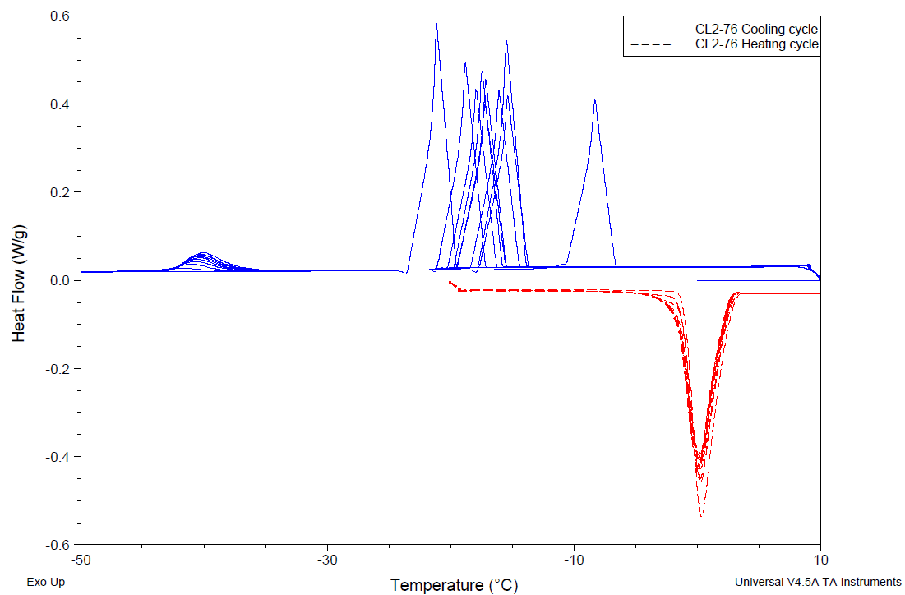



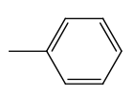









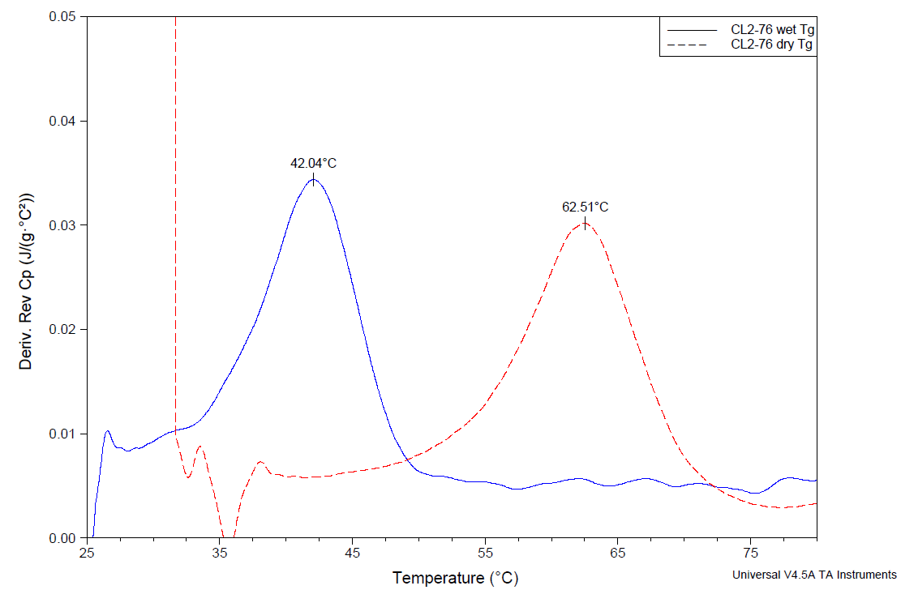
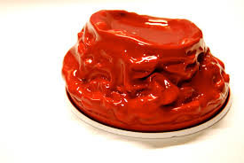
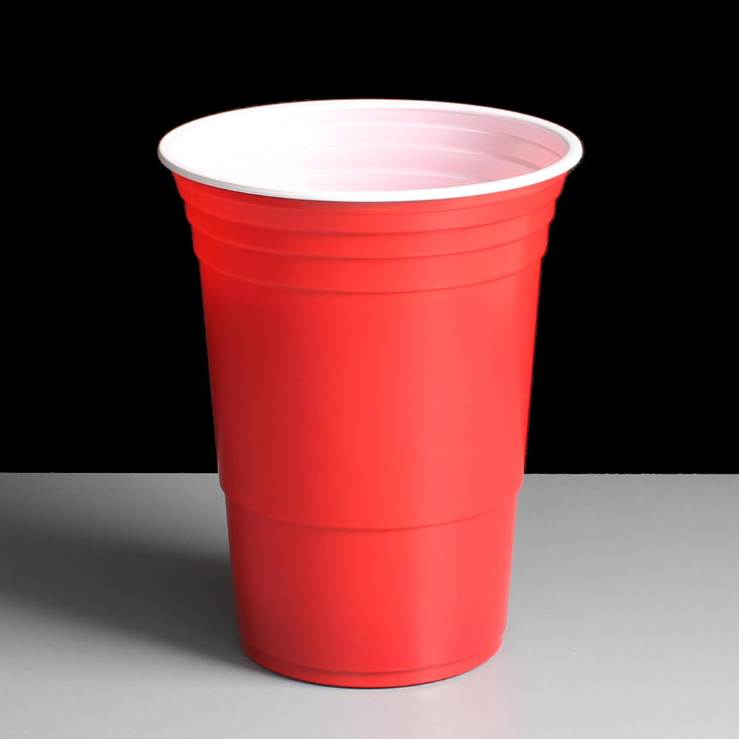
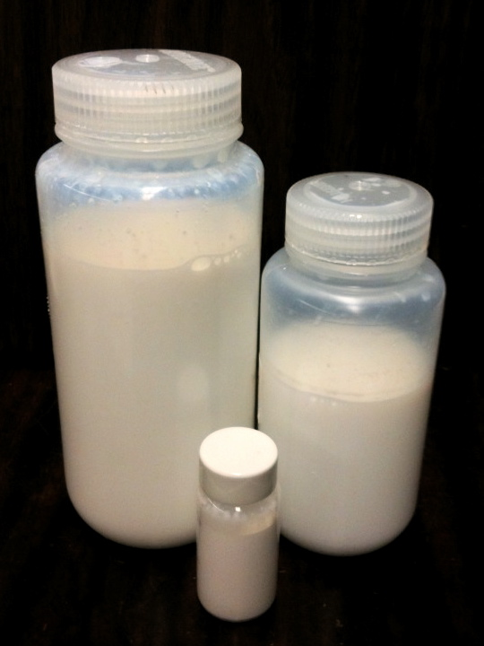
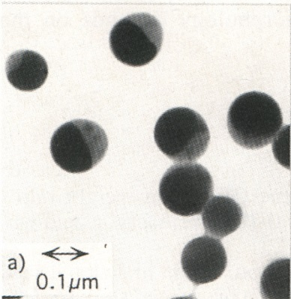
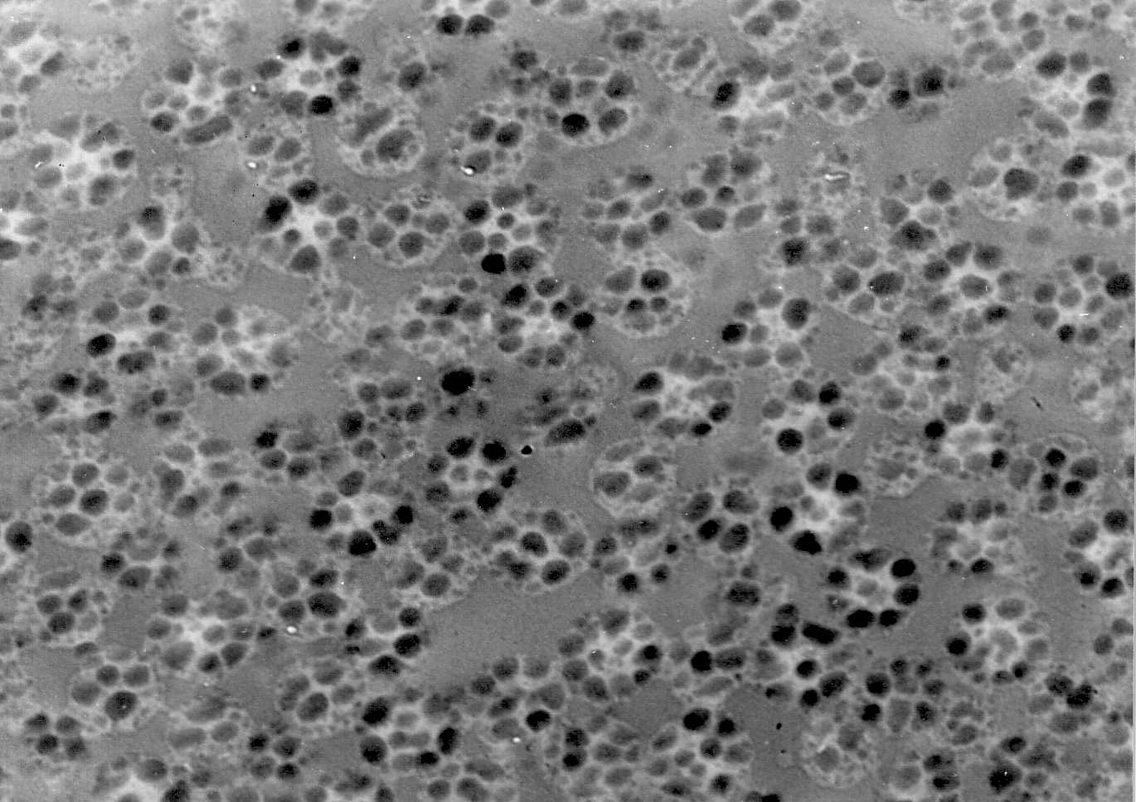
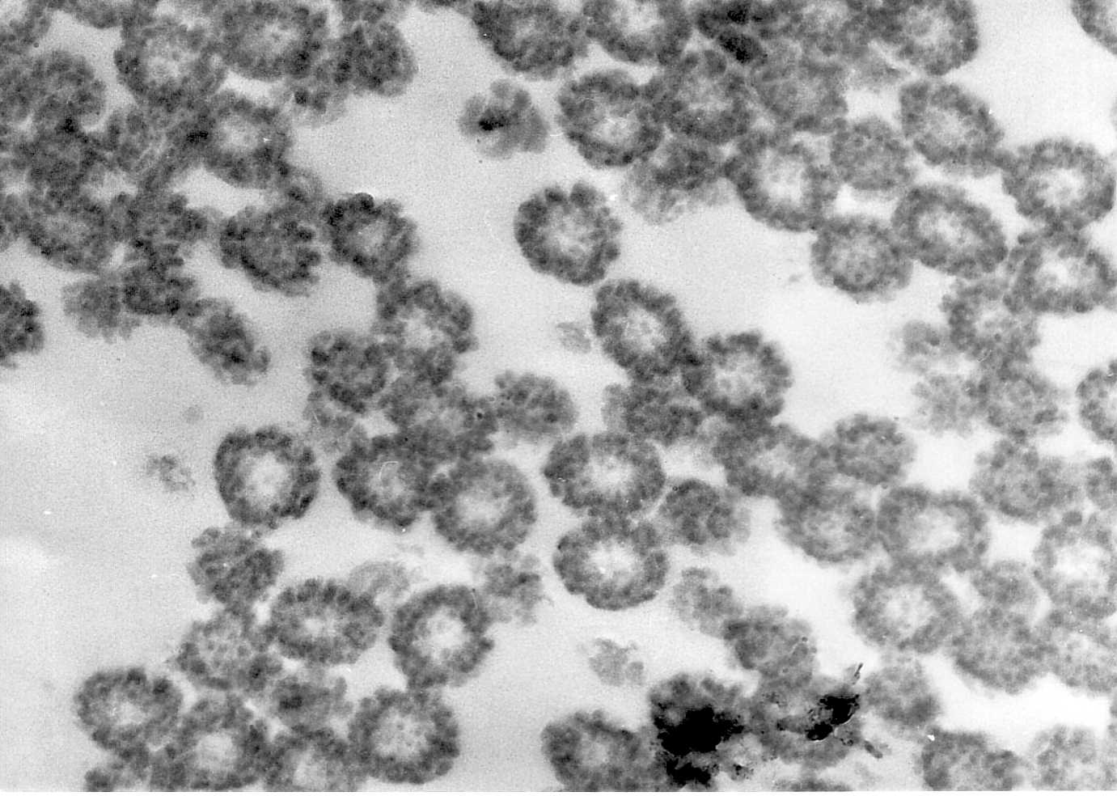
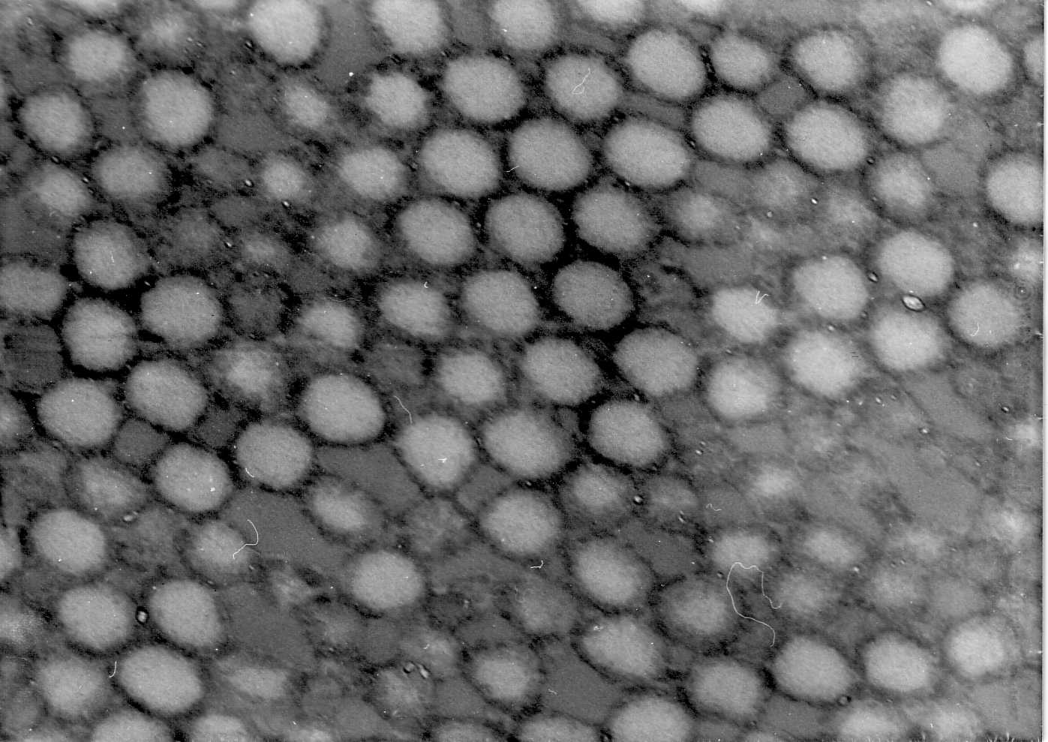
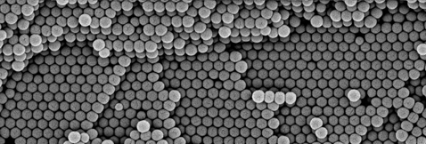
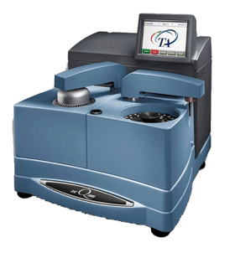

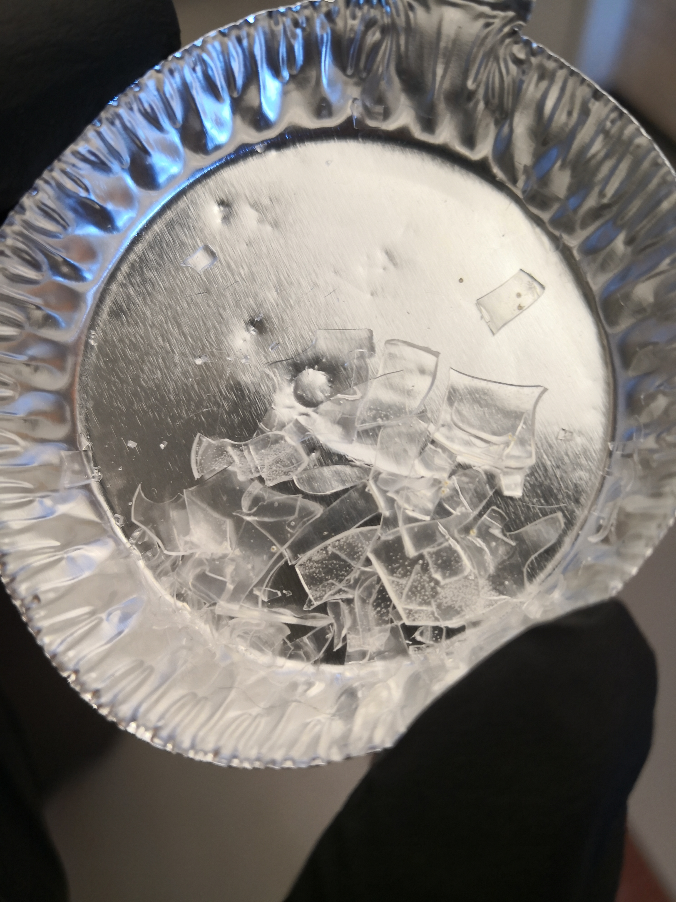
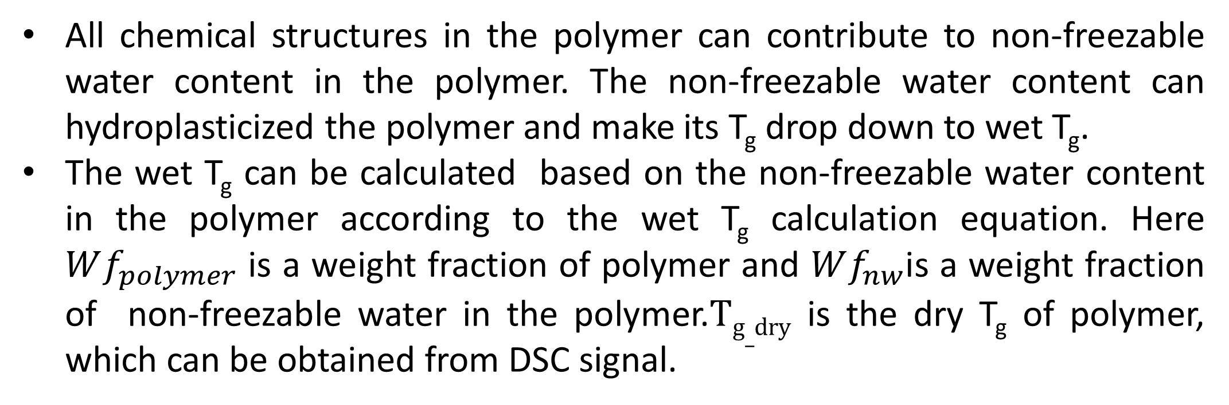
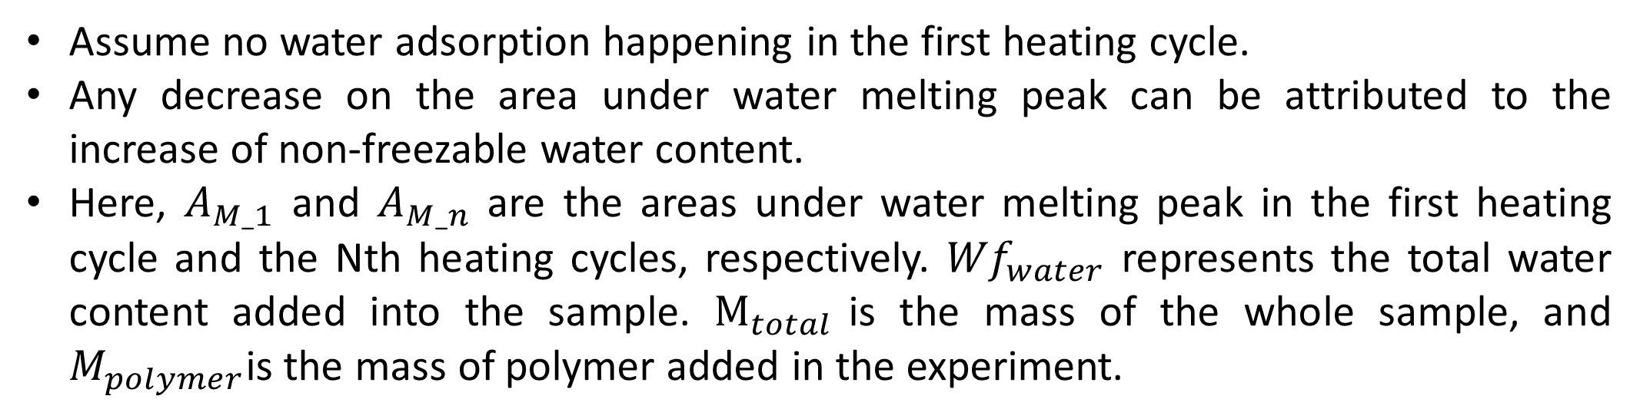
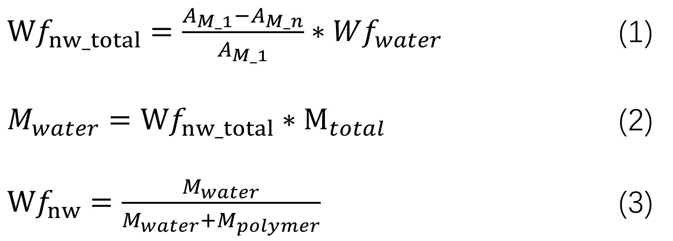
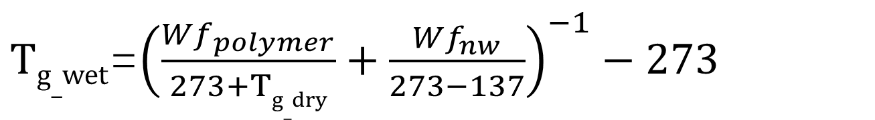
Revealing the Role of Water in Hydrophobic Waterborne Polymers via Differential Scanning Calorimetry(DSC)
Chang Liu, Amit Tripathi and John Tsavalas
Department of Chemistry
University of New Hampshire, Durham, NH, USA
Objective
Result & Discussions
Result & Discussions
Hydrophobic waterborne polymers are synthesized as a dispersion in water and applied widely in coatings, adhesives and dental materials. Water can associate with it in three states: free water, freezable bonded water and non-freezable bonded water.
Minor
Contributors
Major
Contributors
Latex Polymer analyzed
Table 2:Comparisons between experimental wet T_{g} and calculated wet T_{g} for different polymers .
1.3
MMA/MA
Outside layer to inside layer:
Non-freezable water;
Freezable bonded water;
Free water.
Higher interaction
5e-5
More Hydrophilic
Sample | Experimental wet T_{g} (℃) | Calculated wet T_{g} (℃)
STY-BA | 59.50 | 59.55
MMA-MA | 56.17 | 55.81
Lower interaction
0.005
2.0
Cooling
0.1
11.3
STY/BA
Heating
n
n
n
0.2
Figure 3: Experimental non-freezable water content for different polymer samples.
n
n
Structural
Group
#
More Hydrophobic
Non-freezable water contents given by DSC results can match the theoretical number very well for both hydrophobic and hydrophilic samples.
n
n
0.3
Where # =
Moles H₂0
@ R.H. =1.0
Hydroplasticizatio
n
Figure 2: Theoretical non-freezable water content contribution of chemical structures and polymer chemical structures used in this research.
Table 3:Comparisons between experimental wet T_{g} and calculated wet T_{g} polymers different MMA-MA samples
$Tg_wet$=${\left(\frac{Wf_{polymer}}{273+Tg_dry}+\frac{Wf_{nw}}{273−137}\right)}^{−1}−273$
Water added | Experimental wet T_{g} (℃) | Calculated wet T_{g} (℃)
24wt% | 56.17 | 55.81
29wt% | 56.32 | 52.54
33wt% | 55.73 | 57.22
10wt% | 56.09 | 57.53
15wt% | 55.9 | 56.88
Softer
Equation 1: Wet T_{g} calculation based on Fox equation.
(-137 ℃ is used as a T_{g} for pure water)
Wet
Dry
All chemical structures in the polymer can contribute to non-freezable water content in the polymer. The non-freezable water content can hydroplasticized the polymer and make its T_{g} drop down to wet T_{g}.
The wet T_{g} can be calculated based on the non-freezable water content in the polymer according to the wet T_{g} calculation equation. Here $Wf_{polymer}$ is a weight fraction of polymer and $Wf_{nw}$is a weight fraction of non-freezable water in the polymer.$Tg_dry$ is the dry T_{g} of polymer, which can be obtained from DSC signal.
Glass Transition Temperature (T_{g}) Change
Figure 4: Experimental non-freezable water content for MMA-MA samples with different water content added.
Figure 1: Typical DSC curve assignments. The top represents the peak assignments for different types of water, The bottom represent the polymer T_{g} peaks.
The water content will not affect the final non-freezable water content, because the number of site for water-polymer bonding is limited by polymer chemical composition.
The experimental reproducibility is high.
The developments of three different types of water in the hydrophobic waterborne polymer are qualitatively and quantitatively characterized via DSC.
Three effects on the distribution of three types of water in the polymer matrix are evaluated. These three effects are water content, surfactant concentration and polymer chemical composition.
The influence of water on the polymer property change is evaluated.
Table 1: General information for polymers used in this research.
Ionic Sulfate Group.
Sample | Chemical Composition (wt%) | Theoretical Non-freezable water content (wt%) | Dry T_{g} (℃) | Theoretical wet T_{g} (℃)
MMA/MA | 71:29 | 3.76 | 75.5 | 56.16
STY/BA | 75:25 | 0.8 | 65.9 | 61.9
Figure 6: The structure of the surfactant (SDS).
Polymer with SDS can have much higher W𝑓_{nw} , because of the sulfate group in SDS.
Approach & Considerations
How to calculate non-freezable water content from the melting peak shown in DSC curve?
Figure 5: The influence of surfactant (SDS) on non-freezable water content in the sample.
${Wf}_{nw_total}=\frac{A_{M_1}−A_{M_n}}{A_{M_1}}∗{Wf}_{water}$ (1)
$M_{water}={Wf}_{nw_total}∗M_{total }$ (2)
${Wf}_{nw}=\frac{M_{water}}{M_{water}+M_{polymer}}$ (3)
Conclusions
RR
Three types of water in polymer matrix can be qualitatively and quantitatively characterized via DSC.
The non-freezable water can change the polymer properties a lot.
Non-freezable water content will not be affected by water content added but can be significantly affected by the polar surfactant.
Dry
References
s
Assume no water adsorption happening in the first heating cycle.
Any decrease on the area under water melting peak can be attributed to the increase of non-freezable water content.
Here, $A_{M_1}$ and $A_{M_n}$ are the areas under water melting peak in the first heating cycle and the Nth heating cycles, respectively. ${Wf}_{water}$ represents the total water content added into the sample. $M_{total }$is the mass of the whole sample, and $M_{polymer}$is the mass of polymer added in the experiment.
RR
Acknowledgements
DSC Analysis
Tsavalas, J. G.; Sundberg, D. C. Langmuir 2010, 26 (10), 6960–6966.
Lei, Y.; Child, J. R.; Tsavalas, J. G. Colloid Polym. Sci. 2013, 291 (1), 143–156.
Tripathi, A. K.; Tsavalas, J. G.; Sundberg, D. C. Thermochim. Acta 2013, 568, 20–30.
Jiang, B.; Tsavalas, J.; Sundberg, D. Langmuir 2010, 26 (12), 9408–9415.
Jiang, B.; Tsavalas, J. G.; Sundberg, D. C. Prog. Org. Coatings 2017, 105, 56–66.
UNH Latex Morphology Industrial Consortium for its funding
Department of Chemistry in UNH.
Dr. Tripathi’s insightful discussion.
Prof. Tsavalas’s helpful advising.
Support from all our group members.
Scheme 1: A Flow Chart for Experimental Approaches.

