Slide 1

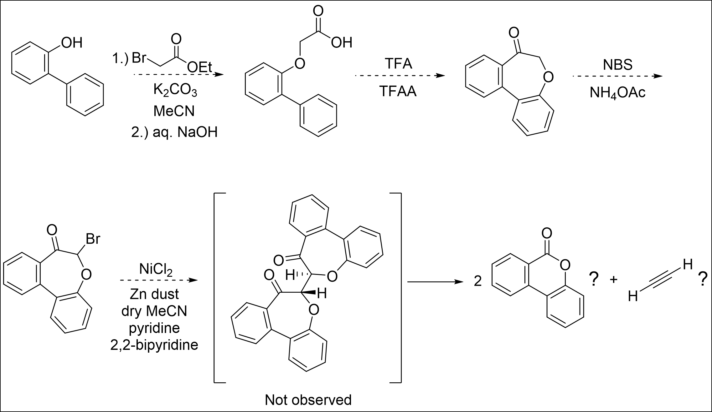
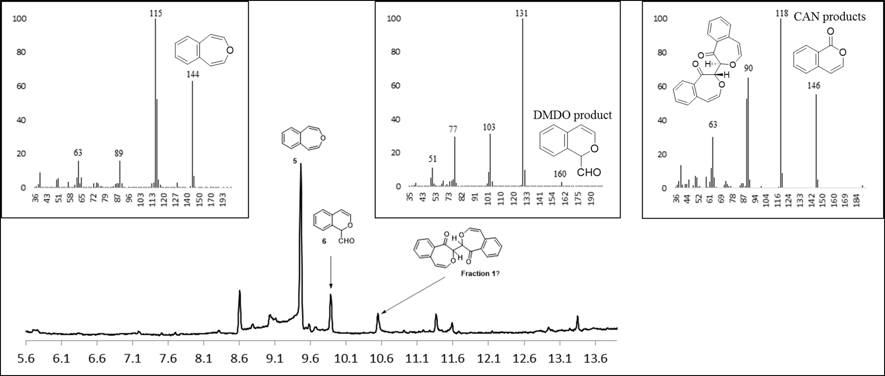
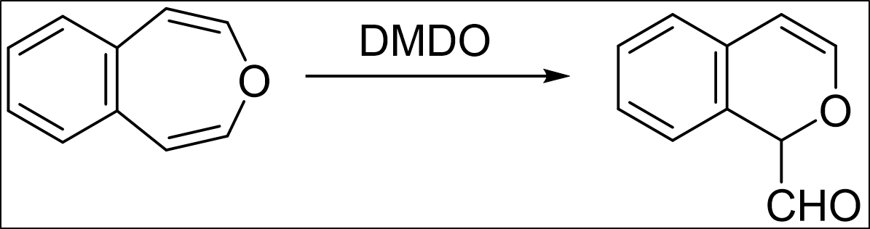
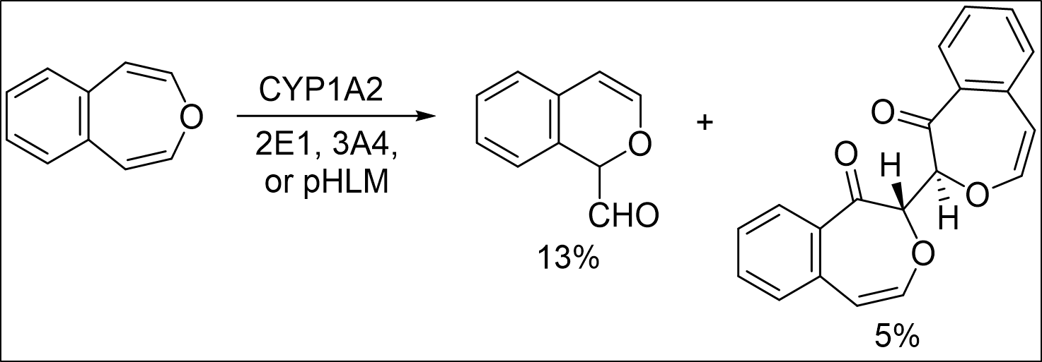
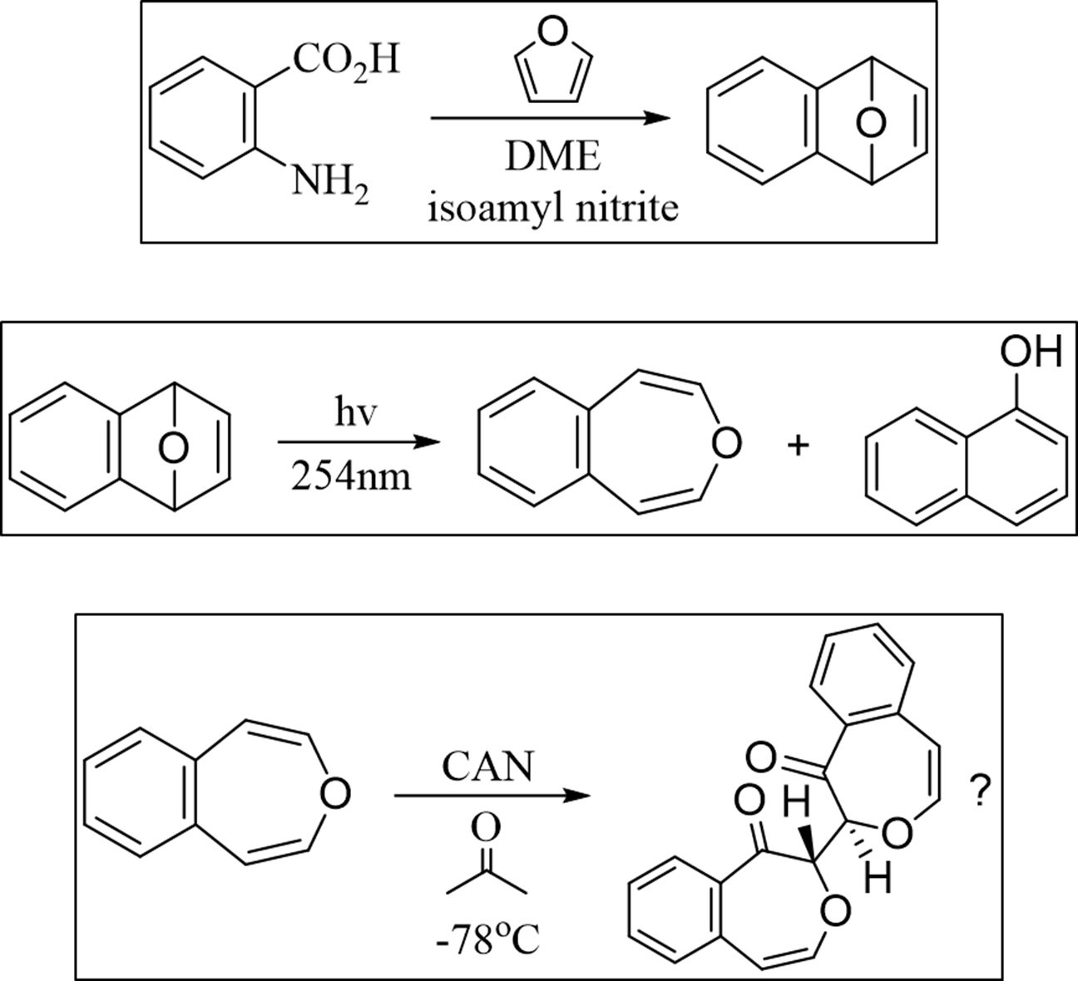
Synthesis of Model Oxepin Substrates for Benzene Metabolic Mechanistic Studies with Dimethyldioxirane, Cerium (IV) Ammonium Nitrate, and Cytochrome P450
Ryan W. Fitzgerald¹, Noah A. Cote^{2a}, Tristan Hart-Bonville^{2b}, Arthur Greenberg^{3*}
rwj9@wildcats.unh.edu, Department of Chemistry, University of New Hampshire, Durham, NH
Benzene is a known carcinogen and dangerous chemical used in industry. Knowledge of the mechanistic pathways by which potential toxins break down in the body is useful to prevent illnesses and help those ailing presently. Benzoxepin derivatives are useful models in investigating the ring opening mechanism of the oxepin tautomer as seen in benzene metabolism.
4,5-Benzoxepin is a suitable substrate for use in comparative enzymatic oxidation studies with cytochrome P450. This project focuses on synthesizing 4,5-benzoxepin and other model oxepins for use in enzymatic reactions by the Greenberg research group at UNH to establish the metabolic mechanism of benzene to E,E-muconaldehyde.³
Scheme 1. Metabolic routes of benzene in vivo.^{1,2,3}
Introduction:
Synthesize a 2,3-benzoxepin derivative (not shown) and a benzodimer derivative (below). Explore enzyme reactions with new model oxepins. Attempt to grow crystals of the potential dimer to validate its structure further.
The organic synthesis of 4,5-benzoxepin was completed and improved. Enzymatic studies using benzene and 4,5-benzoxepin were finished. Preliminary results indicate that benzene can go through both epoxidation and two consecutive one electron oxidation mechanisms. The true structure of proposed dimer remains unidentified and will require further analysis via GC-MS and an X-ray crystal structure.
Results and Discussion:
Future Work:
Figure 1. NOESY NMR (500MHz) of CAN product.
Figure 2. Enzymatic reactions with 4,5-benzoxepin model.
Conclusions:
Acknowledgements:
The Sower research group, Elsawa research group, and UNH chemistry department are gratefully acknowledged. My assistants Noah and Tristan are also acknowledged for all their constant support and contributions to the project and 2,3-benzoxepin synthesis.
Experimental Work:
References:
CHCl₃
0°C
Vogel, E., Gunther, H., Angew. Chem. Int. Ed. 1967, 6, 385-476
Davies, S. G., Whitham, G. H., J. Chem. Soc. Perkin Trans. I, 1977, 1346-1347
Morgan, J., Greenberg, A., J. Org. Chem. 2010, 75, 4761-4768
Greenberg, A., et. al., Structural Chemistry, 1998, 9(3), 223-236
Nauduri, D., Greenberg, A., Tetrahedron Letters, 2004, 45, 4789-4793
Paquette, L. A., Barrett, J. H., Org. Synth. 1969, 49, 62.
Rabideau, Peter W., Burkholder, E., J. Org Chem. 1978, 43, 4283-4288
Enzyme | Substrate | [Substrate] | [Enzyme] | NADPH | MgCl₂
2E1 | 4,5-benzoxepin | 300 μM | 50 pmol/mL | 1.0 mM | 3.3 mM
1A2 | 4,5-benzoxepin | 300 μM | 35 pmol/mL | 1.0 mM | 3.3 mM
3A4 | 4,5-benzoxepin | 300 μM | 35 pmol/mL | 1.0 mM | 3.3 mM
pHLM | 4,5-benzoxepin | 300 μM | 0.5 mg/mL | 1.0 mM | 3.3 mM

