Slide 1


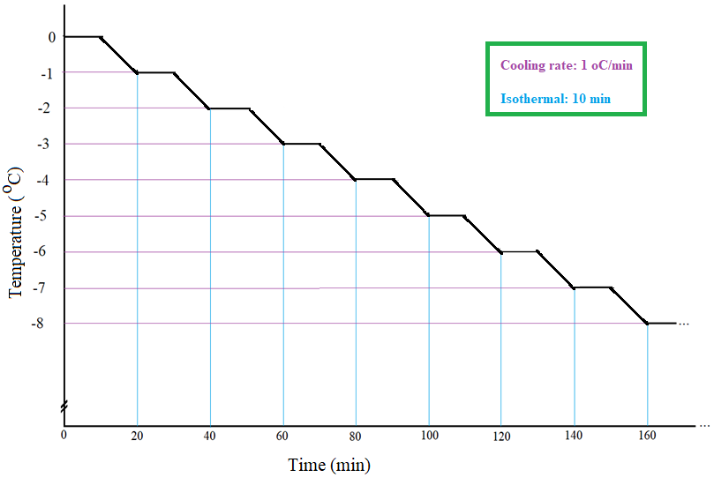
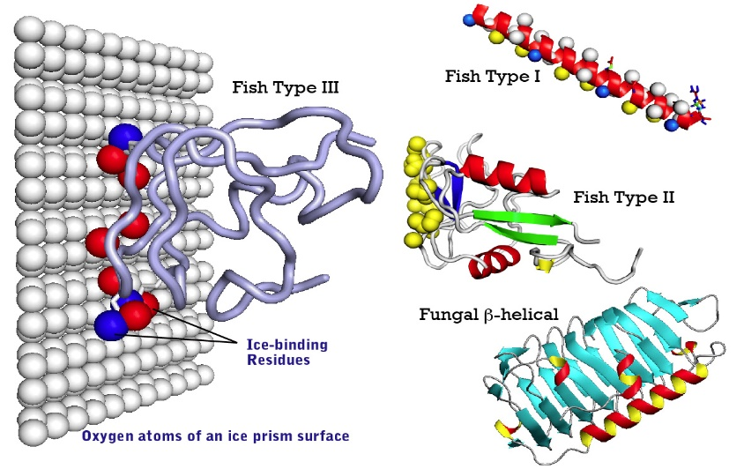
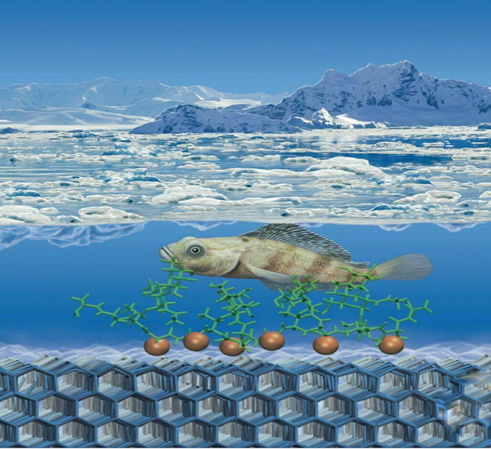
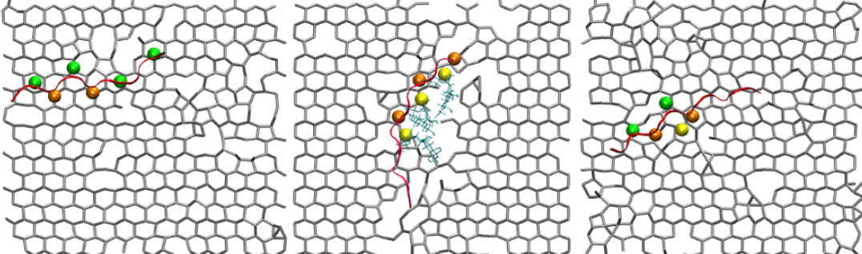
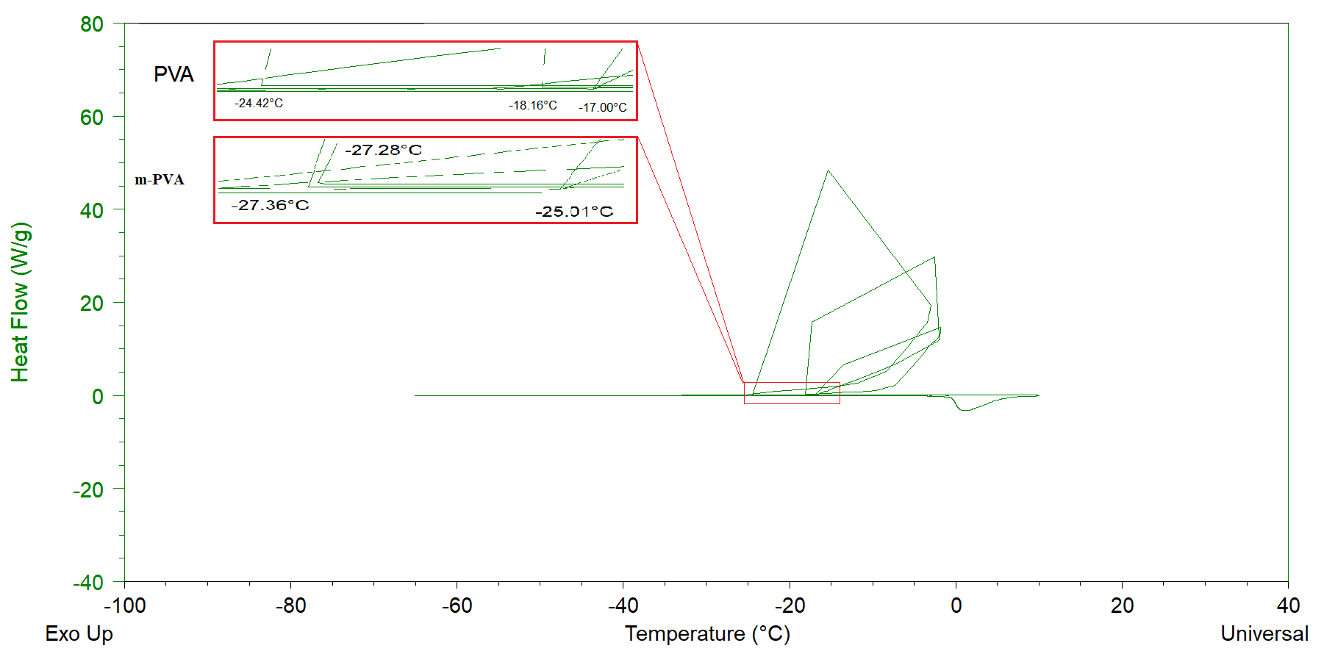
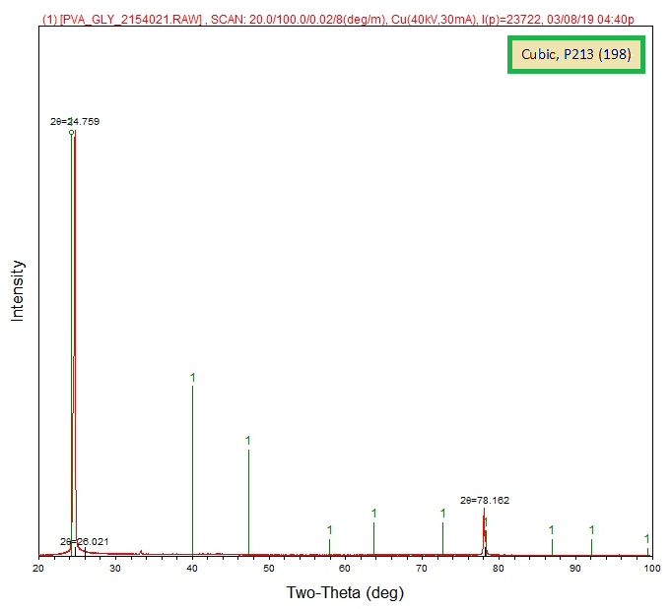

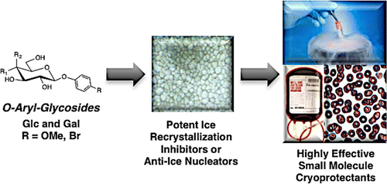
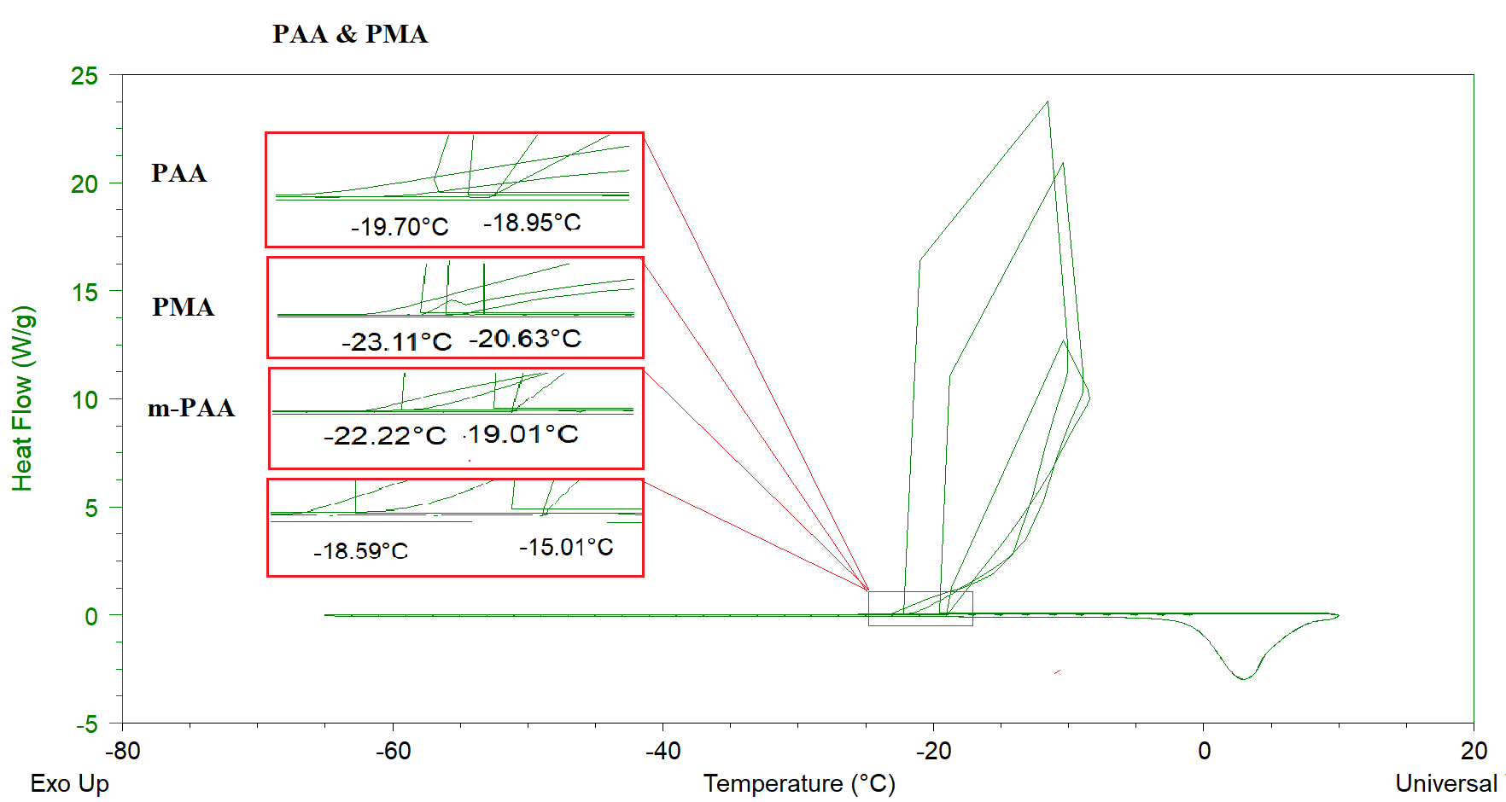
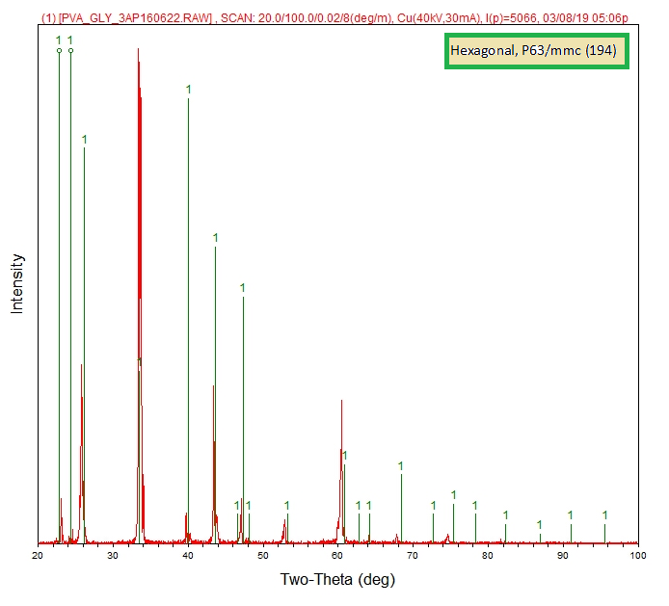
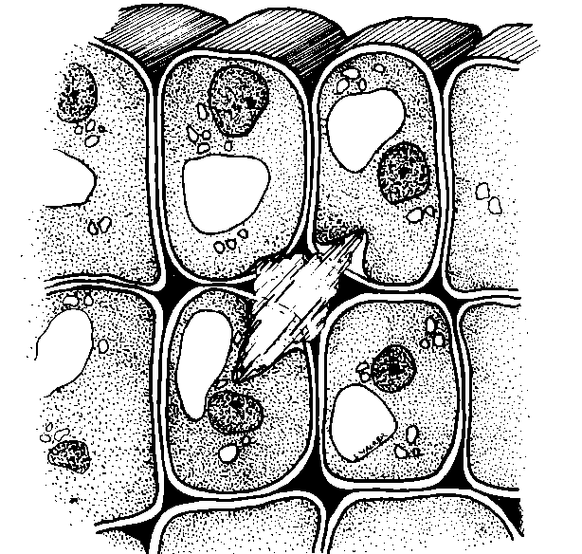
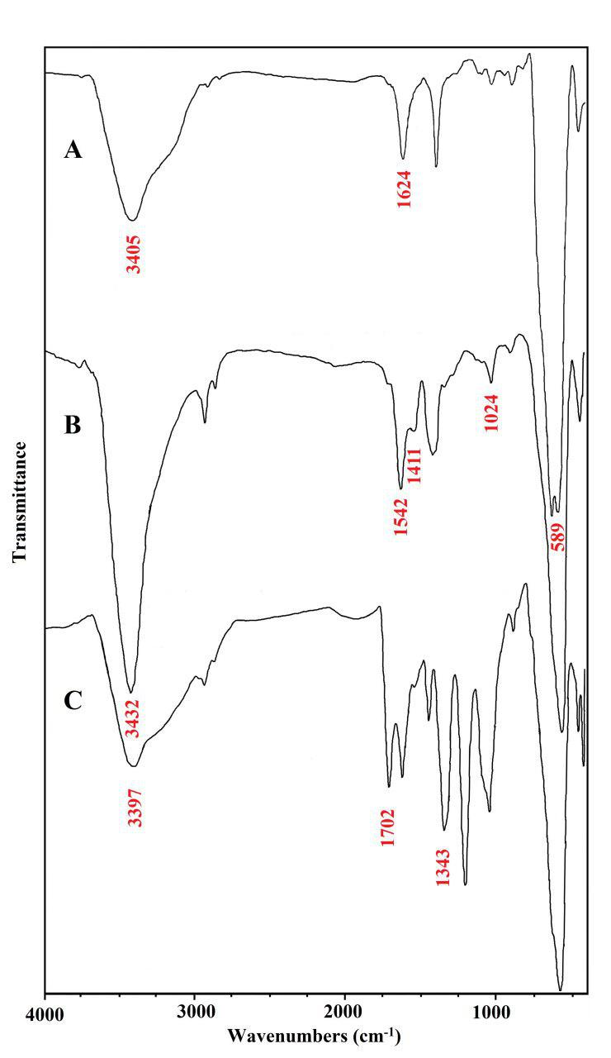
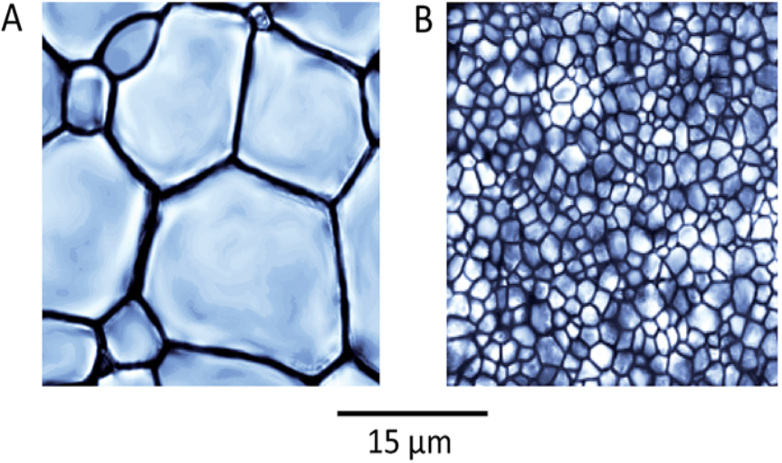
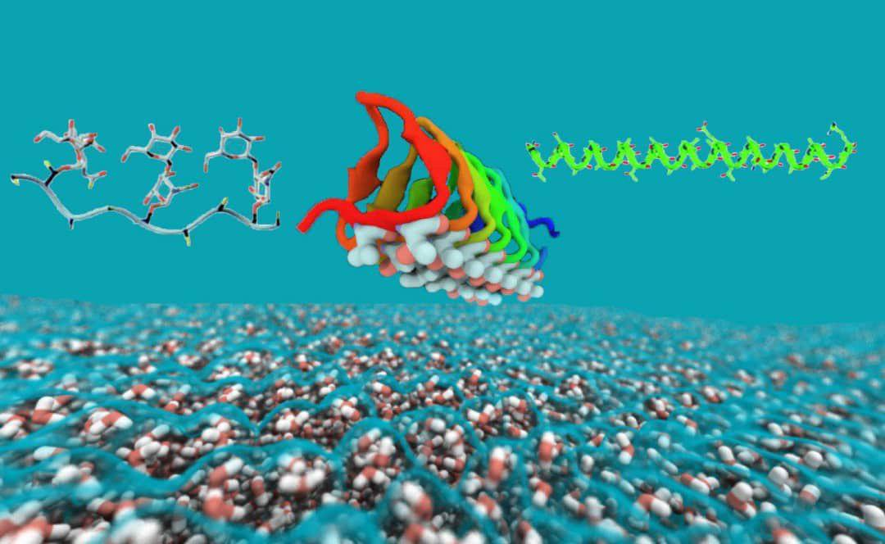
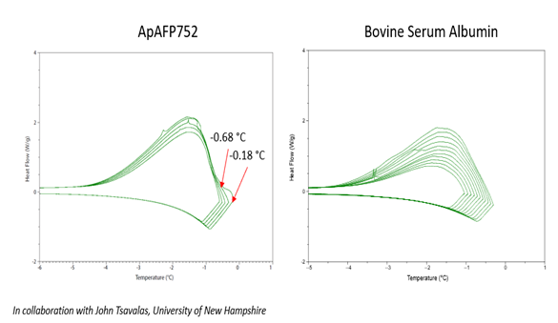
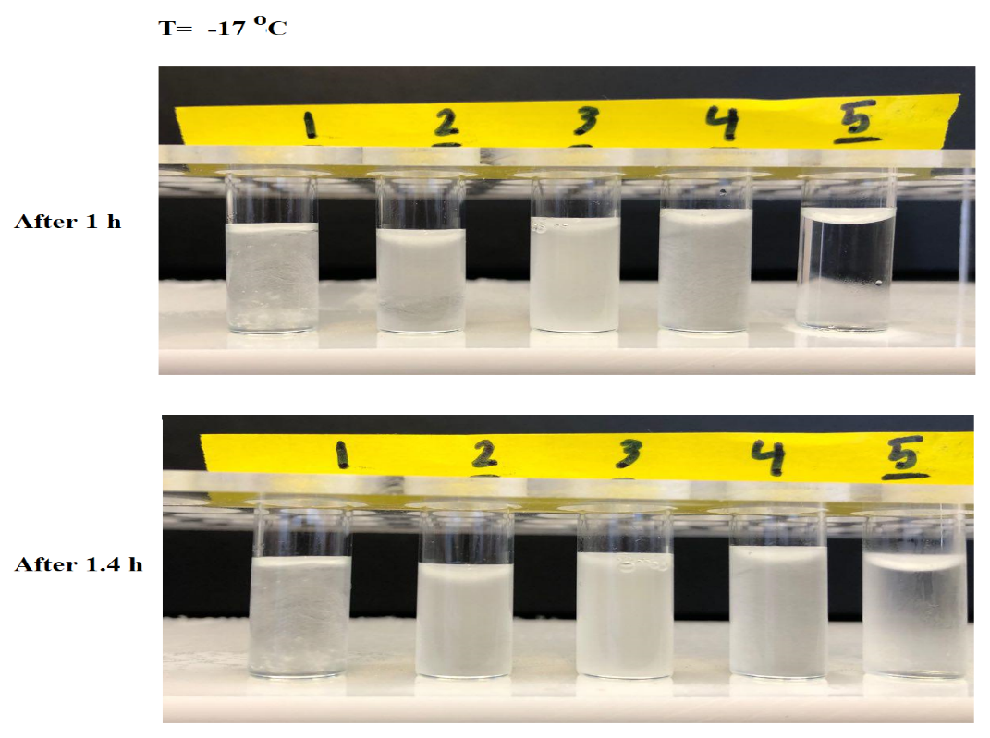
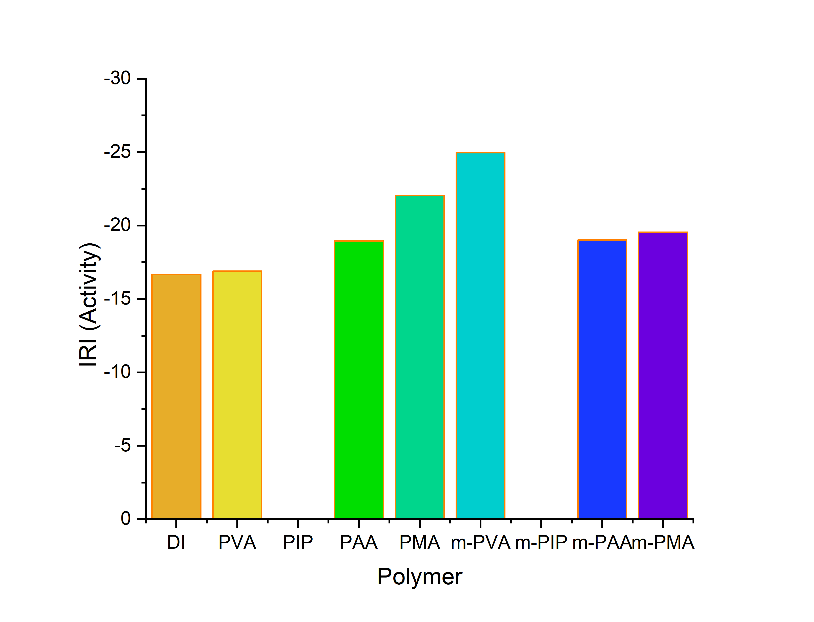
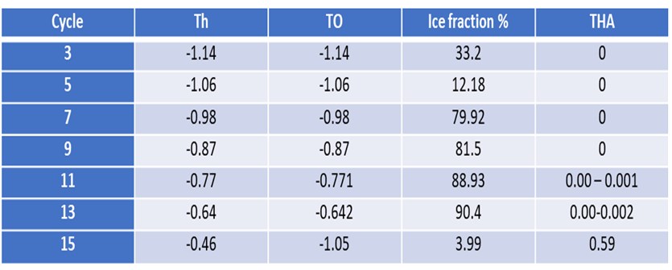

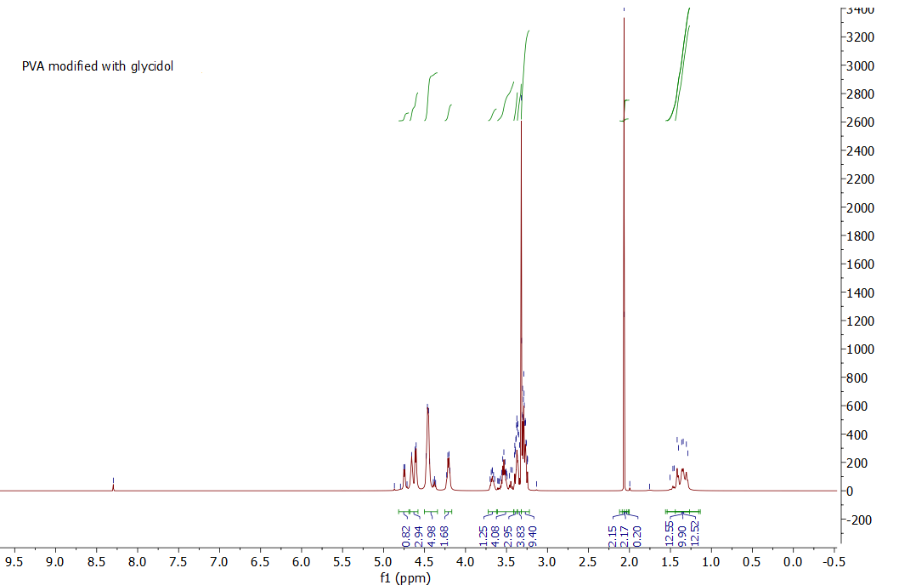

Modification and Characterization of Polyol Based Polymers for Ice Recrystallization Inhibition and Thermal Hysteresis
Activity
Mohammad Mousazadehkasin, John Tsavalasa, Paul Bauresb, Krisztina Varga, Emily Asenath-Smithd
Department of chemistry, University of New Hampshire, Durham, NH 03824
1. Introduction
3. Experimental
4. DSC results
5. XRD results
Antifreeze (glycol)proteins have ice recrystallization inhibition (IRI) activities- a desirable property in application such as cryopreservation, frozen food and industry[1]. However, the high cost, low availability, and instability of AF(G)Ps impede their large-scale production and use in industrial
applications. Polyol- based polymers
could be developed to inhibit ice formation. Polyvinyl alcohol and antifreeze proteins have been reported to inhibit ice formation. Studying ice crystallization process by different methods could be helpful to improve freezing inhibition by functionalizing PVA.
Part 1. Polyvinyl alcohol and Poly isopropanol modified with Glycidol.
4.1. Stepwise method used for IRI determination. In this method time and cooling rate considered at the same time in measuring freezing point. The data from different cooling rate and stepwise method shown on the DSC plots.
Cubic and hexagonal are two most common crystallization
form for water. Hexagonal is most stable form compared to cubic.
m-PVA shows cubic crystallin form and it means at the same
condition it is more effective than PVA and also modified acids.
1.PVA modification:
PVA modified with high percent shows high IRI property.
2. Methods
Part 2. Poly acrylic acid and Poly methacrylic acid modified with Glycerol.
To study IRI mechanism, four types of polymer with structures similar to the PVA were used. The polymers and modification mechanism explained in the experimental section.
To measure freezing point, Differential Scanning calorimetry (DSC) was used with different method and for the first time we used stepwise method to include both time and cooling rate parameters at the same time to in determining exact freezing point.
To study polymer contribution in ice crystallization, XRD method has been used and the types of crystal that ID water from comparted with crystal that it forms in the presence of polymers.
2.PAA and PMA modification:
6. Conclusions
The resulting difference between the melting and freezing points termed thermal hysteresis (TH) is usually a measure of antifreeze activity.
TH= Tm-Tf
IRI activity for polymers and functionalized form
In DI water are compare here and the result show
that functionalization improves IRI activity but it
efficiency depends mostly on polymer itself.
The reason for
FT-IR and H-NMR analysis to confirm polymerization and modifications
Small IRI active organic molecules are easy to use for studying IRI mechanism compared to AFP which is complicated molecule. Modifying polymers backbone with functional groups similar to the small alcohols shows great improvement in IRI activity. The results from DSC and XRD confirm this improvement. The results show that improvement in IRI mostly depends on original polymer and the modification percent which increase hydroxyl group concentration on the polymer backbone. The data from XRD shows that modified IRI active polymer has great impact on the ice crystallinity. The most IRI active polymers keep the crystallinity in cubic form in the same condition compared to original polymer which is less active.
Functional Characterization of AFP
Studied using differential scanning
calorimetry
Thermal hysteresis activity of 0.5 °C
7. References:
A computer simulation of the spruce budworm antifreeze proteins and ice. Kuiper et al. (2015) (CC BY 4.0)
https://unit.aist.go.jp/bpri/bpri-afp/research_e.html
Chantelle J. Capicciotti et al. -Aryl-Glycoside Ice Recrystallization Inhibitors as Novel Cryoprotectants: A Structure–Function Study, ACS Omega (2016)
Mochizuki, Kenji, and Valeria Molinero. "Antifreeze glycoproteins bind reversibly to ice via hydrophobic groups." Journal of the American Chemical Society 140.14 (2018): 4803-4811.‏

Slide 2

This poster template provided courtesy of
UNH ESRC Poster Printing Services
Trust us to make your poster look GREAT!
Website: http://posters.unh.edu
Poster Guide: http://goo.gl/1E7TJY
DELETE THIS SLIDE BEFORE PRINTING

