Slide 1


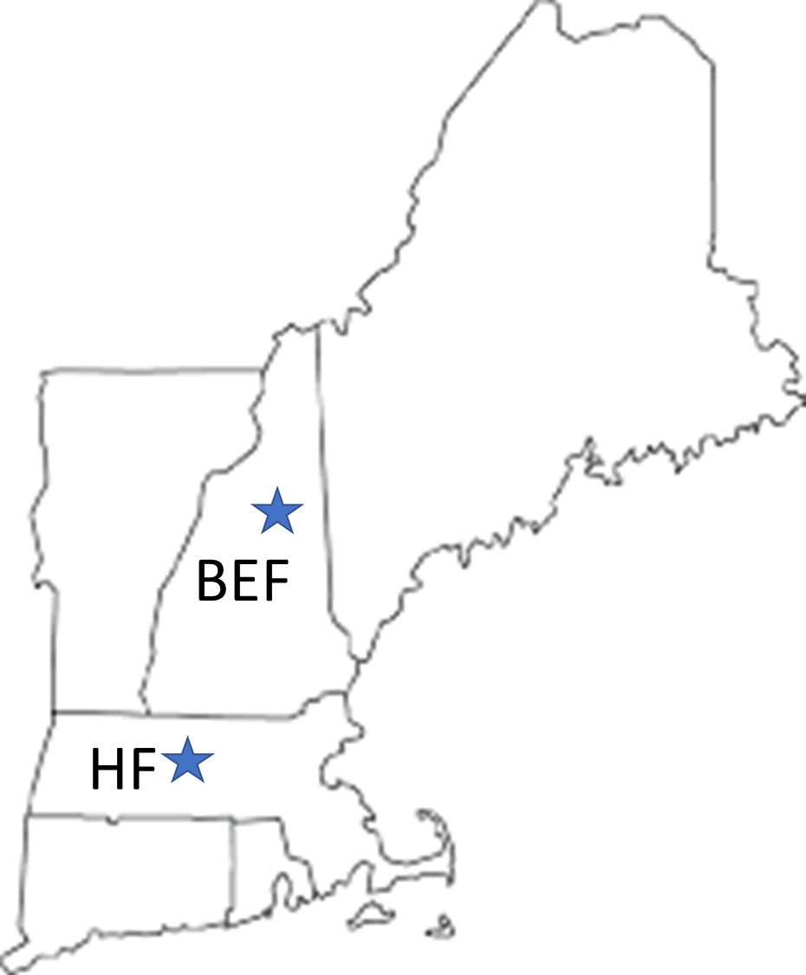
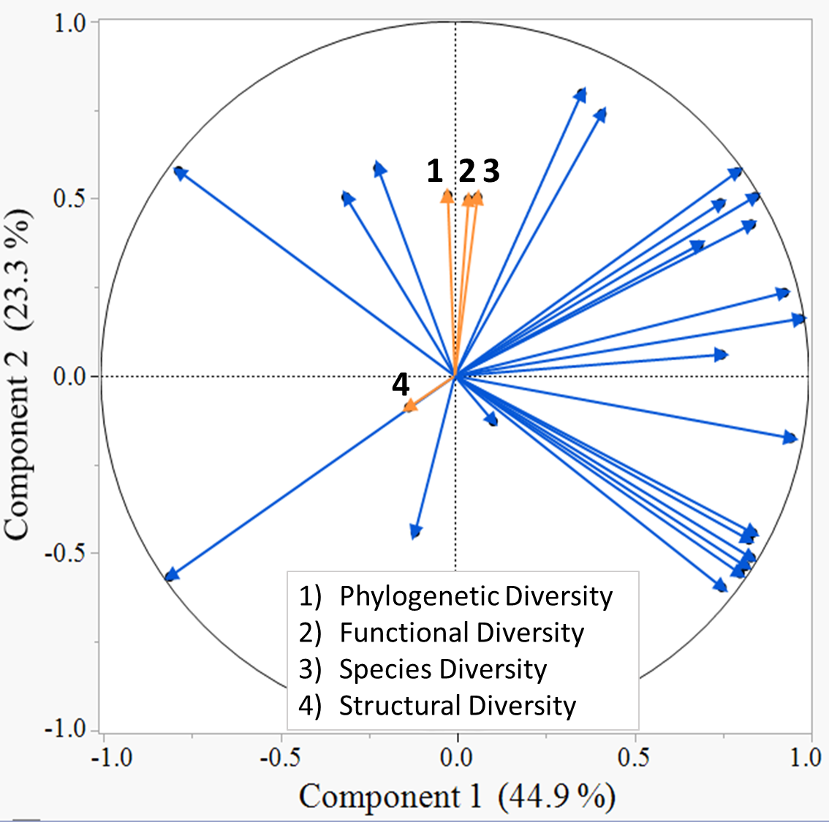
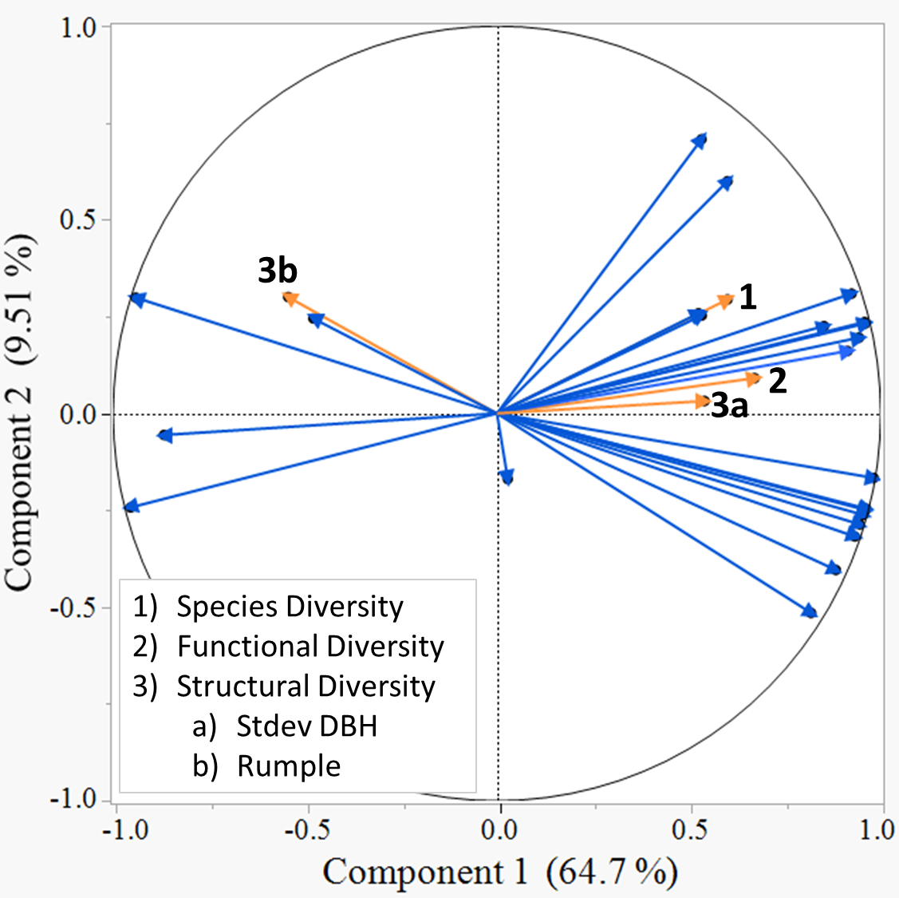
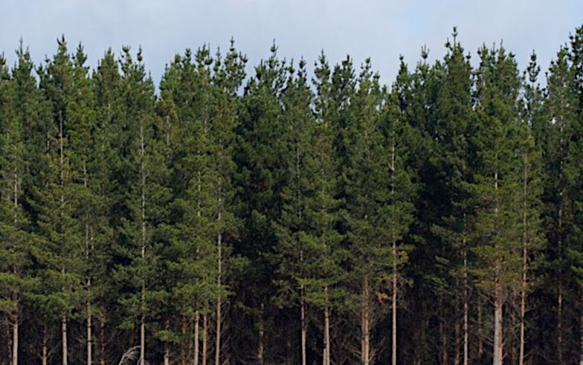
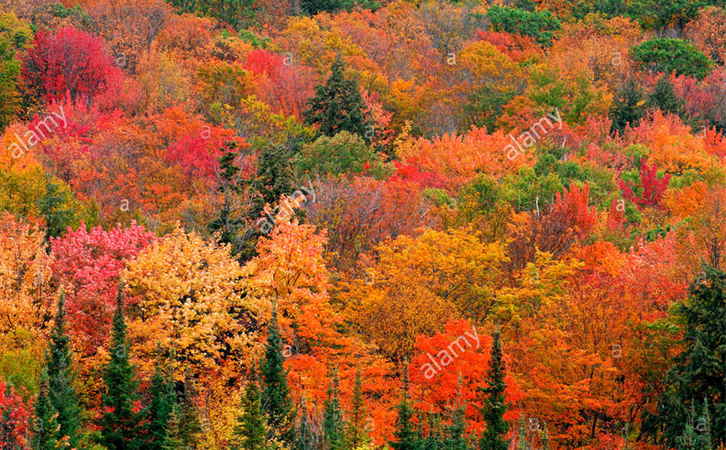
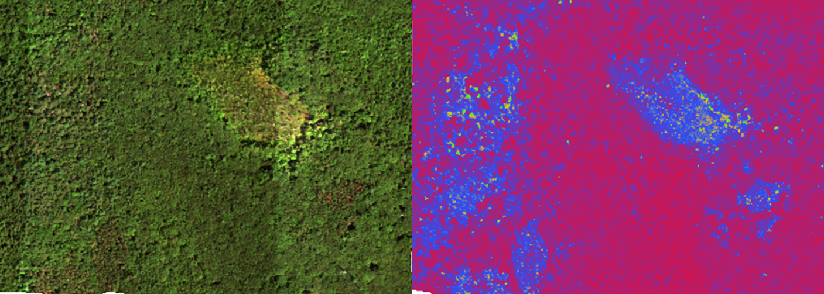
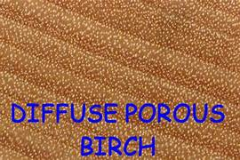
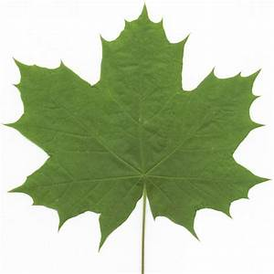
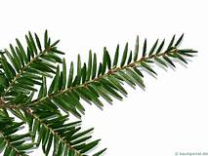
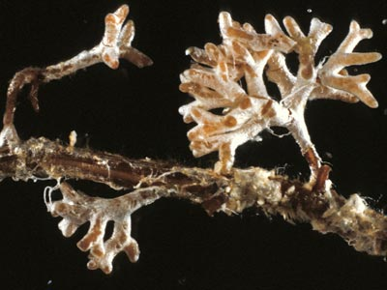
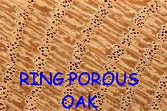
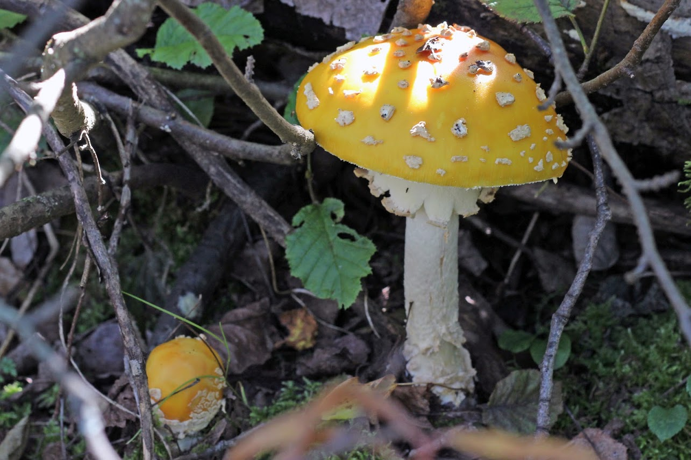
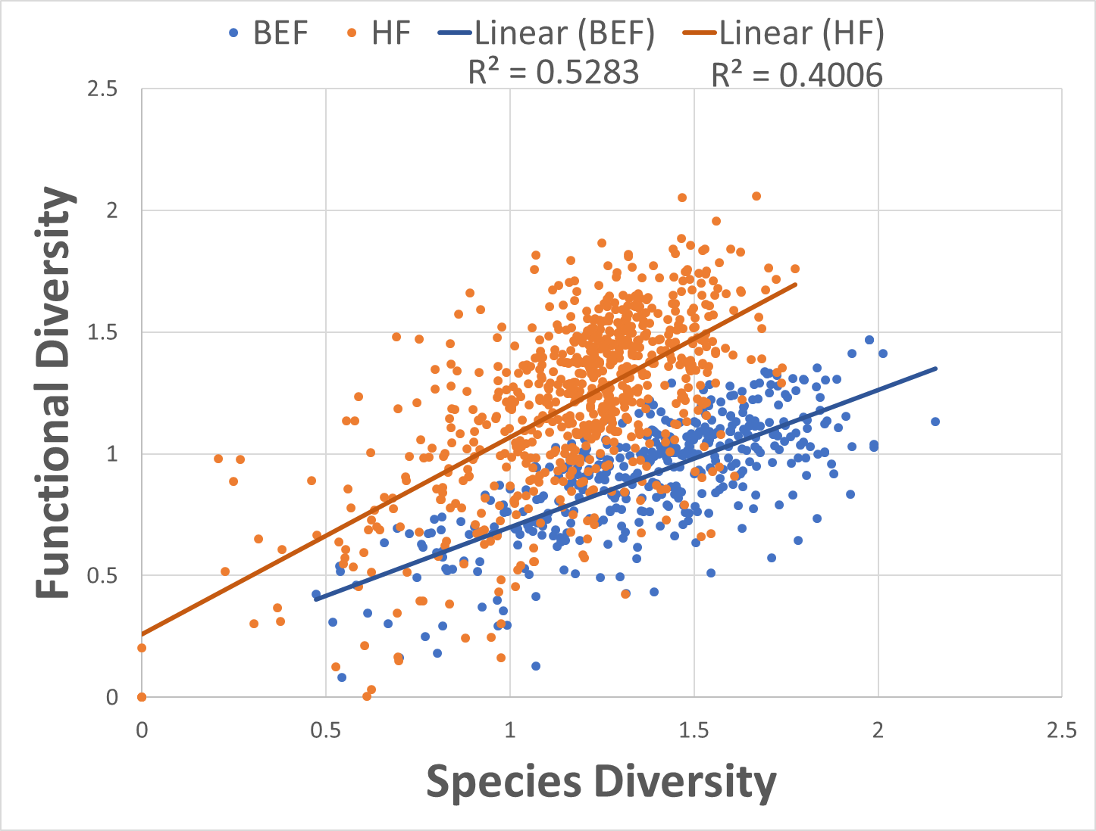
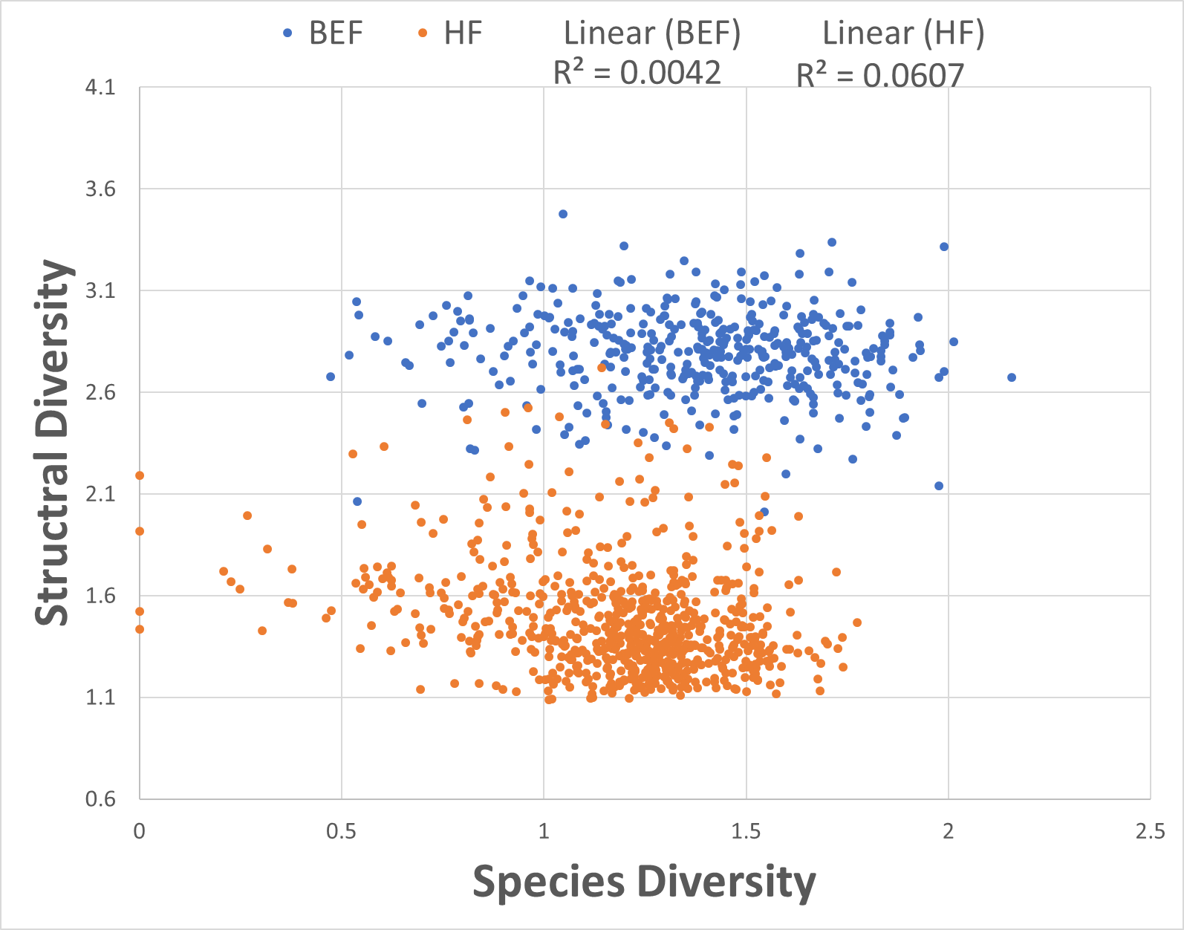
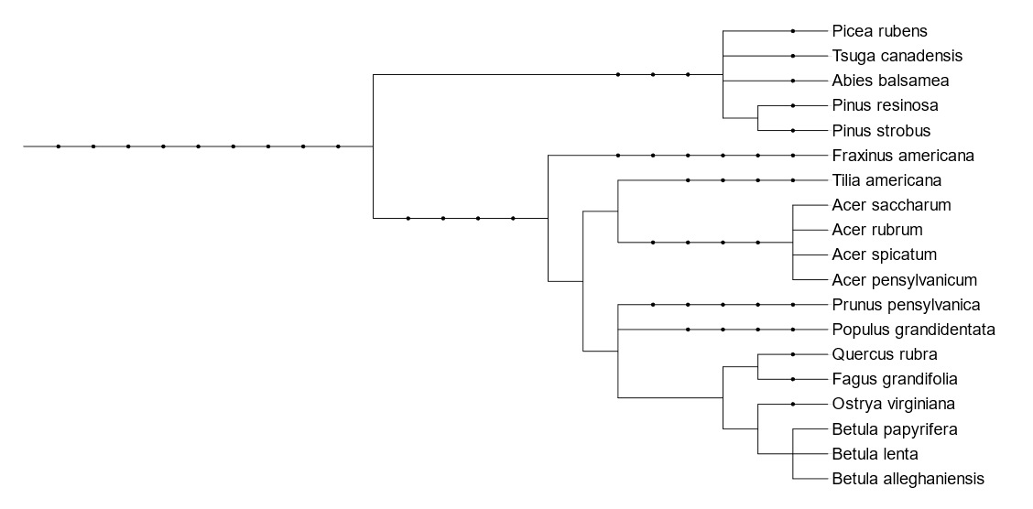
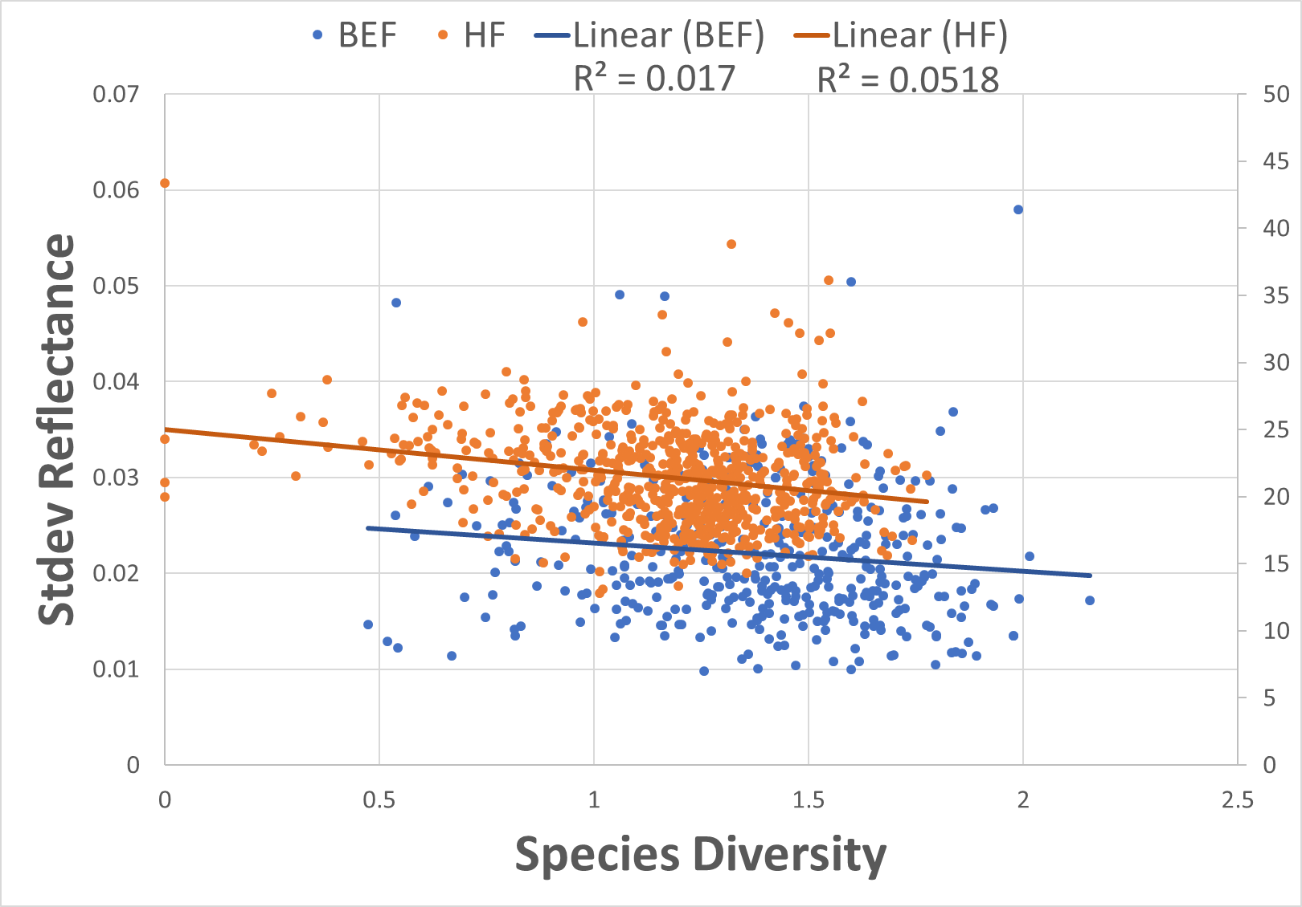
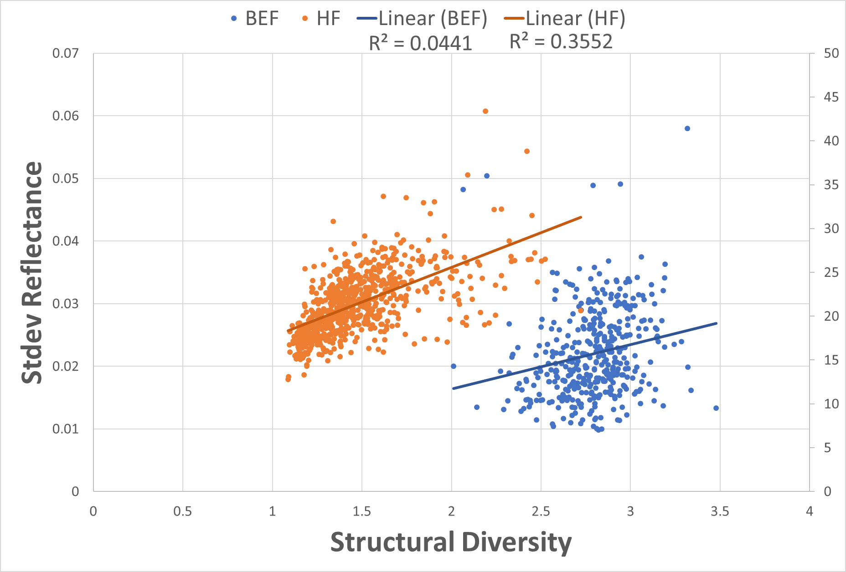
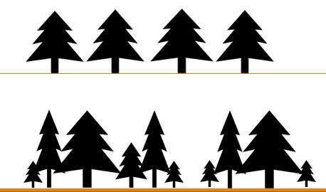




Evaluating the Ability to Derive Estimates of Biodiversity from Remote Sensing
Kaitlyn Baillargeon (kab2014@wildcats.unh.edu)
Scott Ollinger, Andrew Ouimette, Rebecca Sanders-DeMott, Franklin Sullivan, Zaixing Zhou, Jack Hastings
Department of Natural Resources and the Environment, University of New Hampshire, Durham, NH
Institute for the Study of Earth, Oceans, and Space and Department of Earth Sciences, University of New Hampshire, Durham, NH
Background:
Methods:
Estimating Diversity with Remote Sensing:
Quantifying forest biodiversity is an important way to evaluate forests health, ecosystem services, management priorities and assess loss. An array of metrics have been used to define forest biodiversity using both ground and remote sensing based measurements.
Understanding the accuracy in which we can measure different biodiversity metrics from remote sensing imagery will help improve biodiversity assessments.
Here we test our ability to estimate several biodiversity metrics through remote sensing in two northern temperate forests: Bartlett Experimental Forest in NH and Harvard Forest in MA
Study Sites
Bartlett Experimental Forest (BEF) in Bartlett, NH. 1,052 hectare northern-hardwood forest containing 400⁺ evenly spaced inventory plots.
Harvard Forest (HF) in Petersham, MA. 35 hectare mixed hardwood forest containing inventory data across a continuous area.
Figure 5: Map of New England depicting approximate locations of the two study sites; BEF and HF.
Figure 8: Principal components analysis (PCA) of relationships between diversity metrics and select vegetation indices for BEF (A) and HF (B).
Metrics of Diversity:
1) Species Diversity: Variation in species composition
Vegetation Indices
Vegetation indices (e.g. NDVI, EVI, ARVI, SAVI, etc.) were calculated from multispectral data. Selected indices were shown in previous studies to correlate with biodiversity under the assumption that increased spectral heterogeneity represents increased diversity.
A
A
B
Diversity Calculations
Shannon H Index: H = -∑(Pi * ln Pi)
  Pi = proportional number of species, groups, classes:
  Pi = ni/N
  Used for calculation of species, functional, structural diversity
Faith’s PD: sum of the branch lengths in the minimum spanning path
  Used for calculation of phylogenetic diversity
Legend:
Ground Diversity Metrics:
Vegetation Indices:
Figure 1: (A) Example of a low diversity forest with only conifer species present (B) Example of a high diversity forest with a mixture of tree species
Table 1: The percent variation in each diversity metric described by all vegetation indices when run through a bootstrapping and partial least squares analysis.
2) Functional Diversity: Variation in species traits that describe their ability to acquire light, water, and nutrients.
(A) Wood anatomy
(B) Leaf Types
(C) Mycorrhizae Fungi
B
Figure 6: True color hyperspectral image of HF (left) compared against the region’s NDVI values (right) where red represents high NDVI and blue represents low NDVI.
 | Bootstrap – Forest (%) |  | Partial Least Squares (%)
 | BEF | HF | BEF | HF
Species Diversity | 26.9 | 47.4 | 40.9 | 59.0
Functional Diversity | 23.6 | 49.9 | 33.7 | 58.5
Phylogenetic Diversity | 18.0 | N/A | 22.3 | N/A
Structural Diversity | 8.1 | 47.5 | 34.3 | 62.9
Figure 2: Selected functional traits to derive functional diversity
Relationships Among Diversity Metrics:
3) Phylogenetic Diversity: Variation in taxonomic groups derived from evolutionary connectedness
Conclusions and Future Directions:
Based on the linear regressions, the strongest relationship between diversity metrics was between functional and species diversity. However species diversity was able to explain only about 50% of the variation found within functional diversity.
Most predictive models had limited success in predicting the various biodiversity metrics. In general, models were able to predict structural diversity with higher success than other metrics.
To take this research further, things to consider would include:
  Look at how relationships between biodiversity metrics and remote sensing analyses change with increasing pixel size (spatial resolution) and spectral bandwidth (spectral resolution).
  Assess how other remote sensing analyses will relate to biodiversity metrics
  Apply additional statistical methods to improve the ability to predict biodiversity from remote sensing.
A
B
Figures 7: Linear regressions analyzing relationships between biodiversity metrics and spectral analyses showing moderate relationships between functional and species diversity (A), weak relationships between species diversity with structural diversity (B) and spectral heterogeneity (C), and possible relationship between structural diversity and heterogeneity of reflectance (D).
Figure 3: Cladogram displaying common species found in the White Mountains of NH
4) Structural Diversity: Variation in tree shape, size, and arrangement.
Low
Figure 4: Depiction of a forest with low structural diversity (top) and high structural diversity (bottom) showing variations in height, width, and spatial arrangement.
Acknowledgments:
High
This material is based upon work supported by the National Science Foundation under Grant Number (1638688). Partial funding was also provided by the New Hampshire Agricultural Experiment Station, the Hubbard Brook Long Term Ecological Research program (NSF 1114804), the Harvard Forest Long Term Ecological Research program, and the University of New Hampshire graduate school. We also acknowledge the help and support of infrastructure and staff at Bartlett Experimental Forest and Harvard Forest. Inventory data of species compositions at BEF was collected by the University of New Hampshire 2014 and for HF was collected by Orwig D, Foster D, Ellison A. 2015. LiDAR data and HF hyperspectral imagery (1m spatial resolution) was obtained from the National Ecological Observatory Network and BEF hyperspectral imagery (5m spatial resolution) was obtained from SpecTIR.
C
D

