Slide 1

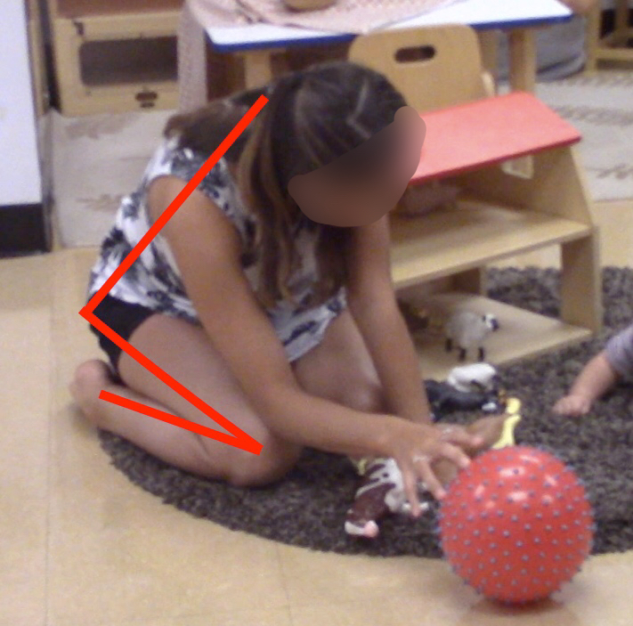
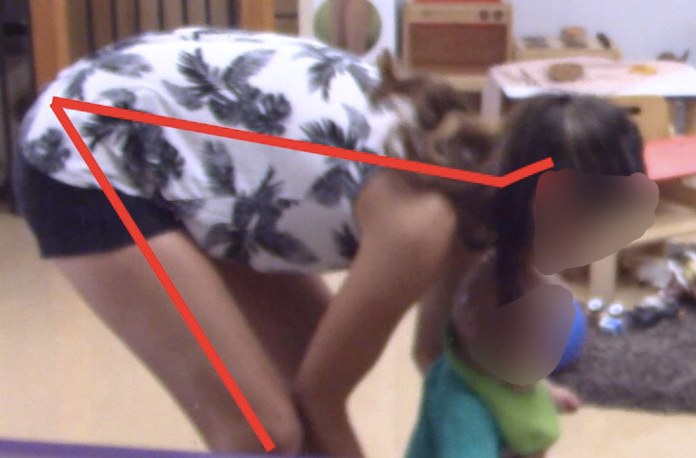
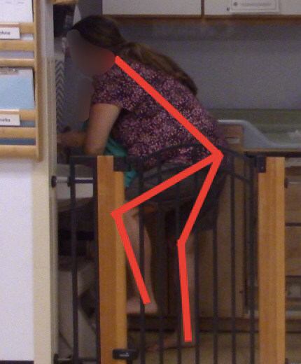
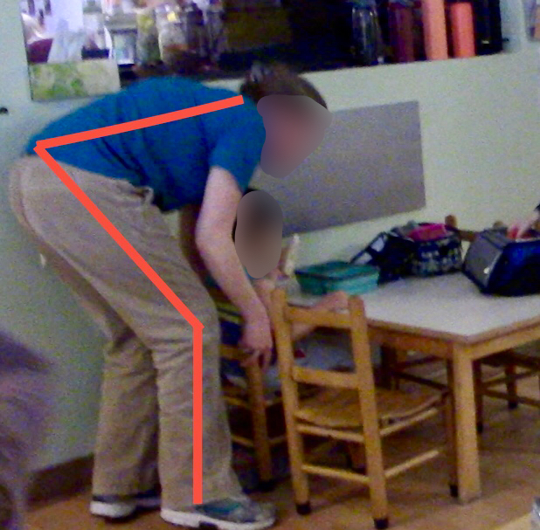
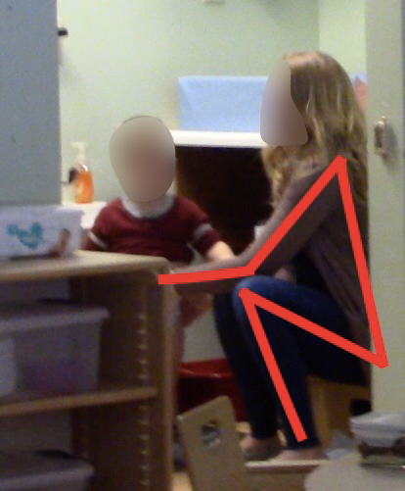
When They’re in my Arms: An Occupational Risk Assessment for Early Childcare Professionals
Kimberly Reilly, OTS & Vidya Sundar, PhD, OTR/L
Occupational Therapy Department, University of New Hampshire, Durham, NH - 03824
Background
There are over 1,200,000 childcare professionals currently working in the U.S. (Bureau of Labor Statistics)
The rate of musculoskeletal disorders among this population is estimated to be between 40-90% (Erik & Smith, 2011)
Psychosocial risk factors exist through job perceptions and high and unpredictable demands (Widnarko et.al, 2014)
Previous research focuses on infectious disease, environmental concerns and stress related factors, with very little focus on musculoskeletal and psychological risks (Sanders & Morse, 2005).
Results
Discussion
Playing on the floor, naptime routine and toilet training presented the highest potential for musculoskeletal risk factors.
Playing with young infants on the floor often involved multiple awkward postures such as trunk twisting, shoulder extension and abduction, neck flexion etc.
Helping young infants with naptime involved lowering infants into cribs with high sides while carrying young infants (unstable load)
Diaper changing stations and child-size furniture presented additional environmental hazard.
The findings from our focus groups confirmed findings from observation-based risk analyses
Person factors such as role-identity played a major role on how the task was performed.
Participants who strongly identified with their caregiver role reported putting the needs of the child first before their own need for safety and proper body mechanics.
This dynamic was often complicated by environmental demands such as increased noise levels in the classroom and toys that presented tripping
hazards.
Infants | Toddlers | Preschool
Playing with children on the floor | Playing with children on the floor | Playing with children on the floor
Feeding at the table | Assisting children at lunch table | Changing diapers at the changing table
Helping children with nap time | Completing paperwork | Changing diapers while child is standing
Feeding with bottle | Changing diapers at the changing table | Playing at the table
Cleaning and setting up | Toilet Training | Helping children with nap time
Soothing children | Playing at the table | Assisting with dressing
Completing paperwork | Assisting with dressing | Toilet training
Changing diapers at the changing table | Helping children with nap time | Completing paperwork
 | Soothing children
 | Changing diapers while child is standing
Task | REBA Right Side Risk | REBA Left Side Risk
Bouncing child | 4.50 | 4.00
Diaper change (Child standing) | 3.33 | 3.33
Diaper change (Diaper table) | 2.67 | 2.83
Dressing | 2.75 | 2.50
Feeding at table | 3.00 | 2.67
Nap time | 5.00 | 4.67
Paperwork | 3.00 | 3.00
Playing on Rug | 6.40 | 6.00
Rocking infant | 2.80 | 2.40
Feeding at table (lunchtime) | 3.67 | 3.67
Playing at the table | 3.25 | 3.25
Toilet training | 4.67 | 4.33
Research Questions
What specific job tasks and routines do childcare professionals perceive to be physically stressful?
What specific job tasks and routines do childcare professionals perceive to be the most emotionally stressful?
What specific job tasks contribute to the highest musculoskeletal risk factors for childcare professionals?
Classroom Average | REBA Right Side Risk | REBA left side risk
Infant | 3.76 | 3.61
Toddler | 4.05 | 3.8
Preschool | 2.9 | 2.8
    Methods
    Mixed methods study
    Convenience sample, (N=18)
    Fulltime and part-time childcare professionals
    Recruited from 3 childcare centers in Seacoast New Hampshire region
Implications
For clinicians:
OTs can play a valuable role in supporting childcare professionals’ health and safety in the workplace
The PEO framework can be used to guide interventions to minimize occupational risk factors for childcare professionals
In addition to behavioral and educational interventions focused on proper body mechanics, work flow and job task demands should be considered to reduce risk exposure.
For Childcare Professionals:
Awareness of proper body mechanics and stress management techniques is critical for health maintenance
Focus groups
4 focus groups, audio-recorded
60 minutes each
3-6 participants each
Risk assessment based on job sampling
Rapid Entire Body Assessment (REBA)
Job Sampling
Classroom observations and video recordings
Field notes
Data Analysis
Quantitative: Descriptive statistics, risk analysis
Qualitative: Descriptive coding and interpretive analysis using Nvivo
Synthesis of qualitative and quantitative guided by the PEO framework
RESULTS
Limitations & Conclusion
Small sample size (N=18)
Cross-sectional design
For Researchers:
Follow up study focused on the impact of behavioral and organizational intervention on actual and perceived risk
This study provides a valuable understanding of early childcare professionals’ actual and perceived musculoskeletal and psychosocial risk factors in their work
“I would say its 10 percent or less physical, almost all emotional from my perspective.”
“I think it’s hard because there’s always something going on until that moment when they go to sleep and everyone’s like ‘what just happened-I don’t know’”
”For me its thinking about the long term impact of being 6 feet tall and often standing up and down getting in and out of 13 inch chairs- I’m worried about my hips in the long run.”
Demographic Characteristics | N
Female | 18
Infant Classroom | 7
Toddler Classroom | 8
Preschool Classroom | 3
Full Time employment | 15
“I guess I don’t really
think about it because I feel like if I have a kid in my arms they’re more of my worry than myself. So like I said I never really thought about it that much.”
References
Bureau of Labor Statistics. Occupational Outlook Handbook-Childcare Workers. (n.d.). Retrieved February 26, 2018,
from https://www.bls.gov/ooh/personal-care-and-service/childcare-workers.htm
Erick, P. N., & Smith, D. R. (2011). A systematic review of musculoskeletal disorders among school teachers. BMC Musculoskeletal Disorders, 12. doi:10.1186/1471-2474-12-260 12(1) 1-11.
Sanders, M. J., & Morse, T. (2005). The Ergonomics of Caring for Children: An Exploratory Study. American Journal of Occupational Therapy, 59, 285-295. doi:10.5014/ajot.59.3.285
Widanarko, B., Legg, S., Devereux, J., & Stevenson, M. (2014). The combined effect of physical, psychosocial/organisational and/or environmental risk factors on the presence of work-related musculoskeletal symptoms and its consequences. Applied Ergonomics, 46, 1610-1621.
Twenty-five childcare tasks were observed and scored using the REBA.
One-sample t-tests revealed a significant difference for musculoskeletal risk as identified by REBA for left and right side based on job tasks (p<.001) and for infant and toddler classrooms (p<.01)
“So it’s all about supporting a child’s independence, but we’re also putting ourselves in those awkward positions.”
Notes:
Cronin, G. A., & Meyer, G. C. (1992). The Role of the Occupational Therapist in Cardiac Rehabilitation. Journal of Cardiopulmonary Rehabilitation, 12, 2.
Tooth, L., & McKenna, K. (1996). Contemporary Issues in Cardiac Rehabilitation: Implications for Occupational Therapists. The British Journal of Occupational Therapy, 59, 3, 133-140.
MAKE SURE THAT RQ WORDING AND PATIENT WORDING IS CONSISTENT THROUGHOUT ALL SECTIONS
Old discussion
Emotional support important coping mechanisms for patient
Numerous patients feel they have no autonomy in their hospital structure- feel as if they must follow “protocol”
Lack of understanding of staff members and their roles
Patients have a hard time understanding the transferability of skills learning in OT to their home
Challenges with hospital structure impacts clients ability to actively participate in occupational therapy
Old Implications
Hospital structure is impacting the effectiveness and impact of occupational therapy success on the patient
Day to day operations of the hospitals impacts patients level of alertness for therapy
Lack of education and generalizability of therapy impacting the longevity of success of occupational therapy services upon patient returning home
Patients have a difficult time understanding that skills learned in OT will help them safely and effectively live at home
Confusion of staff and staff roles by patients impacts the clients level of comfort during hospital stay
Increases level of uncertainty in the hospital stay and contributes to
Looking into the future…
Improving client education on how skills learned in OT will carry over into home life
Creating a stricter schedule for clients to avoid feeling overwhelmed and fatigued
Provide patients with daily schedule
Technology to minimize overnight medication interuptions
Developing informational materials regarding who each member of the hospital staff is and their role
Photo system

