Slide 1

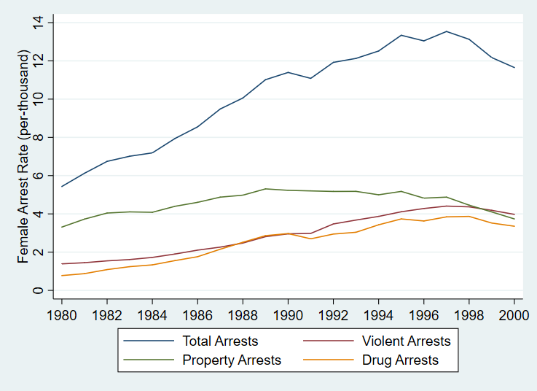
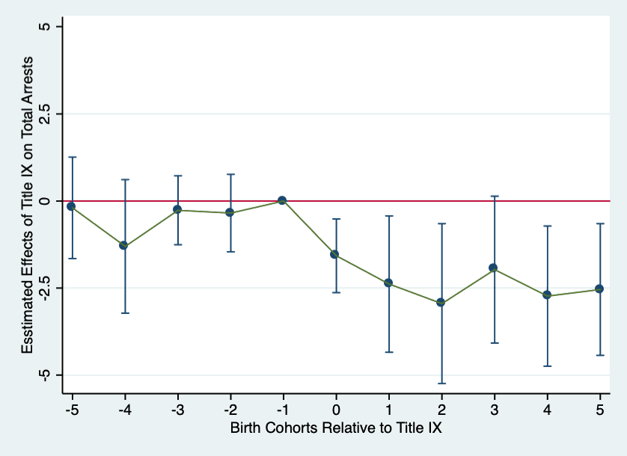
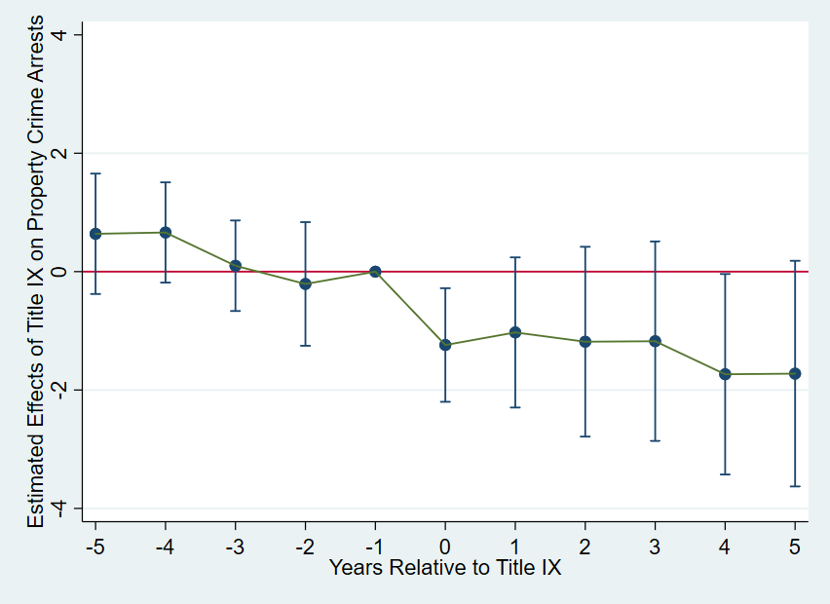
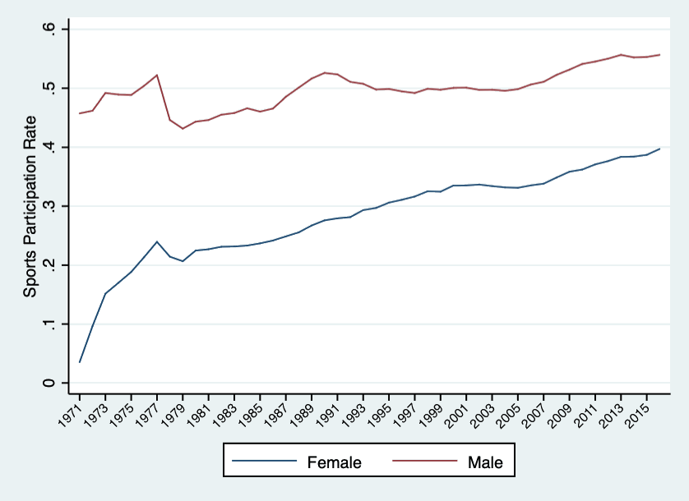
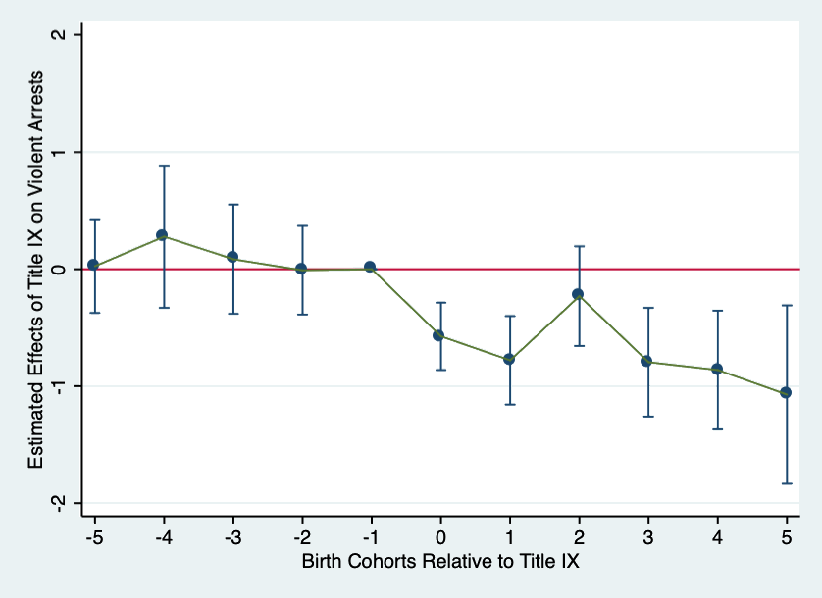
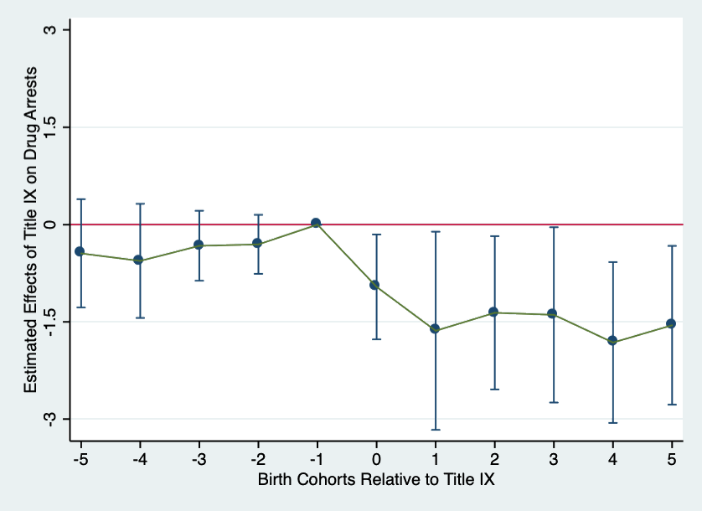
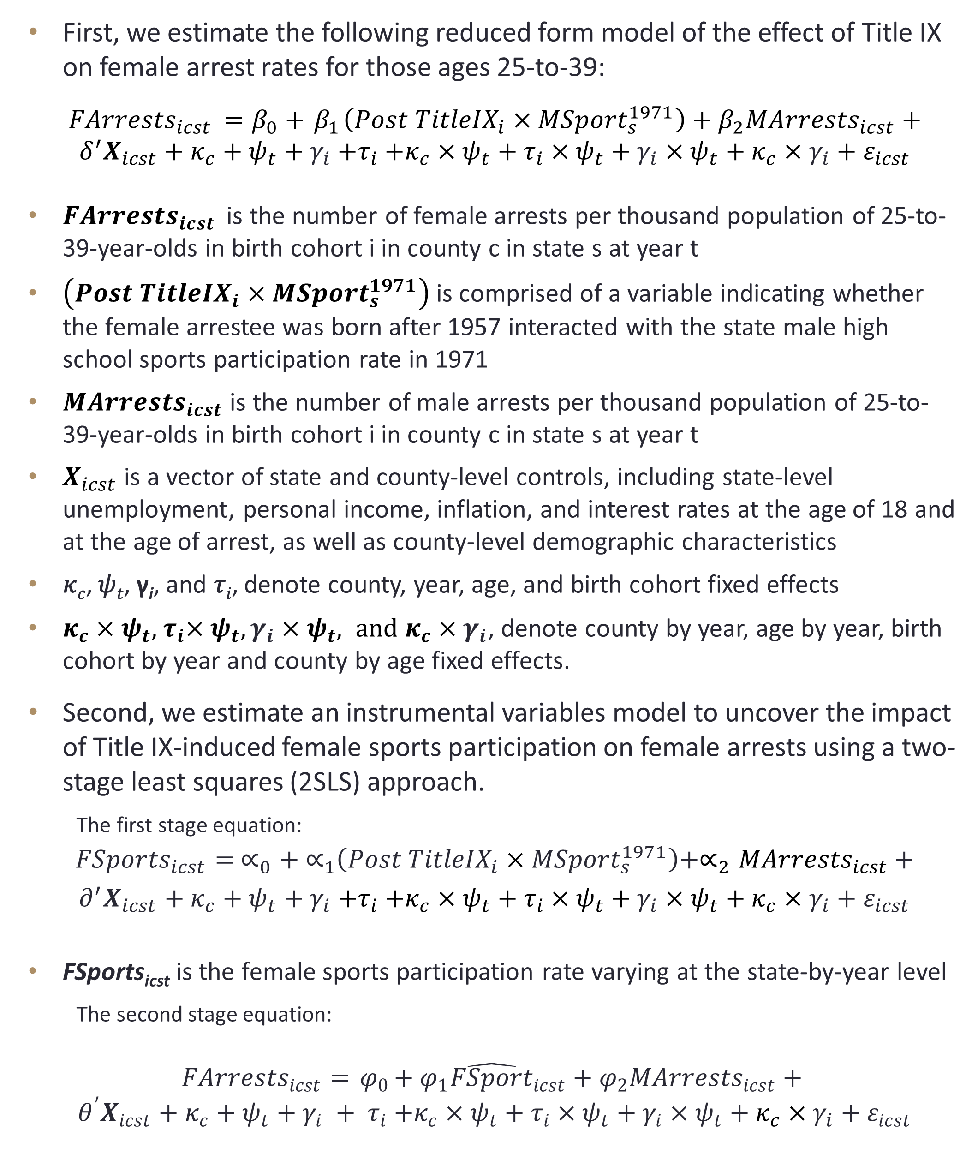
More Sports, Less Crime?
New Evidence from Title IX*
Gokhan Kumpas (UNH)
Joseph J. Sabia (Director of Center for Health Economics & Policy Studies, SDSU, UNH, Research Fellow, ESSPRI & IZA)
TITLE IX
DATA
Main Results
President Richard Nixon signed educational amendments to Title IX (20 U.S. Code § 1681) into law on June 23, 1972.
The amendments state, in part:
        “No person in the United States shall, on the basis of sex, be excluded from participation in, be denied the benefits of, or be subjected to discrimination under any educational program or activity receiving financial assistance.”
(20 U.S. Code § 1681 – Sex)
Title IX applies to any educational institution that receives federal financial assistance from the U.S. Department of Education, which includes approximately:
  16,500 local school districts, 7,000 postsecondary institutions, charter schools, for-profit schools, and education agencies across all 50 states and the District of Columbia
  (Department of Education Office for Civil Rights, 2015)
The largest impact of Title IX was on female sports participation (Stevenson, 2007; Kaestner and Xu, 2010).
Between 1971, the final year prior to Title IX’s enactment, and 1978, the last year of Title IX’s five-year compliance window, the share of females participating in high school sports increased by from 1 in 27 to 1 in 4 (more than 600 percent) (Kaestner and Xu, 2010; Stevenson, 2010).
Uniform Crime Reports (UCR)
  We compile county-by-year arrest rates per 1,000 females ages 25-to-39 from 1980 to 2000.
Total Arrests | Property Arrests | Violent Arrests | Drug Arrests
Reduced Form
-1.902** | -1.101*** | -0.747*** | -1.093*
(0.774) | (0.358) | (0.208) | (0.646)
Instrumental Variables
-10.23** | -5.894** | -4.000*** | -5.880
(4.678) | (2.544) | (1.356) | (3.582)
Number of Obs. & Means
132,748 | 131,709 | 130,893 | 127,508
11.82 | 4.88 | 2.47 | 2.88
Event Study Analysis
Figure 2. Female Arrest Rates Among 25-to-39 Year-Olds, 1980-2000
Empirical Strategy
First, we estimate the following reduced form model of the effect of Title IX on female arrest rates for those ages 25-to-39:
$${FArrests}_{icst }=β_{0}+{ β}_{1}\left({Post TitleIX}_{i}×{MSport}_{s}^{1971}\right)+β_{2}{MArrests}_{icst}+$$
$$δ^{′}X_{icst}+κ_{c}+ψ_{t}+γ_{i}{+τ}_{i}+κ_{c}×ψ_{t}+τ_{i}×ψ_{t}+γ_{i}×ψ_{t}+κ_{c}×γ_{i}+ε_{icst}$$
${FArrests}_{icst }$ is the number of female arrests per thousand population of 25-to-39-year-olds in birth cohort i in county c in state s at year t
$\left({Post TitleIX}_{i}×{MSport}_{s}^{1971}\right)$is comprised of a variable indicating whether the female arrestee was born after 1957 interacted with the state male high school sports participation rate in 1971
${MArrests}_{icst}$ is the number of male arrests per thousand population of 25-to-39-year-olds in birth cohort i in county c in state s at year t
$X_{icst}$ is a vector of state and county-level controls, including state-level unemployment, personal income, inflation, and interest rates at the age of 18 and at the age of arrest, as well as county-level demographic characteristics
𝜅_{𝑐}, 𝜓_{𝑡}, γ_{i}, and 𝜏_{𝑖}, denote county, year, age, and birth cohort fixed effects
$κ_{c}×ψ_{t}, { τ}_{i}×ψ_{t}, γ_{i}×ψ_{t}, and κ_{c}×γ_{i}$, denote county by year, age by year, birth cohort by year and county by age fixed effects.
Second, we estimate an instrumental variables model to uncover the impact of Title IX-induced female sports participation on female arrests using a two-stage least squares (2SLS) approach.
  The first stage equation:
$${FSports}_{icst}{= ∝}_{0}+{ ∝}_{1}\left({Post TitleIX}_{i}×{MSport}_{s}^{1971}\right)+∝_{2}{MArrests}_{icst}+$$
$$∂^{′}X_{icst}+κ_{c}+ψ_{t}+γ_{i}{+τ}_{i}+κ_{c}×ψ_{t}+τ_{i}×ψ_{t}+γ_{i}×ψ_{t}+κ_{c}×γ_{i}+ε_{icst}$$
FSports_{icst} is the female sports participation rate varying at the state-by-year level
  The second stage equation:
$${FArrests}_{icst}={ φ}_{0}+{ φ}_{1}{\hat{FSport}}_{icst}+φ_{2}{MArrests}_{icst}+$$
$$θ^{′}X_{icst}+κ_{c}+ψ_{t}+γ_{i} {+ τ}_{i}+κ_{c}×ψ_{t}+τ_{i}×ψ_{t}+γ_{i}×ψ_{t}+κ_{c}×γ_{i}+ε_{icst}$$
Figure 3. Total Arrests
Figure 4. Property Arrests
Figure 5. Violent Arrests
Figure 3. Drug Arrests
conclusions
This study exploits the introduction of Title IX as a natural experiment to estimate the causal impact of female sports participation on female arrests
Using county-level crime data between 1980 and 2000 from the Uniform Crime Reports (UCR), reduced form estimates show that a 10 percentage-point higher pre-Title IX state male sports participation rate was associated with a 1.6 percent decline in female arrests among affected cohorts
Findings are robust to controls for state-level economic conditions, male crime rates, county by year, birth cohort by year, and age by year fixed effects. Event study analyses, suggesting that our estimates are causal in nature. 2SLS estimates confirm our pattern of results
25-percentage point increase in female sports participation induced by Title IX generated approximately $2.4 billion per year in cost savings in property crime reductions and approximately $7.6 billion per year in cost savings in violent crime reductions
Figure 1. Sports Participation Rate by Gender 1970-2016
Contributions
To our knowledge, this study provides the first causal estimates of the impact of sports on crime.
We exploit the introduction of Title IX, which required educational institutions to achieve greater gender parity in sports participation, to isolate the impact of female sports participation on female arrests.
We conduct event study analysis and falsification tests to examine the credibility of our empirical strategy.
Notes:
To change this poster, replace our sample content with your own. Or, if you'd rather start from a clean slate, use the New Slide button on the Home tab to insert a new page, then enter your text and content in the empty placeholders. If you need more placeholders for titles, subtitles or body text, copy any of the existing placeholders, then drag the new one into place.

