Slide 1
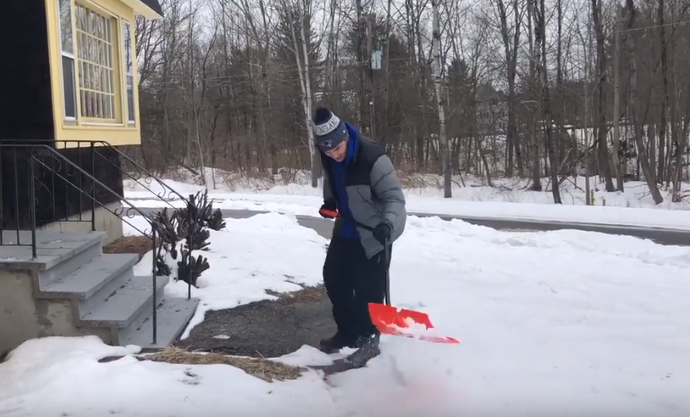
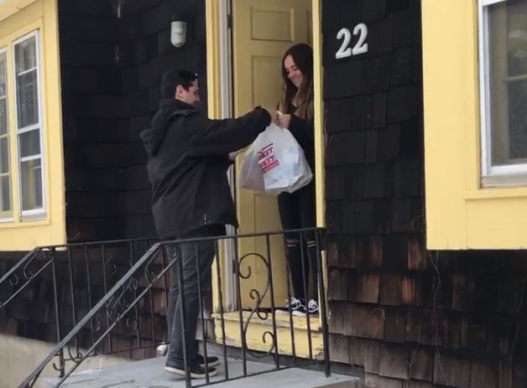

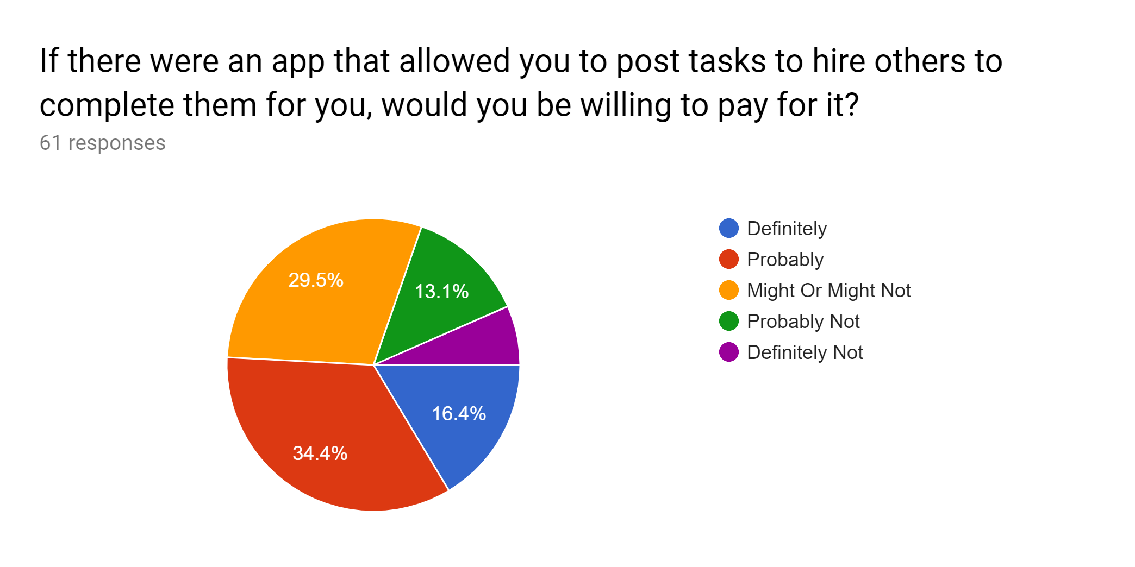
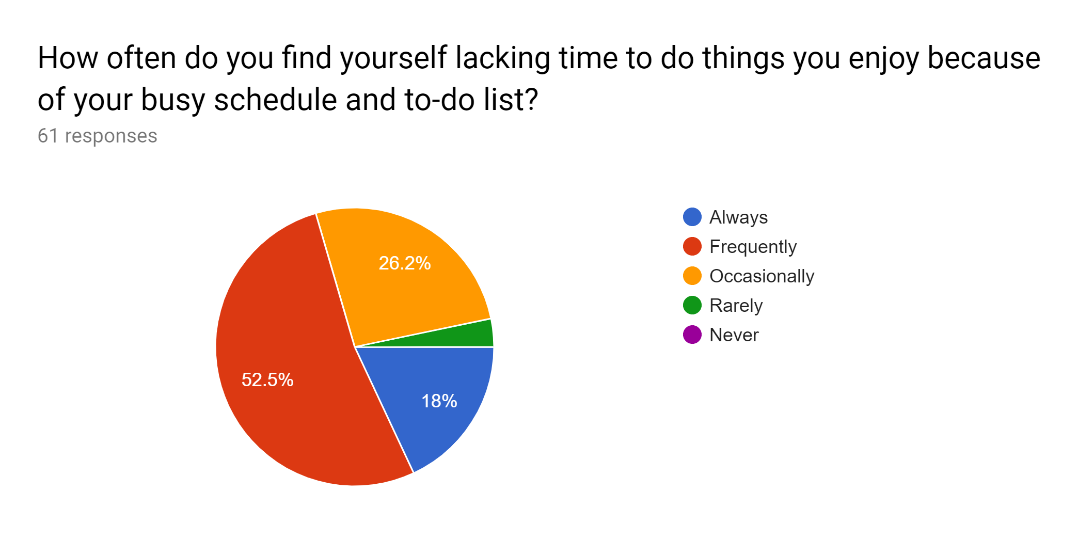
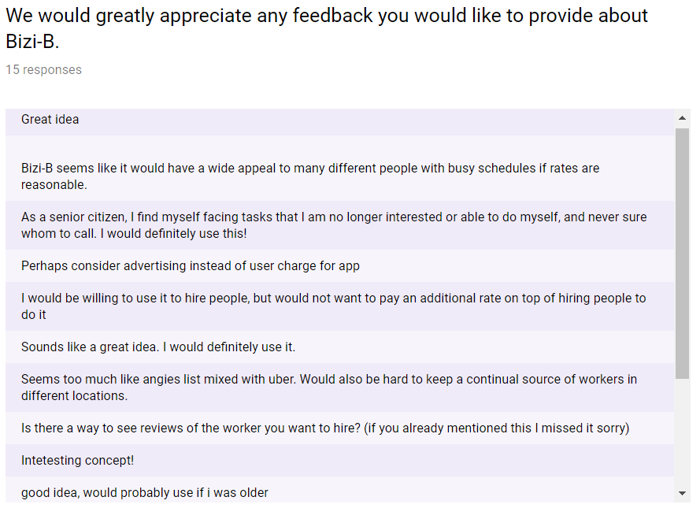
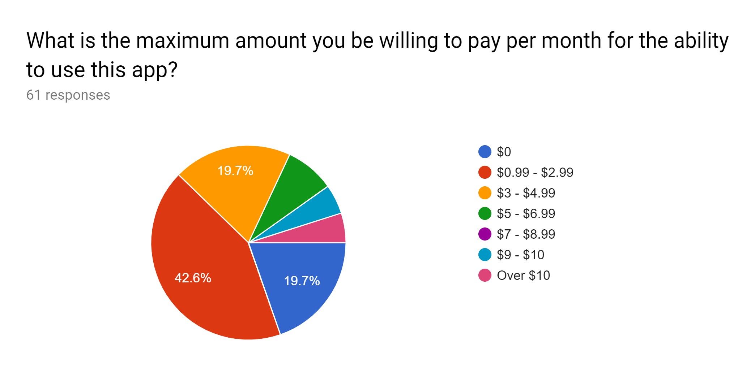
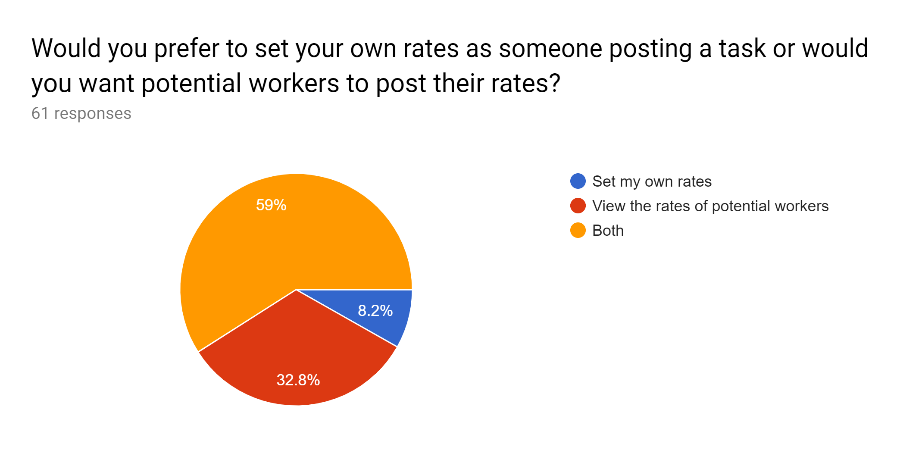
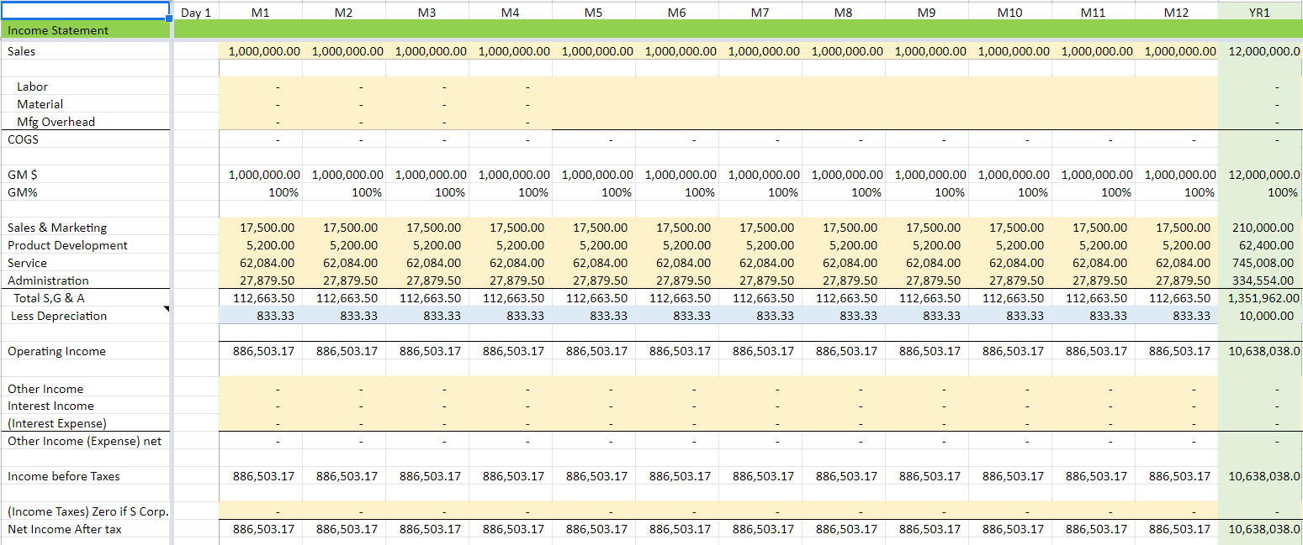
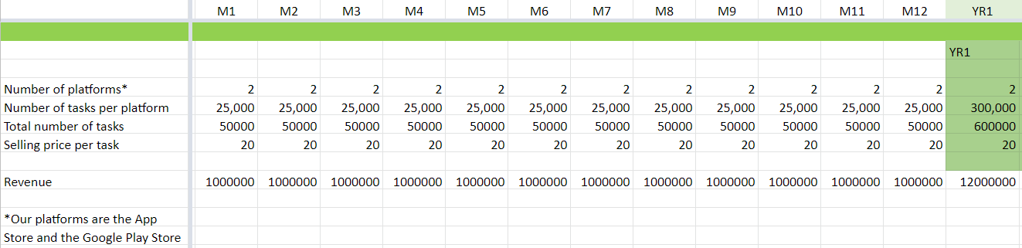
Bizi-B
Ryan Anastasi, Emily Cunningham, Alex Leo, and Evan Diaz
What is the Need?
Who are we?
What is our Solution?
  People lead busy lives and sometimes need help completing simple chores and tasks. Also, the elderly and people with disabilities often have trouble completing tasks.
Bizi-B was founded by a team of four Paul College Senior Business Administration majors, ranging in options from Management to Information Systems and Business Analytics. We see an opening in the market for an application that allows people to have tasks completed in a safe, efficient, and cost-friendly way.
  Our app, Bizi-B, helps hardworking, middle-class consumers who want to hire others to complete their chores which would allow them to have more time to spend on more important things and eliminate tasks from their to do list. Unlike our competitor TaskRabbit, Bizi-B allows people to connect with friends who can recommend reputable workers to complete their tasks and it is not limited by location.
  Also, our app includes the following:
A code of ethics for things that are
allowed/not allowed to be posted
Safety alert button on the app for
users to press, hold for 3 seconds,
and release to send alert to local
police
Moderators that review posts
flagged/reported by users as
“inappropriate”
Users can be banned for violating
the Bizi-B code of ethics
Who are our Competitors?
Business Model
The current solutions on the market today that are considered competitors for our idea are companies such as TaskRabbit. Instead of tasks being restricted by city, our app allows anyone, anywhere to get the help they need. Our competitors typically operate exclusively in cities or urban areas. Also, our app includes a referral system in which people can recommend a worker that they have hired in the past.
  Our app utilizes a peer-to-peer platform where users pay as they hire people for tasks. Bizi-B will make money by receiving a 15% fee for each task completed. We will also be an ad-supported app, offering companies the opportunity to pay us to post ads on our app. There will also be a $3.00 subscription fee per month for all customers and workers who download our app.
Market Conditions
Our overall market size is approximately 112 million people. This is a potential range based on research we have done and is not an exact value.
Customer Survey Responses
Customer Survey Comments
Financials
  To develop and get the app on the App Store and Google Play, we would need $200,000. Bizi-B is a great investment because of our high growth potential. Many people would be engaged through our app, whether they have tasks that they want others to complete or they are willing to do tasks.
Projected Income Statement, Year 1
Projected Monthly Sales, Year 1

