Slide 1

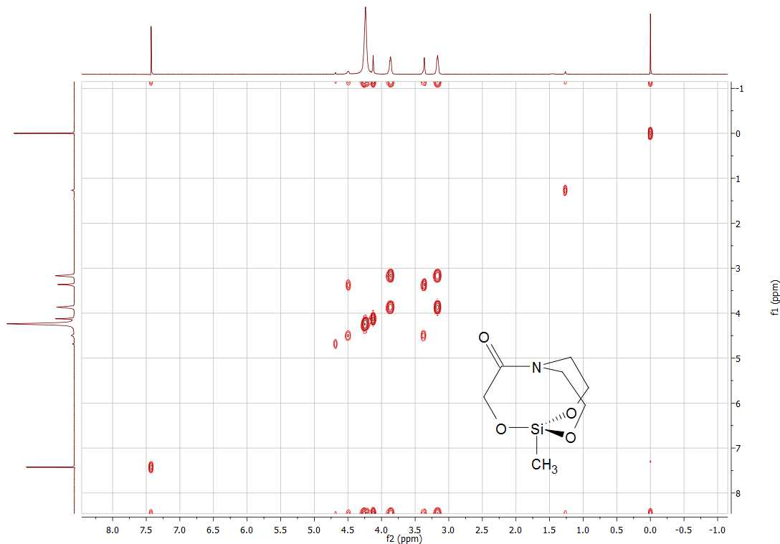
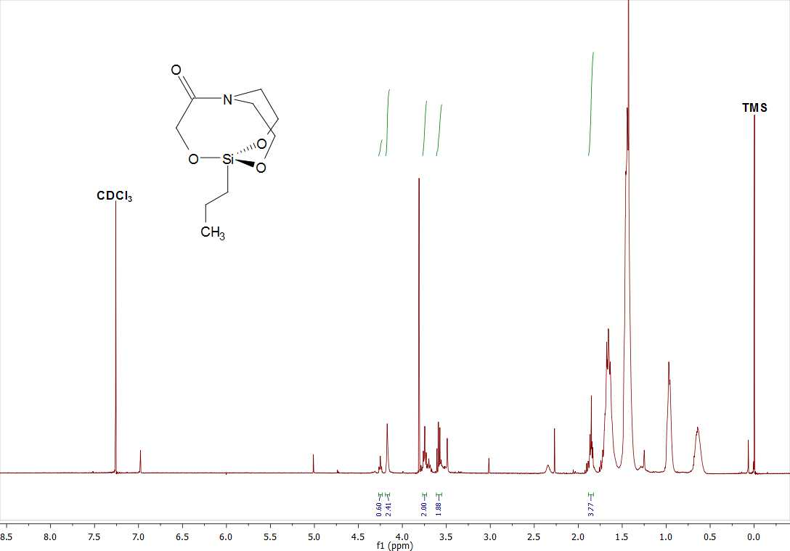
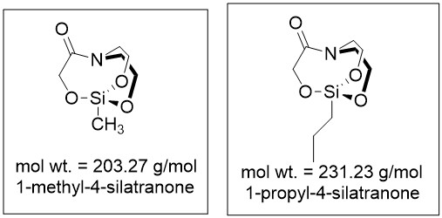
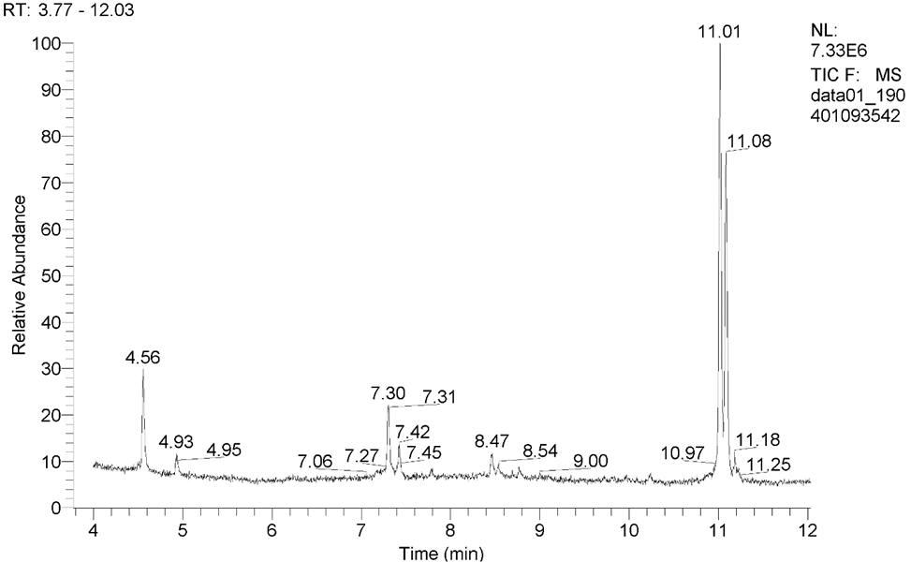
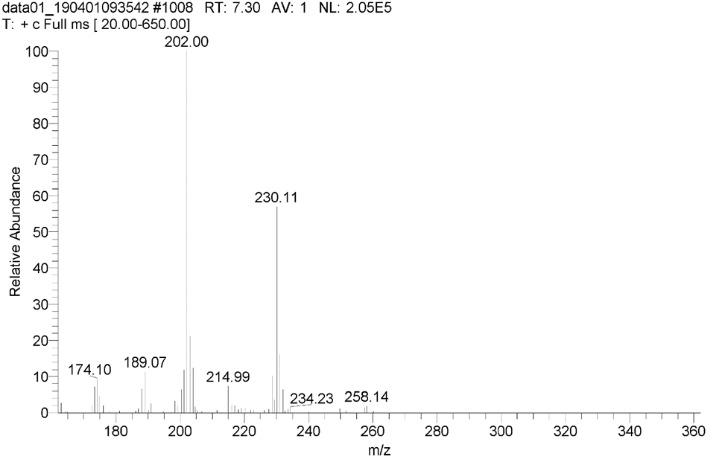
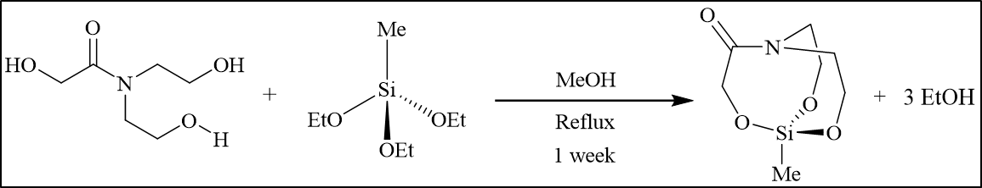
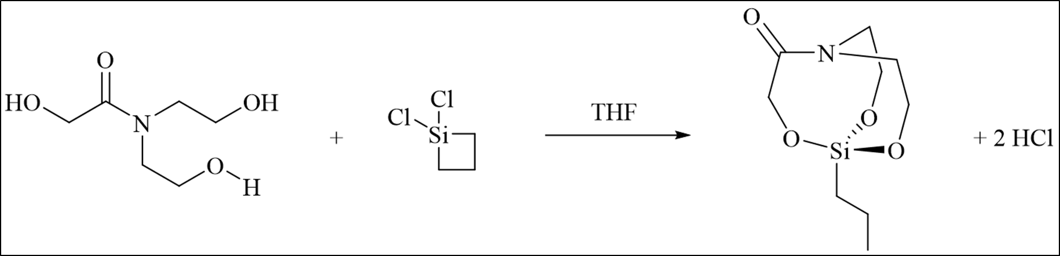
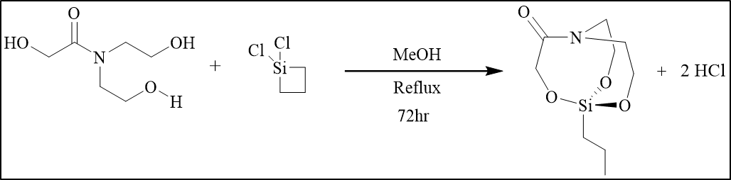
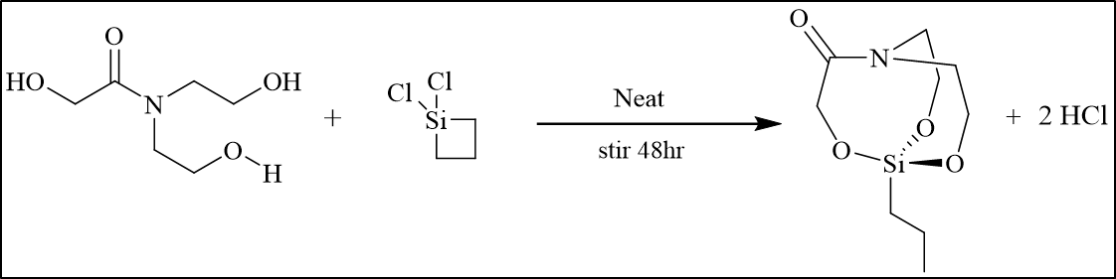
The First Conventional Synthesis of 1-methyl-4-silatranone and
Novel synthetic routes toward 1-propyl-4-silatranone via strained silacyclobutanes
Ryan W. Fitzgerald¹, Tristan J. Hart-Bonville², Noah A.Cote³, Arthur Greenberg^{4*}
rwj9@wildcats.unh.edu, Department of Chemistry, University of New Hampshire, Durham, NH
Amides and lactams are common structural motifs found in a variety of natural products and construct the backbone of amino acid chains, DNA/RNA, proteins, and enzymes. There are 3 major resonance contributors (see Figure 1) to amides in chemistry and in life.^{2,3,4} Silatranones have been calculated previously to have the nitrogen lone pair delocalized like in normal amides vs. having a coordinate covalent bond with silicon such as in silatranes, which is a bridged bicyclic amine.^{1,4} This research aims to synthesize strained lactams known as silatranones and to help elucidate who wins the competition for nitrogen’s lone pair-the silicon or the amide carbonyl.¹
Introduction:
Results and Discussion:
Future Work:
Characterize 1-propyl-4-silatranone further and attempt to rerun GC/MS after recalibrating the instrument to see if 203 M/Z is observed vs. 202 M/Z for 1-methyl-4-silatranone.
Figure 3. COSY NMR (400MHz) of 1-methyl-4-silatranone?
Figure 4. GC/MS (EI) of 1-methyl-4-silatranone.
Figure 5. ¹H NMR (400MHz) of potential 1-propyl-4-silatranone.
Figure 1. Various amide resonance structures.^{2,3,4}
Conclusions:
The organic synthesis of 1-methyl-4-silatranone was completed and improved. Synthesis of 1-propyl-4-silatranone has been started and is undergoing optimizations at present time. Preliminary electron impact GC/MS results indicate that our target compound was made as a minor product with a 202 M/Z just below our target of 203.27 g/mol indicative of a calibration issue, but this further supports our NMR analyses. Oligomeric products are the major product at this time with a 275 M/Z.
Figure 2. Structure of 1-methyl-4-silatranone¹
and 1-propyl-4-silatranone, respectively.
Acknowledgements:
Experimental Work:
Jesse Ambrose, the Elsawa research group, and UNH chemistry department are gratefully acknowledged. My assistants Noah and Tristan are also acknowledged for all their constant support and contributions to this project and the benzene metabolism project.
References:
Morgan, J. P.; Weaver-Guevara, H. M.; Fitzgerald, R. W.; Dunlap-Smith, A.; Greenberg, A. Struct. Chem. 2017, 28, 327.
Morgan, J.P.; Greenberg, A. J. Chem. Thermodynamics. 2014, 73, 206-212.
Morgan, J.P.; Greenberg, A. J. Phys. Org. Chem. 2012, 25, 1422-1428.
Weaver-Guevara, H.M.; Fitzgerald, R.W.; Greenberg, A. Can. J. Chem. 2017, 95, 271-277.
Scheme 1. Attempted syntheses of silatranone derivatives.^{1,4}

