Slide 1
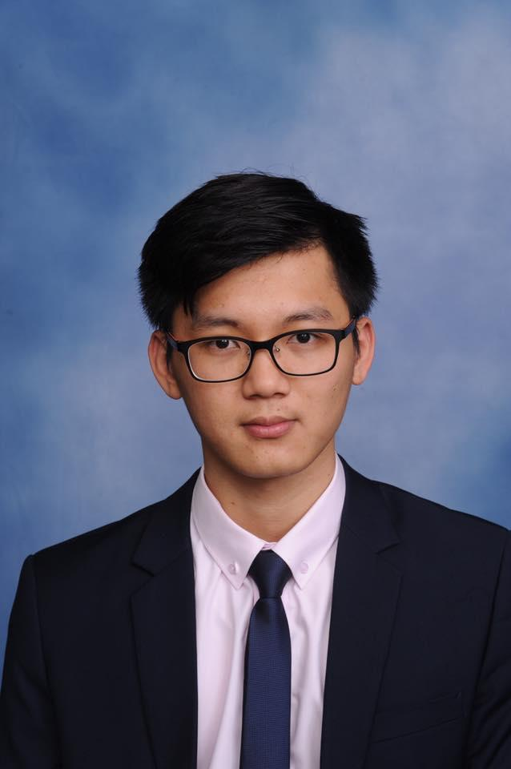
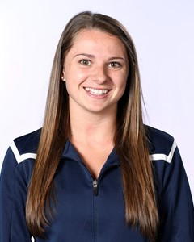
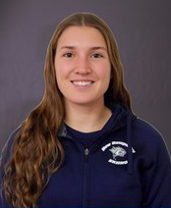




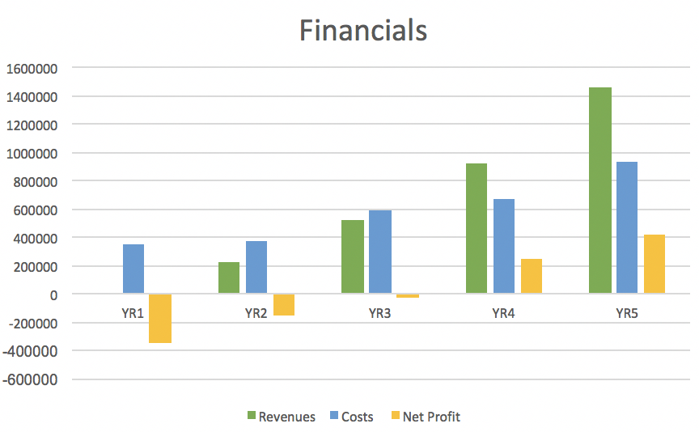

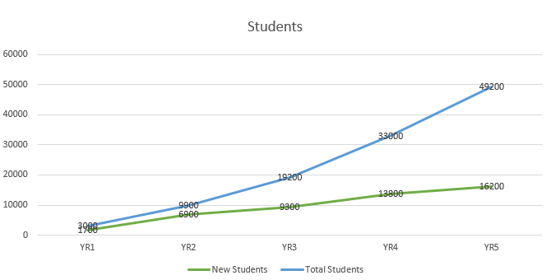
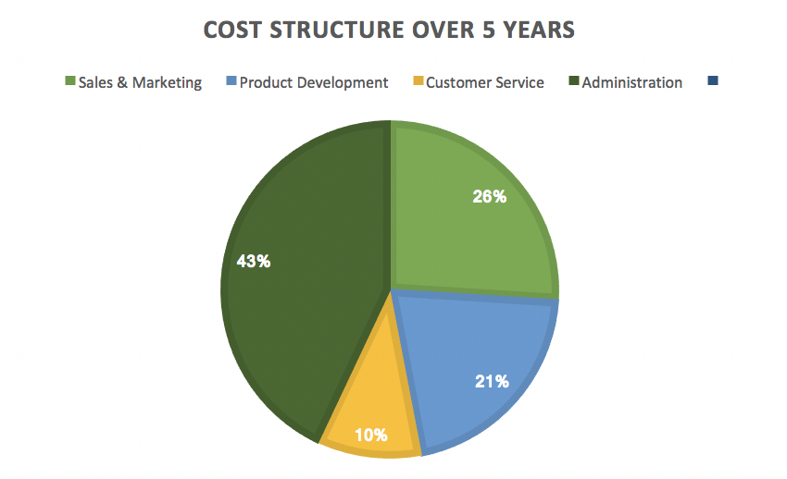
MONEY MA$TER
WHO WE ARE
Tuyen Nguyen
Nicole O’Leary
Emma Woodhouse
PROBLEM
SOLUTION
MARKET
Individuals struggle with budgeting their money
College students, in particular, generally have little to no income while in school
Because of this, budgeting and saving money is more important than ever
We are interested in solving the problem of how college students can easily & effectively stay organized while saving money & improving their budgeting skills
Creation of Money Master
App compatible on all smartphones
Individual inputs their monthly budget
Connects to all bank/credit card accounts
App will keep track of all purchases made
App will categorize all purchases and warn user when approaching budget
App will work friendly for different universities targeting different areas to provide best solutions of budgeting
Initial Target Market: college students at UNH
Once established, will expand to other college campuses
After entering the market, our plan for scaling up our business is to expand our services & eventually meet 50 universities by year 5
Eventually we plan to expand to all individuals in need of financial help
Other potential target markets: single parents and/or busy entrepreneurs who are always on the go
FINANCIALS
App will take 6 months to develop
Expect to see positive net income by end of year 3
Need roughly $500,000 in first stage
BUSINESS MODEL
50 individuals in our target market will receive the app for free
Users will have the option of a free version which includes in app ads, or a premium version
The premium version will be a one time fee of $3.00
Main source of revenues come from in-app clicks and advertisements and coupons from local partners
Every time individual stays within budget, they are rewarded with $5.00 cash back

