Slide 1




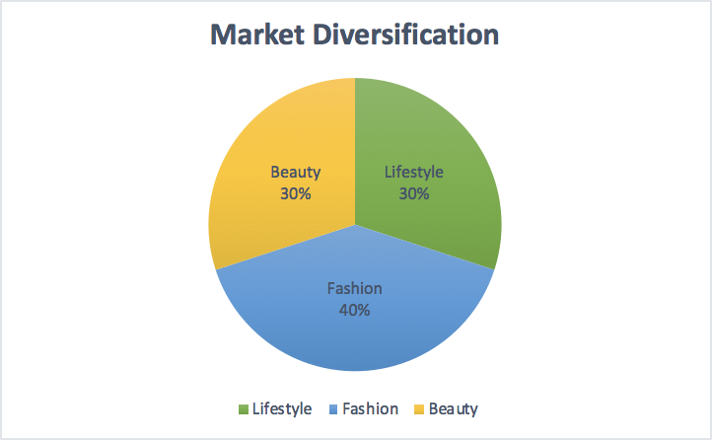
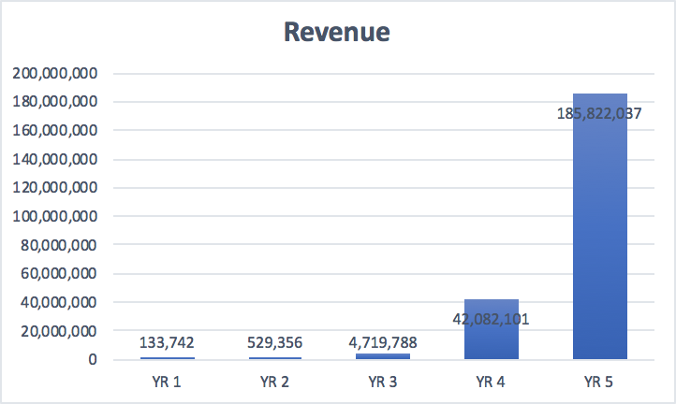
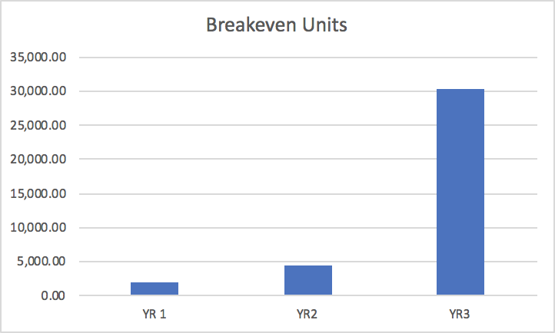
Sharing
Ruming Deng, Leilei Chen, Jiayun Lin, Fangzhou Xu
University of New Hampshire, Durham, NH 03824
Introduction
Main Function
Market
Sharing is an application that gives you the ultimate pleasure of shopping experience. Our product is focused on providing the brand-new shopping experience for our customers. The users can share their thoughts about anything, foods, travel, make-up, and dressing. They can make their posts by text, images and videos. With a simple click, users can buy the things they find useful in the posts. In sharing, we have assembled a team of the best and brightest minds in software development, marketing, and leadership. The app. is designed to fit the shopping habits of the customers and make them the best app. they have used in their daily lives.
E-commerce Platform
Social Platform
Plan for the next five years:
The total units sold is further breakdown into the times of the number of registered members and groups sold per member. The growth forecast for the first four years is around 20% for the number of members that are registered. In the fifth year, the outlook is down to 10% as a sign of slowing growth. We come up with the data that it is common for people to purchase around five items per month through the whole years and this figure is expected to stay stable in the next few years.
Financials
Business Model
Future Revenue
This is a per-member revenue model, which is similar to Amazon’s “per-click” revenue model.
We can cooperate with other well-known third-party merchants or some independent merchants to put on the soft advertisements.
The Problem
The online shopping platform is becoming more and the products they sell are also dazzling. Sometimes customers have a hard time making choices among various products on the online platform. Customers have no idea on which to buy and they may end up buying ones that are not suitable for them.
Financials
Methodology
Future Breakeven Units
We plan to gather $500,000 as out start-up fund for Sharing on the initial app development and marketing fees on building up the first group of customers.
Based on our financial forecast, with even a conservative forecast on the number of stores opening on our ecommerce platform, we can bring out investor a rate of return near 10 percent every year in revenue. As we are not taking any debt, the revenue of the platform will be given back to our shareholders as increasing value in their shares or in dividends.
.
This app. would be built as a lifestyle sharing community and users can share their thoughts about anything, foods, travel, make-up, dressing and so on, by text, images, and videos.
Members can use tags to show others the products they used in their posts. At the same time, the tagged item has a recommendation link to the shopping page on this app.
With a simple click, users can finish their online purchase if they want.
This app. to make sure that users are view a series of posts we feed to them based on their view history.

