Slide 1
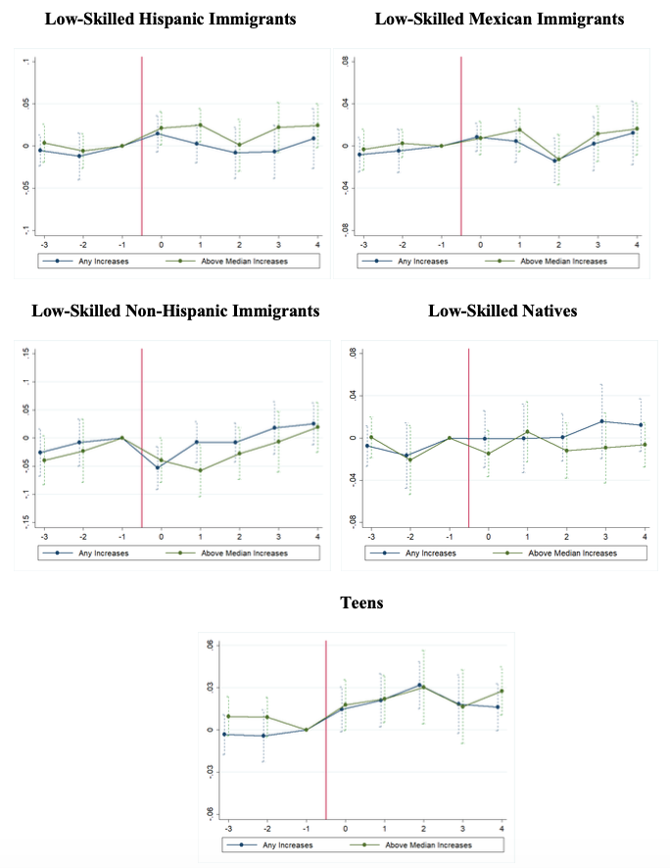
The Effects of Minimum Wages on Low-Skilled Immigrants’
Wages, Employment and Poverty
Joseph J. Sabia (Director of Center for Health Economics & Policy Studies, SDSU, UNH, Research Fellow, ESSPRI & IZA)
Brandyn F. Churchill (Vanderbilt University)
Minimum Wages & Low-Skilled Immigrants
DATA: Current Population Survey
Event Study Analysis: Hourly Wages
Minimum wages may be particularly effective in reaching low-skilled poor immigrants
  U.S. Department of Labor policy requires enforcement of minimum wage laws, independent of the whether an immigrant is legally authorized to work or is an undocumented immigrant (U.S. Department of Labor 2016)
  Minimum wages may not be effective for those participating in the informal labor market
While a wide literature has examined the effects of minimum wages on teenage or restaurant employment, relatively less is known about the impact of minimum wages on immigrants
Low-Skilled Sample (4 Groups)
  20-to-54 year-old foreign born individuals with less than a HS education
    Hispanic
    Non-Hispanic immigrants
    Mexican immigrants
  20-to-54 year-old natives with less than a HS education
Measures
  Outgoing Rotation Groups
    Hourly Earnings
    Employment-to-Population Ratio
    Hours & Employment
  Basic Monthly Data
    Employment
  Annual Social & Economic Supplement
    Household Income-to-Needs Ratio (INR)
    Poverty (< 100%, <150%, <200%)
Previous Literature
Orrenius and Zavodny (2008examines the effect of minimum wages on immigrants’ earnings and employment
This papers uses repeated cross-sections of the 1994-2005 Current Population Survey Outgoing Rotation Groups and a difference-in-difference approach
A 10% increase in the minimum wage is associated with a 1-2% increase in hourly earnings of 20-to-54 year-old foreign born individuals with no high school diploma
“Results…do not indicate that minimum wages had adverse employment effects among adult immigrants or natives who did not complete high school.” (p. 544)
  They suggest that the lack of employment effects could be explained by higher minimum wages repelling low-skilled immigrants from those states
  Findings are consistent with evidence that immigrants’ location decisions are more responsive to labor market than natives (Borjas 2001; Jaeger 2007; Cadena 2014; Cadena and Kovak 2014)
Empirical Strategy
Difference-in-difference model
E_{st} = α + βMW_{st} + X’_{st}δ + Z’_{st}λ + θ_{s} + τ_{t} + ε_{st}
E_{st} is natural log of the employment-to-population ratio
MW_{st} is the natural log of the real value of the minimum wage (2016$)
X_{st} is a vector of state controls
  State business cycle
    First-time UI claims, GDP per capita, construction permit value
    Prime-age male unemployment and average wage rate
  Share of low-skilled Hispanic immigrants, low-skilled non-Hispanic immigrants, low-skilled natives
Z_{st} is a vector of immigration policies
  E-verify, Secure Communities, 287(g), Omnibus Immigration Law
  In-State Tuition Benefits, Driver’s License
θ_{s} is state fixed effect
τ_{t} is year fixed effect
Motivation
Policy changes and the health of the macroeconomic could have differentially affected the economic impacts of minimum wages on low-skilled immigrants
There were 217 state minimum wage increases and a Federal increase from $5.15 to $7.25
Many immigration policy reforms were undertaken
    Restrictive: E-verify, Secure Communities, 287(g) agreements
    Expansion: Drivers’ licenses to undocumented immigrants, in-state college tuition
Restrictive policies could have induced outmigration or pushed into the informal sector, rendering the minimum wage less binding for low-skilled immigrants
    On the other hand, these policies may make the policy more binding if those remaining are more likely to be in jobs where the policy was binding
    The reverse could be true for expansionary policies, though in-state tuition policies may draw previously employed workers to school
The Great Recession could have induced outmigration of lowest skilled immigrants, making minimum wage less binding
Effects of Minimum Wages: 2006-2016
 | Hispanic Immigrants | Mexican Immigrants | Non-Hispanic Immigrants | Natives | Teens
 | (1) | (2) | (3) | (4) | (5)
Wages | 0.037 (0.072) | 0.156 (0.094) | -0.558*** (0.113) | 0.215** (0.083) | 0.165** (0.060)
Employment | -0.067 (0.079) | -0.062 (0.101) | 0.094 (0.164) | 0.059 (0.109) | 0.055 (0.092)
Hours | -0.013 (0.040) | 0.272 (0.386) | 0.056 (0.080) | 0.020 (0.030) | -0.089 (0.070)
Baseline Results
 | Hispanic Immigrants | Mexican Immigrants | Non-Hispanic Immigrants | Natives | Teens
 | (1) | (2) | (3) | (4) | (5)
Wages | 0.113** (0.051) | 0.165** (0.062) | -0.153 (0.144) | -0.040 (0.053) | 0.183*** (0.036)
Employment- ORG | -0.087* (0.045) | -0.110** (0.052) | -0.068 (0.092) | -0.015 (0.066) | -0.023 (0.107)
Employment- BMD | -0.089** (0.036) | -0.111*** (0.033) | -0.022 (0.097) | 0.025 (0.065) | -0.033 (0.089)
Hours | -0.007 (0.029) | 0.003 (0.043) | 0.051 (0.054) | -0.014 (0.022) | -0.039 (0.040)
Contributions
Begin with the 1994-2005 period and examine sensitivity of Orrenius and Zavodny’s results to controls for:
  The business cycle and immigration policy reforms
Expand the analysis period to include the 2006-2016
  More minimum wage changes; more precise estimates over full period
  Heterogenous minimum wage effects across periods (1994 vs 2005; 2006-2016)
    Heterogenous effects over the business cycle and across immigration policy regimes
First to examine the effects of minimum wages on immigrant poverty
conclusions
Our findings suggest that minimum wage increases increase the earnings of low-skilled immigrants, but also reduce their employment
Effects seem to be declining over time, suggesting the minimum wage is becoming less binding for low-skilled immigrants
On net, there is no effect or perhaps an increase in poverty
There is also perhaps some redistributive effect, making natives better off
Notes:
To change this poster, replace our sample content with your own. Or, if you'd rather start from a clean slate, use the New Slide button on the Home tab to insert a new page, then enter your text and content in the empty placeholders. If you need more placeholders for titles, subtitles or body text, copy any of the existing placeholders, then drag the new one into place.

