Slide 1
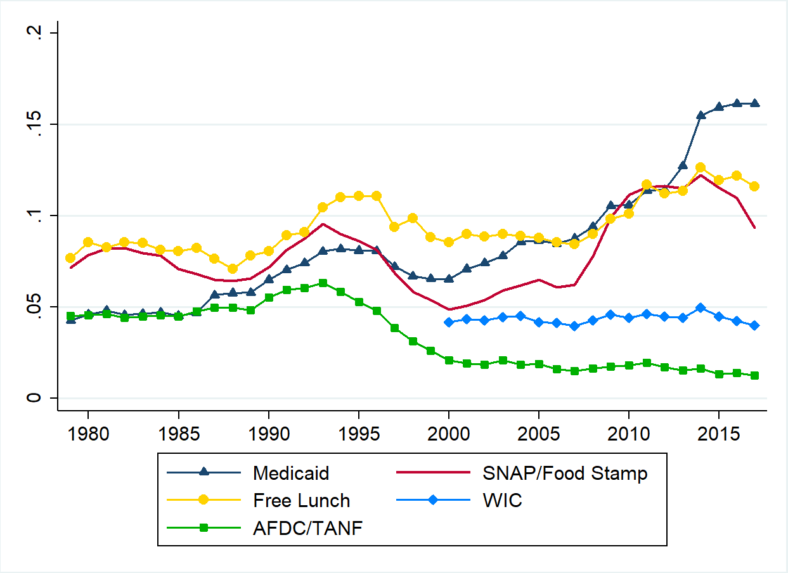
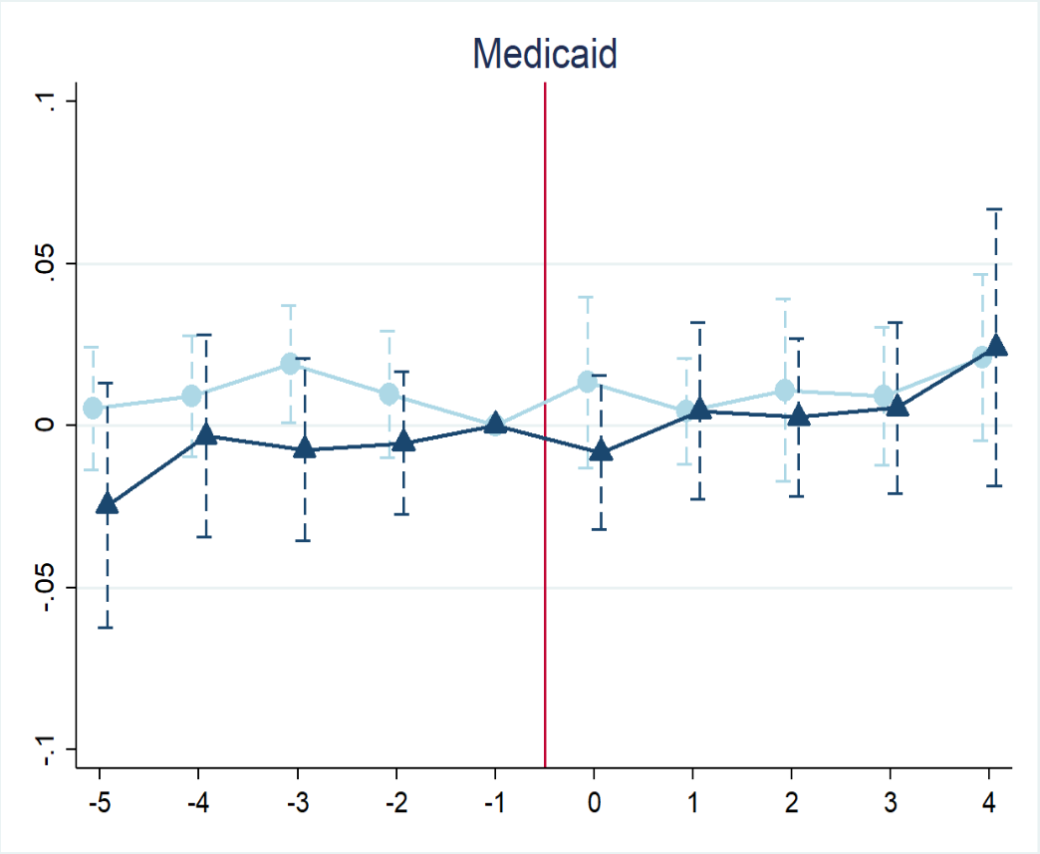
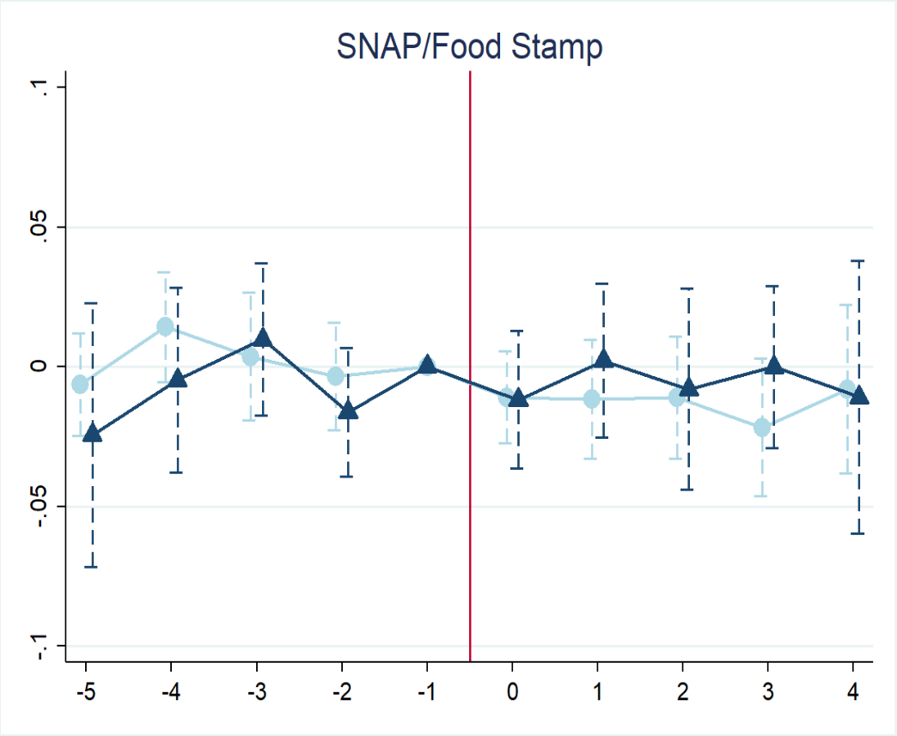
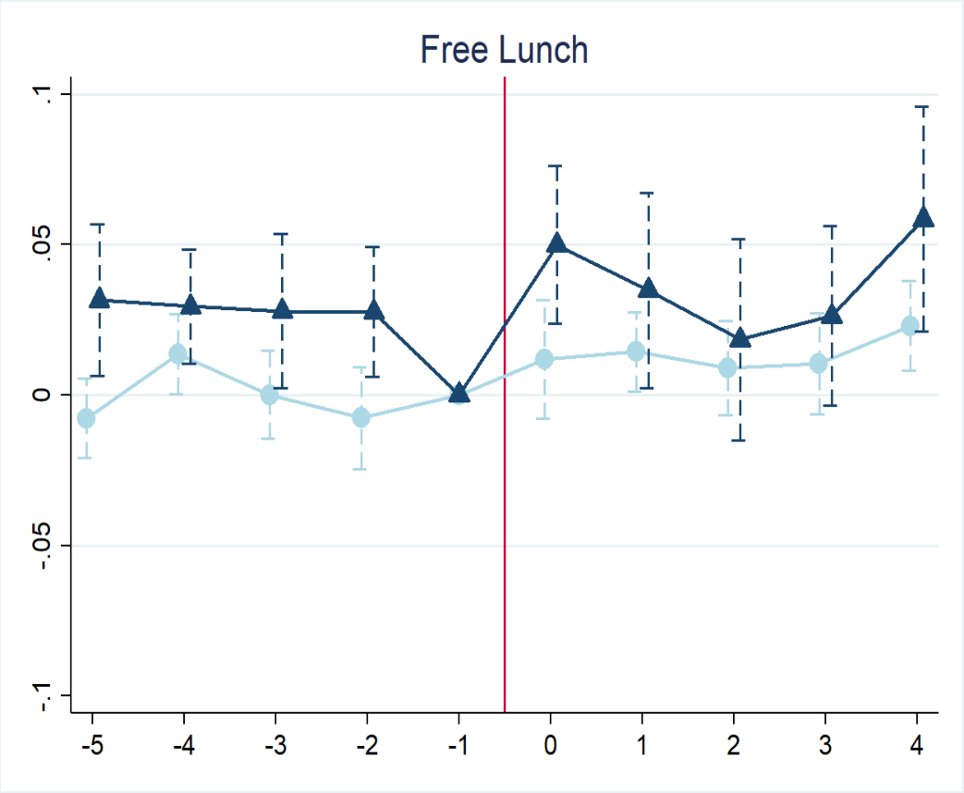
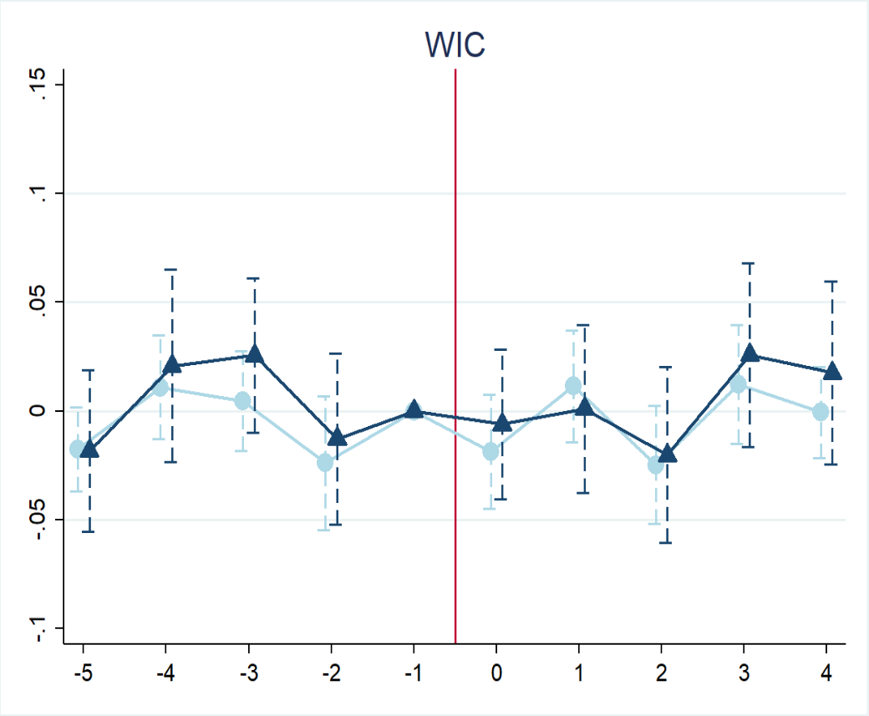
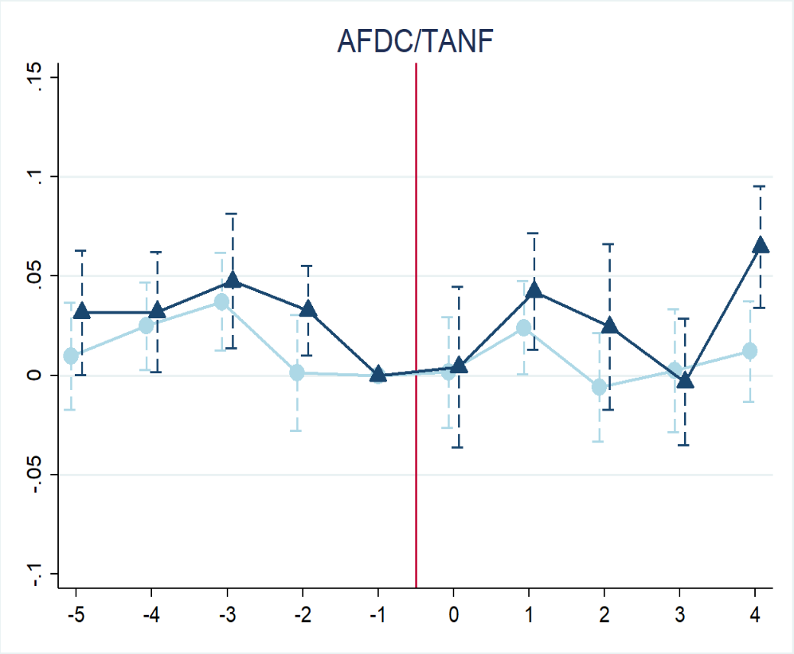
Do Minimum Wage Increases Reduce Means-Tested Program Participation?
Joseph J. Sabia (Center for Health Economics & Policy Studies, San Diego State University, University of New Hampshire)
Thanh Tam Nguyen (University of New Hampshire)
Motivation
DATA
RESULTS
“There are so many very low-wage workers, and we pay for huge social welfare programs for them. [Raising the minimum wage] would save something on the order of tens of billions of dollars. Doesn’t it make more sense for employers to pay their workers than the government?”
  Republican Senatorial Candidate Ron Unz, New York Times (2013)
To appeal to political conservatives, advocates of minimum wage increases argue that such increases may reduce dependence on means-tested public assistance programs.
Using data from the 1980-2018 March Current Population Survey (CPS), this study comprehensively examines the effect of MW increases on means-tested program participation over the last four decades.
If minimum wage hikes increase the earnings of individuals living in poor or near-poor families, earnings gains may render these individuals ineligible for means-tested public program.
On the other hand, if minimum wage increases cause adverse labor demand effects (Sabia et al. 2015; Neumark et al. 2014; Neumark and Wascher 2008), this may increase eligibility for some individuals, increasing means-tested program participation. Thus, minimum wage increases may simply redistribute program participation among eligible and near-eligible individuals.
Finally, if minimum wage increases are poorly targeted to those eligible for public assistance programs (Sabia and Burkhauser 2010), then they may have little effect on receipt of welfare benefits.
The existing empirical evidence on the effect of minimum wage increases on means-tested public program participation is mixed.
  Some studies find that higher minimum wages increase welfare caseloads (Page et al. 2005) or decrease the probability of exit from public assistance programs (Brandon 2008; 1995).
  Others find the opposite (Council of Economic Advisors 1999; Turner 1999; West and Reich 2014a,b), and still others find no net effect of minimum wage increases on net public program participation (Sabia and Nielsen 2014).
There are important limitations with many of previous studies.
  Most examine the effect of minimum wages on welfare receipt over a short time horizon (Brandon 1995; Turner 1999; Sabia and Nielsen 2014).
  Many focus on one particular means-tested public program such as Aid to Families with Dependent Children (AFDC) / Temporary Assistance to Needy Families (TANF) (Page et al. 2005; Brandon 2008, 1995; Council of Economic Advisors 1999), Medicaid (West and Reich 2014b), or the Supplemental Nutrition Assistance Program (SNAP) (West and Reich 2014a).
This paper uses repeated cross-sectional data from the 1980-2018 March CPS (corresponding to calendar years 1979-2017)
  Medicaid. The Medicaid program offers free or low-cost health coverage to low-income families.
  SNAP. The Supplemental Nutrition Assistance Program is the largest nutrition assistance program administered by the USDA.
  AFDC /TANF. The Temporary Assistance to Needy Families, formerly Aid to Families with Dependent Children, program provides temporary cash assistance to needy families.
  WIC. The Special Supplemental Nutrition Program for Women, Infants and Children offers short-term food supplements and nutrition education for low-income pregnant, breastfeeding, and non-breastfeeding postpartum women, and to infants and children up to age five.
  Free or Reduced School Lunch Program. The National School Lunch Program is a federally subsidized meal program that provides low-cost or free lunches to children each school day.
 | Pooled | Non-White | Ages 16-29 without HS | Single Mothers without HS, Ages 16-45
Medicaid | -0.000 | 0.024 | -0.014 | 0.012
 | (0.013) | (0.018) | (0.028) | (0.067)
N | 4,269,904 | 1,308,384 | 391,831 | 32,919
SNAP/Food Stamps | -0.000 | 0.020 | 0.047** | -0.129*
 | (0.011) | (0.017) | (0.014) | (0.075)
N | 4,269,904 | 1,308,384 | 391,831 | 32,919
Free Lunch | 0.020*** | 0.100*** | 0.084*** | 0.107
 | (0.004) | (0.021) | (0.029) | (0.078)
N | 4,269,904 | 1,308,384 | 391,831 | 32,919
WICª | 0.001 | 0.011* | 0.021 | -0.047
 | (0.002) | (0.006) | (0.014) | (0.089)
N | 976,339 | 364,478 | 99,361 | 15,231
AFDC/TANFª | 0.002 | 0.007 | 0.007 | 0.038
 | (0.003) | (0.009) | (0.006) | (0.116)
N | 1,878,403 | 606,807 | 186,727 | 32,919
Conceptual Framework
p<0.1; ** p<0.05; *** p<0.01
ª Sample is restricted to women ages 16 to 54. Data on WIC are only available starting in 2001.
EVENT Study Analysis
Figure 1. National Trends in Means-Tested Program Receipt
Previous Literature
Empirical Strategy
Any Increases
Large Increase
We estimate the following difference-in-difference model via probit:
Program_{ist} = β₀ + β₁MW_{st} + β₂׳X_{st}+ β₃׳Z_{it}+ α_{s} + τ_{t}+ ε_{st}
Program_{ist} is an indicator for whether respondent i (or household i) residing in state s in year t received a particular form of means-tested public benefit.
MW_{st} is the natural log of the higher of the state or federal MW.
X_{st} is a vector of state-specific, time-varying controls.
  Prime-age adult wage rate and unemployment rate, per capita GDP, refundable EITC Key state welfare policies: whether the state program exempts some or all vehicles from the asset test for SNAP eligibility, ACA Medicaid expansion, the presence of binding work requirements and time limits for TANF receipt, excluding owned home value from asset tests for TANF, and maximum TANF benefit level for a family of 3
Z_{it} is a vector of individual controls.
  Race/ethnicity, marital status, educational attainment, age, family size, and number of children under age 18 living in the household
α_{a} and τ_{t} are state fixed effects and year fixed effects, respectively.
Notes: Large changes are those in the top 25th percentile of the percentage increases of real minimum wages. Error bars are 90 percent confidence intervals.
conclusions
Our results suggest that minimum wage increases are largely ineffective at reducing means-tested program participation.
We conclude that minimum wages are poorly targeted to those eligible for means-tested benefits and this is why they are largely ineffective at reducing program participation. The policy objective of alleviating government dependency is unlikely to be substantially advanced by increases in state or federal minimum wages.
Notes:
To change this poster, replace our sample content with your own. Or, if you'd rather start from a clean slate, use the New Slide button on the Home tab to insert a new page, then enter your text and content in the empty placeholders. If you need more placeholders for titles, subtitles or body text, copy any of the existing placeholders, then drag the new one into place.

