Slide 1

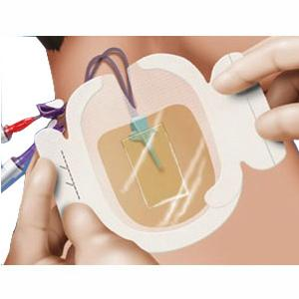
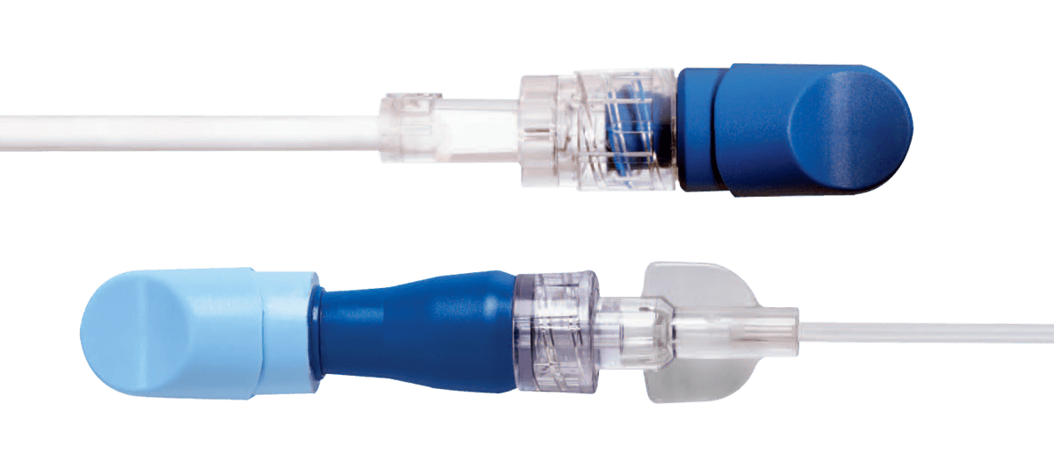
Intravascular Care and Maintenance for Prevention of
Bloodstream Infections (BSI)
Megan Butler
Department of Nursing, University of New Hampshire
Introduction
Recommendations
Research Implications
~ 250,000 CLABSI/year in the U.S. ⁸
1/3 of deaths associated with hospital acquired infections in the U.S. are from CLABSI (~ 33,000/year) ⁸
CLABSI cost per patient is >$16,000 ⁸
Peripheral IV (PIV) are used more frequently than central lines and are subsequently responsible for a large number of BSI ⁵
Goal: achieve a BSI rate of zero
Change NC no more frequently than every 96 hours or when NC is removed, there is residual blood or debris within the NC, prior to drawing a blood sample for culturing from the VAD, upon contamination
Use CHG impregnated dressings with central venous catheters for patients 18 years and older
Implement passive alcohol impregnated disinfection caps to central line NC and to male leur connectors and all needle free valves on tubing and consider use with PIVs
Consider the use of an integrated stabilization feature combined with a bordered polyurethane securement dressing or a standard catheter with an adhesive engineered stabilization device with PIV
RCT on effectiveness of passive disinfectant caps for peripheral and central lines for BSI prevention
Port disinfection scrub time
Effectiveness of CHG impregnated dressings with PIV for PLABSI prevention
Effectiveness of bordered polyurethane securement dressings with PIV allowing longer dwell times
Effects of PIV dwell times on PLABSI
Methods
Figure B. CHG Impregnated Dressing
Databases used: CINAHL Complete, PubMed
Guidelines: CDC, Joint Commission, Infusion Nursing Standards of Practice
Key words: intravascular catheter, care, maintenance, infection prevention, catheter related blood stream infections (CRBSI)
Inclusion criteria: published/revised within past 5 years, English
Exclusion criteria: pediatric and outpatient populations
Figure A. Alcohol Impregnated Caps
References
¹Centers for Disease Control and Prevention. (2017). Guidelines for the prevention of intravascular catheter-related infections, 2011. Retrieved from https://www.cdc.gov/infectioncontrol/guidelines/pdf/bsi/bsi-guidelines-H.pdf
²Duncan, M., Warden, P., Bernatchez, S. F., & Morse, D. (2018). A bundled approach to decrease the rate of primary bloodstream infections related to peripheral intravenous catheters. Journal of the Association for Vascular Access, 23(1), 15– 22. https://doi-org.unh.idm.oclc.org/10.1016/j.java.2017.07.004
³Flynn, J., Larsen, E., Keogh, S., Ullman, A., Rickard, C. (2019). Methods for microbial needleless connector decontamination: A systematic review and meta-analysis. American Journal of Infection Control. https://doi.org/10.1016/j.ajic.2019.01.002
⁴Gorski L. A., Hadaway L., Hagle M., McGoldrick M., Orr M., Doellman D. (2016). 2016 Infusion therapy standards of practice. Journal of Infusion Nursing, 39.
⁵Mermel, L. A. (2017). Short-term peripheral venous catheter-related bloodstream infections: A systematic review. Clinical Infectious Diseases, 65(10), 1757–1762. https://doi-org.unh.idm.oclc.org/10.1093/cid/cix562
⁶Merrill, K. C., Sumner, S., Linford, L., Taylor, C., & Macintosh, C. (2014). Impact of universal disinfectant cap implementation on central line–associated bloodstream infections. American Journal of Infection Control, 42(12), 1274–1277. https://doi-org.unh.idm.oclc.org/10.1016/j.ajic.2014.09.008
⁷Schwebel, C., Lucet, J. C., Vesin, A., Arrault, X., Calvino-Gunther, S., Bouadma, L., & Timsit, J. F. (2012). Economic evaluation of chlorhexidine-impregnated sponges for preventing catheter-related infections in critically ill adults in the dressing study. Critical Care Medicine, 40(1), 11-17.
⁸The Joint Commission. (2019). CLABSI toolkit and monograph. Retrieved from https://www.jointcommission.org/topics/clabsi_toolkit.aspx
Results
Clinical Implications
      Changing needless connectors (NC) more frequently than 96 hours increases CLABSI risk ⁴(II)
      Chlorohexidine (CHG) impregnated dressings reduce the rates of CRBSI, even when baseline rates are low ^{1,4} (IA)
      Passive disinfectant caps that contain isopropyl alcohol have been found to significantly reduce CLABSI rates and PLABSI rates ^{6,2}(II & IV)
      VAD dressings (ie, standard, nonbordered transparent semipermeable membrane dressings, gauze and tape dressings) should not be used for stabilization due to insufficient evidence supporting their benefits as stabilization devices and the use of tape for stabilization has been found to be ineffective ⁴(I)
In a systematic review it was found that compliance with proper disinfection prior to accessing NC can be as low as 10% ⁵
A study at a hospital in Pennsylvania found that almost all CLABSI occurred five days after insertion, indicating that the gap in infection prevention is associated with poor care and maintenance ⁸
There was an estimated savings of $282,840, reduction of 68 patient hospital days, and the prevention of one death at a hospital that found a >40% decrease in CLABSI rates after implementing disinfection caps ⁶
One study found that CHG impregnated dressings were cost-effective even at very low rates of CRBSI ⁷

Slide 2

This poster template provided courtesy of
UNH ESRC Poster Printing Services
Trust us to make your poster look GREAT!
Website: http://posters.unh.edu
Poster Guide: http://goo.gl/1E7TJY
DELETE THIS SLIDE BEFORE PRINTING

