Slide 1


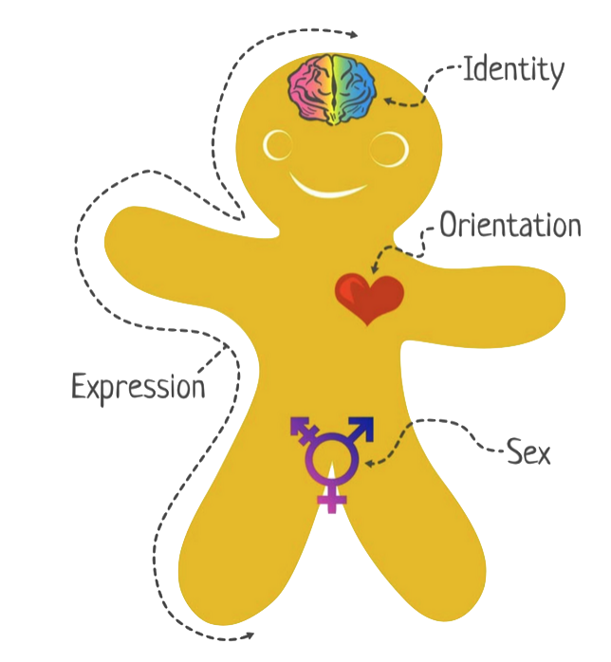
How College Students Discuss Their Relationships
John Domenico, Honors Nursing Student
Alyssa J. O’Brien, PhD, RN, Assistant Professor of Nursing
University of New Hampshire Nursing Department, Durham
INTRODUCTION
SPECFIC AIMS
METHODS
CONCLUSIONS
10 million people report experiencing intimate partner violence (IPV) each year (National Coalition Against Domestic Violence, 2018).
Prevalence and statistics reflect research that is aimed at exploring physical and sexual abuse, and not necessarily emotional IPV.
Edwards (2015) found that “sexual minority” students experience higher levels of IPV, though they are less likely to report (American Psychological Association, 2002).
To understand the experiences of persons who identify as homosexual when in an intimate relationship.
To understand the perceptions of healthy and unhealthy relationships of those who identify as homosexual.
To understand how college students who identify as homosexual share their relationship experiences with healthcare providers
Design: Qualitative, descriptive study
Setting: Medium-sized public university
Sample: Three college-aged (18-24) individuals who identified as homosexual (n = 3)
Procedure: Semi-structured interviews with guiding questions regarding relationships and interactions with healthcare clinicians
Data Analysis: Thematic analysis and coding
There is a high likelihood of intimate partner violence in the client who identifies as homosexual. This study suggests that those who identify as homosexual still do not feel safe disclosing their sexuality.
The heteronormative society we live in may contribute to this.
Nurses must understand this process of protecting oneself when working with the client who identifies as homosexual.
This understanding could potentially allow for those who identify as homosexual to feel safer, and not like they need to protect their true selves
THEORETICAL FRAMEWORK
Protection of one's "true self”
Young adults who identify as homosexual in a college setting still feel the need to protect their “true self,” i.e., their homosexual identity
n = 3
Staying closeted
Hiding the truth from themselves or others
Internalized homophobia
a defense mechanism used by individuals who identify as homosexual
identifying as homosexual is a deviation from the norm (heterosexual) and that deviation demarcates one as “othered"
a learned behavior
causes feeling of shame
Co-dependency
attempting to conceal a homosexual identity was a way for individuals to protect themselves
most often took place in early years
where one comes from may determine how they perceive their sexuality
even after “coming out of the closet” many remained closeted in different situations
reliance on those people that also held a queer identity
this co-dependency developed because these individuals allowed the participants to fully be themselves
all participants chose to divulge negative experiences that were emotionally violent based on their own definition, but did not report
if participants, do not acknowledge their own relationships as abusive or unhealthy, despite having formed a definition of such a relationship, it can be seen as another internalization and deflection in order to protect themselves
NURSING IMPLICATIONS
RESULTS
Research
Practice
more likely to experience abuse, less likely to report
nurses must understand the seriousness of the mental health assessment
continue to examine the differences between homosexual and heterosexual IPV
use emotional IPV survey tools and add specific questions regarding the homosexual experience
examine own bias (heteronormative)
(Cass, 1984)
Homosexual Identity Development
D’Augelli (1994)
Homosexual Lifespan Development
Coming Out
Develop personal LGB identity
Develop social LGB identity
Claim identity as homosexual child
Develop intimacy with other LGB
Enter LGB community
Exit a heterosexual identity
ACKNOWLEDGMENTS
Hamel Undergraduate Research Center
Dr. Joanne Samuels
Zachary Ahmad-Kahloon
Julie Simpson, Melissa McGee, Tracy Birmingham
My participants
Dr. Alyssa O’Brien
REFERENCES
Cass, V. C. (1984). Homosexual identity formation: Testing a theoretical model. The Journal of Sex Research, 20(2), 143-167. doi:10.1080/00224498409551214
D'Augelli, A. R. (1994). Identity development and sexual orientation: Toward a model of lesbian, gay, and bisexual development. In E. J. Trickett, R. J. Watts, & D. Birman (Eds.), Human diversity: Perspectives on people in context (pp. 312-333). San Francisco: Jossey-Bass.
Edwards KM, Sylaska KM, Barry JE, Moynihan MM, Banyard VL, Cohn ES, Walsh WA, Ward SK. (2015). Physical dating violence, sexual violence, and unwanted pursuit victimization: a comparison of incidence rates among sexual-minority and heterosexual college students. Journal of Interpersonal Violence, 30, 580-600.
National Coalition Against Domestic Violence. (2018). NCADV | National Coalition Against Domestic Violence. Retrieved March 10, 2018, from https://ncadv.org/statistics

