Slide 1
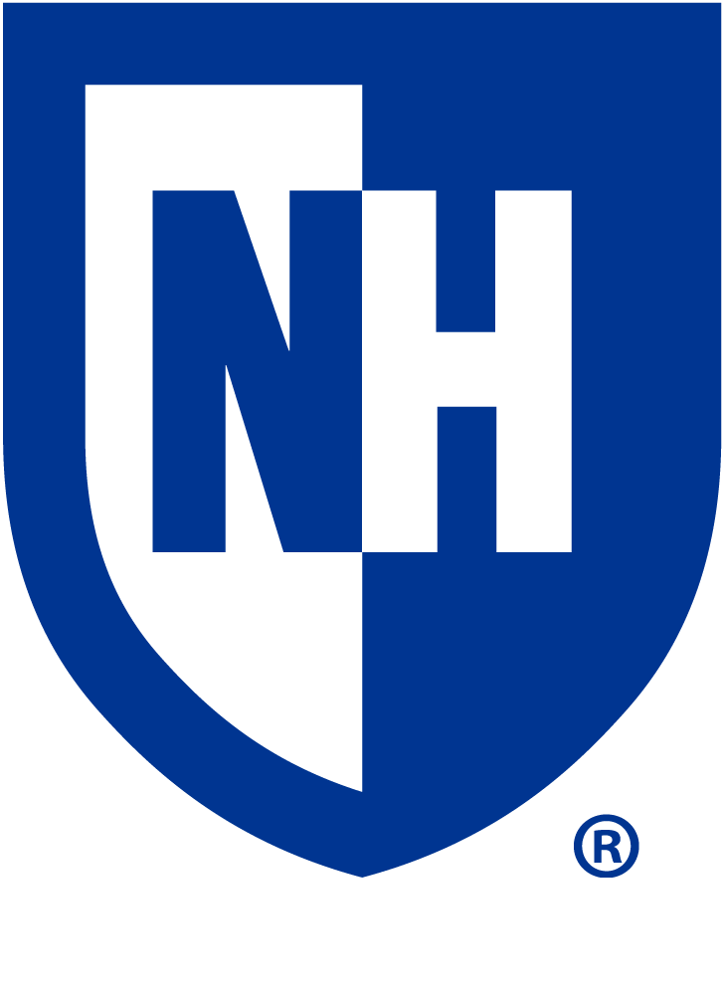



Implementing Standardized NPO Signs On a Pediatric Inpatient Unit
Author: Emily Brown
Organization: UNH Department of Nursing
Purpose
Clinical and Research Implications
The purpose of this scholarly poster is to address the following PICO question:
For the pediatric patients on 9NW at Boston Children’s Hospital will implementing standardized NPO diet signs increase patient safety as compared to not having standardized NPO diet signs?
The research indicates that the clinical and research implications to implementing NPO signs on the unit are increased patient safety because the use of standardized signs would help employees as well as visitors be aware of patient NPO status before entering the patient room. The implementation of standardized signs would also help to ensure that no patient aspirates during surgery due to a violation of NPO. Lastly, the implementation would also help to reduce the number of surgeries canceled because of violation of NPO, in turn reducing the amount of lost OR time and saving the hospital money.
Problem/Goal
Evidence
“Preoperative nil per os (NPO) guidelines have been in existence since the recognition of the risk of perioperative aspiration. These guidelines aim at reducing the risk for gastric content aspiration to the lowest possible, to avoid associated morbidity, unplanned hospital and/or an intensive care admission” (Presta, 2018). Patients may also be ordered to be NPO because they are deemed unable to eat safely or if their diagnoses requires gut rest.
The Neurology/Neurosurgery unit is a busy unit with numerous members of interdisciplinary teams in and out of patient rooms through out the day and night. A standardized NPO sign would help to improve patient safety and reduce the risk of a child receiving food by mouth who should not.
The Child Life Specialists on the unit have to double check with every nurse on their patients NPO status before doing certain activities with the children such as:
  Wednesdays “Treat Train”
  Holiday activities such as cupcake/cookie decorating
The implementation of standardized NPO signs would reduce the need for the Child Life Specialists to check with every nurse prior to their acitivty.
“The NPO policy is important because patients who have full stomachs are at risk for getting food or liquid in their lungs during anesthesia or sedation” (St. Jude's Research Hospital, 2019).
“Standardized signs have several advantages. Since care team members always know where to look for the information they need, standardized signs save employees time. Standardized signs also can help ensure compliance by both visitors and employees “ (University of Iowa Stead Family Children’s Hospital, 2019).
A study done at Cincinnati Children’s Hospital Medical Center showed that “violations of nil per os (NPO)” were one of the 3 top reasons for cancellation on the day of surgery which lead to lost OR time and was costly for the hospital. (Pratap, et al., 2015).
Recommendation for Practice
April 2, 2019: 9NW NPO Diet Signs
S | Recently a student nurse completed a project on the unit. This projects objective was to identify a practice or policy on the unit that could be adjusted or improved and recommend a change in practice.
B | Many patients on 9NW are ordered to be NPO for various reasons but there is not a standardized way of displaying NPO status on the unit.
A | NPO status is important prior to surgery to reduce risk of aspiration pneumonia and to prevent a delay in surgery. With the numerous teams circulating the floor it is important that everyone is aware of the patients NPO status to improve patient safety.
R | The recommendation for practice is standardized NPO signs be implemented on the unit and placed on the door of the patients rooms who are ordered to be NPO.

