Slide 1



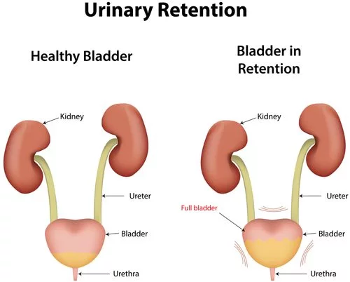

Post-Operative Retrograde Voiding Trial: Does it Help?
Lauren Elizabeth Lee: Senior Nursing Student
UNH Department of Nursing
Introduction
“With a retrograde-fill voiding trial, the bladder is filled retrograde via a transurethral catheter to a set volume, typically 300 mL, and then the catheter is removed and the patient is asked to void” (Geller, 2014).
One of the most common concerns following the removal of a Foley catheter post-operatively is that the patient will develop urinary retention. Urinary retention is defined as an inability to empty the bladder completely. Urinary retention can be assessed through the patient’s ability to void fully following catheter removal (Urinary Retention, 2014).
Retrograde voiding trials are a relatively new implementation in comparison to allowing the patient to void without filling the bladder manually. Due to the unfamiliarity of the trial, many seasoned nurses question the intervention and associated benefits.
In a 2007 American Journal of Obstetrics and Gynecology randomized, controlled trial, 55 post-operative patients were either assigned to spontaneously void or undergo a retrograde fill. Of the participants that experienced urinary retention, 61.5% were in the spontaneous voiding group and 32.1% were in the retrograde group (Foster, 2007).
In a 2010 randomized, controlled trial, 50 post-operative women were studied. Of the 50 women, 25 were assigned retrograde and 25 were assigned to spontaneously void. 84% of the spontaneous group failed the trial, while 62% of the retrograde trial failed. Further statistics within the study showed the individuals undergoing the trial would choose the retrograde fill method over the spontaneous void (Geller, 2010).
In a 2010 prospective, randomized, crossover study, 79 post-operative patients were observed. This study group was divided into a spontaneous void group and a backfill void trial group. 91% of the backfill group passed their voiding trial, while only 56% of the spontaneous void group passed their trial (Pulvino, 2010).
Evidence-Based Practice
(The MGH, 2011).
Retrograde Voiding Trial Policy at MGH
“Just before the Foley is removed, sterile saline or sterile water is instilled into the bladder through the Foley, and the patient’s response, as demonstrated by the ability to retain the instillation briefly followed by near-complete voiding, guides continuing care decisions” (Cronin, 2017).
How is a Backfill Voiding Trial a Nurse Driven Policy?
Nursing Actions Teach the patient about the procedure and prepare to implement. Detach the collection container and attach a 60 mL catheter-tip syringe to distal end of Foley. Slowly fill bladder with 300 mL of sterile water or saline through the catheter-tip syringe. Deflate the Foley balloon and remove the catheter immediately. Instruct the patient to remain supine for 20 minutes and then ambulate to void. Assess and implement follow-up actions within 30 minutes of bladder filling. If the patient voids 200mL or greater, the patient has “passed” the trial and the catheter remains out. If the patient voids less than 200mL, reinsert a Foley catheter and continue gravity drainage. If the patient is unable to void within 30 minutes, reinsert a Foley catheter for continued gravity drainage. | Special Considerations The procedure is ideally implemented in the early morning. Maintain the sterility of the interior catheter and the bladder. Water or saline may be at room temperature. Do not attach the 10 mL syringe for balloon deflation until after the instillation is complete as the increasing hydrostatic pressure may cause the fluid in the balloon to egress. The catheter may slip out of the bladder before instillation is complete. Notify the urogynecologist as instructed with the results of the voiding trial.
Conclusion
When reviewing the evidence regarding retrograde voiding trials to predict urinary retention in post-operative patients, data shows that retrograde voiding trials reduce the occurrence of urinary retention in comparison to instructing individuals to void spontaneously. Therefore, Massachusetts General Hospital’s policy regarding the retrograde voiding trial is supported by sound evidence-based research. Retrograde voiding trials should be implemented on floors that take post- operative patients. This will likely decrease urinary retention rates; therefore, shortening the length of stay for hospitalized individuals. Looking at the bigger picture, this will save the hospital valuable time and finances moving forward.
(Urinary Retention, 2014).
PICOT:
For hospitalized, post-operative patients with a Foley catheter, does the implementation of retrograde voiding trials reduce the occurrences of urinary retention cases in comparison to patients that spontaneously void?
(Cronin, 2017).

