Slide 1


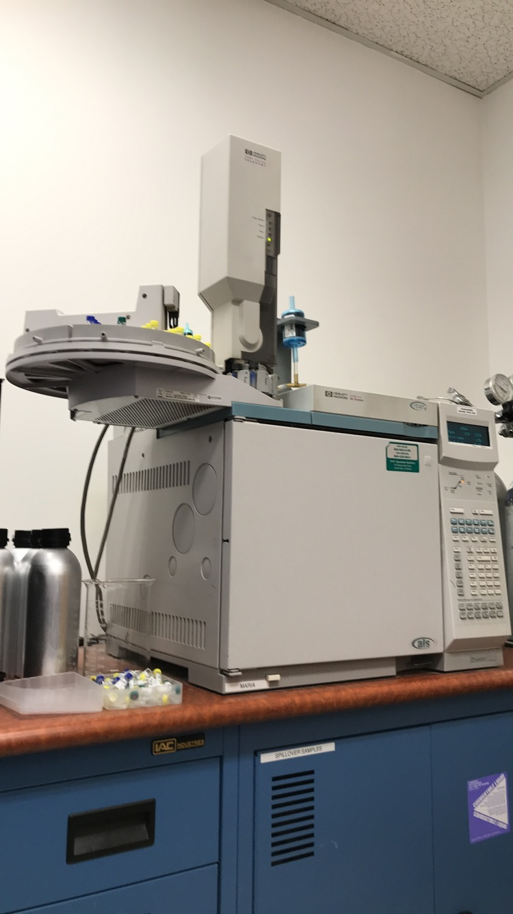
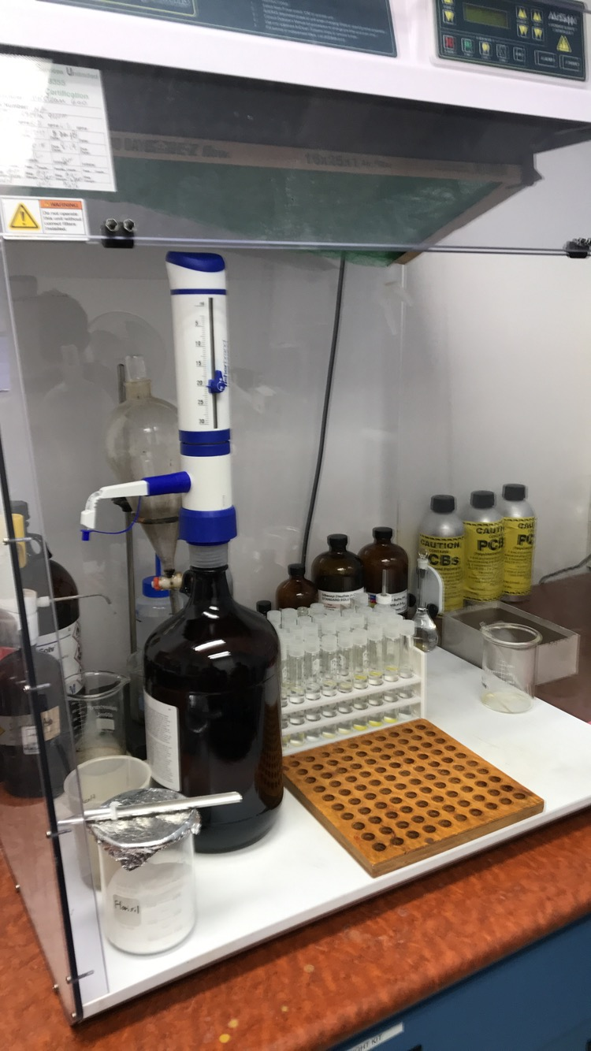
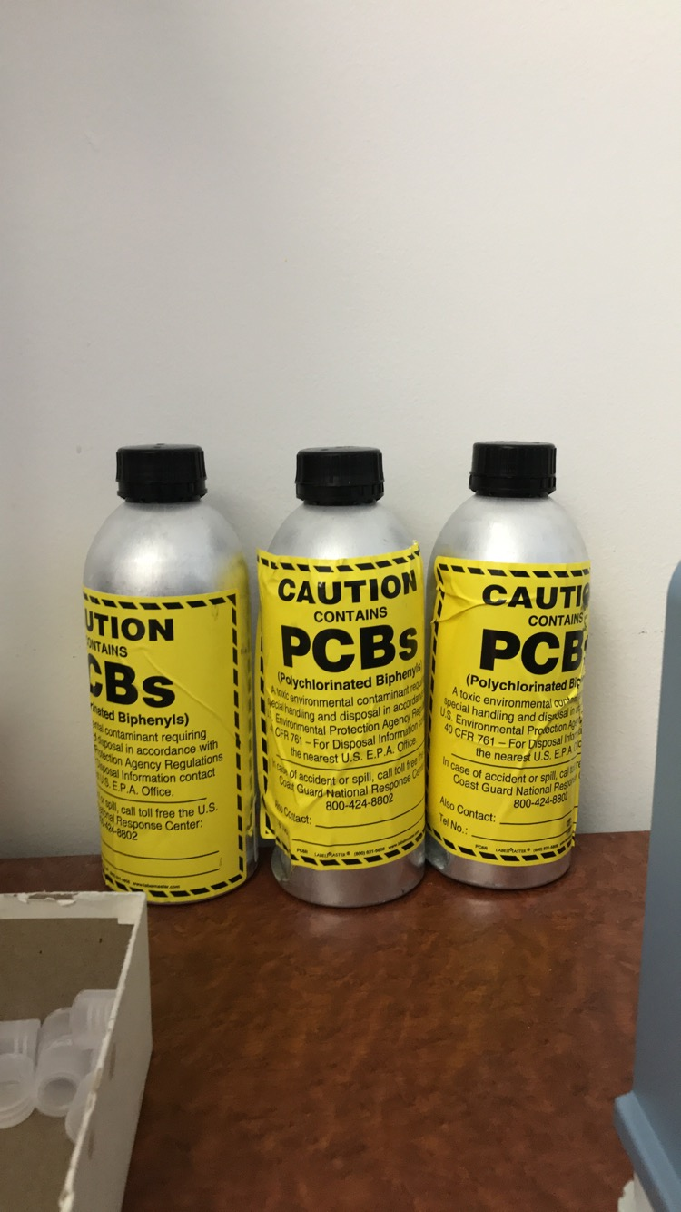
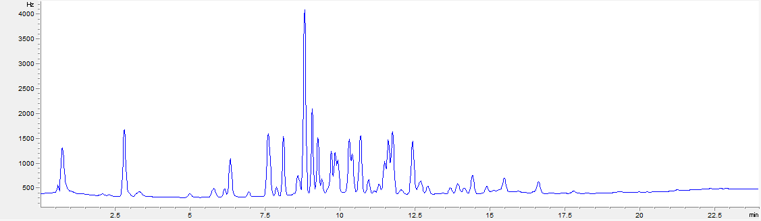
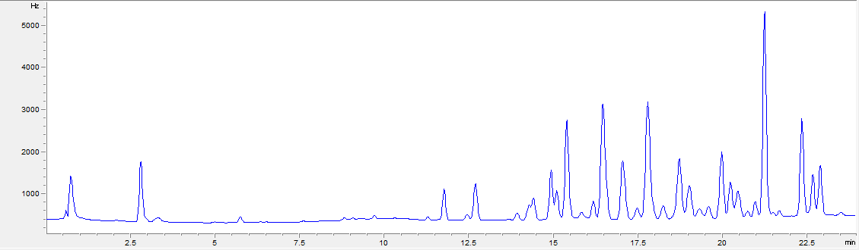
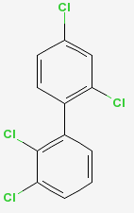
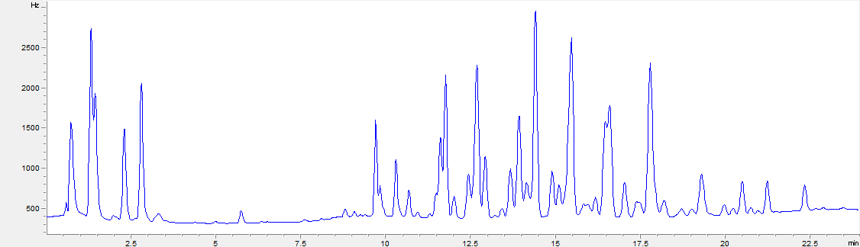
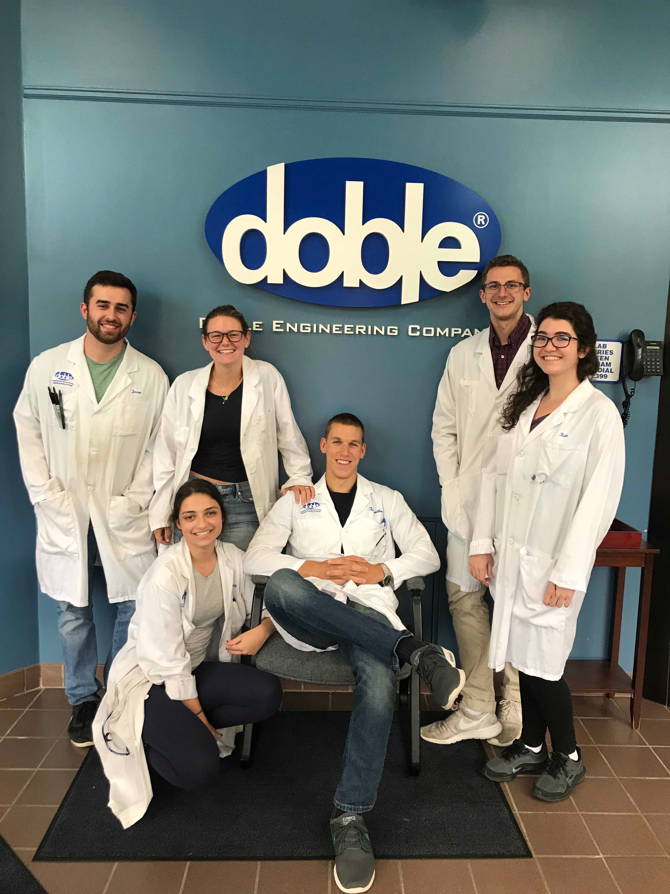
Methodology of Quantifying PCB Presence in Electrical Generator Insulating Oil
Alex McGinn
University of New Hampshire, Durham, New Hampshire, USA
College of Life Sciences and Agriculture
INTRODUCTION
METHODS
What is a PCB?
Polychlorinated Biphenyls (PCBs) are a chemical compound that were largely used in transformer oil as a coolant due to their dielectric strength and their resistance to flammability.
They were deployed in thousands of generators worldwide and were used by major electrical providers.
Sample Prep
Figure 3: Image of Gas Chromatography Machine
Figure 4: Sample Preparation Hood
Integration
Oil samples are received in vials and bottles and a small amount (.1998 +/-.0002g) is pipetted from these containers.
Samples are then diluted with heptane and florisil (two chemicals which help separate the PCBS from the oil).
The resulting chromatograph can be integrated by hand or using a computer program to provide readout of the PCB concentration in parts per million (ppm)
Why do we care?
Despite their efficiency at serving their purpose there was a dark side to them as well. PCBs are incredibly toxic and do not biodegrade. This means they would have nearly infinite residence times in whatever system they were transported to.
PCBs cause a number of detrimental health effects and varying types of cancer to plants, aquatic species, and anyone who consumes them.
Beginning in the 70s concern grew over the possibility of PCBs leaching out of generators and penetrating groundwater and freshwater sources and by 1979 their production was banned in the U.S. and in most of the world as well.
Gas Chromatography
~5mL of solution is then transferred to a GC compatible container and loaded into the Gas Chromatography Machine.
The gas chromatography machine vaporizes a small amount of the sample and runs tests on it to provide us with chromatograph.
RESULTS
TESTING FACILITY
Aroclors
Doble Electrical Engineering Materials Laboratory
, Watertown, MA
Provides analytical services and test results for industrial power users in over 110 countries
Oil testing lab runs over 50 different types of screen tests on oil samples delivered from all over the world
Figure 5: Aroclor 1242
Figure 7: Aroclor 1260
Aroclor type was determined by peak arrival times and peak sizes observed on the chromatograph
Many samples read completely clean however others contained multiple aroclors
The most carcinogenic is 1254 which is also the rarest.
1260 and 1242 are relatively equal in toxicity.
Figure 8: Chemical Structure of 1242
Figure 6: Aroclor 1254
Summary & Takeaways
Summary
Takeaways
Testing findings:
Of the thousands of samples tested over the summer only three were found to breach the 50ppm disposal limit.
These oils need to be held and shipped to a licensed storage facility.
The generators these oils were sampled from are now designated “PCB contaminated generators” and need to be shut down or have their oil replaced.
Large utilities such as National Grid, SPX, and Eversource adhere to EPA guidelines
PCBs still have a presence in the environment and testing needs to be continued until older generators are completely phased out
I gained valuable lab experience and was able to provide an important service for the electrical grid while making great friends and will forever be grateful for this opportunity
Figure 2. Contaminated Oil Containers (these cylinders are the recommended shipping and storage apparatus however we received samples stored in everything from beer bottles to mason jars)
ACKNOWLEDGMENTS
Figure 1. Materials Laboratory Interns
Many thanks to the support from mentors, Connor Heany and Melissa Zajac, for this amazing opportunity and all their help
A huge thank you to my advisor John Aber for supporting my work

