Slide 1


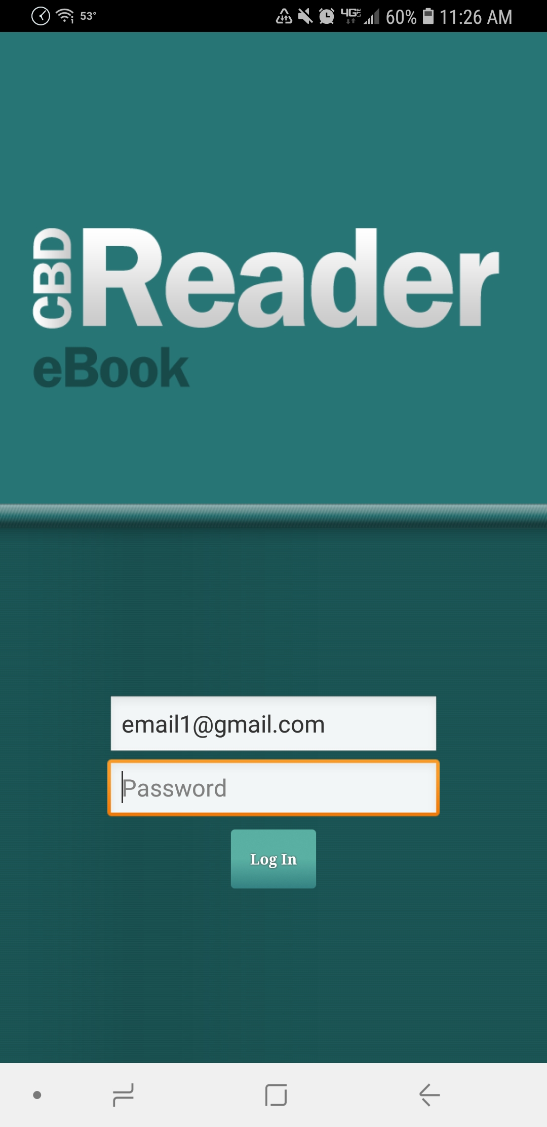
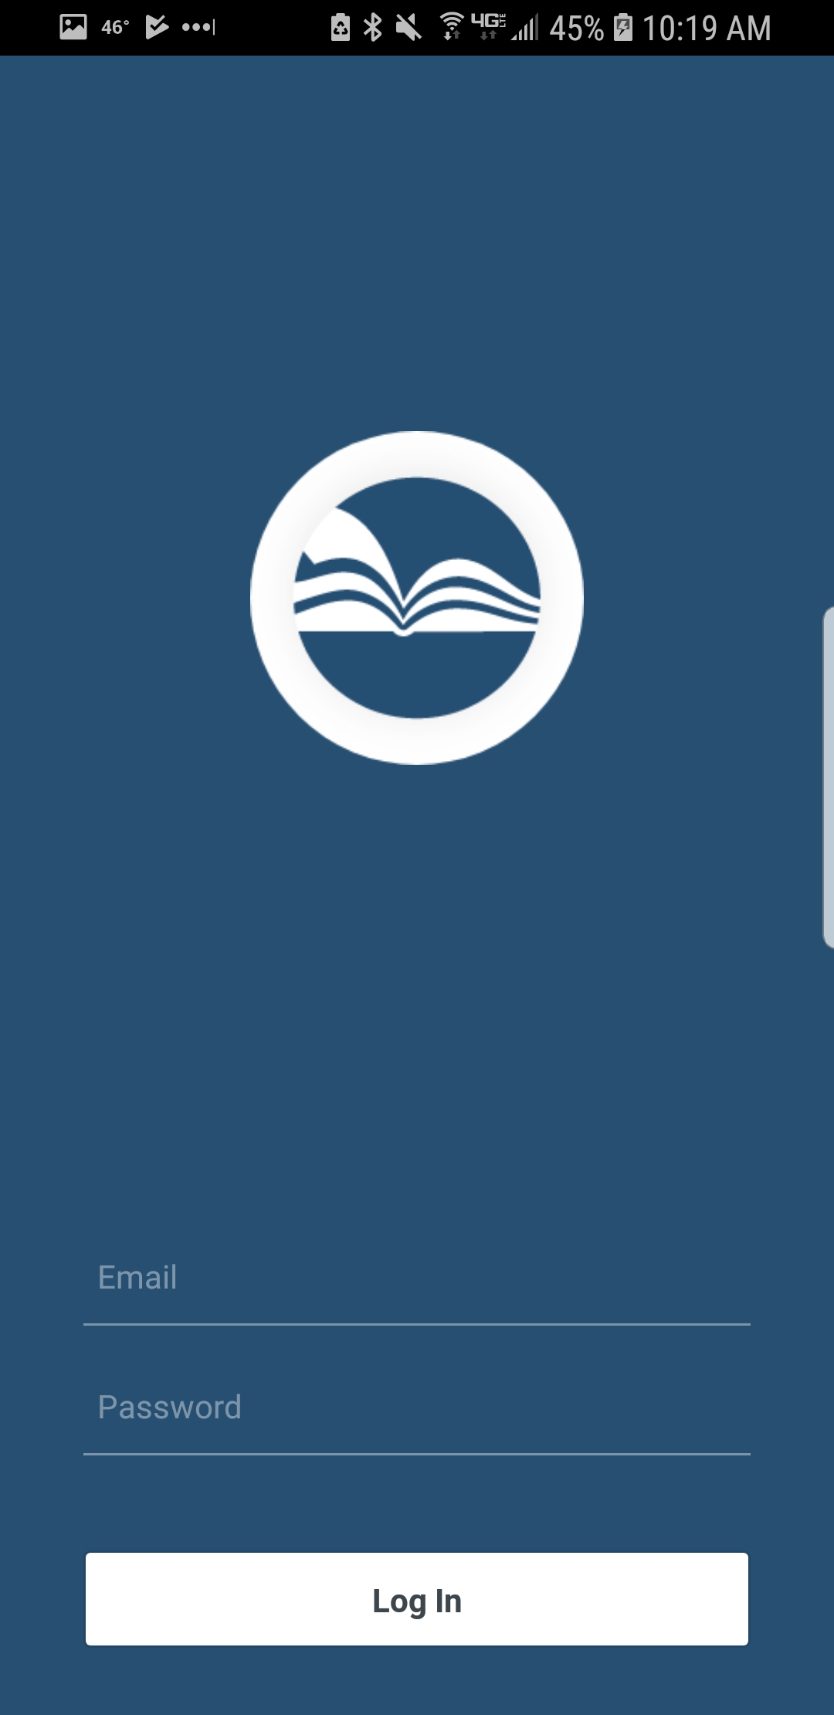
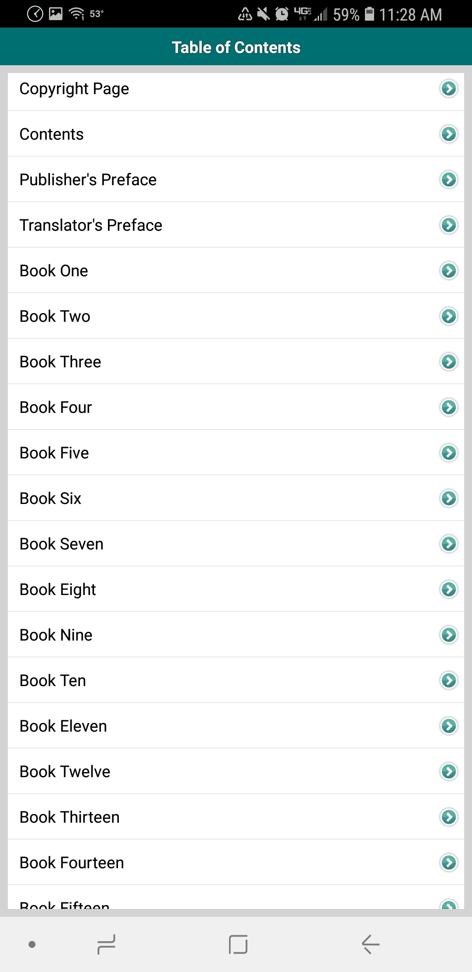
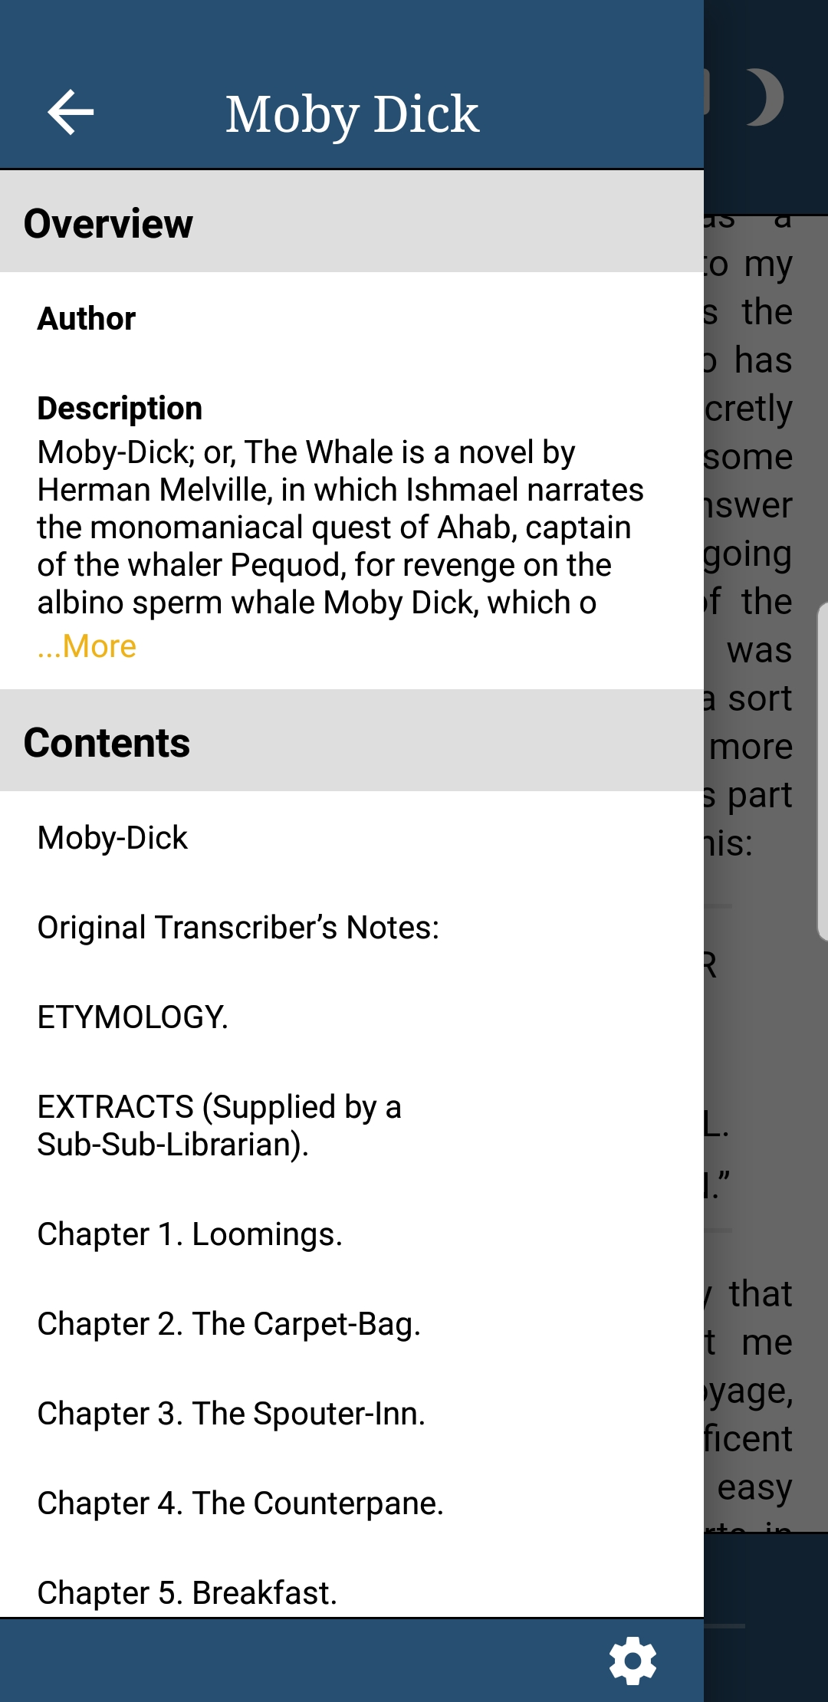
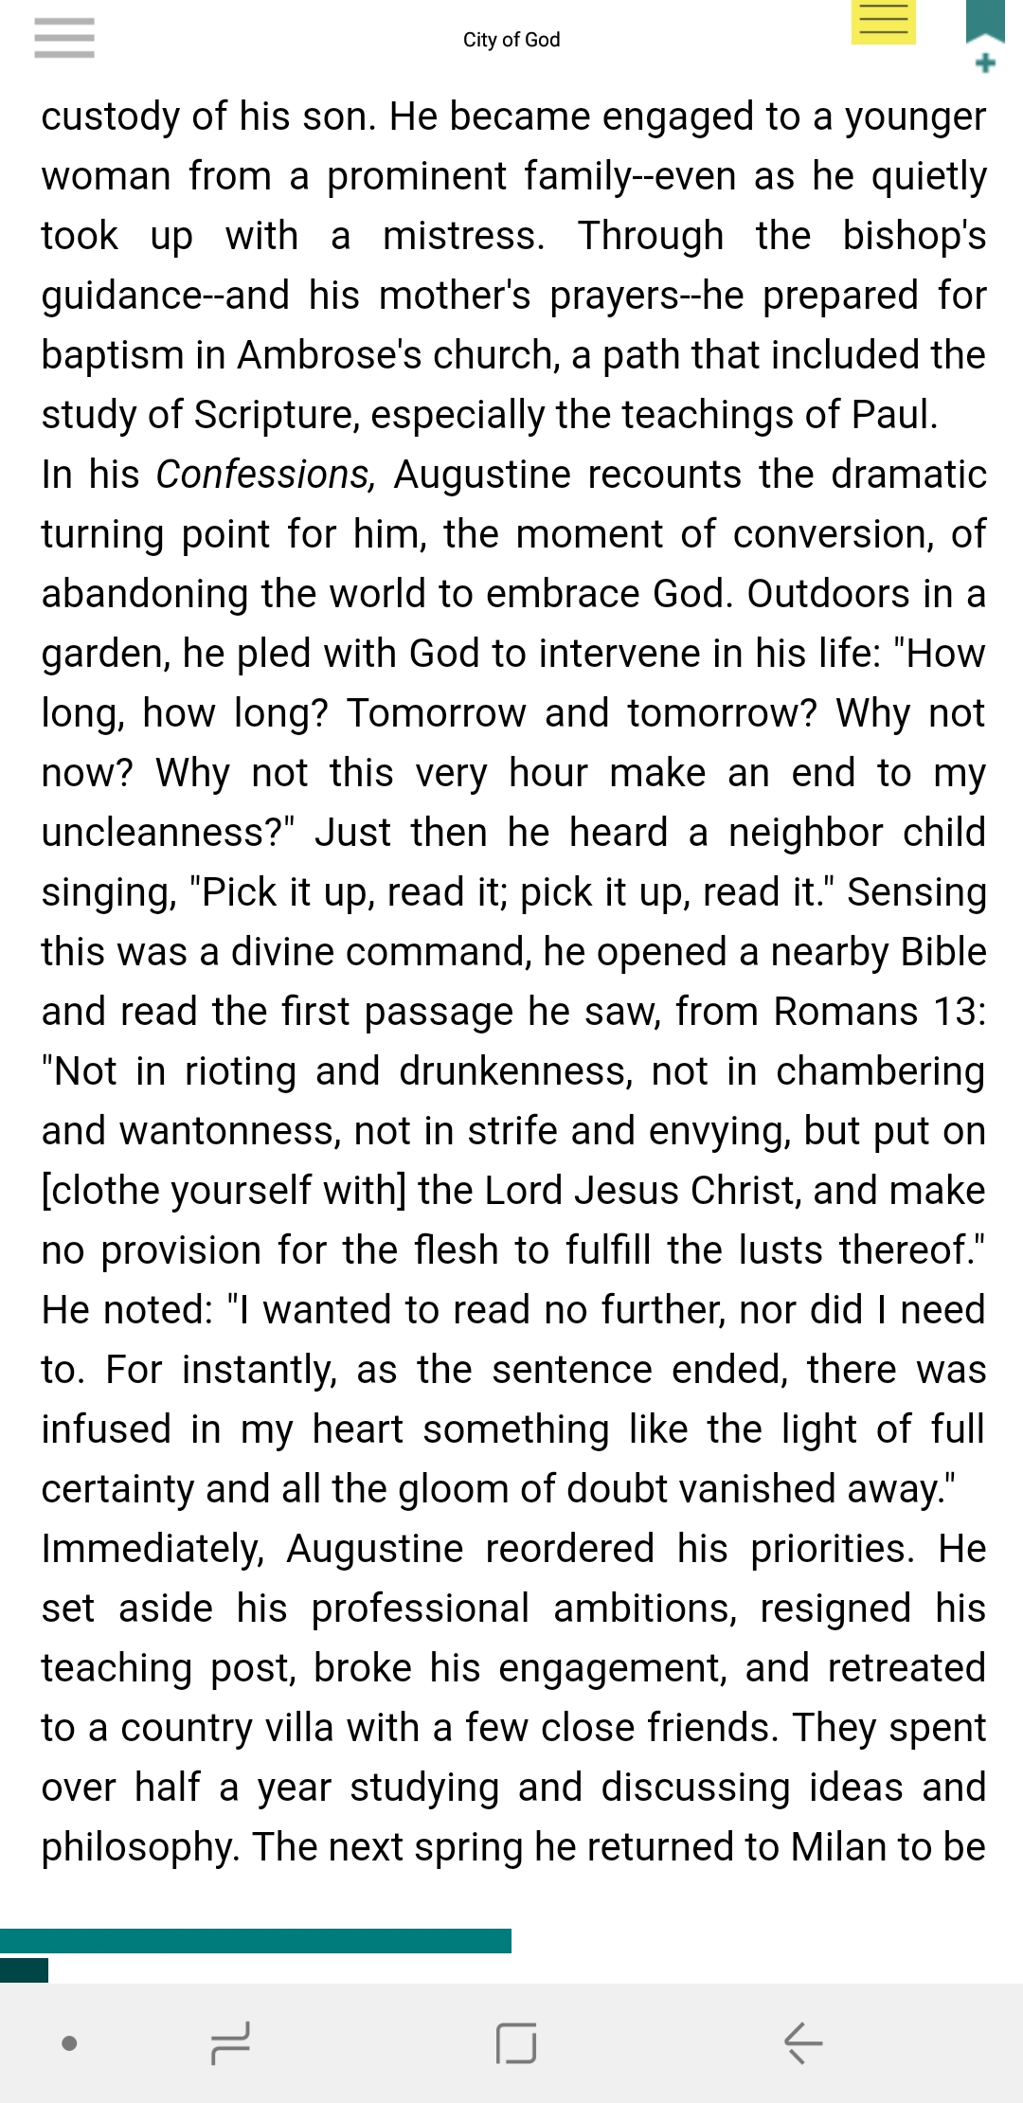
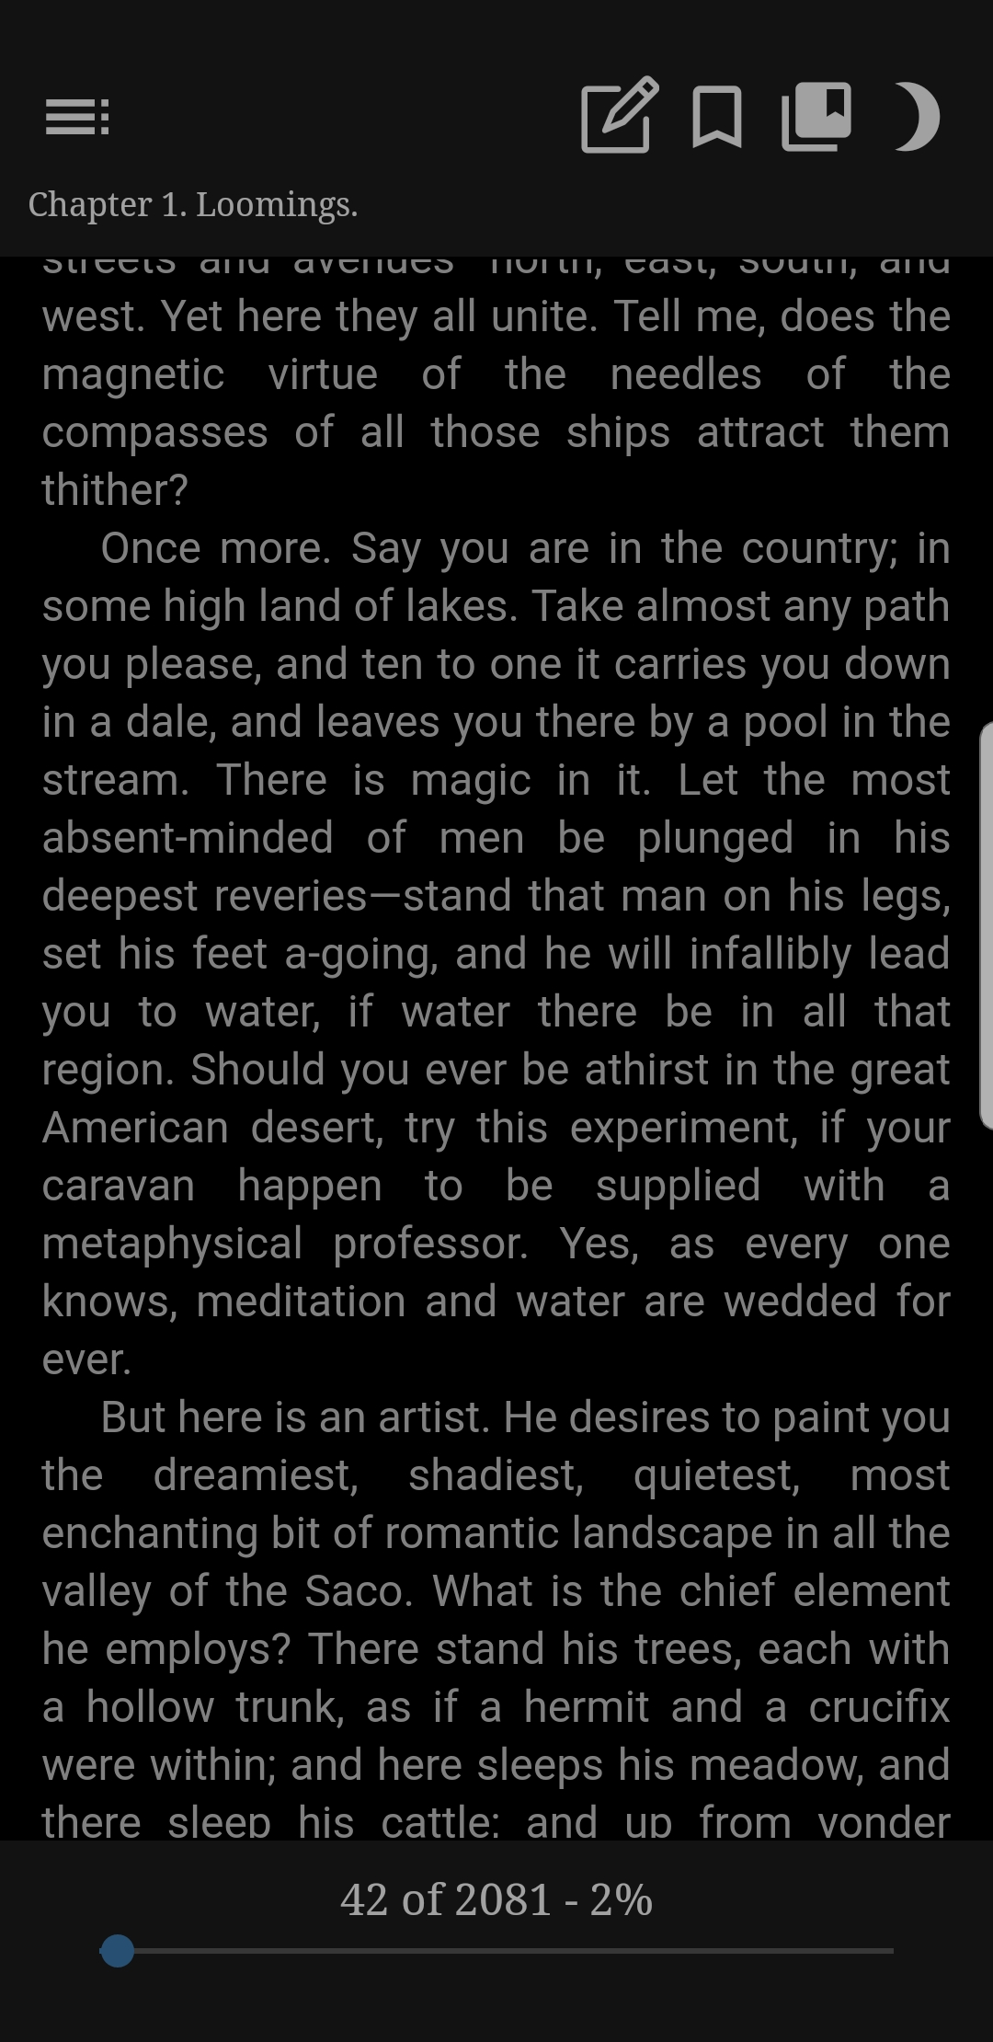
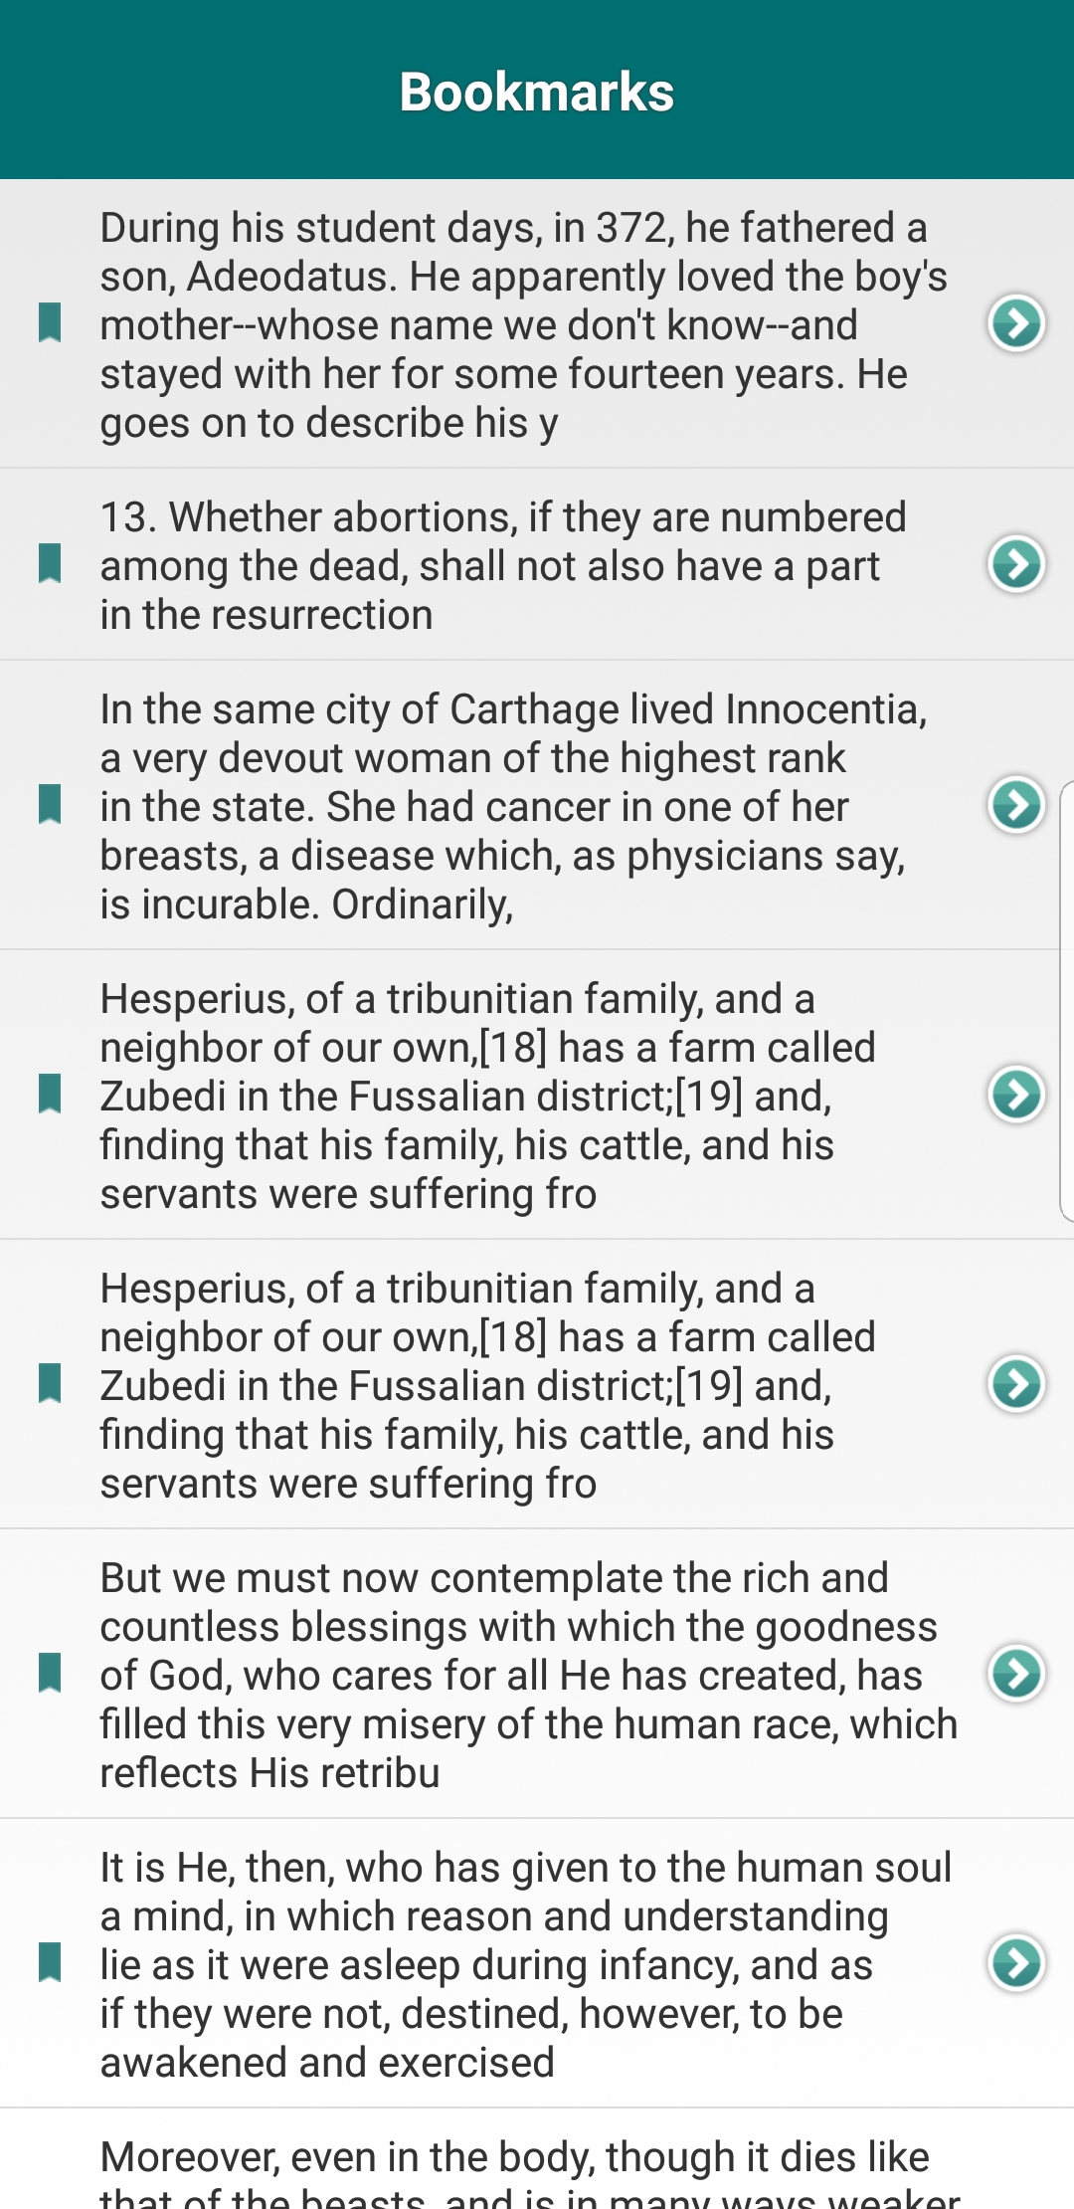
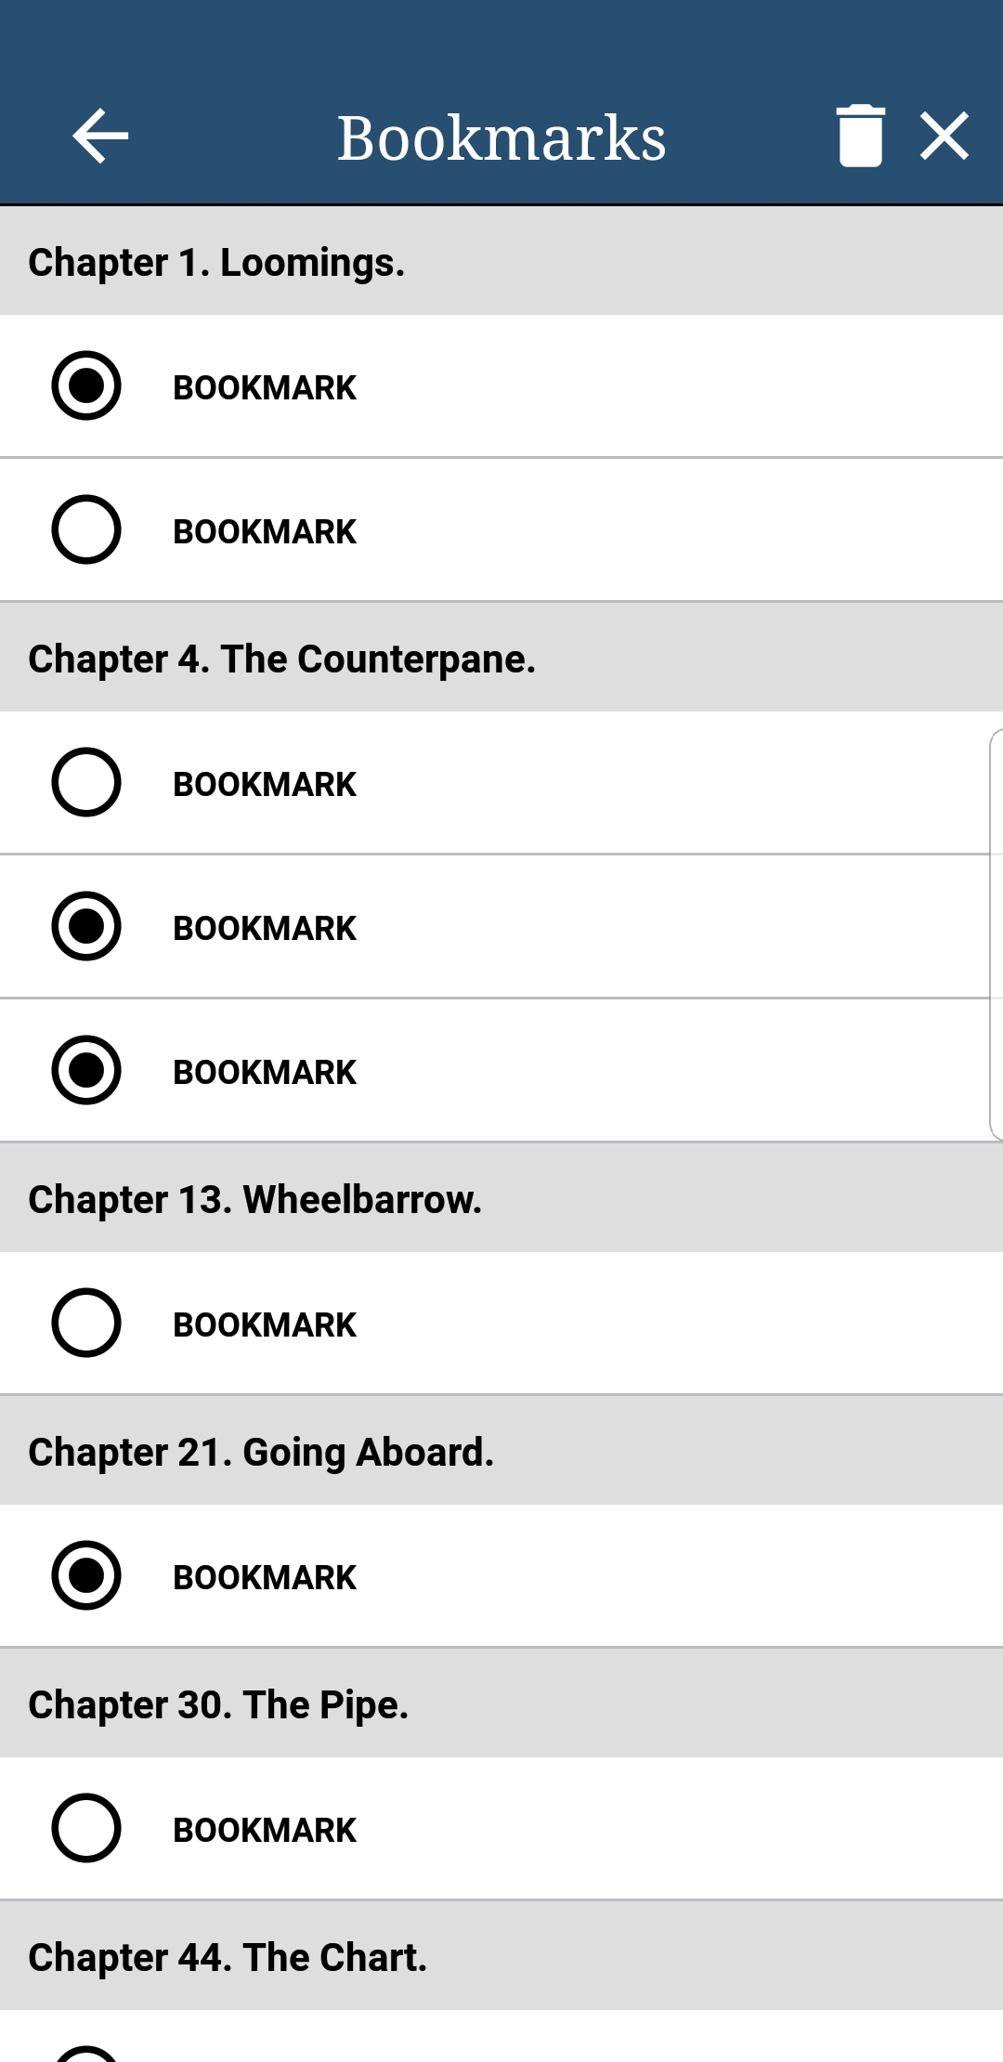
Christian Book Reader
John Schlim
Gordon College: Hugh McSorley
Sponsor: Win Mattina
Computer Science, University of New Hampshire, Durham, NH 03824
Introduction
Solution
Old Versus New Screen Samples
Christian Book Distributors, a catalog and internet retailer, needed a new eBook reader application that carried over existing functionality from the current app while providing a fresh, stable platform for customers to read their eBooks.
Rewrite both IOS and Android versions by utilizing React-Native framework
Allows both Android and IOS to be built while only using JavaScript
Use a library to render EPUB files
Reduces learning curve by only having one repository using primarily JavaScript
Keeps both Platforms closer in feature sets
Login
Table of Contents
Current Issues
Conclusions
Lacks documentation
Current app outdated and hard to maintain
Has many existing bugs
Written in a separate language for each platform
Each platform is at different stages of development
React-Native is very cool, but can be frustrating. Have to test both Android and IOS app frequently
React-Native is a learning curve in itself
Planning and adapting is key to success in any project
Primary features implemented. Reading books, Library, Bookmarks, Notes, Settings, table of contents…
Moving into internal beta within the company
Reader
Bookmarks
Goals
Future Work
Provide clear documentation for current and new employees
Reduce the learning curve required to be able to maintain Android and IOS versions
Make it easier to keep Android and IOS at similar feature sets
Create a new application that keeps existing functionality while increasing stability and usability
Optimizations to reader display and how bookmarks are loaded
Android and IOS highlights
Reading display settings (margins, font family…)
End of book page with suggestions
Bookmarks in bookmark list will show a snippet of text
General bug fixing and UI tweaking

