Slide 1

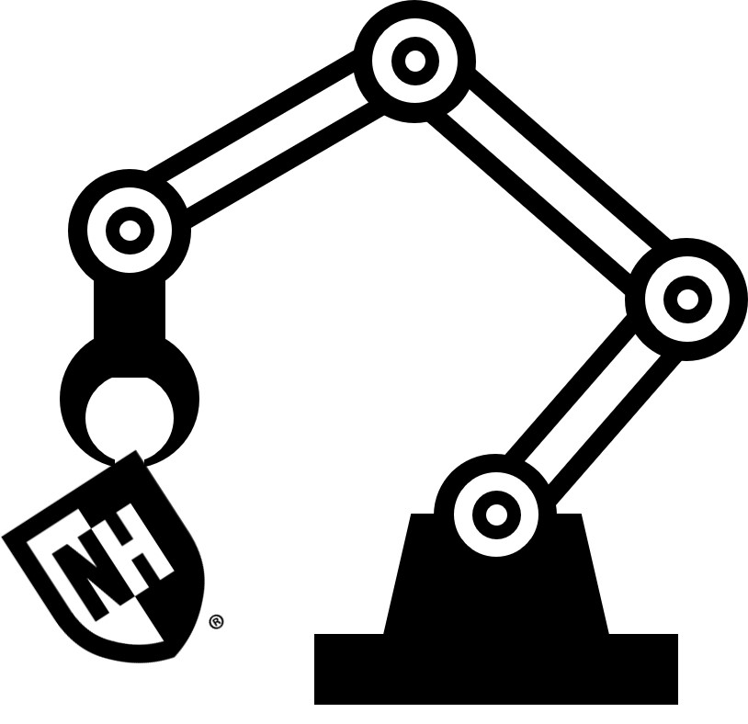
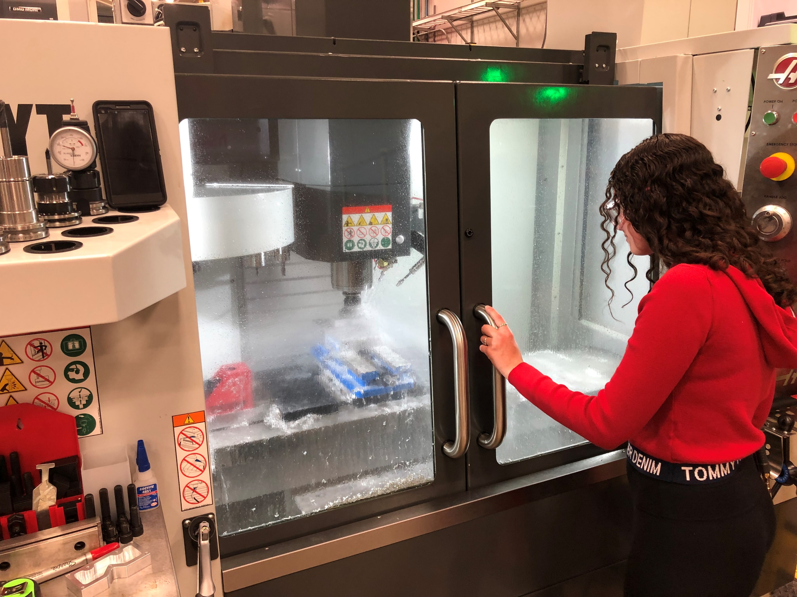
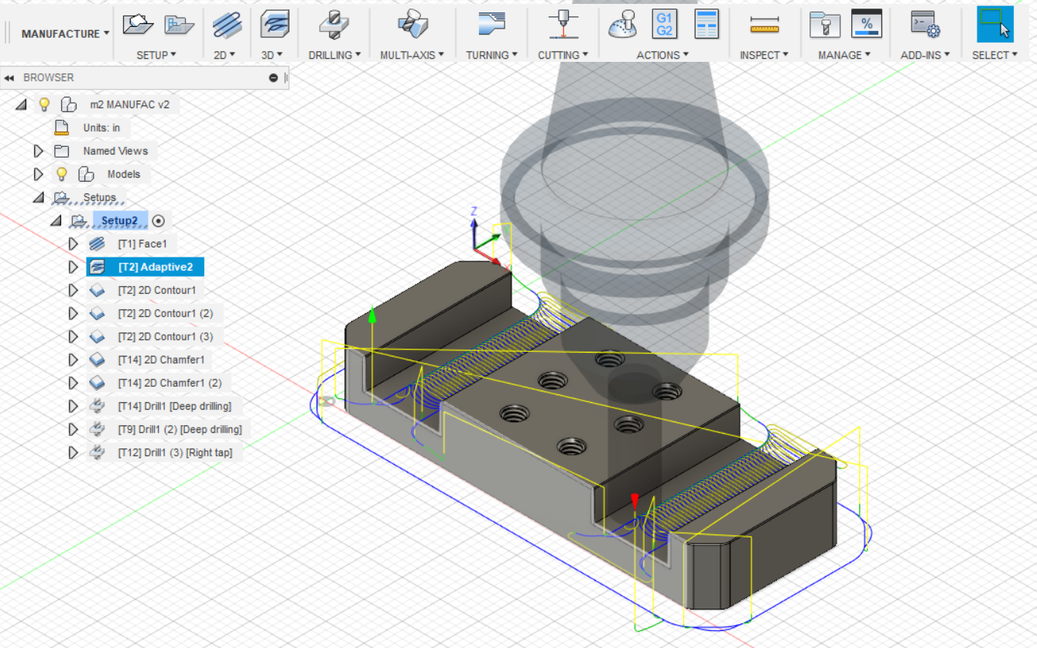
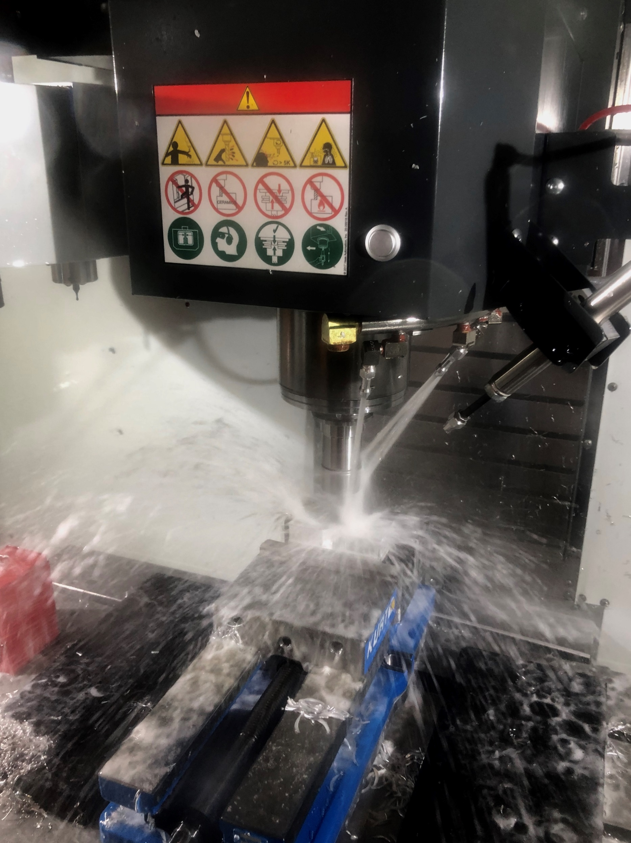

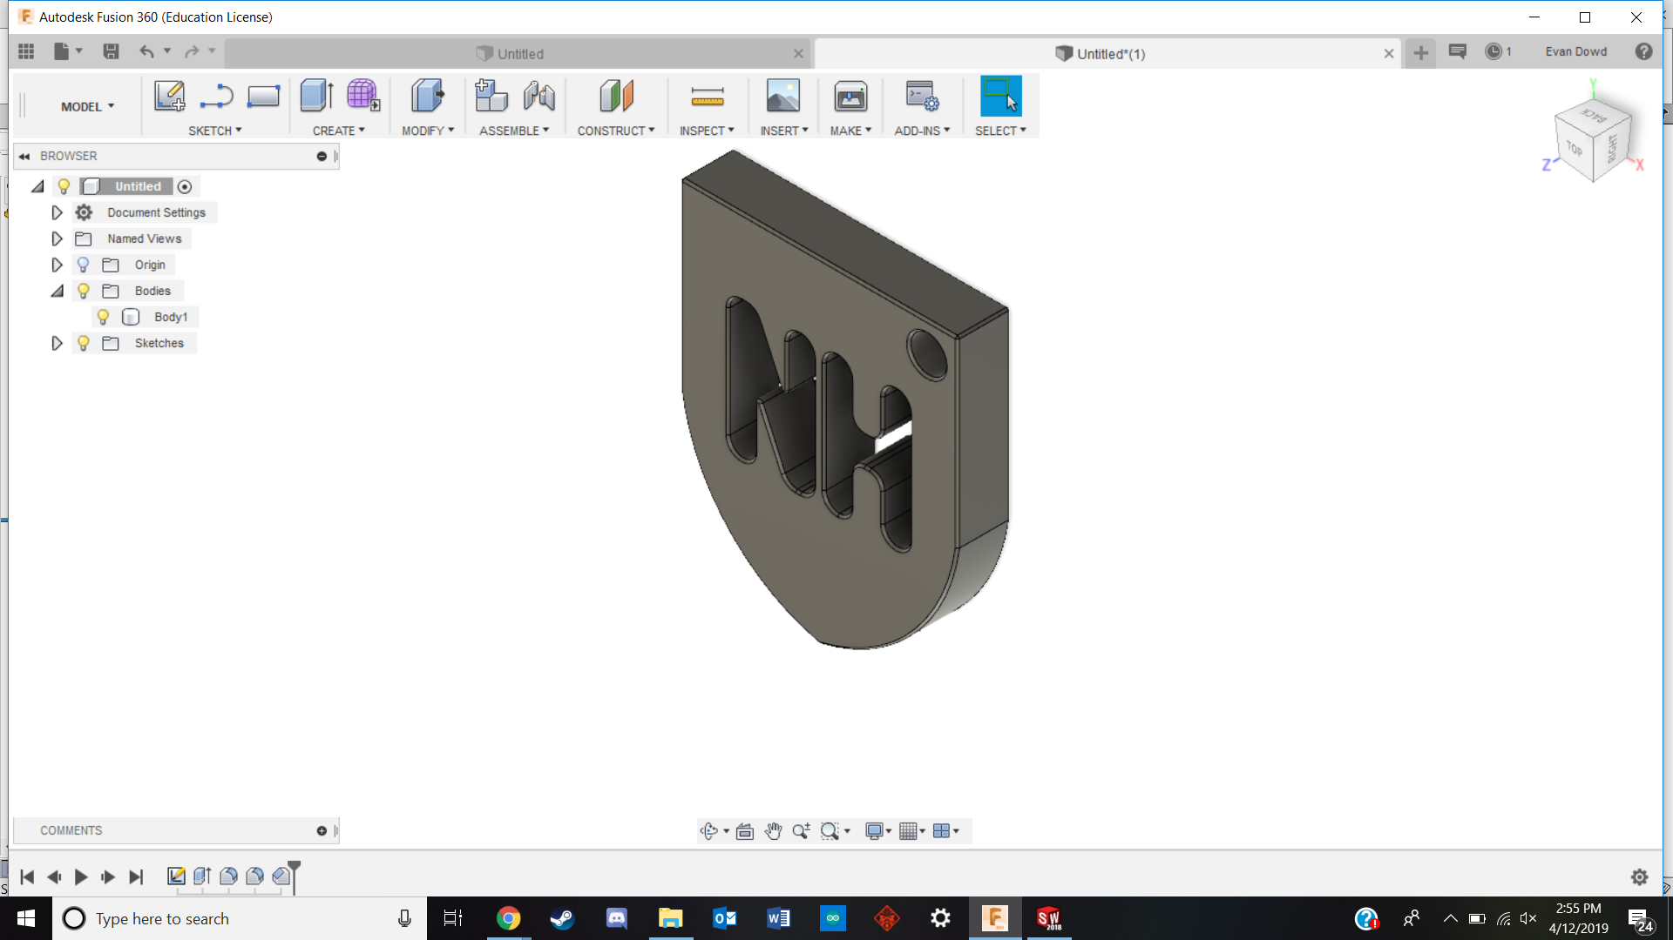
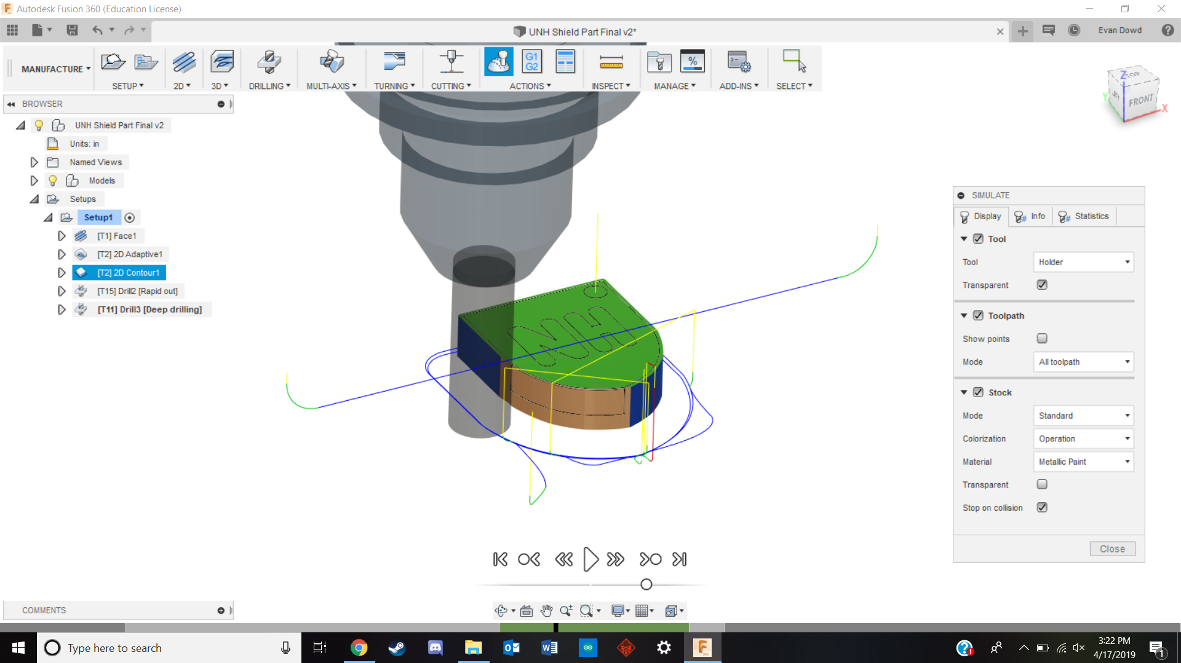
Innovation Scholars CNC Machining Lab
Alexis McGarry, Evan Dowd, Richard Randall
College of Engineering and Physical Science, University of New Hampshire, Durham, NH 03824
Place your Project Logo Here
Introduction
Learning to Machine
Creation of Toolpaths
TECH 411.01/412.01 (Innovation Scholars) is a first year introductory course that teaches various advanced manufacturing processes to students primarily in mechanical engineering. Topics covered included stress/strain testing, metrology, 3D printing, sand casting, and machining.
The machining laboratory consisted of a tour of the machine shop in Kingsbury, and while valuable, was a brief overview of the subject. This lab aims to teach students the CAD (Computer Aided Design) and CAM (Computer Aided Manufacturing) processes in order to give them a base understanding of the CNC (Computer Numerical Control) Machining Process.
Alexis machining the part
TITAN 2M Toolpaths
Using the giveaway part that was made in SolidWorks and converting it to a .step file, we taught in the lab the importance of the design process, and to consolidate both the design and manufacturing of the part to one program. Next we created toolpaths on Fusion 360 on the part for the lab.
The Lab
Machining the Part
Fusion360
Starting with some background on the CNC machining process, the lab is designed to lead the students using images and clear language. The lab flows as follows: Drawing → Toolpaths → Simulation. By following the lab, students with minor CAD experience should be able to learn basic CNC machining.
Learning Process
With the help of our advisor Michael Locke, and our previous SolidWorks experience, we worked our way through the TITANS of CNC labs (www.titansofcnc.com) in order to familiarize ourselves with Fusion 360 and CAM in general.
Some things of note that we learned about were: working with the radii of parts, thinking about the behavior of the material under friction, and using axes and work objects to efficiently machine parts.
Acknowledgements
A big thanks to the Olsen Center Giveaway group for collaborating with us to create the lab.
Also a big thank you to Michael Locke with all of his help on our lab.
References
sTAMD Simulations
“Fusion 360 | Free Software for Hobbyists, Startups & Makers.” Autodesk, www.autodesk.com/campaigns/fusion-360-for-hobbyists.
“Fusion 360 | Free Software for Students and Educators.” Autodesk, www.autodesk.com/products/fusion-360/students-teachers-educators.
“How to Import a CAM Tool Library in Fusion 360.” Autodesk Support & Learning, knowledge.autodesk.com/support/fusion-360/learn-explore/caas/sfdcarticles/sfdcarticles/How-to-import-a-tool-library-in-Fusion-360.html.
“TITANS of CNC: Academy.” Academy.titansofcnc.com, academy.titansofcnc.com/.
Lab Part
Collaboration
UNH Shield Part
Shield Toolpaths
In the process of deciding on a part to use for designing and machining for the lab, we were presented with the challenge of picking a small, cheap part that the students could leave with. With these criteria in mind, we decided to work with the Olsen Center giveaway group and used the same machined part for our lab.

