Slide 1
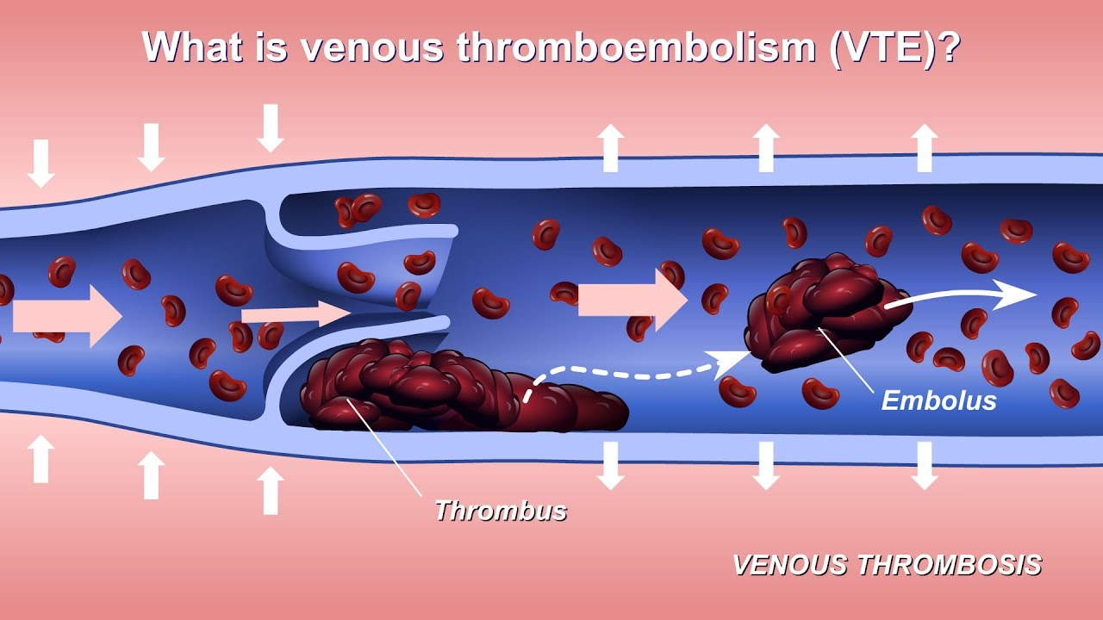

Reducing Patient Refusal Rate of Venous Thromboembolism Prophylaxis
Jacqueline R. Dwyer – University of New Hampshire – Department of Nursing
Clinical Question
Research Implications
Practice Recommendations
For patients on medical units, does education regarding healthcare-associated venous thromboembolisms (HA-VTE) provided by the nurse reduce prophylaxis refusal rates compared to no patient education?
The Center for Disease Control and Prevention reports that as of 2018:
Each year, 900,000 Americans develop a VTE, 100,000 of which result in death
Over 50% of blood clots are related to recent hospitalization or surgery
VTE is the leading cause of preventable hospital death
VTEs costs the U.S. $10 billion annually
Over 70% of HA-VTE can be prevented
It is the responsibility of RNs to integrate VTE prophylaxis compliance into the culture of the medical units at BWH:
The data collected during the QI initiative suggests a positive correlation between VTE education provided by the RN and a decrease in patient refusal rates of prophylaxis
BWH’s medical units should implement a policy that includes a standardized procedure for nurses to follow in the event that a patient refuses ordered VTE prophylaxis:
The policy should provide nurses with a script to educate the patient about HA-VTE in the event that prophylaxis is refused
            If the patient continues to refuse post education, the RN is responsible for documenting the refusal in the EMAR
The nurse should then document that the patient was educated on VTE under the “Education” tab in the documenting system, Epic
The nurse will page the Responding Clinician informing him/her that the patient refused prophylaxis despite education
It then becomes the responsibility of the provider to discuss VTE and prophylaxis with the patient at the bedside
If the patient is still noncompliant, the team will need to discuss a new prophylaxis plan
Goal
Create a policy that provides nurses with a standardized procedure to follow in the event that a patient or family member refuses a dose of venous thromboembolism (VTE) prophylaxis
In turn, reduce the number of patients who do not receive ordered VTE prophylaxis
Clinical Implications
86% of ordered VTE prophylaxis doses are administered to patients on the Brigham and Women’s Hospital (BWH) medical units, which is significantly below the hospital average
Of the doses not administered, 80% were due to patient/family refusal
Between October & December of 2018, a VTE Prophylaxis QI Initiative was piloted on floors 10AB, 14AB, and 14CD
2 RNs from each pod were selected as champions to educate nurses on their units about patient teaching tools and resources regarding HA-VTE education
(Ryan, 2019)
Evidence
Despite the availability of VTE prevention guidelines, prophylaxis is underutilized for patients on medical-surgical units
A study of 358 hospitals conducted in 2010 found that approximately 50% of inpatients were at risk for developing a HA-VTE, but only half received prophylaxis
One community hospital created an education program that was associated with a significant improvement in the quantity and quality of VTE prophylaxis in medically ill patients
Most healthcare institutions lack policies that encourage the application of VTE prophylaxis, perpetuating the underutilization
(Cardoso, 2016; Dobesh & Stacy, 2005)

