Slide 1
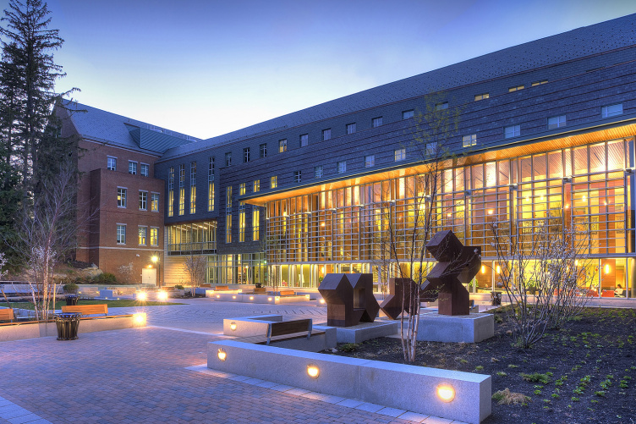











UNH Paul College – Academics Programs
Will Bernard, Clayton Bentley, Danielle Doolin, Jacob Mannix
DS Major Capstone Project Spring 2019
Client: Jen Chagnon
Faculty Advisors: Kholekile Gwebu, Russell Miles, Peter Zaimes
Motivation
Previous Workflow
Solution
Paul College Business in Practice (BIP) courses are new and exciting experiential/hands-on courses taught by industry leaders and companies meant to bridge the gap between theory and practical application. The process to connect these potential instructors to UNH and ultimately students is currently done by our client, Jen Chagnon, who is experiencing issues with:
paper dependency
lag time between contact with potential instructors and when decisions are made
transparency communicating the status of the course/instruction partnership
SharePoint: SharePoint will be where potential BIP instructors will find the online forms. Forms can be found in different locations across the SharePoint site.
Digitized Forms: Jen’s BiP forms will be available for online use via SharePoint. This will allow Jen to complete the process without being reliant on paper forms.
Work-Flow: Microsoft flows will connect to the BiP form and send Jen an approval request with the form for convenience. Jen can choose to accept or decline; if accepted, there will be an email sent to the potential BIP instructor with a link to a Calendly page to schedule meetings, this reduces lag time of contact between BiP instructors and Jen and increases transparency.
Meeting Maker: The meeting maker will be a Calendly page. On this page Jen will be able to create meeting times based on her schedule and when a potential BIP instructor registers for a meeting, an email will be sent to Jen with the name of the instructor, the instructor’s email, and the requested time of the meeting, decreasing lag time of contact between Jen and the BiP instructor.
BIP Team Member sends Potential Instructor a Proposal Worksheet
BIP Team Member sends Potential Instructor a Proposal Worksheet
BIP Team Member sends Potential Instructor a Proposal Worksheet
BIP Team Member sends Potential Instructor a Proposal Worksheet
Objective
BIP Team Member sends Potential Instructor a Proposal Worksheet
Digitize Paul College BiP course business process workflow and automate BiP course business tasks to increase the speed, transparency, and independence of the system.
Next Steps
Tools Used
Continue Working with BIP Coordinators
Broaden administration adoption of digital form use
Budget expense for fully featured services
Updated Workflow
Microsoft
  Outlook
  SharePoint
  Flows
  Forms
  Power BI
Calendly
BIP Team Member sends Potential Instructor a Proposal Worksheet
BIP Team Member sends Potential Instructor a Proposal Worksheet
Acknowledgements
BIP Team Member sends Potential Instructor a Proposal Worksheet
BIP Team Member sends Potential Instructor a Proposal Worksheet
We would like to thank our client, advisors, and department for giving us the opportunity to give back to the UNH Community while learning valuable and applicable job skills during the process. An additional thank you to Russ Miles for his endless support through the process.
BIP Team Member sends Potential Instructor a Proposal Worksheet

