Slide 1


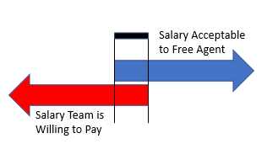
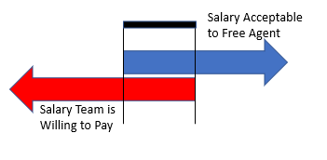
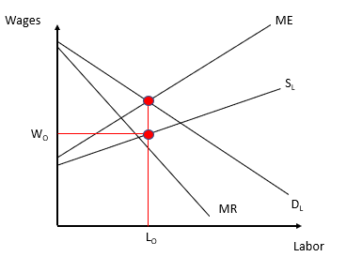
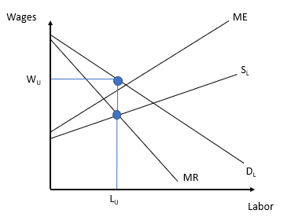
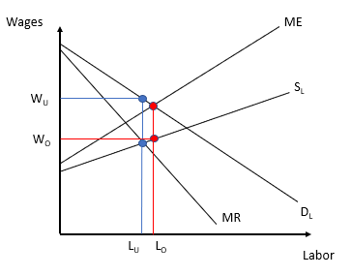
Economic Disadvantages of the Utah Jazz
By: Trevor Lacey
Economics of Sports, University of New Hampshire, Durham, NH 03824
Introduction
Contract Zones
Media
In todays NBA, small market teams are put at a disadvantage compared to teams who operate in a large market. For the purposes of this poster, a small market team will be defined as a team who is located in a metropolitan area that has a population of less than 2 million people. The poster will highlight the Utah Jazz, who are located in the Salt Lake City metropolitan area, and have a market population of 1,203,978 people. This is the smallest population of any current NBA franchise, and because of this Utah is put at a severe disadvantage compared to franchises such as the Los Angeles Lakers, whose metropolitan area population is 13,131,431.
Small Market
Large Market
One disadvantage the Utah Jazz constantly face is the media coverage that the team is given. Due to the small market that the Jazz operate in, they are consistently given less nationally televised games then their large market counterparts. Their number of nationally televised games has increased in recent years due to their recent success of making the playoffs for the last 3 years. This season the Utah Jazz played 17 nationally televised games, whereas the Lakers, who have missed the playoffs the last 6 seasons played 43 games on national TV. This type of media coverage makes destinations like LA far more desirable for free agents, and makes it harder for Utah to retain its young players.
Figure 1
Figure 2
NBA Salary Cap
Bilateral Monopoly
Free Agency
Unlike leagues such as the NFL or NHL, the NBA features a salary cap system known as a soft cap. This means that while there is a salary cap number, teams are allowed to exceed that cap number using different exceptions stated in the leagues collective bargaining agreement. While these exceptions are designed to help small market teams such as Utah retain free agents, these exceptions can actually hurt small market franchises. When a team uses an exception to exceed the salary cap, they are subject to a luxury tax. This means owners have to pay a set dollar amount for each dollar the team is over the tax threshold. The luxury tax bill is easier for large market, and more profitable teams to foot, then it is for a team such as the Utah Jazz, putting them at a disadvantage.
Monopsony Power
Monopoly Power
Bilateral Monopoly
NBA free agency is another spot where small market teams such as Utah are at a disadvantage. One reason for this, is how difficult it is to retain players on small market teams. For example, the Utah Jazz recently lost their star player Gordon Hayward to the Boston Celtics, even though they were able to offer him more money using exceptions. Players often choose more desirable locations to play in order to maximize media coverage and endorsement opportunities. Additionally, small market teams such as Utah often have to overpay less talented players compared to large markets, to incentivize them joining the team. This often leaves small markets teams with contracts that are not conducive to winning
Figure 3
Figure 4
Figure 5
Utah Jazz Salary Distribution
sTAMD Simulations
Analysis of Roster Composition
Lorenz Curve
18-19 Utah Jazz
18-19 Golden State Warriors
Based on figures 6, 7, and 8, it is very clear that small market teams are forced to construct their rosters very differently than their large market counterparts. For the 18-19 season, the Utah Jazz spent 68.8% of its cap space on the top 1/3 of its roster. In comparison, the Golden State Warriors spent 82.53% of its cap space on the top 1/3 of its roster. This illustrates the difference in roster construction between large and small market franchises. Small market teams are forced to distribute their cap more evenly between multiple average players, one or two star players, and draft picks. In contrast, large market teams are able to attract 3 or even 4 stars, and fill the rest of the roster with veterans on minimum contracts and draft picks. In a league where star power reigns supreme, this makes it very difficult for small market teams to compete.
Figure 6
Figure 7
Figure 8

