Slide 1





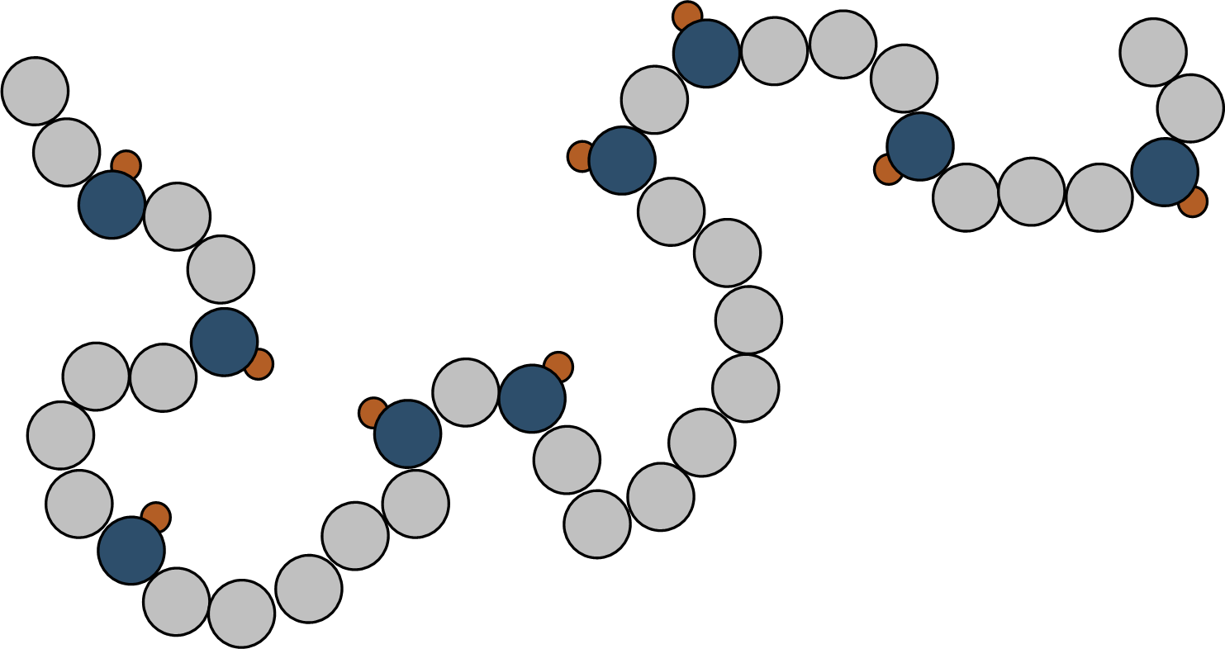
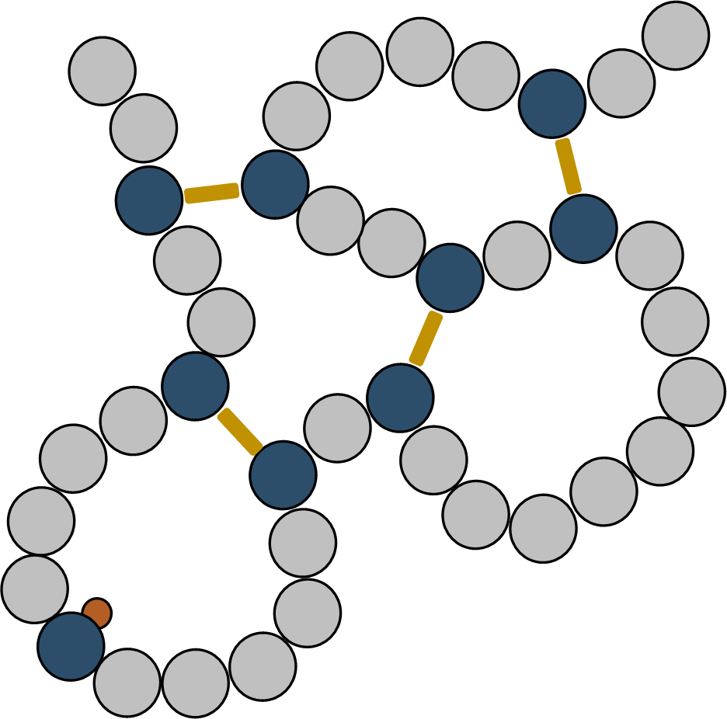
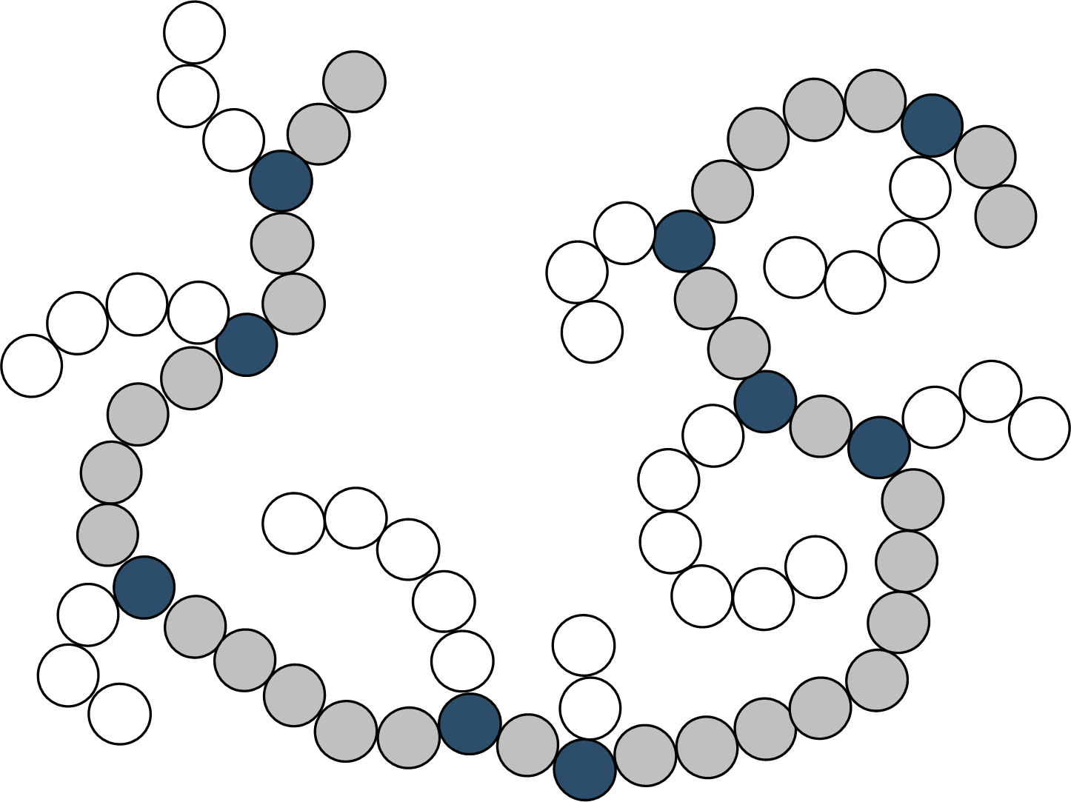
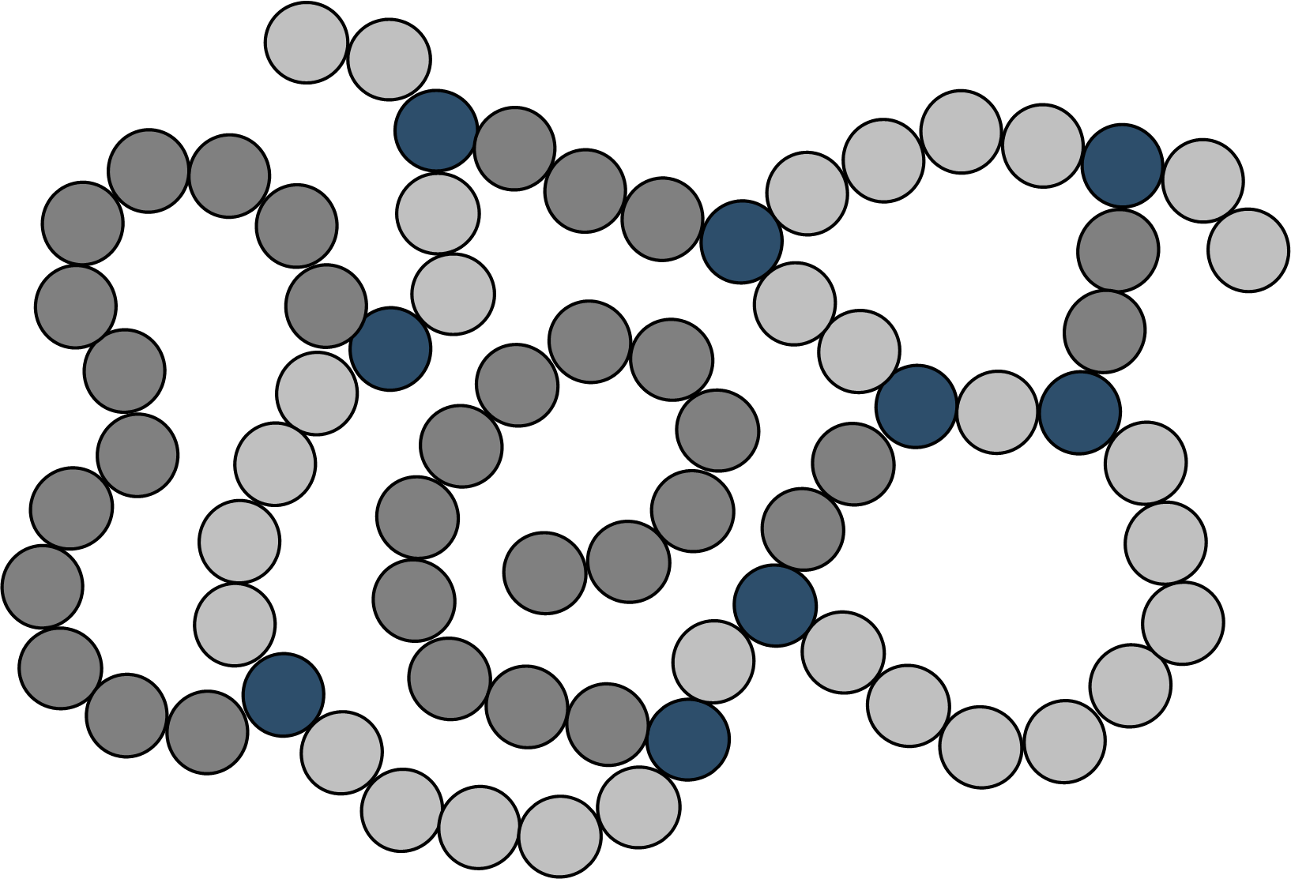
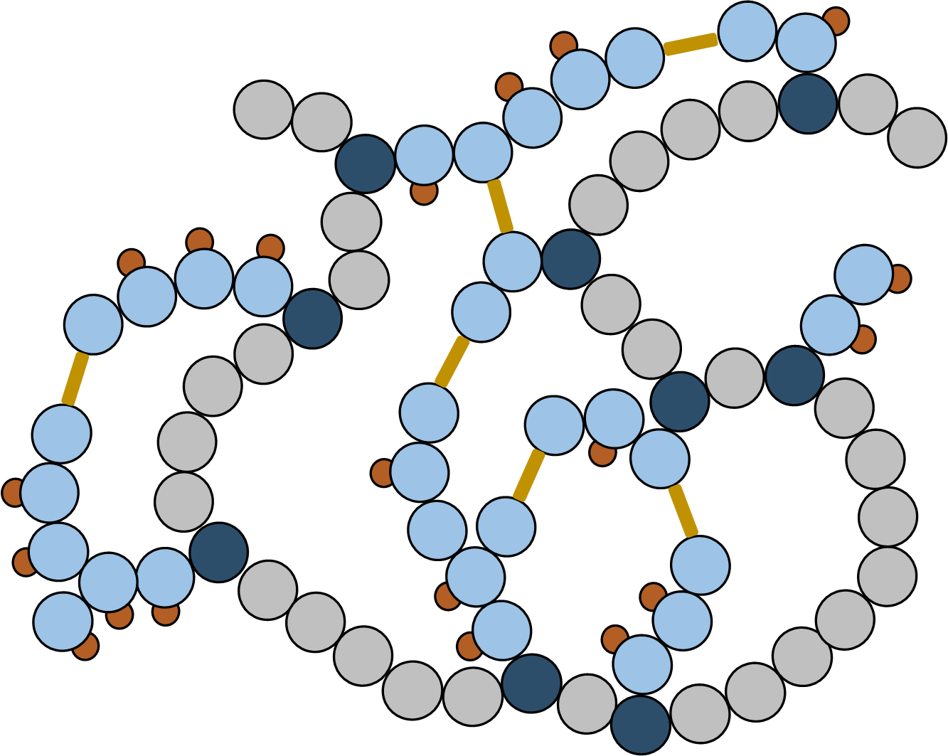
Styrene-Based Single-Chain Nanoparticles via Atom Transfer
Radical Coupling: Structural and Electronic Effects
Christopher LaSalle, Elizabeth Bright, Dr. Erik Berda
Single-Chain Nanoparticles
Collapsed nanoparticle analysis
only the chain ends can couple. In both cases, this occurs due longevity of the radical promoted by resonance stabilization from the adjacent aromatic ring. Multichain aggregation also explains the bimodal character.
Nature has accomplished a high degree of reaction complexity and specificity through its optimization of structure-function relationships. This is the inspiration for synthetic single-chain nanoparticle (SCNP) research. Analogous to enzymes, the primary and secondary structure of these nanoparticles is controlled by monomer selection and incorporation of functional units.
Copolymers were collapsed under varying conditions to yield a simple, opened-brush, closed-brush, or hyperbranched nanoparticle (SNP, OBNP, CBNP, or HNP), Figure 1. This work focuses on developing these structures with styrene-based copolymers due to their high radical stability and molar absorptivity. This leads to better coupling and analysis than the more common MMA copolymers.
Polymers can be assessed by NMR due to the change in chemical shift between vinyl and alkyl protons in the monomer and polymer, respectively. The polymerization was monitored for the 16 hour reaction time.
Conversion
16 Hours
4.48%
1) Monomer-free 2) MMA
3) Styrene 4) PhBrema
4 Hours
b
4.32%
Figure 4: GPC analysis comparing parent polymer and SCNP retention time.
+
1 Hour
4.17%
Future work
1) SNP
2) OBNP
3) CBNP
4) HNP
Optimize RAFT and ATRC conditions to prevent aggregation due to styrene’s radical reactivity
Explore post polymerization modification
Modulate p(styrene-co-PhBrema) solubility, possibly through post polymerization method.
Develop entirely styrene-based copolymers analogous to p(styrene-co-PhBrema).
a
b
c
d
e
e'
a, b, c
Figure 1: SCNP architecture
e, e’
Backbone
d'
d, d’
Conclusion
MMA radicals in solution favor a disproportionation termination mechanism. Styrene’s radicals, however, remain active and continue to polymerize as a brush or alternatively cross-link with other styrene chain ends. Although this introduces greater structural complexity, it also led to interchain aggregation. This unwanted formation yields a higher molecular weight architecture with less structural control and poor solubility which can complicate characterization. Despite these challenges, work with styrene-based copolymers was informative towards the goal of synthetically mimicking some of the structure-function relationships found in enzymes; specifically, their greater density and structural complexity.
Figure 3: (Top) ¹H NMR for tracking copolymerization of styrene and PhBrema at 1, 4, and 16 hours. (Bottom) Crude ¹H NMR of p(styrene-co-PhBrema).
Gel permeation chromatography was used to separate polymers and nanoparticles based on their size for analysis (Figure 4).
Preparation
The copolymers were synthesized though reversible-addition fragmentation chain-transfer (RAFT) polymerization using AIBN as a thermal initiator and a dithioester chain-transfer agent (CTA). The desired functional and spacer monomers were dissolved in dry toluene, sparged with N₂, and stirred at 80 °C for 16 hours with AIBN and the CTA. The polymer was then collapsed using atom transfer radical coupling (ATRC); it was re-dissolved in dry toluene with a Cu(I)Br/PMDETA catalyst and additional monomer if desired, and stirred with a Cu(0) wire reductant under inert atmosphere at 80 °C for an additional 16 hours.
Name | Type | MW (g/mol) | PDI | RH (nm) | Yield | Func. incorp.
p(Styrene-co-PhBrema) | Polymer | 6764 | 2.023 | 1.523 | 2% | 72.80%
np(Styrene-co-PhBrema) | SNP | 6273 | 1.403 | 0.715 | 10% | -
p(MMA-co-PhBrema) | Polymer | 28560 | 1.131 | 5.196 | 43% | 17.50%
np(MMA-co-PhBrema)-g(styrene) | CBNP | 35800 | 2.468 | 1.546 | 6% | -
np(MMA-co-PhBrema)-g(PhBrema) | HNP | 77470 | 1.335 | 5.434 | 52% | -
Figure 5: Polymer and nanoparticle compositions and morphologies.
Collapsing a polymer into a SCNP decreases the hydrodynamic radius of the structure but does not dramatically impact its molecular weight. Therefore, the SCNP will elute slower than the parent polymer. This was observed for the SNP and CBNP. However, the retention time decreased for the HNP due to undesired interchain coupling (Figure 4). This is most prevalent with the HNP since there is a relatively high concentration of coupling moieties with added PhBrema. Aggregation is also possible with added styrene but to a lesser extent since
Acknowledgements
A large thank you to Dr. Erik Berda for his continued support, guidance and funding. Also to Dr. Elizabeth Bright for her mentorship which has been instructive both inside and outside of the lab! Thank you to all Berda group members and other graduating seniors for putting up with my stress! And of course to the NSF and the Army Research Office for funding this research.
Figure 2: RAFT → ATRC → SCNP
Notes:
Add schematic for chamber

