Slide 1


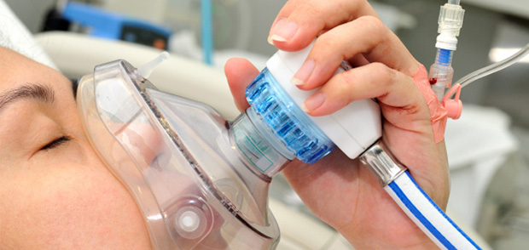
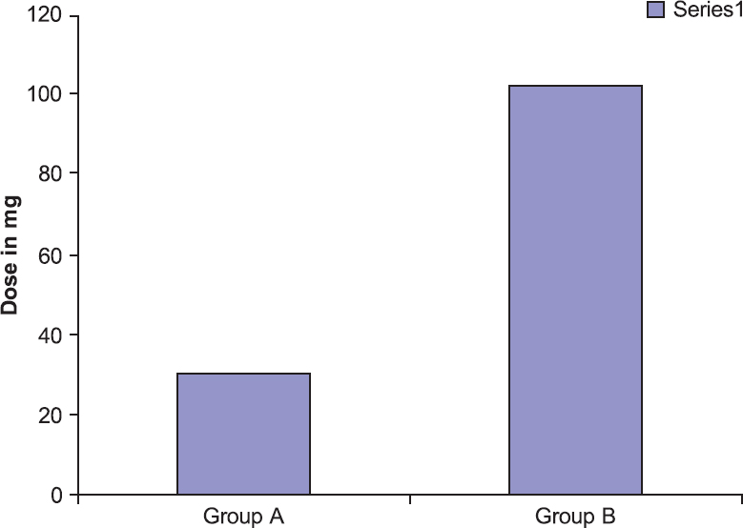
Implementation of Nitrous Oxide at SNHMC Emergency Department
Jaclyn E. Swan Student Nurse
University of New Hampshire
Purpose: In Emergency Departments, could the use of Nitrous Oxide decrease analgesic and sedative complications compared to current use soley of IV medications?
Nitrous Oxide
Nitrous oxide is a colorless odorless gas
N2O is an anesthetic and analgesic by binding to opioid receptors which releases opioids into the brain and inhibits pain signals
It is administered with atleast 30% oxygen to prevent hypoxemia
Minimal amnestic affect, therefore procedures are remembered
Sometimes used with a smaller dose of other analgesia
Evidence
Study conducted over of 12 months for all procedures using nitrous oxide
224 cases, 73% found no complications. 17% experienced mask intolerance, only major complication found was respiratory distress
In a study analyzing the conjuction of propofol and nitrous oxide vs propofol alone, it was found that the use of nitrous oxide significantly decreased the dose of propofol needed by 30-50%
Studies show that recovery time of nitrous oxide compared to ketamine in sedation was a 21.5 minute difference
Background
Standard practice in SNHMC sedation and analgesic is IV medications such as propofol ketamine and fentanyl
Complications of these drugs include respiratory depression, hypotension, upper airway obstruction, apnea and more
Practice Recommendations
Fitted mask appropriate for face
Discourage talking
Discourage mouth breathing and encourage nose breathing
Respiratory rates, SpO2, heart rate, blood pressure, and level of consciousness should be continuously monitored
100% oxygen administration after procedure to prevent hypoxemia and excrete left over particles
Clinical Implications
Increased dosage of sedative medications increases risk of complications
By introducing N2O as an analgesic, other medication dosages can be decreased
Recovery times are shorter in nitrous oxide compared to other medication
No need for vascular access, so can be easier in pediatric population
Research Implications
For future research, compare the adverse effects and complications of N2O alone, N2O combined with other sedative medications, and sedative medications without N2O to determine which procedure will have the best patient outcomes
Group A was given 66% N2O for 3 minutes, while Group B was given 100% oxygen for 3 minutes. This chart is a comparison of induction doses of propofol for sedation for each group.

