Slide 1


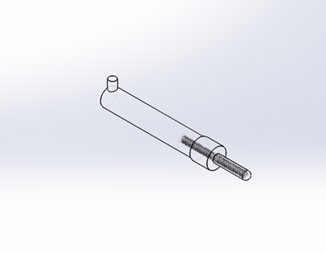
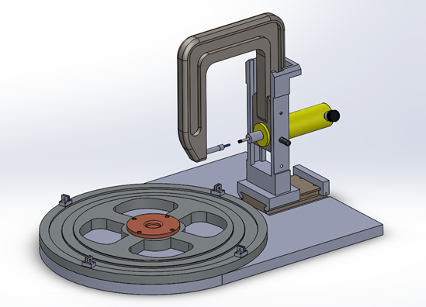
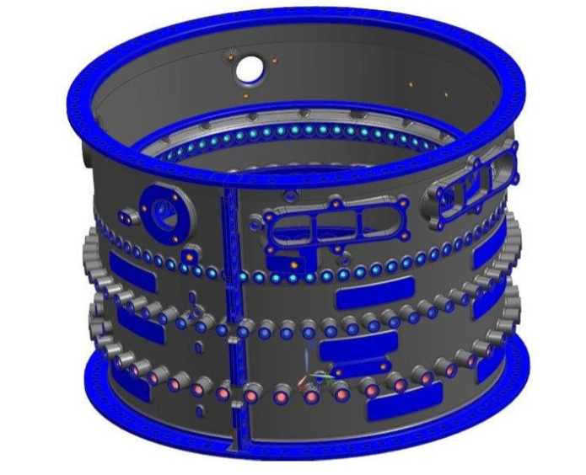
Automated Bearing Sleeve Assembly
Pratt & Whitney
Nicholas Spiller
Department of Mechanical Engineering, University of New Hampshire
Introduction
Proposed Design
Key Components
Pratt & Whitney currently produce high compressor cases that need bushings installed into all 185 holes on the part
Current process takes approximately 2 hours to complete 1 case
Repetitive motion places high ergonomic risks onto the operator
Does not meet cost targets for the assembly operation
Takes approximately 700lbf to push a bushing into the case
Each bushing is manually placed into the case with the use of a hydraulic press.
In progress design incorporates a dynamic body that focuses around pushing the bushings in from the outside of the case. All need for operators to reach in and out of case has been removed from the process in order reduce ergonomic risks.
Pilot Pin: Designed to self align hydraulic press and the hole of the case, as well as prevent any stress on the case due to the pushing force
Yoke: Holds the hydraulic press stationary, while being able to handle the applied forces from the press. Can be set to six different heights depending on which size case and hole stage is being worked on
Rotating Table: Multistage design capable of holding both medium and large cases. External clamps attached to table help lock down cases
Yoke holder: Provides support to yoke, while preventing it from moving in any direction while the yoke is locked into position
Operator will lock yoke into place at desired height, while moving the pilot pin into the hole. Once the bushing is placed on the press and process begins, the pilot pin will act as a self aligner to ensure that the bushing is exactly centered in the hole. Self alignment allows operators to no longer spend time trying to manually align the case and hydraulic press. This feature allows decreases the chance of damage being done to either the case or bushing.
All key components within the new process have been designed so that they can be converted to be fully automatic in the future. Future work will consist of converting these components as well looking at where more time can be reduced.
High Compressor Case
Goals
Produce a process that is able to become automated over time with only minor changes needed to be made
Reduce overall assembly time
Reduce ergonomic risks placed on operator
Reduce amount of manual labor
Contacts
For more information contact: Mike Newsky, michael.newsky@pw.utc.com

