Slide 1

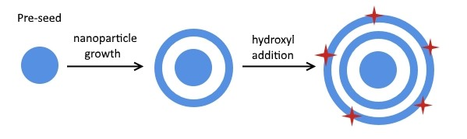
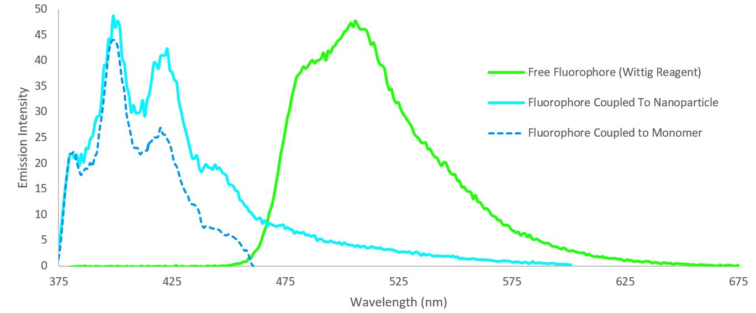
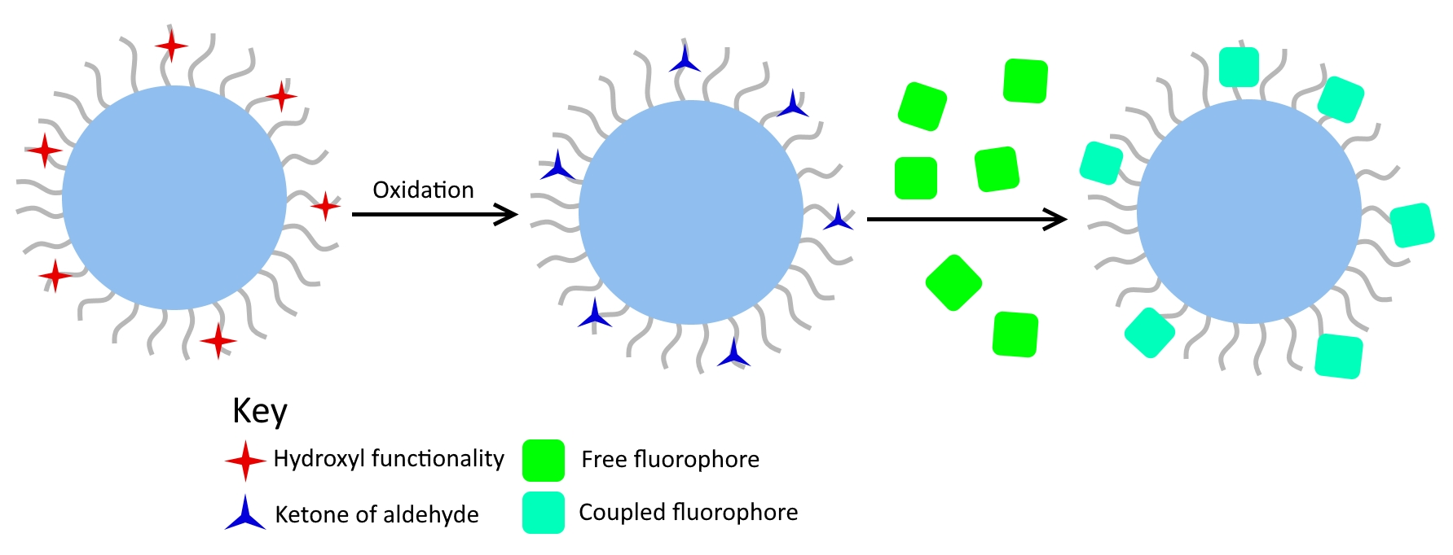
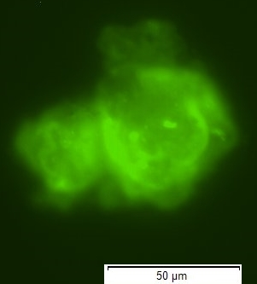
Determination of Hydroxyl Surface Coverage on Waterborne Polymeric Nanoparticles via Grafting with Fluorescent Pyrene Tag
Benjamin J. Adams and John G. Tsavalas
Department of Chemistry, University of New Hampshire
Introduction
Discussion
  Characterization of surface functionality on polymer nanoparticles is crucial to identifying the interaction between that surface and other chemical species external to the particles. Numerous techniques exist for a variety of chemical functionalities, an exposed hydroxyl group has been a particular challenge for waterborne nanoparticle systems. This poster investigates the coupling of a fluorescent tag to a carbonyl containing surface particle (after conversion of the hydroxyl via oxidation to such) via a Wittig reaction. The goal of the research is to quantify this surface coverage of hydroxyl functionality. Polystyrene nanoparticles were copolymerized with 1% (4-vinyl benzyloxy)-2-propanone in the surface region and were successfully coupled with the fluorescent tag.
  The Wittig reactions produce nearly a quantitative yield in a water medium, even though the regents had minimal solubility. Because the latex being analyzed already uses water as a medium, a Wittig reaction is an ideal method of characterizing surface functionality.
  The shift in emission between the coupled and uncoupled fluorophores results from the change in hyperconjugation. The unreacted Wittig reagent has more π-overlap than the resulting product due to the phosphonium ylide extension of its π-system to the phenyl rings. The larger π-system creates a smaller energy gap between π the π* energy levels. The smaller energy difference causes a smaller emission energy (longer wavelength) resulting from the demotion of an electron from the antibonding to bonding orbital.
Scheme 3: The reaction of the Wittig reagent (triphenyl (1-pyrenyl) phosphonium inner salt) with the surface region of the nanoparticle. No additional solvent was required as the nanoparticles were suspended in water. The reaction took place at 20°C and went to completion in 24 hours.
Results
All synthesized materials were characterized by ¹³C and ¹H NMR. The emission spectra for the free fluorophore and the coupled fluorophore is shown in figure 1. The free fluorophore, triphenyl (1-pyrenyl) phosphonium inner salt, had a peak emission intensity (λ_{max}) of 507 nm, while the coupled fluorophore had three distinct peaks at 380 nm, 400 nm, and 423 nm. This discernible shift in emission wavelength can be used to identify the presence of either a ketone or an aldehyde. In order to quantify the surface region functionality, an internal standard using an alternate fluorophore, such as fluorescein, could be used.
Next Steps
Nanoparticle growth with the addition of hydroxyl surface functionality.
In this poster, we have successful shown characterization of a waterborne nanoparticle with carbonyl surface functionality via a fluorescent tag. For this work we are proposing to oxidize hydroxyl surface functionality into ketones via silver(II) picolinate and then to to characterize the presence of the hydroxyls on the surface region of the nanoparticles.
Methods
The initial step was to create a model nanoparticle with known surface functionality to test the practicality of the method. Scheme 1 shows the synthesis of the ketone containing monomer (4-vinyl benzyloxy)-2-propanone. Next, a polystyrene nanoparticle was synthesized via free radical emulsion polymerization. The nanoparticle was then grown with 1% (4-vinyl benzyloxy)-2-propanone addition. The preparation of the Wittig reagent is shown in scheme 2. The grafting of triphenyl (1-pyrenyl) phosphonium inner salt to the polymers surface is shown in scheme 3.
Scheme 4. General oxidation reaction of a secondary alcohol to a ketone via silver(II) picolinate. The reagent can also oxidize primary alcohols in aldehydes. Oxidation of hydroxyl containing surface functionality will allow for a reaction with a Wittig reagent.
Figure 1. Emission spectra of the pyrene based fluorophore with an excitation of 345 nm. The fluorophore coupled to the monomer and the free fluorophore were analyzed in chloroform, while the nanoparticles were analyzed in their original water emulsion.
Silver(II) picolinate holds several advantages over traditional oxidizing agents such as chromates. The reaction conditions require aqueous conditions at a neutral pH.
Scheme 1: The synthesis of (4-vinyl benzyloxy)-2-propanone via reduction.
Acknowledgements
Figure 2. A cluster of 60 nm nanoparticles undergoing fluorescence
A special thanks to Dr. John G. Tsavalas, the Christine Caputo group, and the Anyin Li group.
Funding from the UNH Latex Morphology Industrial Consortium
References
Scheme 2: Preparation of the Wittig reagent fluorophore: 1-(bromo methyl) pyrene and triphenyl phosphine were used to synthesize the corresponding phosphonium salt. The phosphonium salt was then reduced to the Zwitterionic form, making it viable for the Wittig reaction.
Figure 3. Multistep characterization scheme of hydroxyl surface functionality. Step one is the oxidation of surface hydroxyl groups via silver(II) picolinate to aldehydes or ketones (not yet accomplished). In the second step, the fluorophore is coupled to the nanoparticles surface via a Wittig reaction.
El-Batta, A.; Jiang, C.; Zhao, W.; Anness, R.; Cooksy, A.L.; Bergdahl, M. J. Org. Chem., 2007, 72, 5244-5259.
J. Org. Chem. 1992, 57, 5787-5790.

