Slide 1

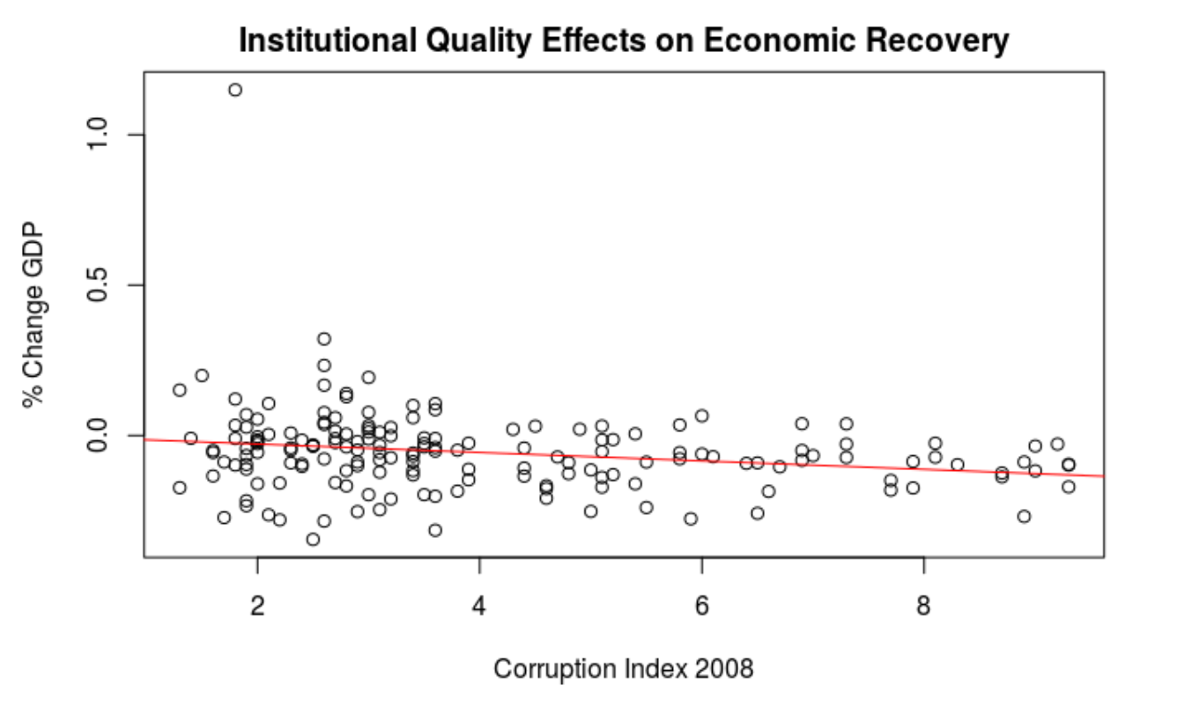
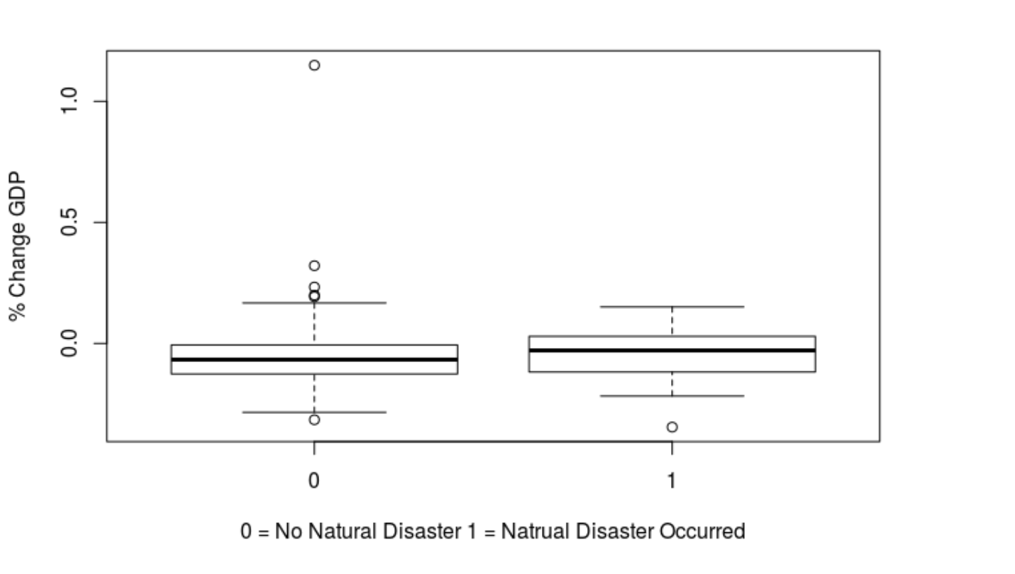
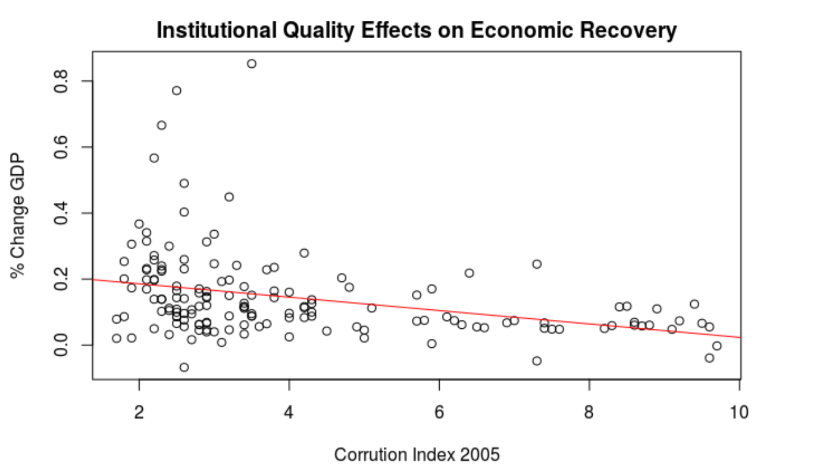
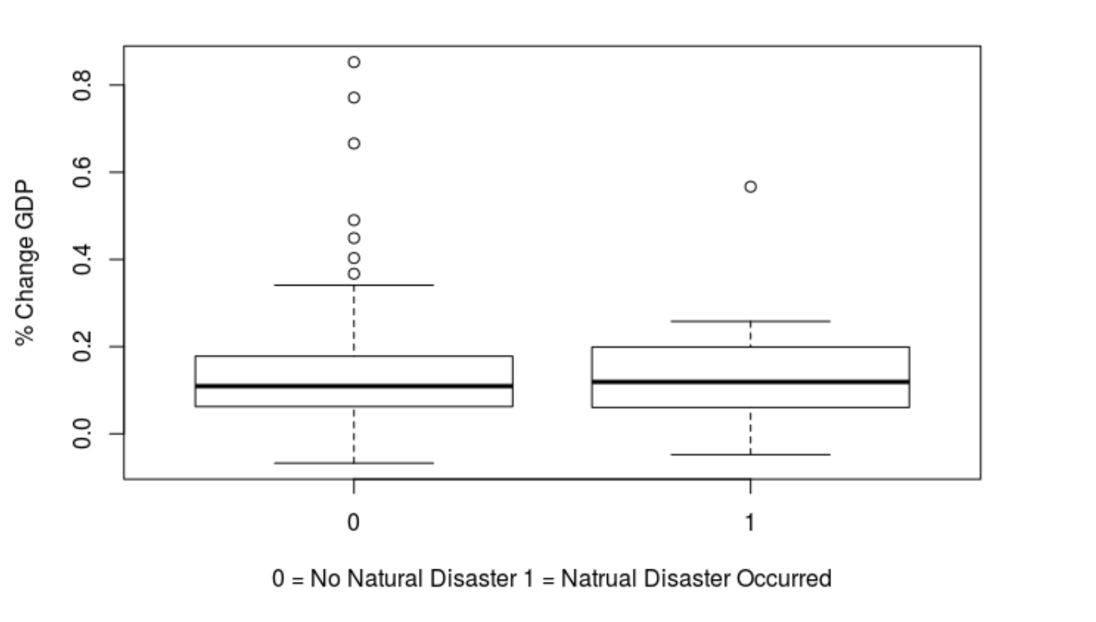
Examining the Effects that Institutional Quality has on Economic Recovery After a Natural Disaster (2005 and 2008)
Brendan Mooney, Peter T. Paul School of Business and Economics, University of New Hampshire
background
methods
results
Many institutional economists cite institutions as having the greatest impact on a country’s economic development (Rodrik, Subramanian & Trebbi 2004)
Natural disasters may cause a short term shock to a country’s economy, and whether or not they recover is a global issue.
By examining the effects of natural disasters and institutions on an economy, we can possibly understand why some nations recover better than others.
The year 2005 was picked for the amount of extreme events that occurred in the year, and 2008 was picked purely out of interest.
Collecting data from Transparency International, the World Bank, and other sources, a regression model testing for institutional quality against economic recovery after a natural disaster was created.
Data was collected from 174 countries in IQI, %ΔGDP per Capita, and whether or not a natural disaster reportedly occurred (dummy) in each country in the years 2005 and 2008.
This model does not take into account other economic variables (integration, geography, and etc.)
The data shows several trends, however the statistical significance of the variables is near non-existent
P-values for all variables are high, along with a very low R value for each graph (2005 R=0.116, and 2008 R=0.04825) which all shows little significance from the data.
Several outliers remain in countries which experienced no reported natural disasters, where GDP per capita increased at higher rates than in the rest of the dataset.
From the distribution, there appears to be very little impact of institutional quality on economic recovery, but this is likely due differences of severity of events, and the localized nature of some catastrophic events
Results
The above graphs show a percentage change in GDP per capita in the year 2008 graphed against institutional quality (left), and the distribution of the change in countries which, and did not have a natural disaster (right).
The above graphs show a percentage change in GDP per capita in the year 2005 graphed against institutional quality (left), and the distribution of the change in countries which, and did not have a natural disaster (right).
%ΔGDP per Capita
%ΔGDP per Capita
Hypothesis
Institutional Quality Index
conclusions
If countries have higher Institutional quality then they will recover from a natural disaster better than those with lower institutional quality.
Although the research I conducted proved an interesting subject, there are many issues with the model constructed. My model at a first glance indicates that there is little impact from institutions on economic recovery, and further that natural disasters have little impact on economic growth. Additionally this model fully looks to institutions as the primary driver of economic development, there are many other variables to take into account. Future research examining the severity of events, examining other economic variables of each country, and all around a better constructed model is much needed.
%ΔGDP per Capita
%ΔGDP per Capita
Institutional Quality Index

Slide 2
This poster template provided courtesy of
UNH ESRC Poster Printing Services
Trust us to make your poster look GREAT!
Website: http://posters.unh.edu
Poster Guide: http://goo.gl/1E7TJY
DELETE THIS SLIDE BEFORE PRINTING

