Slide 1

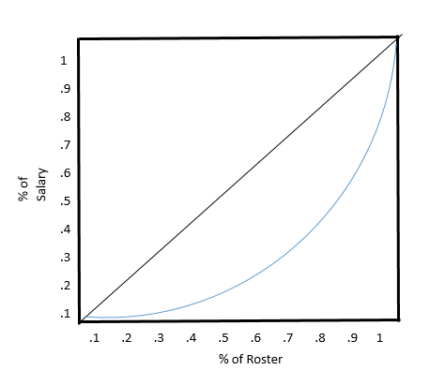
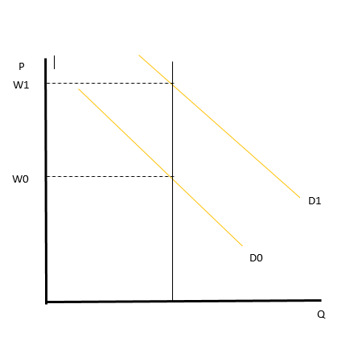
Oakland Raiders: Salary Analysis
Doug Rose, Economics of Sports, Spring 2019, University of New Hampshire
Introduction
Data and Methods
Analysis
Conclusions
The Oakland Raiders had a winning percentage of just .250 in 2018. There has been a lot of noise regarding adding talent and impending high draft picks. The goal is to take a deeper dive in order analyze the potential outcome of these moves: whether they are truly win maximizing or simply increasing demand for profit. Theories include Bilateral monopoly, Superstar Economics, and Lorenz curve.
The main analysis of salary structure came in the form of salary distribution. Correlation between high performing teams and a more balanced distribution was found. Comparing the 2018 and 2019 Raiders shed light on the direction of the team’s performance. Running superstars (QB’s) against salary allowed for a simple view of which teams overpaid for their superstar. Some teams were able to underpay (monopsony power) and gained an unpredicted superstar.
The Data was taken from www.spotrac.com for the salary analysis.
Figure 3:
The Raiders were victim to superstar economics and overpaid for a slightly better product.
The team added more depth to lessen the need/gamble on one sole superstar, increases likelihood to win.
Rookie contracts are a form of monopsony power and provide teams with cheap, high potential players.
Top Teams appear to have more evenly distributed salary among their top 10 players on the roster.
The QB, Derek Carr is an overpaid, under performer that must be given supporting talent or let go to free up cap space (Rookie QB Contract).
Better resembles top teams in terms of distribution, holding 3 first round picks (monopsony power, cheap), have real chance for deep playoff run.
The Raiders distribution highlights a deeper “sag” on the lorenz curve (Figure 1) than the top contenders. Their top player signed the highest salary deal (at the time) and has since skewed their distribution.
Player Wages
Figure 4:
Teams are the only buyer in the market (Monopsony) and players are the only seller (Monopoly) setting up a bilateral monopoly scenario in the league. The distribution of salary via Lorenz curve is another theory being used. The economics of superstars are also at play as teams are willing to pay substantially more for marginally better talent. This poses a problem for teams that bet big and watch as their prized talent underperforms.
Results
Figure 3, 4 : The raiders in 2018 paid Derek Carr almost $5 million more than the average #1 player cap hit as compared to the top 5 teams of 2018. There gamble on a superstar left less money for mid range talent. In 2019, they have acquired top talent such as Antonio Brown, Trenton Brown, Tyrell Williams, and 3 first round draft picks. Additionally, they get to pay Derek Carr slightly less ($2.5 million) – money that can be used to add supporting characters.
Figure 5: Logically, the best quarterback should earn the most… all the way to the 32nd earning the least. There is some early correlation in the 2,4,5,6,7 rankings but no real correlation after that. Major Franchises have locked in talent and pay accordingly while the rest gamble high or low and try to get what they pay for/ get lucky on high performers.
Having a slightly cheaper year with Carr, trading Khalil Mack, and adding top talent in the 2-7 range, has allowed the Raiders’ Lorenz curve (Figure 1) to show more equal distribution than the Average top 5 teams of last year.
Figure 1:
The Lorenz curve shows the equal earnings with the black line. The further the sag, the more unequal of pay distribution.
Figure 5:
Oakland Raiders
NFL Salary Cap
Salary Cap has been steadily rising, slated for 188.2 million in 2019
Teams cannot exceed this limit without penalty, must use at least 89% of cap (Average over 4 years).
Salary distribution is roughly: top 1/3 makes 2/3.
Figure 2:
The Economics of Superstars. The demand for an average quarterback is D0 but the demand for a marginally better quarterback is much greater at D1
QB end of season ranking data being run against salaries for each quarterback. Players were ordered by their rankings, with the expected line of reasonable correlation shown above. 65% of the Teams below this line had a winning record while 23% of teams above the line had a winning record.

