Slide 1

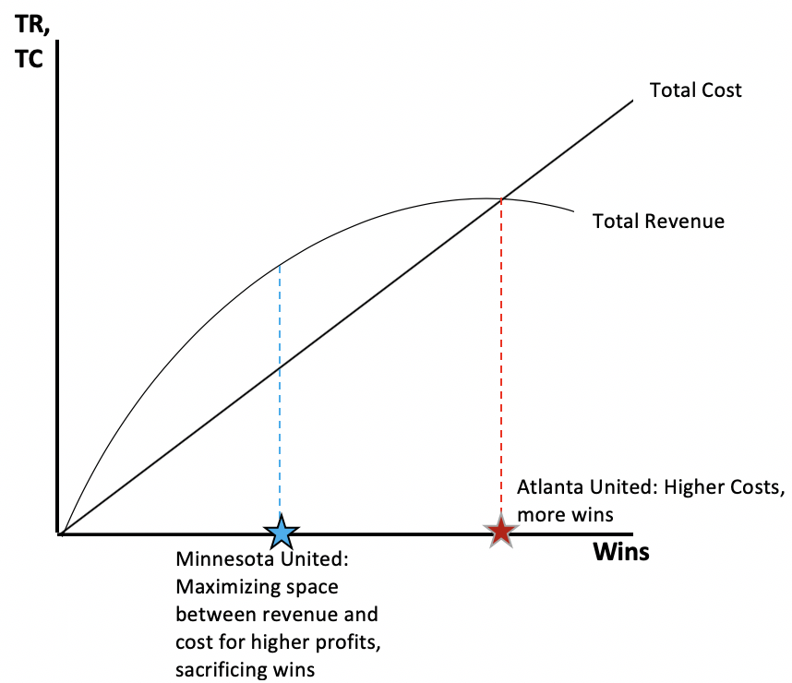
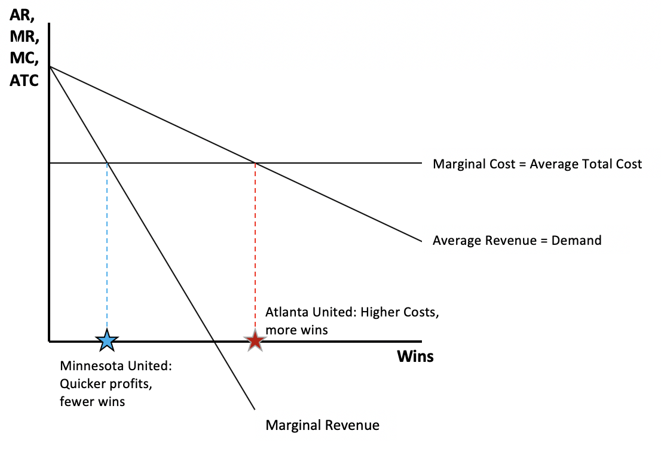
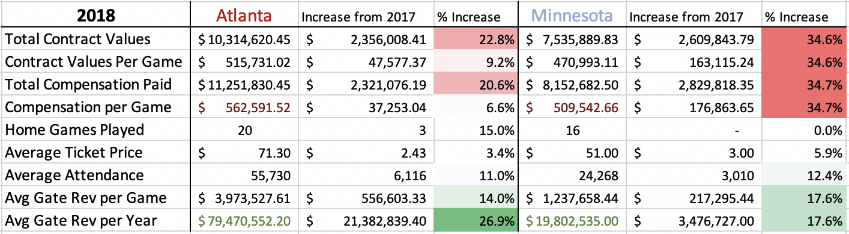
Economic Analysis of Firm Operations of Atlanta United FC
Jack Niles, Department of Economics, University of New Hampshire
Introduction
Methods
Fewer short-term profits are to be had when a team focuses on win maximization rather than profit maximization, but winning more games ensures brand recognition and a greater opportunity for performance-driven monetary incentives. Atlanta United owner Arthur Blank adapted a win-maximizing strategy, allocating more funds for young South American stars to be transferred later at high prices driving demand for tickets.
Founded in 2017, Atlanta United Football Club has achieved global renown, shattered multiple Major League Soccer transfer records, and are the current MLS Cup champions and highest valued soccer franchise in North America. The club that has broken all molds and conventions of what people thought a Major League Soccer franchise could achieve has cashed in on their recent success by selling their star playmaker this January for a league record fee. With the obstacle of sharing a stadium with an NFL franchise as well as a crowded American sporting landscape, the barriers to entry for any soccer club to succeed economically are difficult to navigate, especially in a city famous for apathy toward its professional teams. A few factors contributing to the club’s debut atop Forbes’ list of most valuable MLS clubs include: accounting for ¼ of the league’s merchandise sales due to creative marketing, attendance figures that have broken league records many times over, and a forward thinking player acquisition strategy that has paid swift dividends.
Examine economic factors that shift demand for tickets to sporting events.
Explore 79 instances of attendance data, club revenue, and city demographics over two years for both Atlanta United FC and Minnesota United FC, whom entered MLS in the same year.
Identify economic theories that explain the overperformance of Atlanta United and the underperformance of Minnesota.
Compare 117 instances of salary distribution information, gate revenue data, and supporter demographics between Atlanta and Minnesota.
Apply theories to data and observe results
Conclusions
Results
Atlanta United have capitalized on untapped player demographics and allocated its resources to maximize on-field performance: investing in exciting, young talent and fan experience to further the global brand of the club and promote regular fan attendance.
Although Minnesota United was a known brand having played in the new NASL, their conservative roster spending has put an uninspiring product on the field, resulting in weak, short-term profits.
Economic factors driving demand for Atlanta United tickets:
Low price of good
Abundance of affordable compliments
  “Fan First” concessions: 673 concession points, $2 for soda, hot dogs etc.
Consumer income
  $65,381 median household income, up 12.31% since 2014
General increase in sport popularity
  MLS-wide attendance increased 12.68% since 2014
Objectives
Determine links between player investment and success.
Explain reasons for difference in performance between two teams that joined MLS in the same year.
Define measurable factors explaining Atlanta United’s success
References
Bueno, L., Lisi, C. and Boehm, C. (2019). 2019 is another test of MLS parity. [online] US Soccer Players. Available at: https://ussoccerplayers.com/2019/02/2019-is-another-test-of-mls-parity.html [Accessed 13 Apr. 2019].
Lamle, K. (2018). 46,000 fans a game: Atlanta United's strange success far from soccer's heartland. [online] The Guardian. Available at: https://www.theguardian.com/football/blog/2017/aug/21/atlanta-united-mls-soccer-popularity-average-attendance [Accessed 13 Apr. 2019].
Mandel, E. (2018). Atlanta United is Major League Soccer's most valuable team. [online] Bizjournals.com. Available at: https://www.bizjournals.com/atlanta/news/2018/11/14/forbes-atlanta-united-is-major-league-soccers-most.html [Accessed 14 Apr. 2019].
Lawrence, J. (2019). State Of Major League Soccer Attendance and Tickets - 2018. [online] Blog.ticketiq.com. Available at: https://blog.ticketiq.com/blog/2018/03/mls-attendance-ticket-market-2018 [Accessed 15 Apr. 2019].
Contacts
Jack Niles – Senior: Information Systems & Business Analytics
Jack.Niles@outlook.com
(717) 961 - 6189

