Slide 1


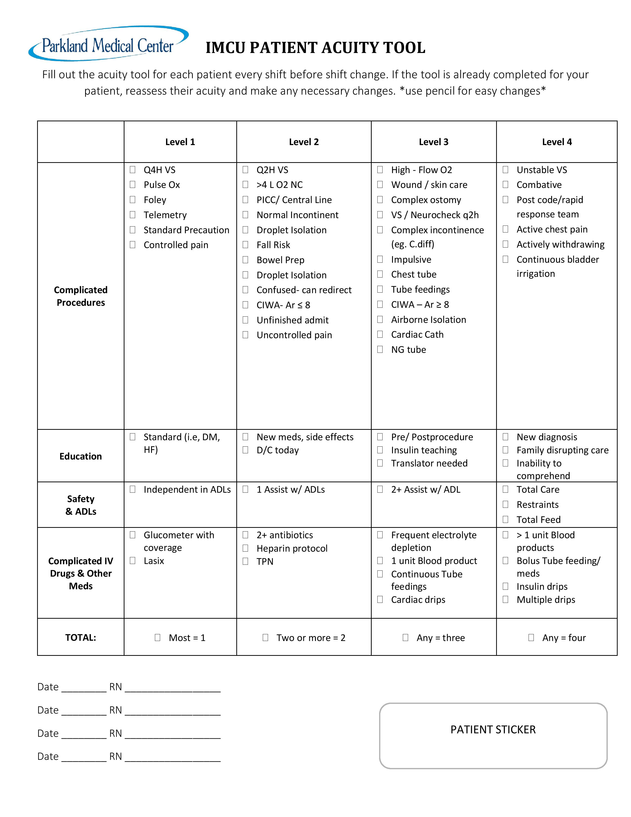
THE IMPLEMENTATION OF AN ACUITY TOOL IN THE IMCU TO IMPROVE NURSE SATISFACTION
Cherry Wu, Senior Nursing Student
University of New Hampshire Nursing Department
BACKGROUND
PICOT QUESTION
PRACTICE RECOMMENDATION
There is a decrease in average length of stay for patients in hospitals with 6.1 in 2014 compare to 11.4 in 1975. Thus, nurses face higher acuity and increase workloads (Center for Disease Control and Prevention, 2015).
High nurse turnover is one of the main contributions of nursing shortage. Job dissatisfaction was identified as one of the primary causes of high nursing turnover (Cicolini, Comparcini & Simonetti, 2014).
Job satisfaction can affect patient safety and quality of care. Increase job satisfaction is linked to optimal working environment and well-balanced workloads. Higher acuity patients are closely related to low nurse job satisfaction (Ilies et al., 2009).
What is the effect of a patient acuity tool utilized in the IMCU when determining nurse-patient assignments on nurses’ job satisfaction?
Nurses should be aware of the specific acuity tool available online and on the unit.
Nurses should be involved in developing and improving the tool to suit the unit’s needs.
Nurses should be educated on the proper use of the tool.
Acuity tool should be only be completed by the nurse caring for the patient.
Acuity tool should be used to make nursing assignments.
GOALS
Create a succinct acuity tool to be utilized in the IMCU unit.
Nurses would use the acuity tool to determine their patients’ acuity before the end of their shift.
Charge nurses would use the acuity tool to make nursing assignments.
CLINICAL IMPLICATIONS
The possible implementation of an acuity tool on other units in Parkland Medical Center.
Future incorporation of acuity tool into the EMAR.
PROBLEM
SAMPLE ACUITY TOOL
REASEARCH IMPLICATIONS
Nurses in the IMCU are frustrated and dissatisfied with their nursing assignments. The assignments are based strictly on the charge nurse’s judgment and experience.
unfair and overwhelming assignments grounded by educated judgments rather than evidence-based methods.
contributes to nursing dissatisfaction and burnout.
negatively impacts patient care.
Larger sample size studies.
Future research on nursing job satisfaction over longer periods of times.
Evaluation of patient outcomes as a result of a more balanced patient assignment.
POLICY CHANGES
CURRENT EVIDENCE
There is no current policy on acuity tools and its use in the hospital. A future recommendation would be to develop a policy related to this topic.
“Nurses with adequate support and manageable work levels report increased satisfaction; and patient care, quality, and safety are optimized” (Barton, 2013).
“One study determined that 70% of nursing acuity is contributed to patient acuity” (Van Oostveen et al., 2014).
“7% nurse satisfaction before the implementation of the new tool and 55% 6 months following its introduction” (Kidd, Grove, Kaiser, Swoboda and Taylor, 2014).
REFERENCES
Barton, N. (2013). Acuity-Based Staffing: Balance Cost, Satisfaction, Quality, and Outcomes. Nurse Leader,11(6), 47-64. doi:10.1016/j.mnl.2013.08.005
Center for Disease Control and Prevention [CDC]. (2015). Hospital utilization in non - federal short-stay hospitals. Retrieved from http://www.cdc.gov/nchs/fastats/hospital.htm
Cicolini, G., Comparcini, D.,& Simonetti, V. (2014). Workplace empowerment and nurses' job satisfaction: a systematic literature review. Journal of Nursing Management, 22 (7), 855 -871 17p. doi:10.1111/jonm.12028
Llies, R., Wilson, S. & Wagner, T. (2009). The spillover of daily job satisfaction onto employees’ family lives: The facilitating role of work–family integration. Academy of Management Journal 52 (1), 87 – 102
Kidd, M., Grove, K., Kaiser, M., Swoboda, B. & Taylor, A. (2014). A new patient-acuity tool promotes equitable nurse-patient assignments. American Nurse Today 9 (3). Retrieved from http://www.americannursetoday.com/wp-content/uploads/2014/03/ant3-WorkforceManagement-Acuity-304.pdf
Van Oostveen, J., Ubbink, T., Veld, H., Bakker J., & Vermeulen, H. (2014). Factors and models associated with the amount of hospital care services as demanded by hospitalized patients: A systematic review. PLoS One, 9 (5) doi:http://dx.doi.org/10.1371/journal.pone.0098102

