Slide 1

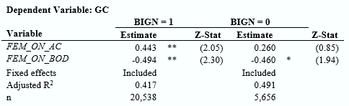
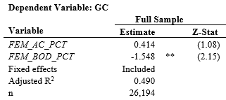
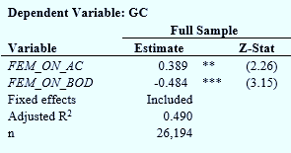
Gender in Corporate Governance and Going Concern Opinions
Anna Peaslee
Department of Accounting, University of New Hampshire
Faculty Advisor Dr. Jonathan Nash
background
methods
results
Going Concern Issuance
An auditor issues a going concern opinion if they believe that the client will not likely stay in business.
The auditor and their client have different incentives, thus negotiations between these parties occur.
Board of Directors
Monitors a company’s activities and impacts firm performance.
Previous studies find conflicting results as to whether women on the board improve firm performance.
Audit Committee
Oversees the audit process and mediates disputes between the external auditor and management.
More diligent and watchful audit committees improve going concern reporting.
Women in Negotiations
Hold less bargaining power than male counterparts as they are less assertive and more agreeable.
Due to gender stereotypes, people tend to agree with the opinions of men over women.
Women and Financial Reporting Quality
Women are more conservative in their reporting decisions, often recognizing negative news quickly.
Women are less likely to engage in opportunistic and unethical behavior.
Sample
Dependent variable
Independent variables
Control variables
26,194 observations from 2000 to 2015 collected from Compustat, Audit Analytics, and BoardEx.
GC, an indicator variable marked 1 if the company received a going concern opinion that year and 0 otherwise.
FEM_ON_AC and FEM_ON_BOD, indicator variables marked 1 if there is at least 1 female and 0 otherwise.
Controlled for various financial variables, corporate governance characteristics, and auditor size.
Observations with Big N audit firms are much more significant than Non-Big N auditors.
We are more interested in Big-N audit clients as they are public companies required to have BODs and ACs
Results
The independent variables were also measured on a percentage basis: FEM_AC_PCT and FEM_BOD_PCT.
These results support the directional findings in the first model; however, they are not significant.
Using indicator variables is more relevant as the AC and BOD are small, with an average of 8 board members in our sample, and women have low representation already.
conclusions
FEM_ON_AC
Significantly and positively correlated with GC, meaning that as the number of females on the audit committee moves from 0 to 1, the chance of a GCO is increased by 38.9%.
FEM_ON_BOD
Highly significantly and negatively correlated with GC, indicating that as the number of female board members moves from 0 to 1, the chance of a GCO is decreased by 48.4%.
As female participation in corporate governance increases and other countries impose mandates requiring minimum levels of female board participation, the impact of gender in corporate governance is an important social issue.
Hypothesis
These results do not support hypothesis 1
Female board representation decreased the GC issuance which may indicate that female board members have a positive impact of the board’s oversight and the firm’s financial performance.
These results do support hypothesis 2
Female representation on the audit committee likely increases GC issuance because women are less aggressive in negotiations and more willing to accept a GCO to report more accurate and conservative information.
Hypothesis 1:
Female representation on company boards will have no impact on the likelihood of the external auditor issuing a going-concern opinion.
Hypothesis 2:
Female representation on audit committees will increase the likelihood of the external auditor issuing a going-concern opinion.

