Slide 1


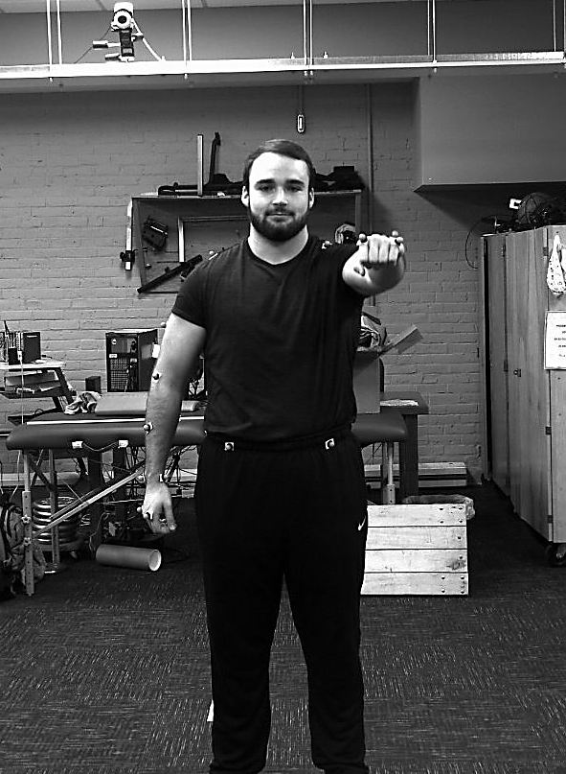
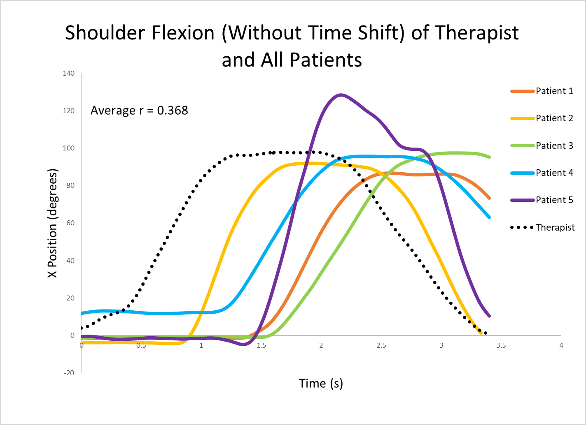
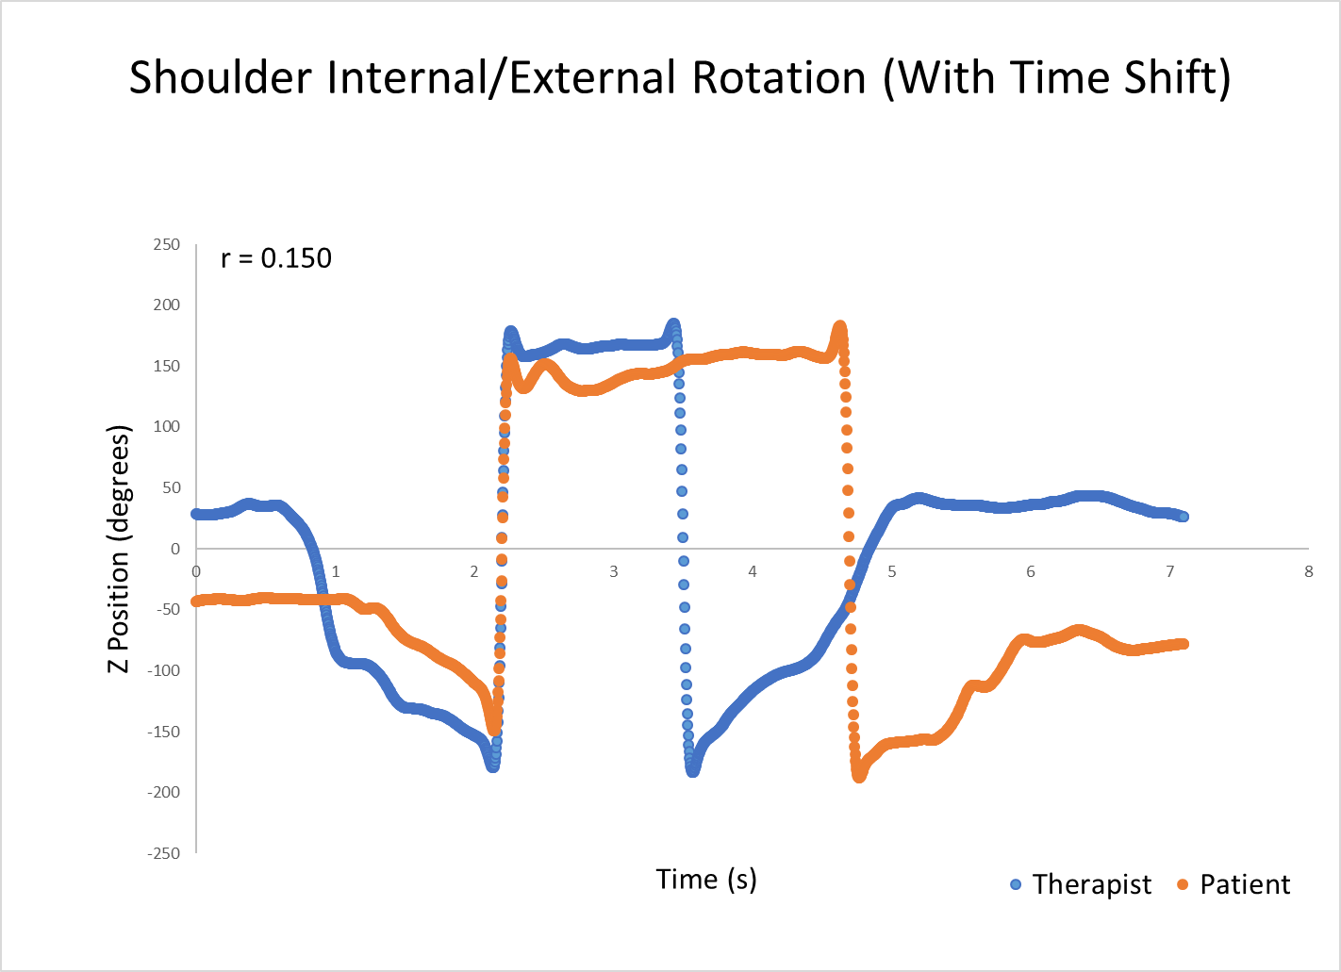
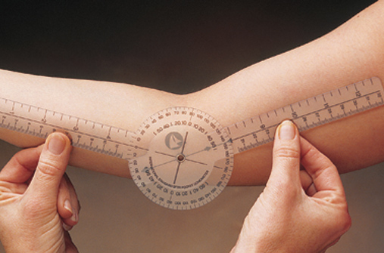
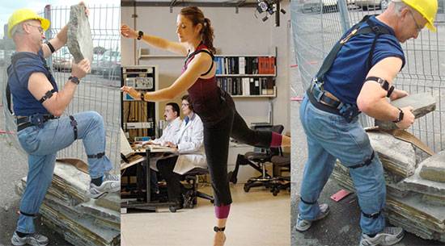
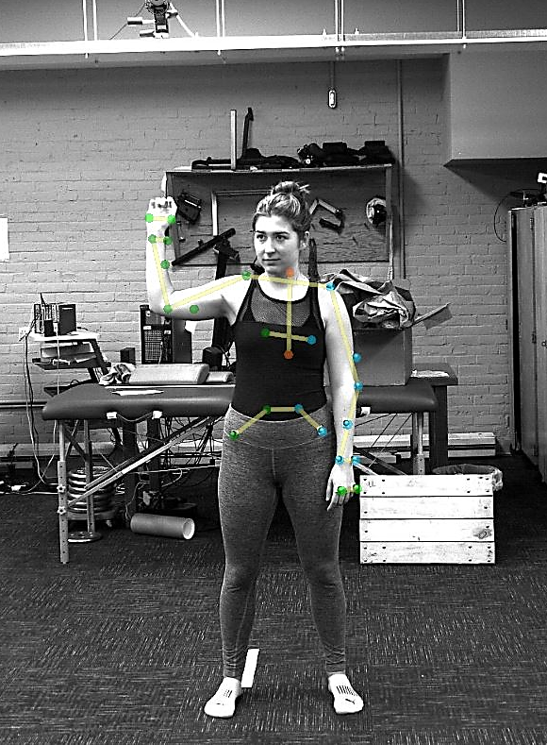
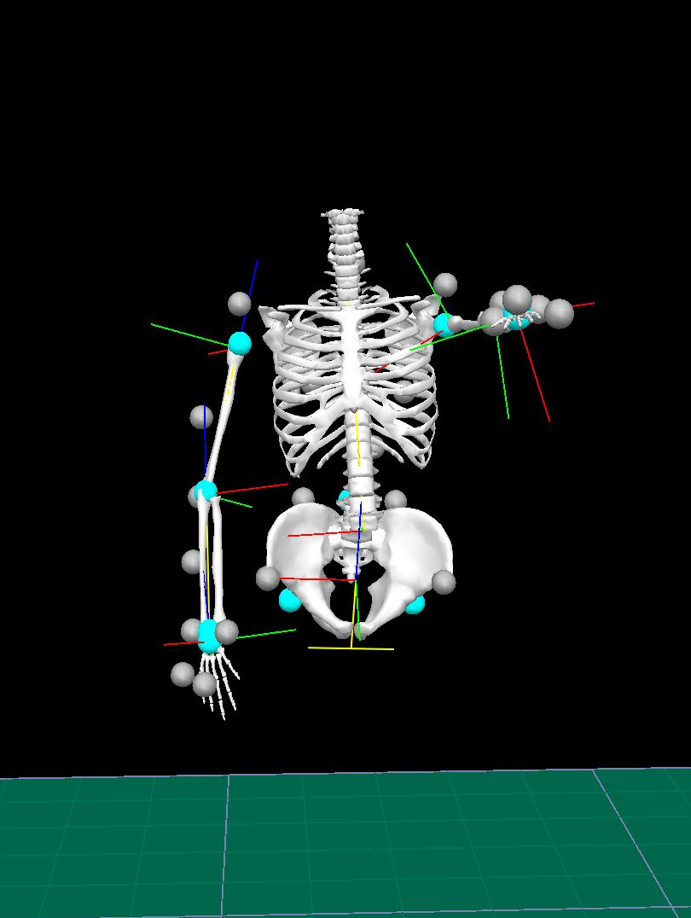
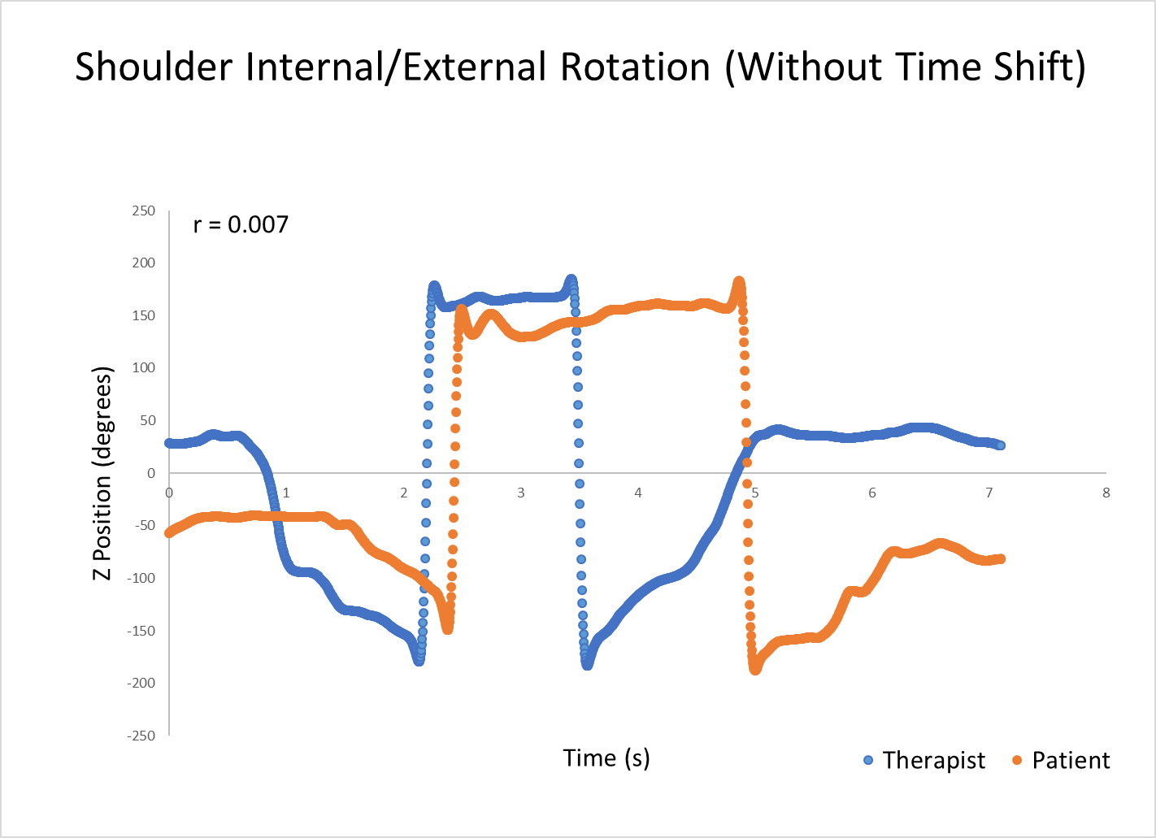
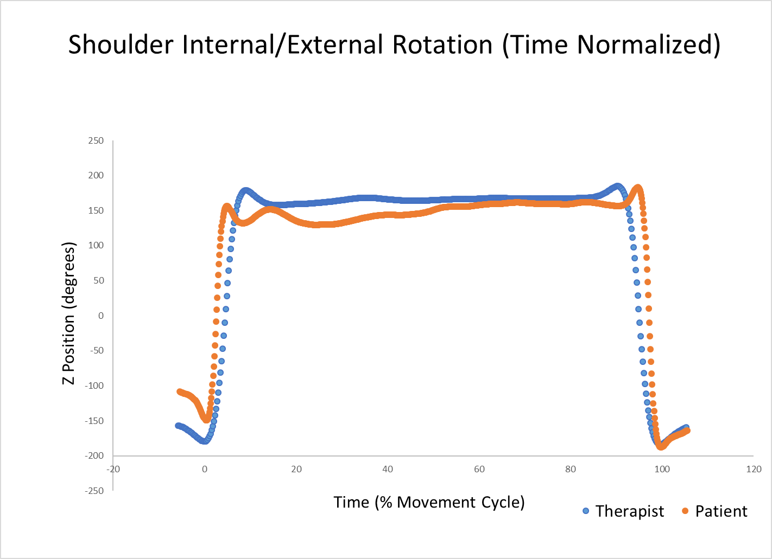
Quantifying Movement Agreement between Therapist and Patient
Casey Poirier, Dr. Thomas Foxall, and Dr. Dain LaRoche
College of Life Sciences and Agriculture
University of New Hampshire, Durham, NH
College of Health and Human Services
INTRODUCTION
METHODS
RESULTS
The current method for measuring range of motion in physical therapy practices is through the use of a goniometer, but this method can be inaccurate and limited to static measurement
Research is being conducted on new technology, such as Inertial Measurement Units (IMU’s), which are shown to accurately track motion and could potentially be used in clinical settings as a more convenient way to measure range of motion dynamically
There is a lack of research on the error that exists between a healthy individual attempting to mirror the movements of a therapist, which is essential for validating the use of motion tracking in clinical rehabilitation settings
Once we know the margin of error that naturally occurs and the issues that arise in this analysis, software could potentially be upgraded to account for these differences and a practical technique of applying the technology in clinical settings could be developed
Six 20-22 year old UNH students: one played role of therapist demonstrator and the remaining five played roles of patients
Reflective markers were placed on anatomical landmarks based on the Helen Hayes upper body model
A series of shoulder exercises were demonstrated by the student therapist and recorded using a 2D camera (figure 3)
Student patients watched the video of the therapist and mirrored the exercises in order (figure 4)
3D video motion capture (Qualisys) recorded joint angles in the x, y, and z planes
3D skeletal model applied to marker data to obtain joint kinematics in Visual3D (figure 5)
Table 1. Correlation of joint angles of therapist vs patient 1 during shoulder flexion, abduction, and rotation with and without time shift manipulation of the data.
Correlation | Flexion | Abduction | Internal/External Rotation
Without Time Shift | -0.128 | 0.219 | 0.007
With Time Shift | 0.873 | 0.843 | 0.150
Figure 3. Student “therapist” demonstrating forward shoulder flexion while wearing reflective markers on anatomical landmarks.
Figure 6. Joint angles of therapist and 5 patients performing forward shoulder flexion.
Figure 8. Shoulder internal/external rotation of therapist vs patient with time shift applied.
Figure 1. Standard goniometer used by physical therapists to measure range of motion in patients.
Figure 2. Individuals wearing Inertial Measurement Units (IMU’s) as a way to measure movement and joint angles.
PURPOSE
To test the ability of young, healthy individuals to mirror a demonstrated exercise
To develop a quantitative approach for evaluating movement agreement between therapist and patient
Figure 7. Shoulder internal/external rotation of therapist vs patient without time shift applied.
Figure 9. Shoulder internal/external rotation of therapist vs patient with time normalized.
CONCLUSIONS
HYPOTHESES
There is natural variability in movement when individuals attempt to mirror another individual’s exercise patterns
Many technical and statistical issues involved in this technique of motion analysis, such as a lag in start time of the exercise, time taken to perform the exercise, and over or under extension of the patient relative to the therapist, were identified when interpreting data
A movement agreement score that could account for the difference in time taken to execute the motion should be utilized to allow new technology in clinical settings to be utilized
H₁ Substantial variability will exist between the shoulder joint angles of a therapist and a healthy patient while performing the same shoulder exercises in real time
H₂ Quantifying movement agreement will be difficult because of the inability of the patient to perform the same motion in the same time frame as the therapist, resulting in different range of motion measurements
Figure 4. Student “patient” mirroring external rotation of shoulder with Qualisys 3D marker overlay.
Figure 5. Visual3D skeletal model while student “therapist” demonstrated forward shoulder flexion.
INTRODUCTION
Older adults spend nearly ten hours of the waking day sedentary, which increases the risk for loss of function and disease progression
Physical activity and sedentary behavior may be partially mediated by physiological determinants of walking effort
Exercise interventions have the potential to reduce walking effort and positively affect physical activity behavior

