Slide 1
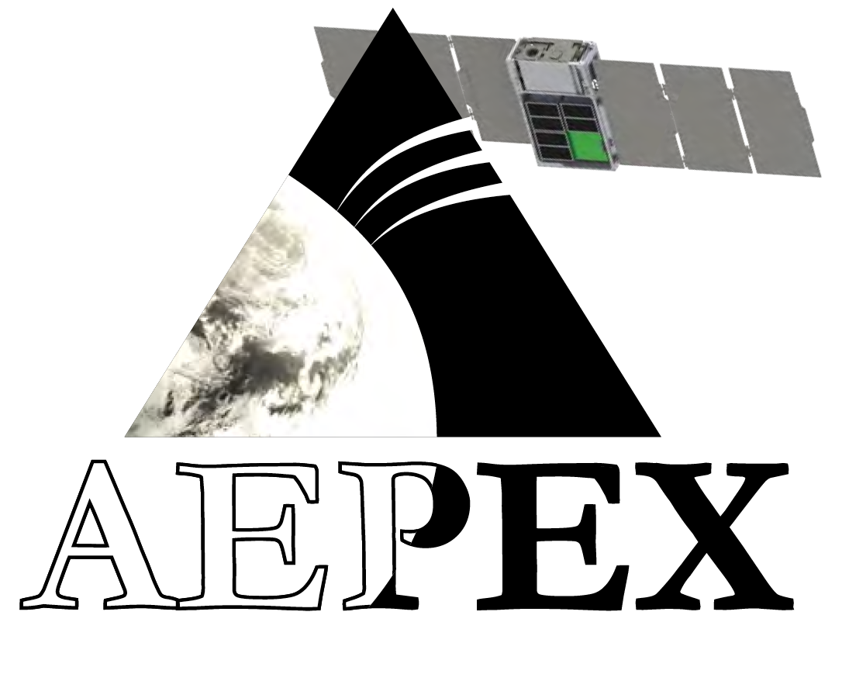



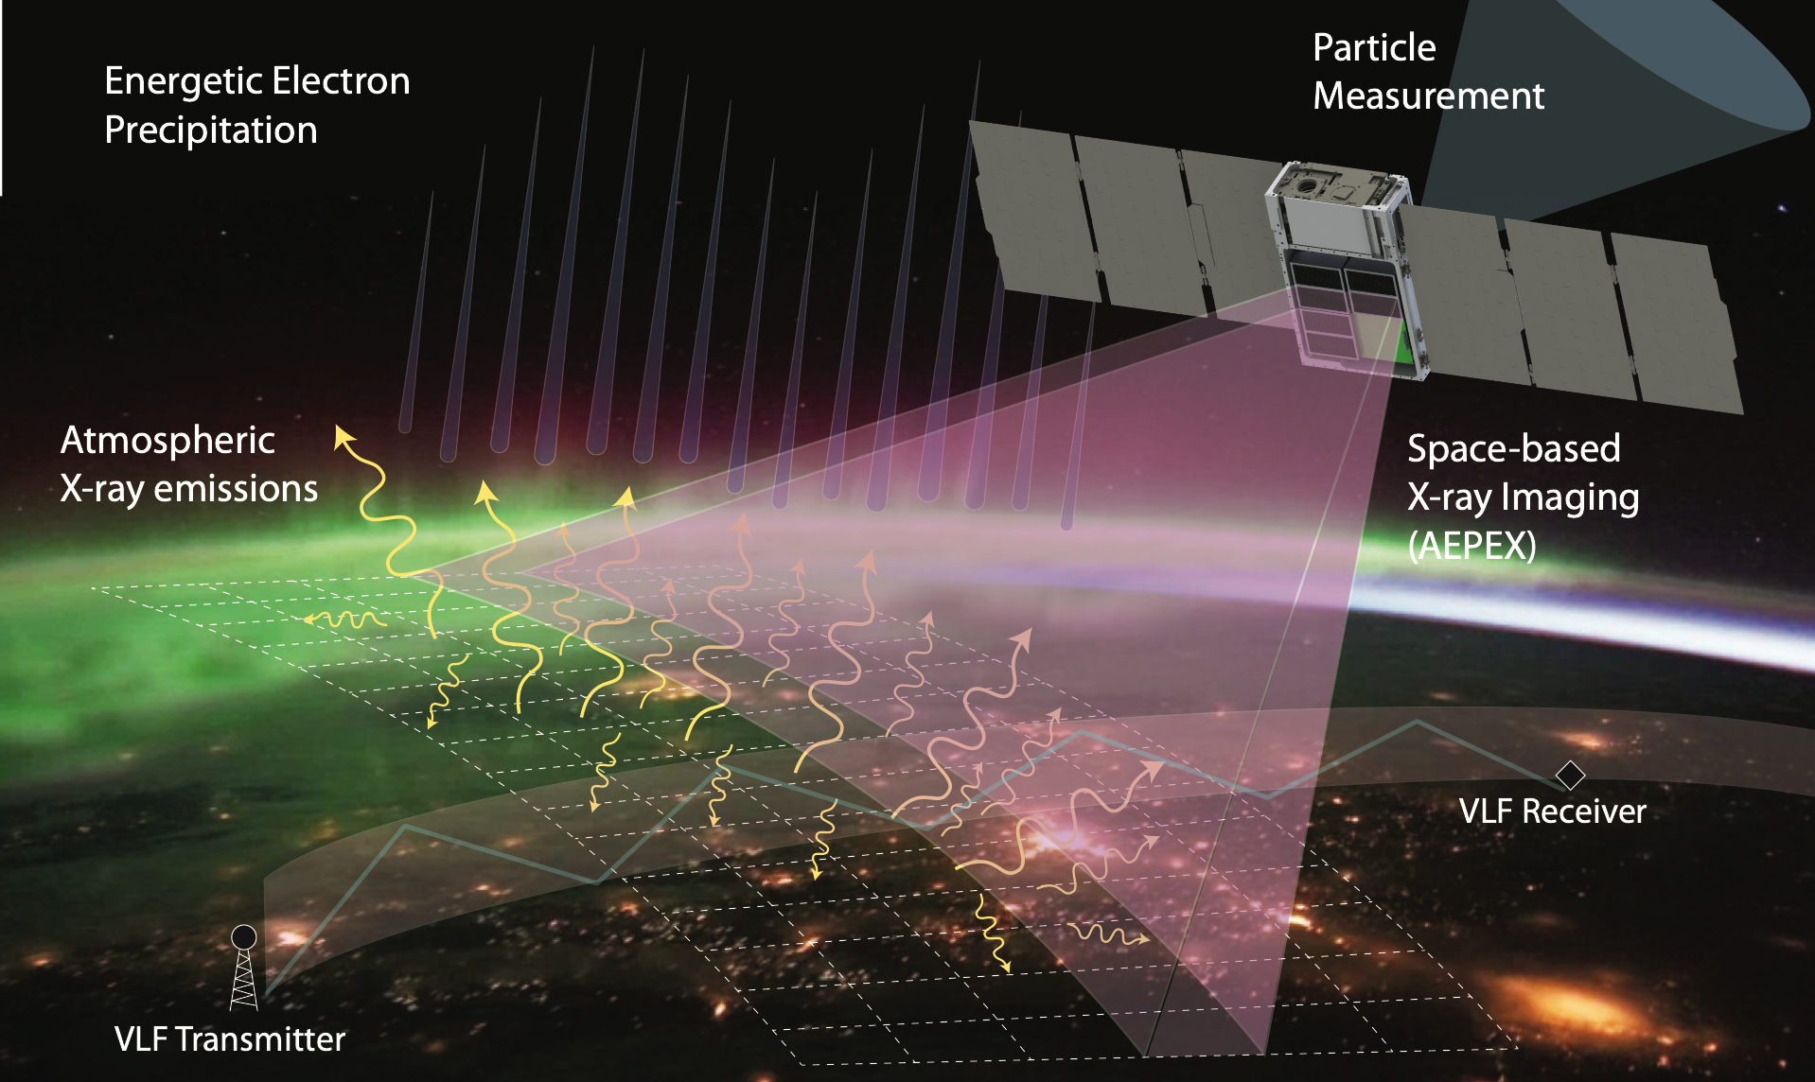
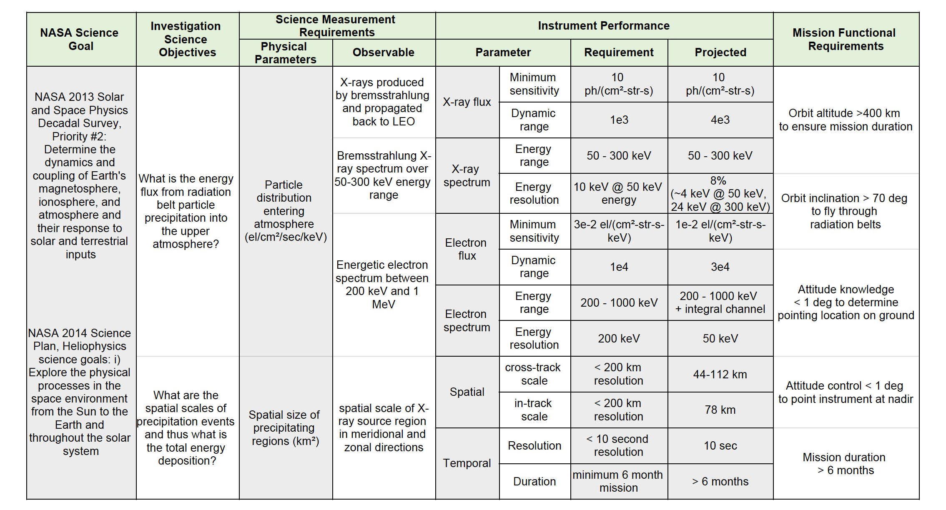
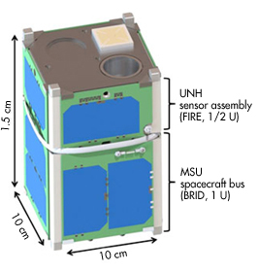

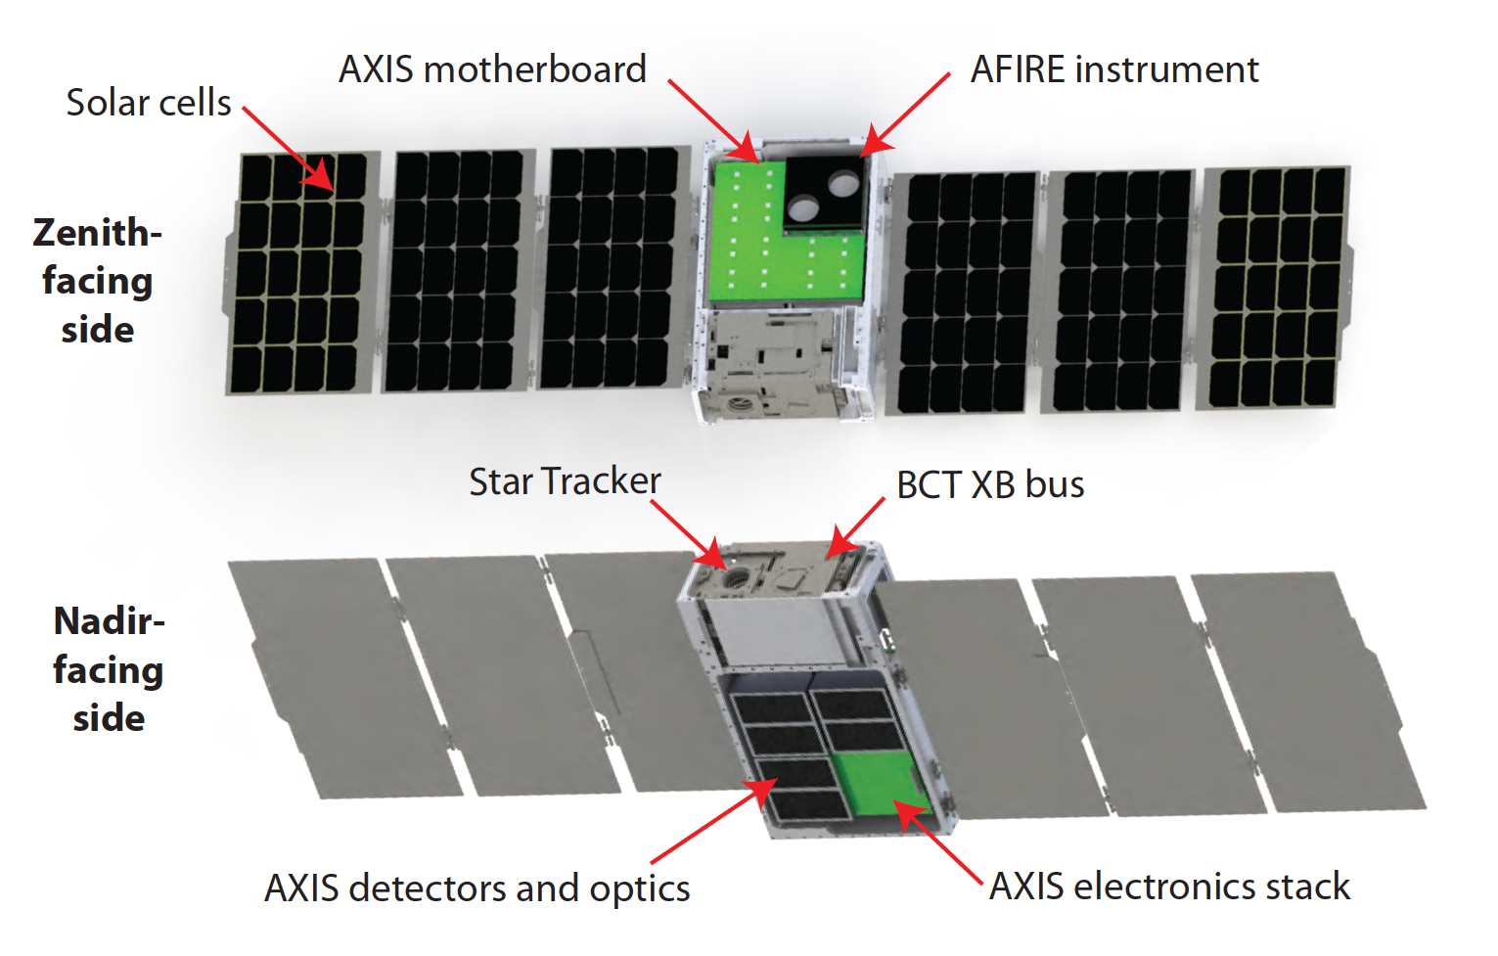
A Summary of the AEPEX CubeSat mission
and AFIRE instrument
Sonya Smith¹, Harlan Spence¹, and Robert Marshall (AEPEX PI)²
on behalf of the entire AEPEX and AFIRE Team
¹University of New Hampshire/Space Science Center, ²University of Colorado Boulder
Mission Overview:
AEPEX (Atmospheric Effects of Precipitation through Energetic X-rays) is a NASA H-TIDeS 6U CubeSat mission currently in Phase A. We propose to launch AEPEX into a high-inclination, low Earth orbit in 2021. The overarching goal of AEPEX is to better understand the influence of the magnetosphere on the Earth’s atmosphere through energetic particle precipitation (EPP). One of the key uncertainties in reaching closure on how EPP impacts the atmosphere is the lack of knowledge regarding how much energy is actually input to the atmosphere via EPP. To address this uncertainty, the primary objective of AEPEX is to quantify the energy deposition to the atmosphere from energetic particles that precipitate from the radiation belts and other sources.
Science Questions:
The AEPEX mission will characterize the energy input into the atmosphere due to EPP during background conditions as well as geomagnetic storms, substorms, and other events. It will accomplish this by a) measuring the X-ray flux emitted by the atmosphere and the precipitating electron distribution, and using these measurements to determine the precipitating flux and energy deposition; and b) imaging the X-ray emitting region to measure the spatial extent of precipitation events. Using these measurements, the AEPEX CubeSat mission will address two science questions:
SQ1. How much energy is deposited into the upper atmosphere through EPP? How is it related to geomagnetic storm and substorm activity? How does it vary over seasons, latitudes, and magnetic local time?
SQ2. What is the spatial scale of precipitating regions during EPP events? What does this tell us about the total particle and energy flux removed from the radiation belts and deposited in the atmosphere?
Figure 1: AEPEX will image X-rays produced by bremsstrahlung in the upper atmosphere due to energetic particle precipitation. It will thus provide measurements of the energy deposited by the precipitation and the size of precipitation regions.
AEPEX will accomplish these goals using a novel X-ray imaging instrument (AXIS), for the first time providing direct spatial measurements of energetic particle precipitation, together with a loss-cone particle detector (AFIRE) to measure the precipitating electron spectrum. Histograms of X-ray counts will be measured with 10 second time resolution and 50–100 km spatial resolution, covering the high-latitude regions of the Earth’s atmosphere, i.e. the radiation belts and ring current regions in LEO. These measurements will provide maps of X-ray emissions and their parent EPP fluxes on short timescales, as well as longer-term integrated emissions over the duration of substorms and geomagnetic storms, and very-long-term seasonal and MLT integrations. Integrated emissions will be used to determine the total precipitating energy over the duration of these events.
AFIRE Instrument Summary:
The AEPEX FIREBIRD Instrument for Relativistic Electrons (AFIRE) is a copy of the successful FIRE payload from the two NSF-funded dual-CubeSat FIREBIRD missions [Spence et al., 2012; Klumpar et al., 2015; Crew et al., 2016]. The instrument includes two solid-state detectors, one with a 180°field-of-view and one with a 45°field-of-view, i.e. within the atmospheric loss cone. Both detectors measure electrons from 200 keV to 1 MeV in 16 energy channels, along with an integral channel for electrons with E > 1 MeV (FIRE used only six energy channels in order to reduce data volume, but it is capable of 10 keV energy resolution). The two detectors have geometric factors of 9 (loss cone) and 23 (omnidirectional) cm²-str and time resolution of 20 ms; for AEPEX, data will be binned in time to reduce the data volume. The instrument uses less than 0.5U volume, weighs 252 grams, and consumes 117 mW of power during continuous operation.
FIRE instrument model (left) and engineering unit (right) = AFIRE.
For more information:
Mission Website: http://culair.weebly.com/small-satellites.html
AEPEX questions: Robert.Marshall@colorado.edu
AFIRE questions: Sonya.Smith@unh.edu; Harlan.Spence@unh.edu

