Slide 1
Yining Zhang
Political Science – COLA
Subject: The Willingness to Have Children
Date of presentation: 4/26/2019
Please don’t print this page. Thank you.

Slide 2

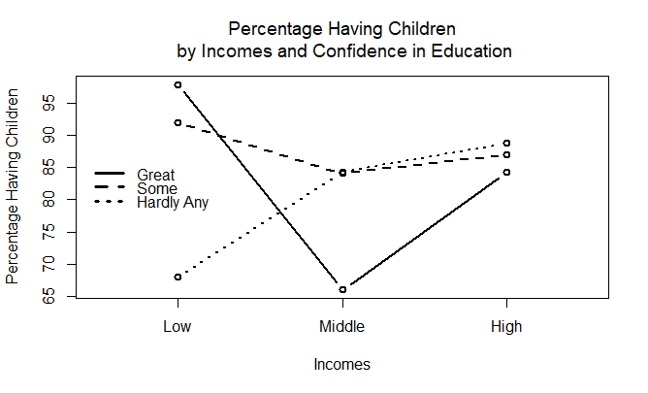
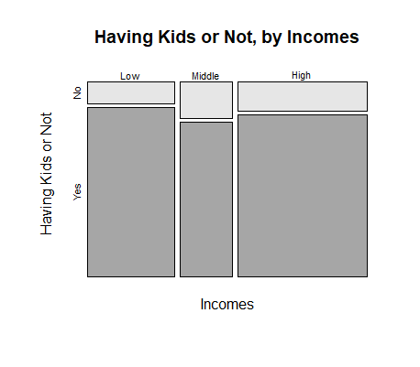
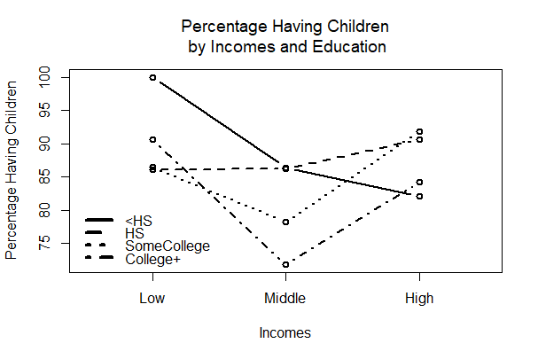
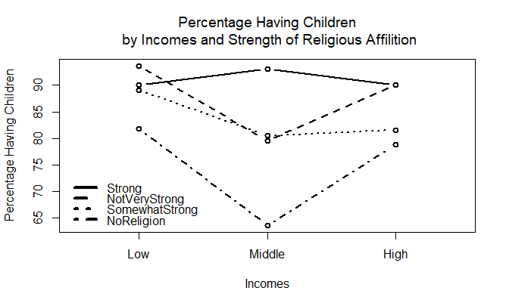
Willingness to
Have Children
Yining Zhang
Department of Political Science
University of New Hampshire Durham NH
Introduction
Data Analysis
As the living standard increases, people’s willingness to have children has been declining these years.
A large number of researchers say that income is a significant factor in determining willingness to have children.
Are there other factors?
Figure1:
The Chi-square shows us the P-value is 0.07.
As a result, the relationship shown in this chart may be resulted from random sampling error.
Literature Review
Figure 4
Figure4:
When people have hardly any confidence in education, their willingness to have children goes up from low income to high income.
After World War II, in about two-thirds of the developed countries, fertility rates are now close to or below replacement levels (Barber 1979).
When incomes are higher than people’s expectation of the amount of money they need to have a decent life, birth rates would rise (Easterlin 1966). This is about the influence of relative incomes on willingness to have kids.
While a number of researches talked about relative incomes, my research focuses more on absolute income.
P-value: 0.07
Figure 1
Figure2:
When people have less than high school education, their willingness to have children goes all the way down from low income to high income.
Conclusion
The working hypothesis is false.
Under most circumstances, people with middle incomes are less willing to have children, while people with low and high incomes are more willing to have children.
Education, religious affiliation and confidence in education are having significant impacts on willingness to have children. They even change the original pattern under some circumstances.
Methodology
Figure 2
Quantitative Statistics are from GSS database. (The General Social Survey (GSS) collects information and keeps a record of the concerns, experiences, attitudes and practices of residents of the United States.)
Data Analysis: RStudio
Figure3:
When people have strong religious affiliation, the pattern in Figure1 is reversed.
References
Hypothesis
Notestein, F. W. (1967). The population crisis: Reason for hope. Foreign Affairs (Pre-1986), 46(000001), 167.
Feng, Y., Kugler, J., & Zak, P. J. (2000). The politics of fertility and economic development. International Studies Quarterly, 44(4), 667-693.
In comparison of individuals, people with higher incomes are more willing to have children than those with lower incomes.
Figure 3

