Slide 1

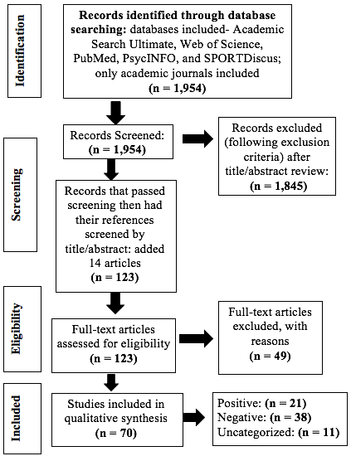
Positive and Negative Aspects of Youth Football Participation in Relation to Socio-Emotional Wellbeing: A Systematic Review
Sarah Wildes, Dr. Amy Ramage, & Dr. Erik Swartz
Communication Sciences and Disorders
Background
Methods cont.
Results cont.
• Currently, there is growing controversy surrounding football participation because of worry that participation may results in later-life impairment
• Media reports on CTE, numbers across the nation dropping, NFL athletes retiring early– it is hard to know what is true and what is not
• Youth football is of particular interest because this is where the numbers are highest across all levels of play [1]
• It is argued that youth receive benefits by participating in football, especially in development of social and life skills– for example learning what it takes to “be a man” [2]
Specific Aims
Are there positive and/or negative aspects to youth football participation in relation to socio-emotional wellbeing?
If there are different positive and negative aspects, what are they?
How do parents, coaches, and they football culture play into these positives and negatives?
Identify themes that relate to players’ socio-emotional wellbeing that present throughout the literature
Figure 4. Distribution of articles across themes and classified as “positive”, ”negative” and “uncategorized”
Conclusions
Concussion Education
Moral Atmosphere
Emotional Status
• Conflicting results
• Preexisting emotional wellbeing
Athlete Identity
Social Support/
Relationships
Masculinity
Four Stakeholders: professionals, parents, coaches, and athletes
Warrior Mentality
Influences Reporting
Violence & Aggression
Servant leadership
Autocratic v. Democratic style
Initial Pressure
Methods
Figure 1. The flow chart above outlines the steps that were taken to sort through articles identified to the final studies that were included for qualitative synthesis
Inclusion Criteria:
Exclusion Criteria:
Results
Concept | Terms Used
Sport | (football OR “American football”)
Population | AND (youth* OR adolescent* OR "young adult" OR teen* OR parent* OR coach*)
Study Focus | AND (social* OR emotion* OR efficacy OR attitude OR percept* OR "mental health” OR pressure)
Exclusion | NOT (soccer OR rugby)
Topics resulting in a study being removed:
• duplicates
• not ”American” football (specific culture; other countries excluded)
• not written in English
• results did not address a component of socio-emotional wellbeing of athletes
• studied populations outside of the youth, high school, or collegiate level
• biased literature (essay, literature review that were not systematic, etc.)
Figure 5. Venn diagram illustrating the relationship between the themes. It is important to note that across the literature, there were overlaps of themes within studies, however there were no articles that encompassed all themes.
Relevance
References
Figure 2. Classification of articles as “positive”, “negative”, and “uncategorized” (left).
Figure 3. Distribution of articles across the identified themes (right). MA= Moral Atmosphere, C= Concussion Knowledge, AI= Athlete Identity, SS/R= Social Support/Relationships, M= Masculinity, ES= Emotional Status
•ASHA Scope of Practice describes one role of an SLP being: “Educate parents of children involved in contact sports about the risk of concussion” [3]
•SLPs in schools are often times responsible for return-to-play (RTA) protocol- important to know what else the child may be experiencing
•It is important for all health professionals to give insight into all possible pros and cons of youth football participation, to give parents and players the ability to make well-informed, unbiased decisions.
[1] Daniel, R. W., Rowson, S., & Duma, S. M. (2014). Head Impact Exposure in Youth Football: Middle School Ages 12–14 Years. Journal of Biomechanical Engineering,136(9), 094501. doi:10.1115/1.4027872
[2] Steinfeldt, J. A., Foltz, B. D., Mungro, J., Speight, Q. L., Wong, J. Y., & Blumberg, J. (2011). Masculinity Socialization in Sports: Influence of College Football Coaches. Psychology of Men & Masculinity,12(3), 247-259. doi:10.1037/e613252010-001
[3] Scope of Practice in Speech-Language Pathology. (1970, January 01). Retrieved from https://www.asha.org/policy/sp2016-00343/

