Slide 1

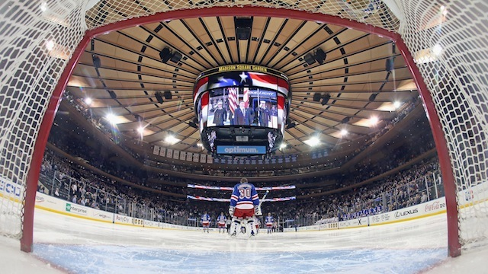
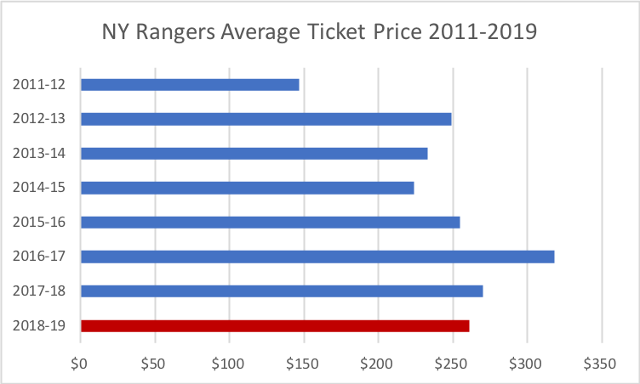
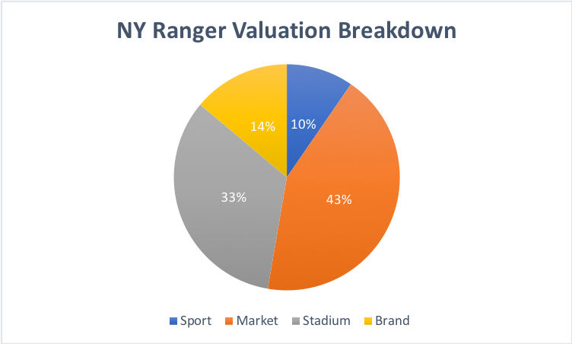
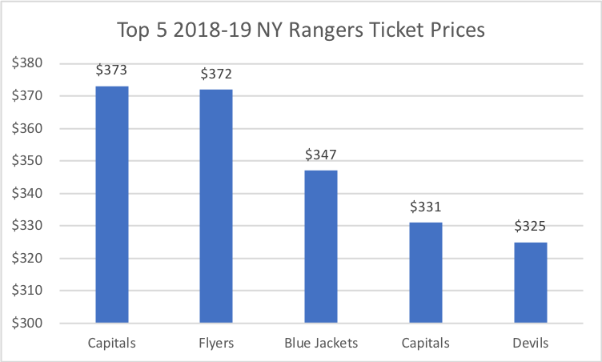
An Economic Analysis of the New York Ranger Franchise
Mario De Bueriis Economics B.A. University of New Hampshire
introduction
Economic Theory
Data
The New York Ranger franchise was founded in 1926. The New York Rangers home arena is Madison Square Garden in New York, New York.
The Rangers play in the Metropolitan Division in the Eastern Conference of the NHL.
In 1997, the franchise was purchased by the Madison Square Garden Company for 195 million dollars. As of December 2018, the New York Ranger franchise is now worth 1.6 billion dollars.
The New York Rangers are the most valued franchise in the National Hockey league by using its monopoly and monopsony power effectively and efficiently in their market.
Monopoly power within the market will allow the franchise to use strategic ticket pricing to increase profits.
Dynamic ticket pricing is a type of ticket pricing strategy that sport franchises use to change ticket prices based on consumer demand.
Popular teams, all star players, and rivals are all factors that give the Ranger franchise the ability to increase ticket prices.
Theory suggests that large market teams should be more profitable and more competitive leading to an increase of wins and championships compared to small market teams
NHL Franchise | Value
New York Rangers | $1600 million
Toronto Maple Leafs | $1500 million
Montreal Canadiens | $1300 million
Chicago Blackhawks | $1000 million
Boston Bruins | $925 million
Los Angeles Kings | $810 million
Philadelphia Flyers | $800 million
Detroit Red Wings | $775 million
Vancouver Canucks | $735 million
Washington Capitals | $725 million
Pittsburgh Penguins | $650 million
Vegas Golden Knights | $575 million
Edmonton Oilers | $540 million
Dallas Stars | $525 million
San Jose Sharks | $510 million
Minnesota Wild | $490 million
St. Louis Blues | $465 million
Anaheim Ducks | $460 million
New Jersey Devils | $455 million
Calgary Flames | $450 million
Tampa Bay Lightning | $445 million
New York Islanders | $440 million
Ottawa Senators | $435 million
Colorado Avalanche | $430 million
Nashville Predators | $425 million
Carolina Hurricanes | $420 million
Winnipeg Jets | $415 million
Buffalo Sabres | $375 million
Columbus Blue Jackets | $320 million
Florida Panthers | $295 million
Arizona Coyotes | $290 million
Data
conclusions
Source: Ticket IQ
Economic theories and patterns can be seen throughout professional sports leagues and franchises. The New York Rangers have monopoly power in the market starting by their strategic ticket pricing in order to increase revenues. Madison Square Garden can alter ticket prices when star players, attractive opponents, and rivals come to play the Rangers.
Empirical data does suggest that large market teams will bring in more revenue and value, but it does not necessarily mean that the large market team will me more successful when it comes to wins and championships. A perfect example is comparing the New York Ranger and Nashville Predators. New York is the most valued NHL franchise at $1.6 billion, and Nashville is one of the least valued team at $425 million. Although, Nashville continues to win games and make the playoffs for the past four consecutive years while the Rangers have missed the playoffs the past two years.
Overall, the New York Ranger franchise does conduct monopoly power in the market allowing them to be the most valued franchise in the NHL.
Source: Forbes, 2018
Source: Ticket IQ

Slide 2
This poster template provided courtesy of
UNH ESRC Poster Printing Services
Trust us to make your poster look GREAT!
Website: http://posters.unh.edu
Poster Guide: http://goo.gl/1E7TJY
DELETE THIS SLIDE BEFORE PRINTING

