Slide 1

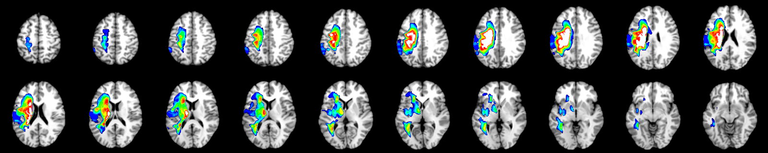

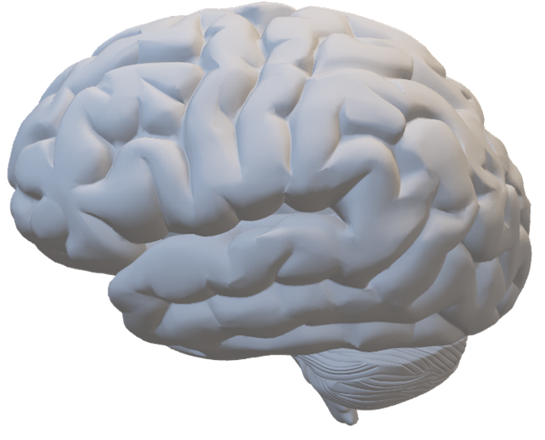
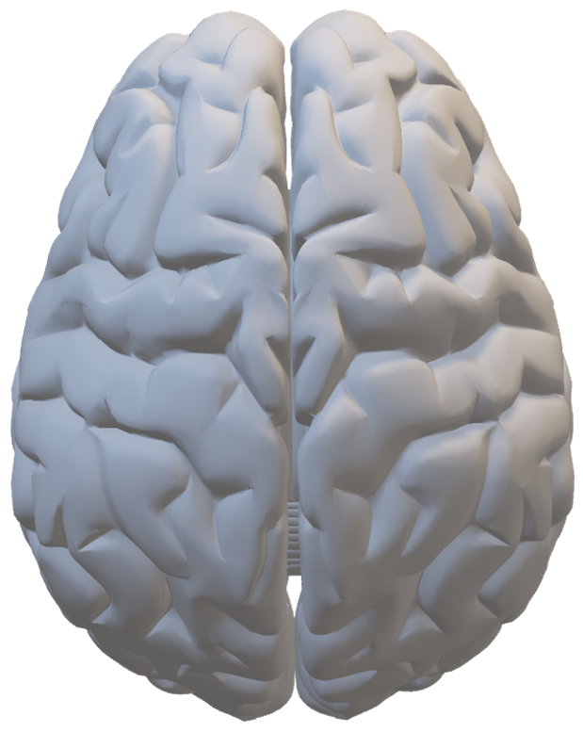
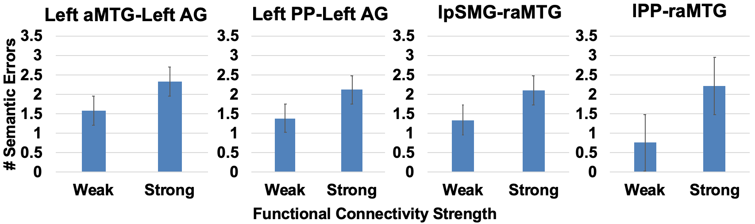
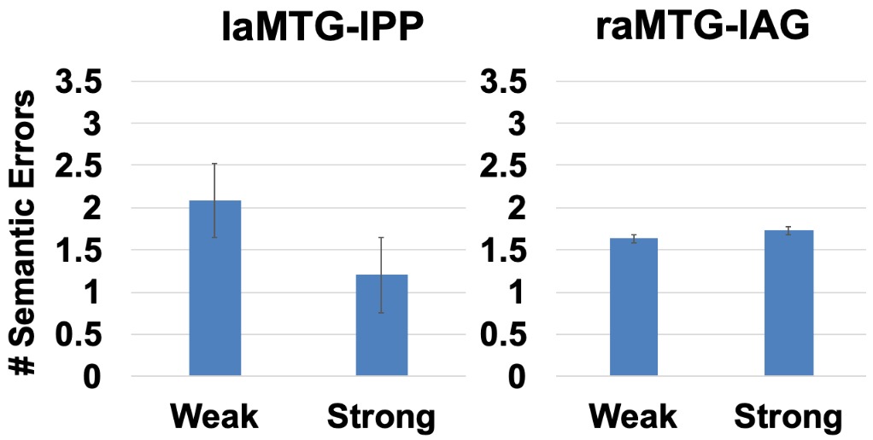
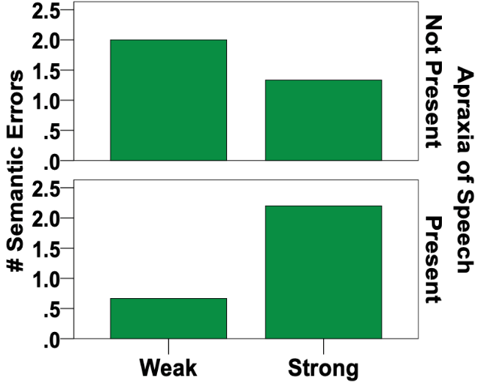
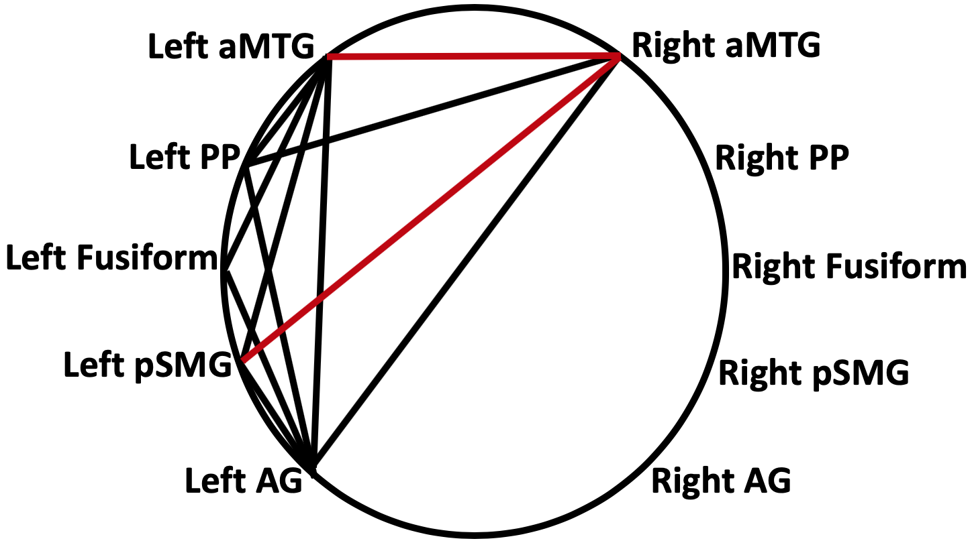


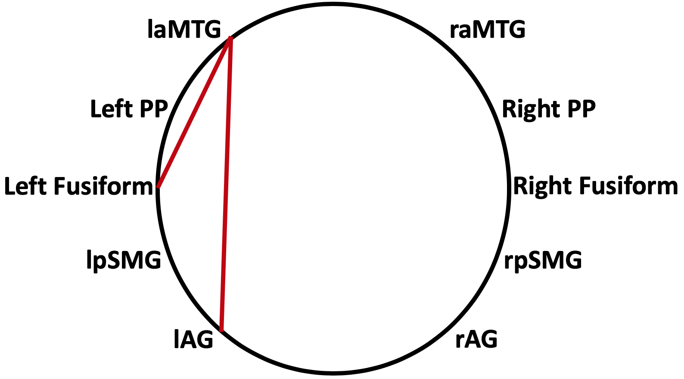
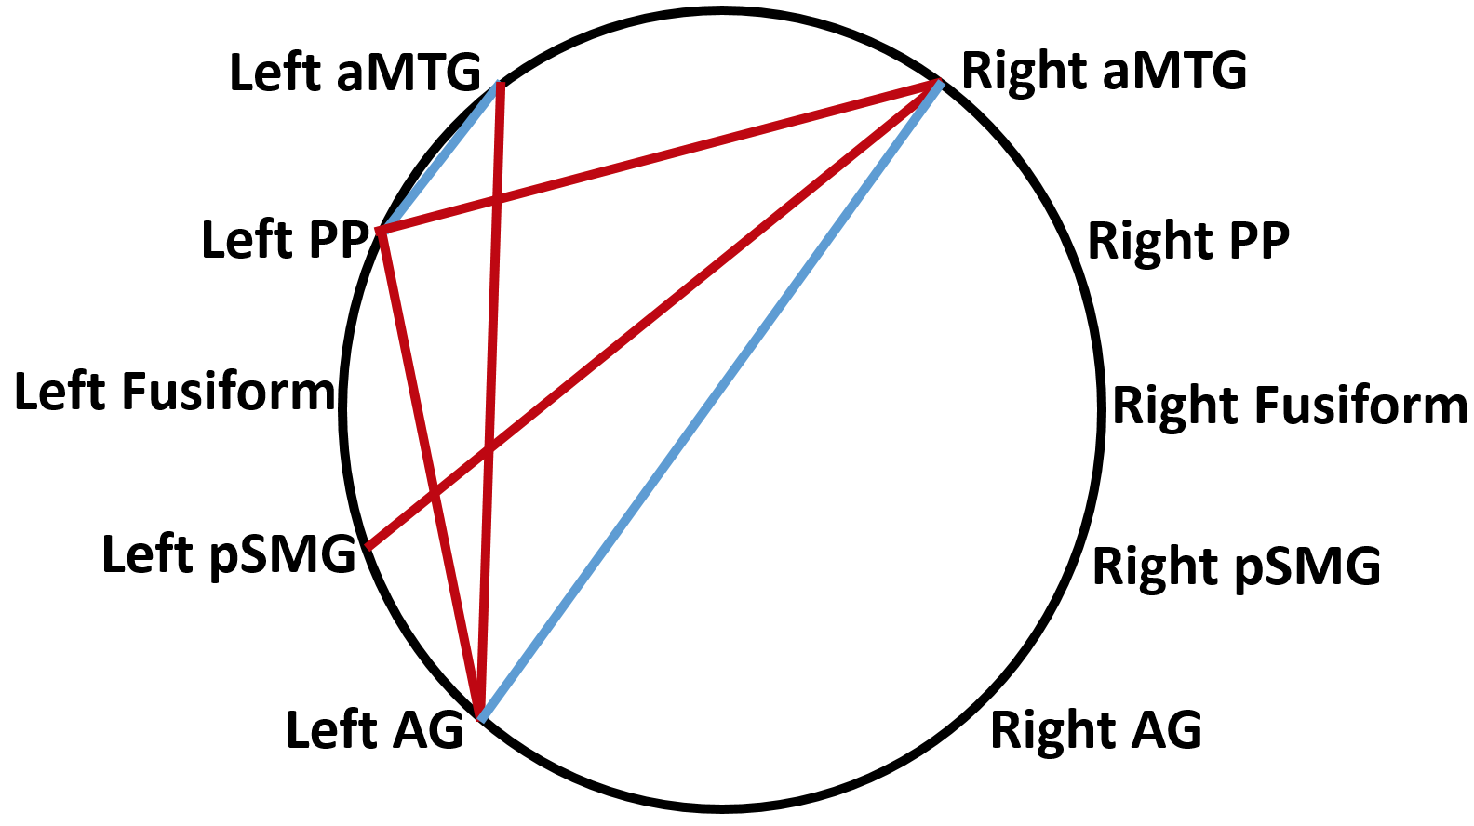
Semantic Network Resting State Connectivity in Healthy Controls and Stroke Victims
Cognition Brain and Language Team
Jessica N. Lee Advisor: Amy E. Ramage, Ph.D. Committee: Donald A. Robin, Ph.D. and Kirrie J. Ballard, Ph.D.
Introduction
Participants
Predicting Semantic Performance and Errors
Aphasia is an acquired language disorder resulting from a focal brain lesion in the left hemisphere.¹ Language in aphasia is characterized by deficits in lexical retrieval, comprehension of auditory information, repetition and fluency. Verbal output may contain errors in semantic, phonologic, and speech quanta (amount and ease of verbal production).
Neuroplasticity in aphasia recovery can be an adaptive process of reactivation or reorganization, but can be maladaptive and result in persistent errors.¹ Thus, it is important to understand the reorganization of the brain following stroke in terms of adequate and impaired performance.
Here we focus on semantics in connected language performance in 22 people with aphasia (PWA) and 18 healthy control participants. Semantics, in this study, is assess in a picture description task for: semantic errors (SE) or paraphasias, significant pauses indicative of lexical retrieval deficits, aphasia severity, and the variety of different types of words used (type-toke ratio, TTR).
We investigate the relationship between the brain regions responsible for semantics (a semantic brain network), and how these relationships are altered in aphasia, using resting-state functional magnetic resonance imaging (rsfMRI).
Participants: Mean age = 63.5; Mean years education = 15; Mean MPO = 46; Mean lesion volume = 87 cm3, Mean AOS severity y= 2.1; Mean WAB AQ = 73.4; Number of Females= 4; Number of Males= 18
Group Differences in Functional Connectivity. Network connectivity was similar among both controls and patients in three connections: laMTG-raMTG, lpSMG-lAG and raMTG-lAG. All other connections were unique solely to either controls or patients. Red connections indicate statistically significant differences in which controls > patients for connectivity strength.
Semantic Access. Stronger connectivity between the left aMTG and the (1) left fusiform gyrus and the (2) left AG predicted higher performance on Factor 3, the ‘Semantic’ factor.
R_{adj}² = .44, F_{2,19} = 9.4, p = .002
y = 1.981 (laMTG-lFusi) + 2.338 (laMTG-lAG) - .483
z=56
z=26
Figure 1. Lesion overlap map for all 22 stroke patients. Blue indicates overlap of few patients, red/white indicates multiple subjects had lesions in that area. The main brain structures with lesions in multiple patients include the caudate nucleus (body and tail), premotor cortex, and extending into the postcentral gyrus.
AG
aMTG
Data Analysis:
Reliability of transcription of the language samples was difficult to obtain across raters (n = 2), but they met and came to consensus for total number of utterance, retracing, repetition, semantic errors, circumlocutions, and significant pauses
Resting-state images were pre-processed in SPM, lesion tissue was classified, and EPI images were corrected for movement and spatially normalized to the MNI brain template.
Pearson correlations were computed between the extracted time series of each of the ROIs to examine connectivity. r-values were transformed to Fisher’s Z values (connectivity strength). Paired t-tests compared groups.
Principal Component Analysis of CHAT/CLAN picture description data was performed to find a factor that was loaded with semantic features.
Univariate analyses and linear regression with backward, stepwise elimination were used to determine whether functional connectivity amongst the regions of interest could predict amount/percentage of errors (semantic paraphasia, significant pauses) committed in picture description, or performance in components from PCA. The latter were corrected for lesion volumes.
aFusi
Semantic errors were predicted in part by the presence of apraxia of speech (AOS), along with stronger or weaker connections as depicted in Figure 3.
R_{adj}² = .66, F_{8,13} = 6.1, p = .002
y = -.287(AOS severity) – 5.143(laMTG-lPP) + 3.51(laMTG-lAG) + 8.947(lPP-raMTG) + 4.407(lPP-lAG) + 2.89(lSMG-raMTG) - 2.71(raMTG-lAG)+4.412
Specific Aims
Research Questions:
Are there group differences in semantic network connectivity?
  Hypothesis 1: The healthy control group will have stronger semantic network connectivity than the patient group.
Does strength of connectivity relate to semantic access during language performance in persons with aphasia?
  Hypothesis 2: As the strength of connectivity decreases, the semantic access during language performance will decrease.
aMTG
aMTG
PP
SMG
AG
Methods
Functional Connectivity and Semantics
Participants were: Native English speakers, right handed, had no contraindications for undergoing MRI, no previous cognitive impairments, and had suffered a left hemisphere stroke with speech complaints.
Language Test Battery for patients included Western Aphasia Battery-revised, in particular the WAB Content and Picture Description subtest of the WAB and subsequent language measures & semantic errors gained from its CHAT/CLAN transcription.
Semantic Performance Measures included: WAB Content, Components gained from PCA of language measures from transcription evaluation, number of semantic errors, and number of significant pauses.
Regions of Interest (ROIs): the following ROIs have been found significant for semantic processing: anterior middle temporal gyrus (aMTG), planum polare (PP), anterior fusiform cortex (aFusi), posterior superior marginal gyrus (pSMG), angular gyrus (AG).^{2,3}
Proposed Semantic Network included left and right homologues of: aMTG, PP, aFusi, pSMG, AG.
Figure 4. Stronger connectivity between the regions in the top row while weaker connectivity between regions in the bottom row predicted more semantic errors. For the raMTG-lAG connection, in general stronger connectivity correlated with more SE. However, when divided by presence of AOS, it is clear that for those without AOS, weaker connectivity predicts more semantic errors.
Controls
Patients
Conclusion
Figure 2. Network connectivity for all participants, controls only, and patients only. Red = statistically significant differences in which controls > patients for connectivity strength.
Connections present in all/controls only: stronger connections correlated with more semantic access/ fewer semantic errors
  Stronger connections = more intact semantic access
Connections present in only patients: stronger connections correlated with more SE
  While the laMTG was a ‘hub’ of connectivity in the controls, it had only one connection in the Patients, rather the lPP was the focal point for left temporal connectivity. This may be evidence of maladaptive neuroplasticity in these regions.
The role of the raMTG in the semantic network highlights its importance in semantic access, but when its connection with other ROIs is altered semantic errors occur.
References
Figure 3. Connections predicting semantic access (left) and errors (right). Red = positive prediction. Blue = negative prediction.
[1] Spielmann, K., Durand, E., Marcotte, K., & Ansaldo, A. I. (2016). Maladaptive Plasticity in Aphasia: Brain Activation Maps Underlying Verb Retrieval Errors. Neural Plasticity, 2016, 1-11. doi:10.1155/2016/4806492
[2] Halai AD, Woollams AM, Lambon Ralph MA (2016) Using principal component analysis to capture individual differences within a unified neuropsychological model of chronic post-stroke aphasia: revealing the unique neural correlates of speech fluency, phonology and semantics. Cortex, 86, 275-289. doi:10.1016/j.cortex.2016.04.016
[3] Seghier, M. L., Fagan, E., & Price, C. J. (2010). Functional Subdivisions in the Left Angular Gyrus Where the Semantic System Meets and Diverges
from the Default Network. Journal of Neuroscience, 30(50), 16809-16817. doi:10.1523/jneurosci.3377-10.2010

