Slide 1


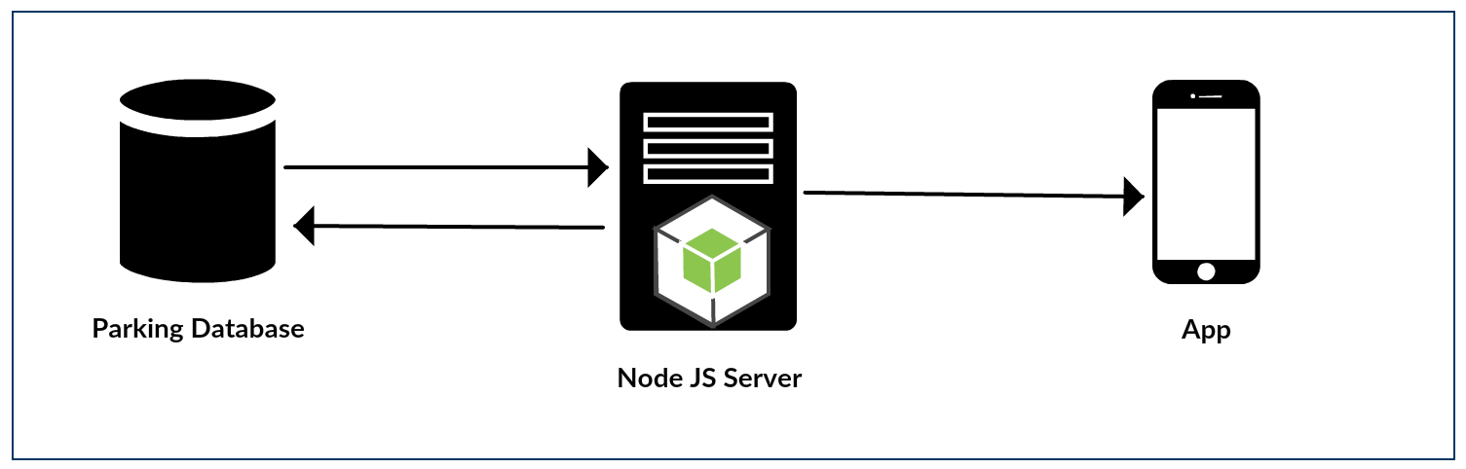
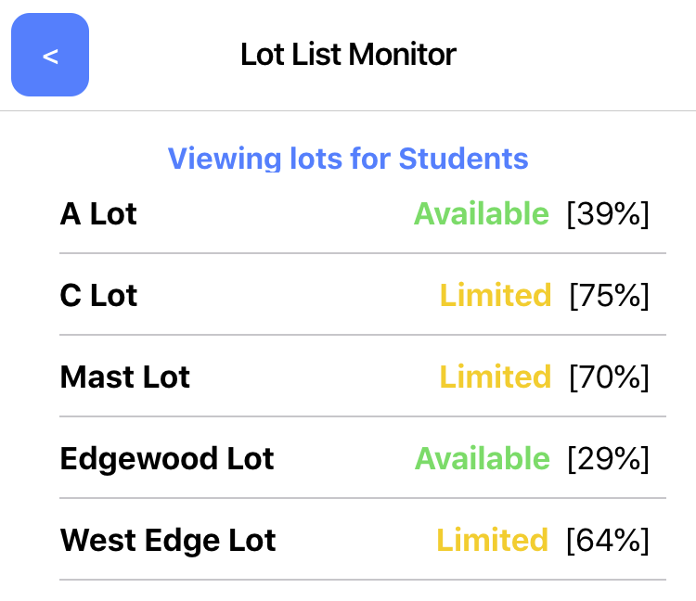
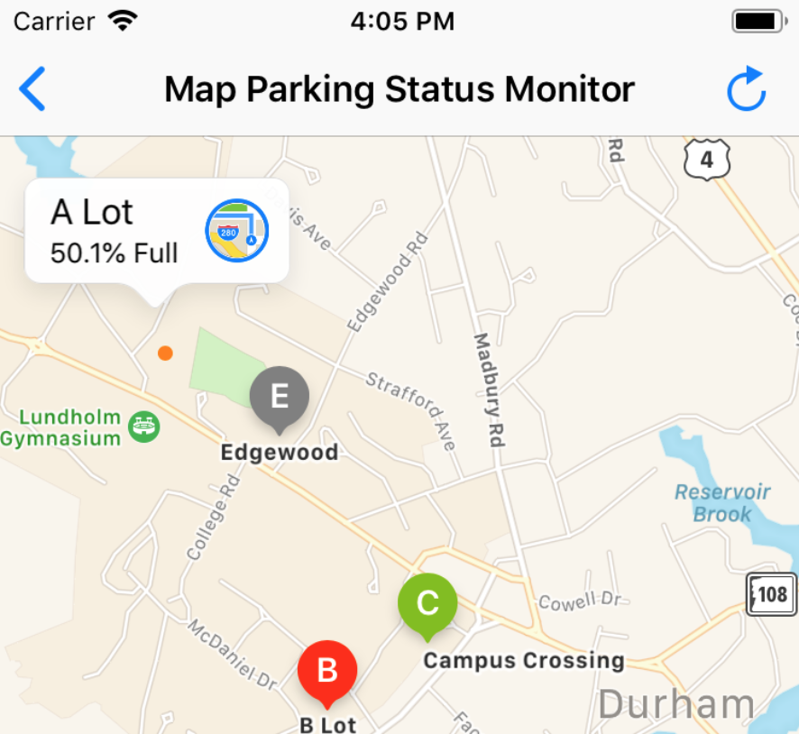
Spotter: A Campus Parking Solution
By: Andrew Chorlian, Matthew Ferullo, Philip Kessler, Michael Leroux,
Christopher Puda, and Chase Sanville -- Advisor: Scott Valcourt
Department of Computer Science, University of New Hampshire, Durham, NH
Problem
Parking on campus can be a time-consuming endeavor
It is difficult to know if a parking lot is available without going to the actual location
Visitors can easily get confused when trying to find a place to park
Network Diagram
The app interacts with a node.js server to receive information from the database
Front-End
Solution
An app that offers a quick, easy way to view parking lot availability
Designed for both iOS and Android
Tailors experience for Visitors, Students, and Faculty
iOS app is integrated with Apple Maps to show directions to parking lots
Helps reduce carbon emissions that come from traffic and idling
Current Status
The server currently supports the PlacePod PNI Sensor data format, which means the only bottleneck is the installation of sensors.
Challenges
Next Steps
Eventual integration with Modo Labs, which is the platform UNH uses for Wildcat Transit's NEXTBUS predictions.
Potentially incorporate parking sensor data into digital signs at the common entrances of the UNH campus
Getting sensors installed and having them provide data to the server
Addressing the primary concerns of Parking Services in our project's vision
Working with cold parking sensor data
Keeping a database running continuously while sending data
Integrating Google Maps with its monthly cost
Adjusting for UI/UX differences in Android & iOS

