Slide 1


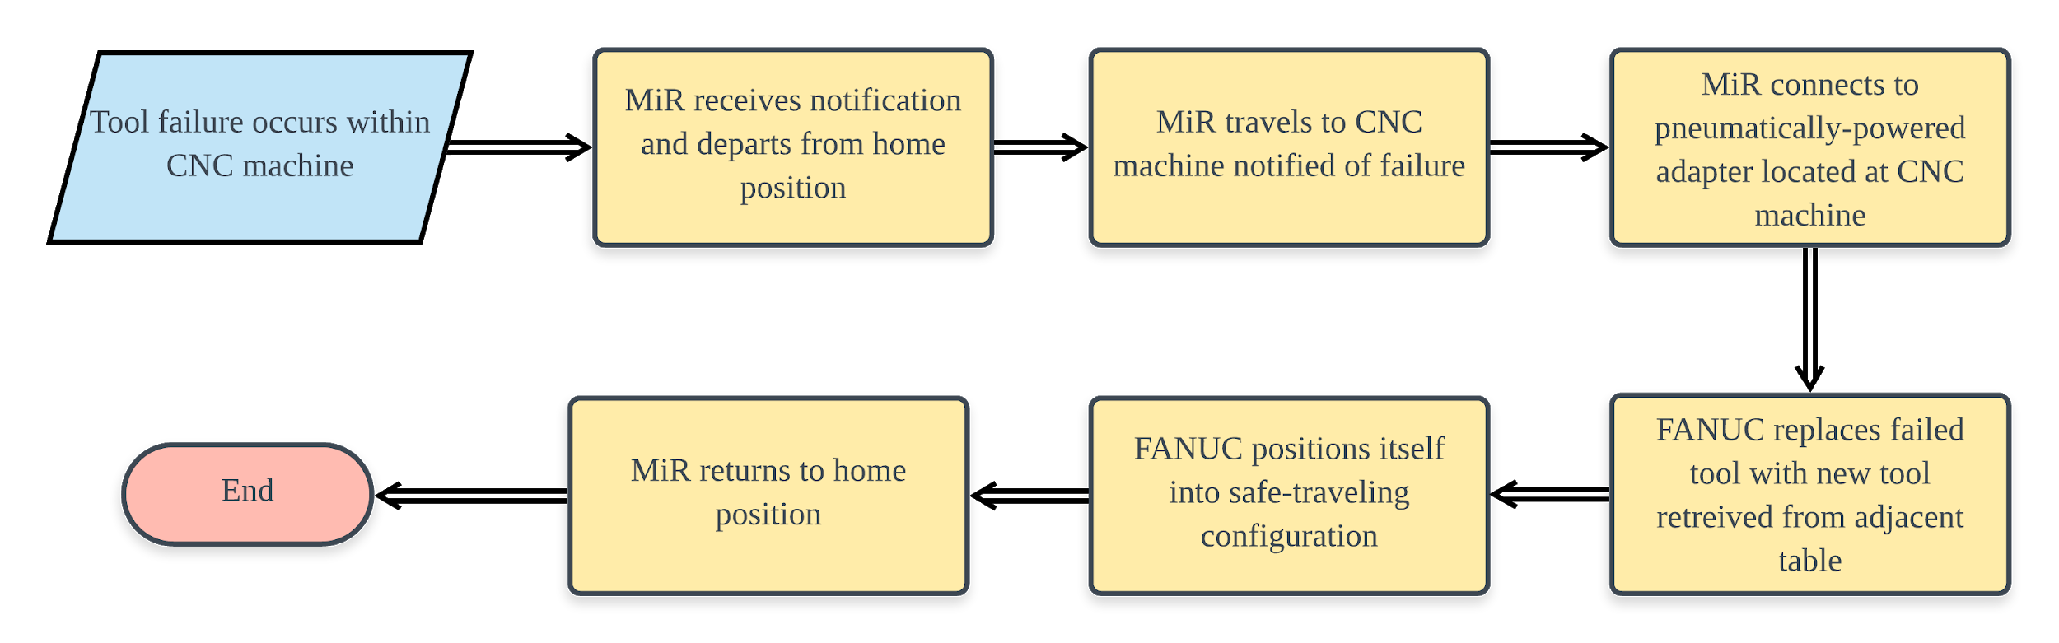
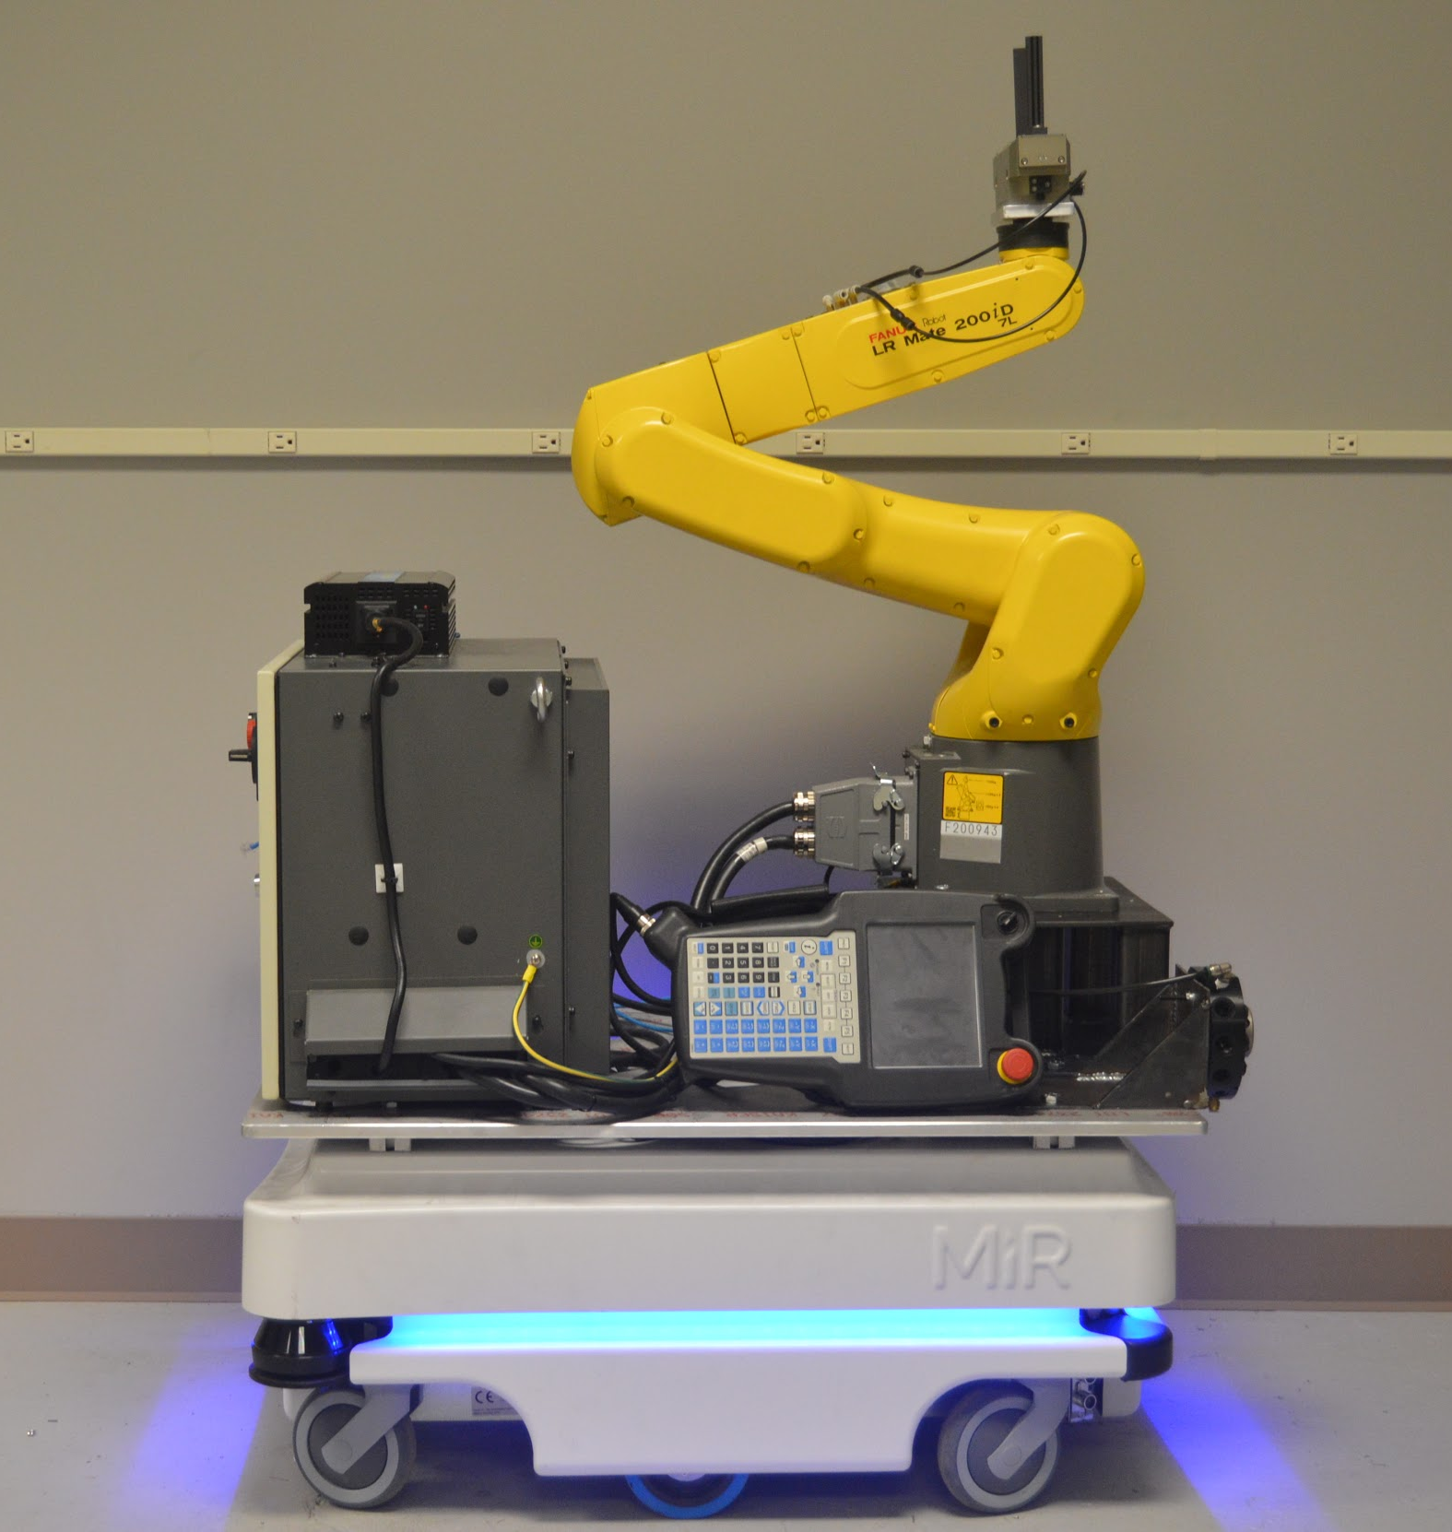
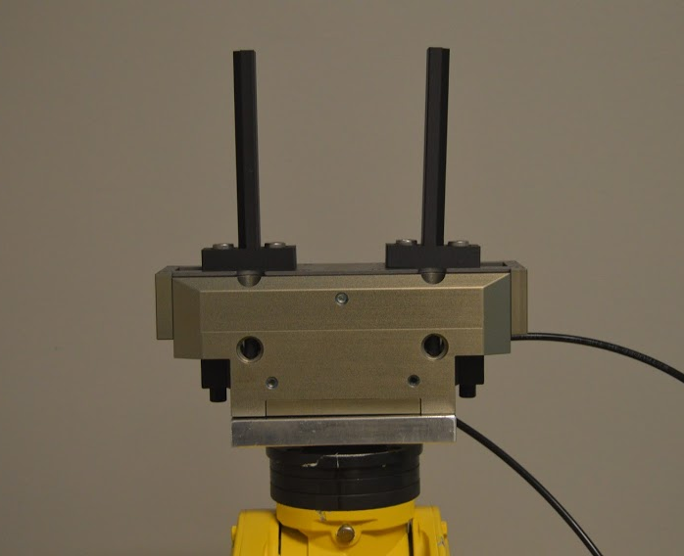
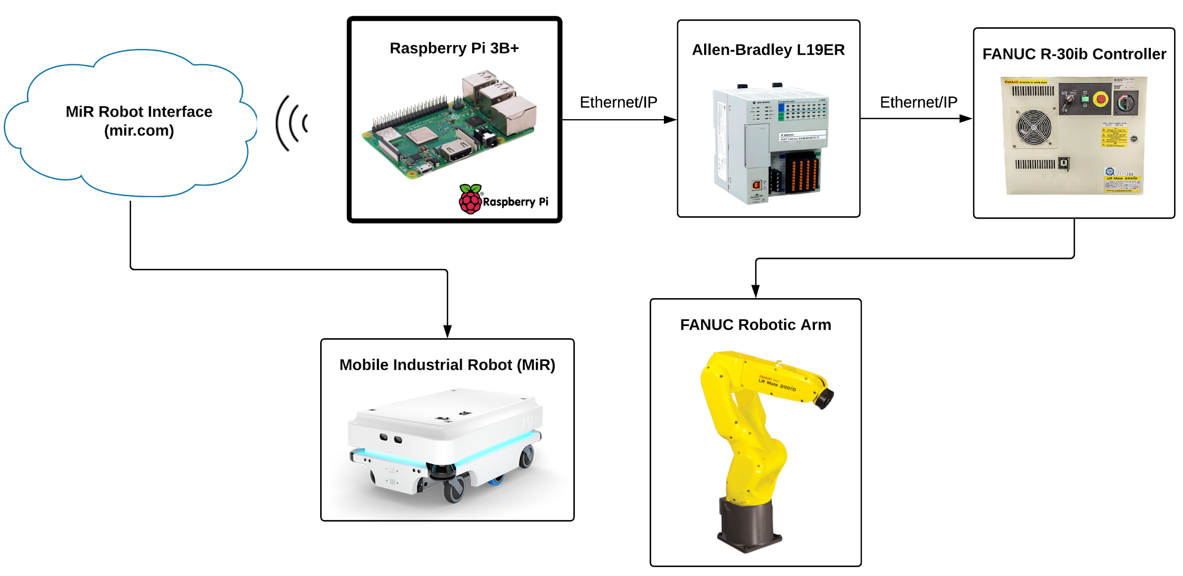
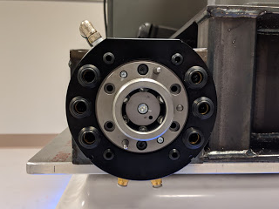
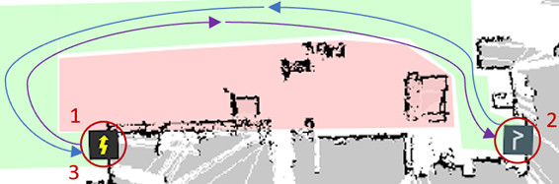
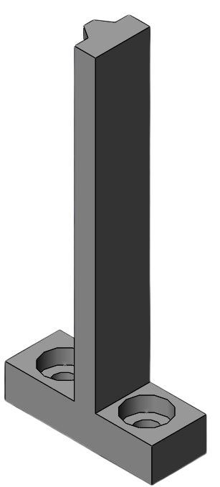
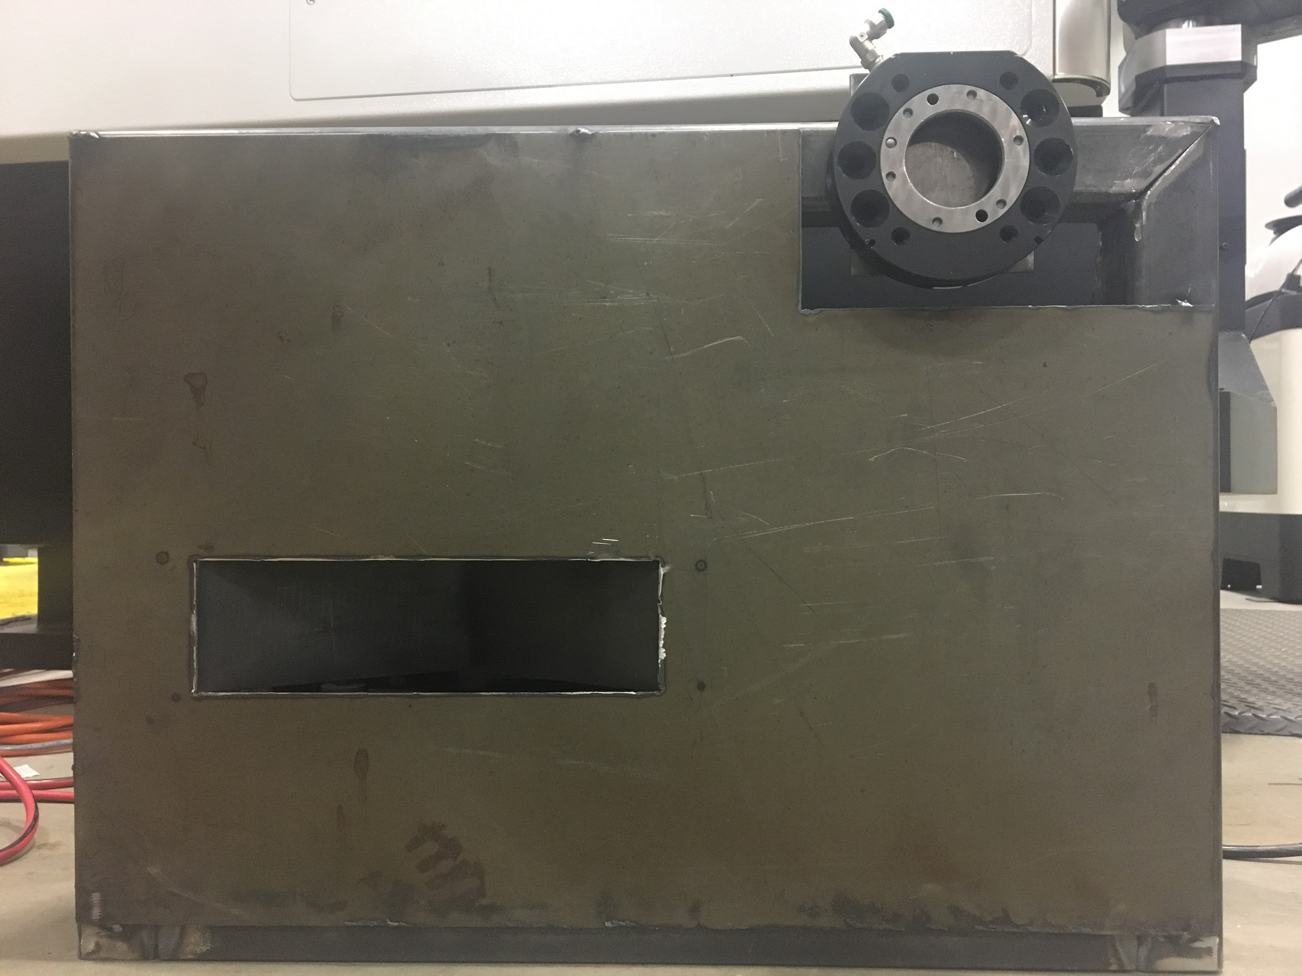
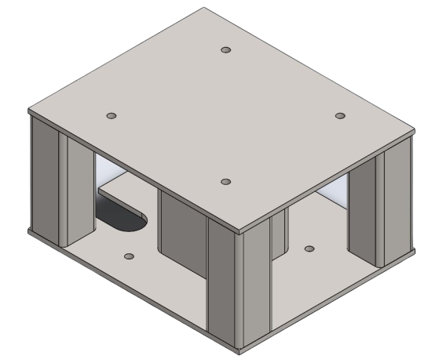
Automated Machine Tooling Utilizing Mobile Robotics
Elise Baribault, Katelyn Dudley, Lucas Gagnon,
Eric Schliemann, Spencer Sullivan, Nicholas Wheeler
Department of Mechanical Engineering, University of New Hampshire
Background
Machine downtime is costly in manufacturing
Manufacturing automation is becoming industry standard to increase overall process efficiency
FANUC Industrial Robot
LR Mate 200iD/7L
Used for moving material around a workspace
Can operate with 7 kg factory payload or 3.47 kg payload with added components
Maximum reach of 892 mm
Movement types consist of Linear and Joint, both based on coordinate destinations
Communications
Raspberry Pi 3 B+
Open source hardware microcontroller
Dual Band 2.4 GHz and 5 GHz WLAN and ethernet
Used as master controller to bridge communications between two dissimilar robots
Python
Native programming language of Raspberry Pi
Python code includes executable commands that allow robotic module to perform tasks autonomously
Communication Capabilities
Foundation for extending functionality into Industrial Internet of Things (IIoT) and Industry 4.0
Potential applications: tool failure, unanticipated part design changes, human error reduction
Project Overview
Use robotic module (MiR and FANUC) to manage and maintain production capabilities by replacing CNC tools as needed
Sample Process Flow Chart
Mobile Industrial Robot (MiR)
Collaborative mobile robot
Provides module with mobility and acts as main power source
System allows for adaptability in work environment
Mapping capabilities (ultrasonic and laser detection)
MiR is capable of accurate and reliable docking
  MIR specifications: +/-50 mm of position, +/-10 mm to docking marker
    charging station
    pneumatic dock
Battery life study
  MIR specifications: 10 hrs or 20 km
  Measured MIR battery life: 8 hrs 19 mins
  Measured MIR and FANUC battery life: 7 hrs 30 mins
Communication Network
Tooling
End-of-Arm Grippers
Originally designed to hold a CAT40 tool holder
Redesigned to pick up raw stock for CNC
Docking Station
Provides pneumatic power that allows functionality of grippers
Platform
Designed to give the FANUC robotic arm the height needed to reach into the CNC work area
Progress
Missions are in place for MiR to travel from charging station to CNC machine autonomously
FANUC robotic arm programmed to load material into CNC work area
Raspberry Pi can remotely control the MiR through Python code utilizing the MiR’s wireless network
Established Ethernet/IP connection between Raspberry Pi and PLC (Allen-Bradley L19ER)
Finalist for 2019 ASME/SME Student Manufacturing Design Competition
John Olson Advanced Manufacturing Center Map
Gripper Finger
MiR Docking Station
FANUC Platform
Acknowledgements: Olson Center (Brad Kinsey, Mike Locke), Turbocam (Jonathan Bicknell, Kris Fargo, Bryce Mazzochi), MiR Representative (Andrew Feeney)

