Slide 1
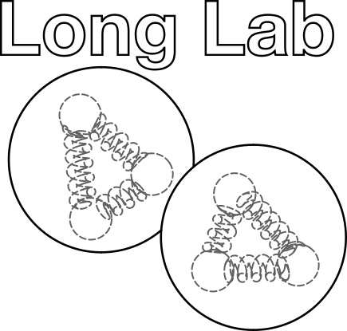

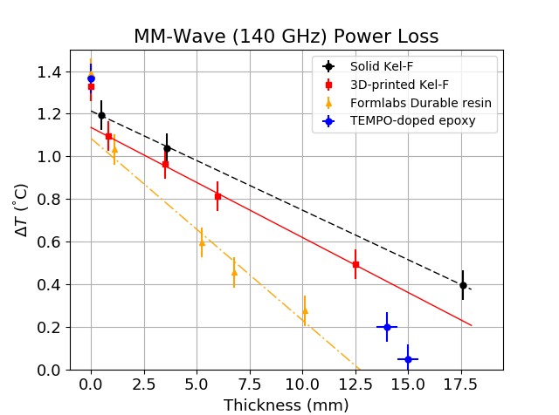
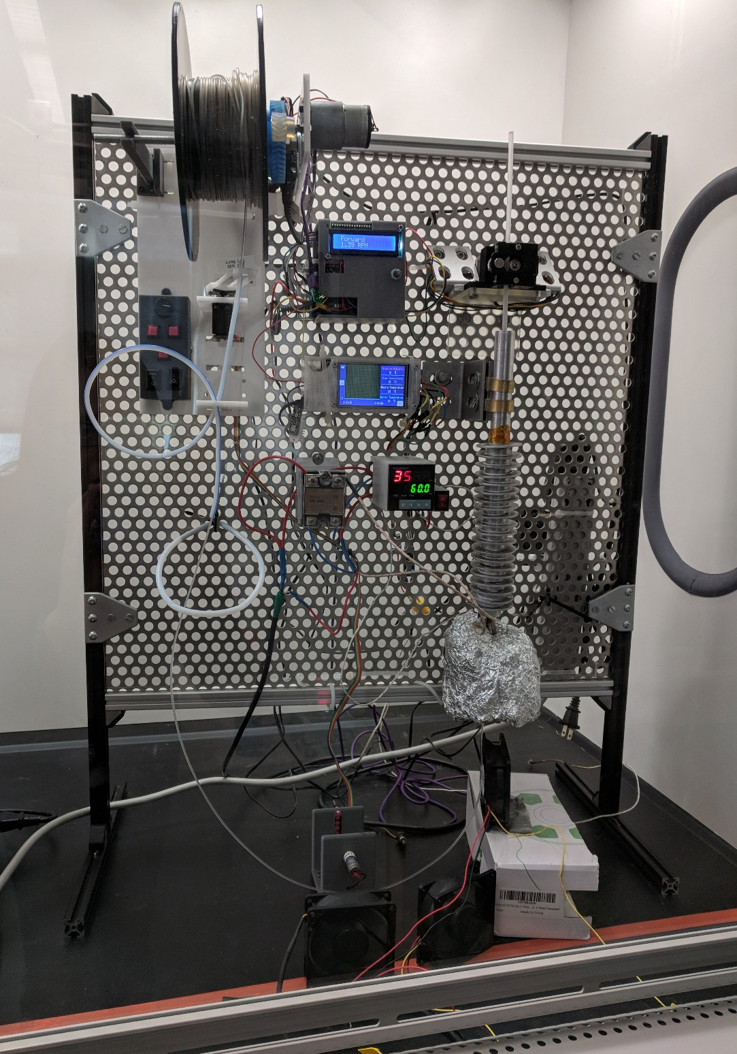
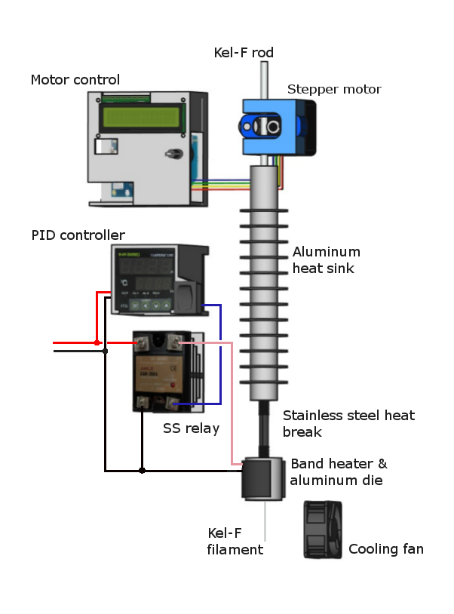
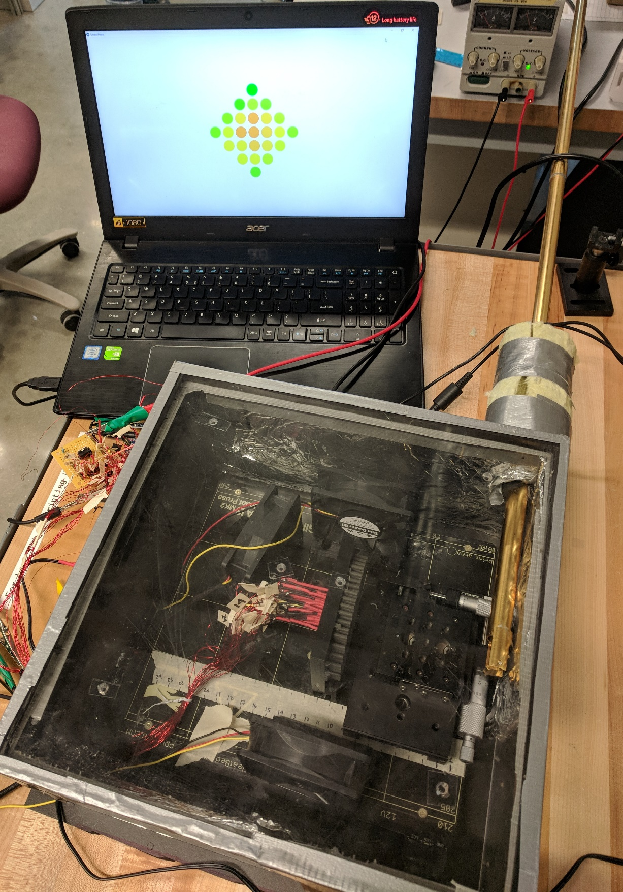
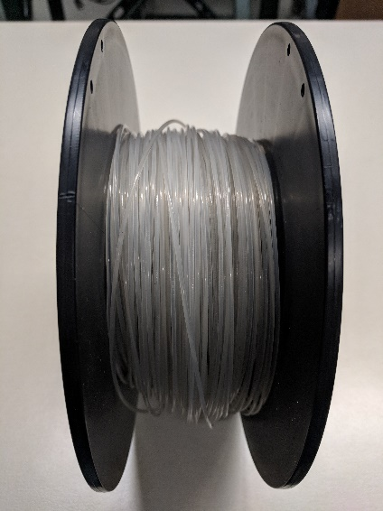
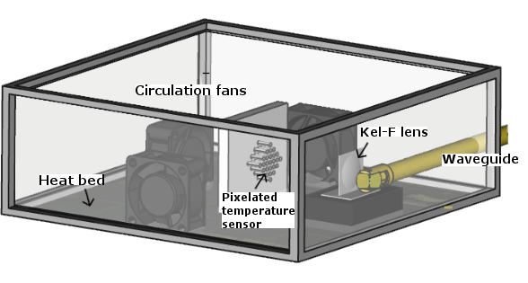
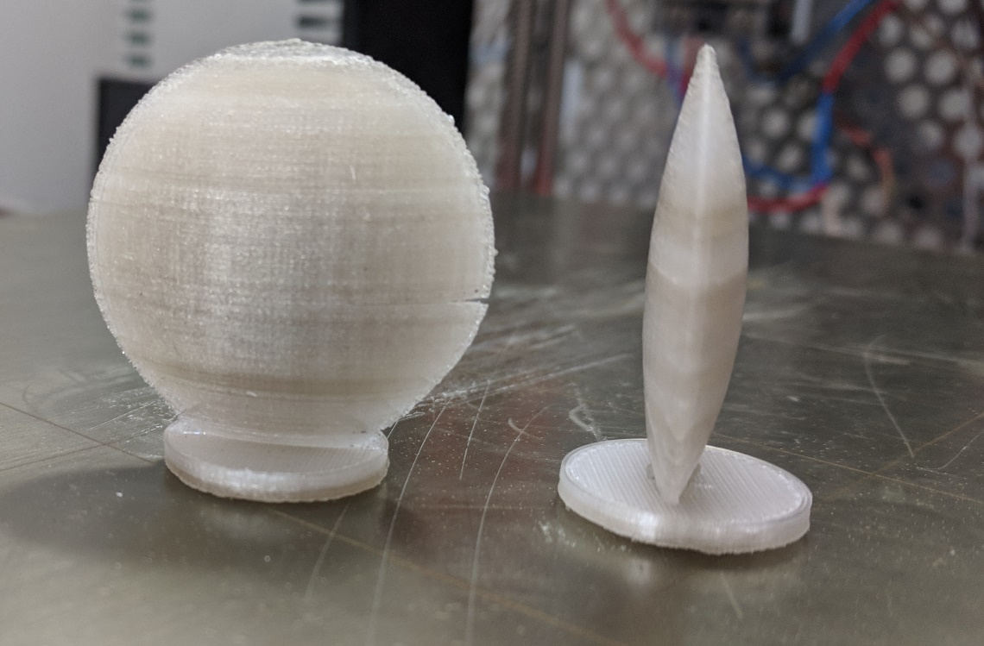


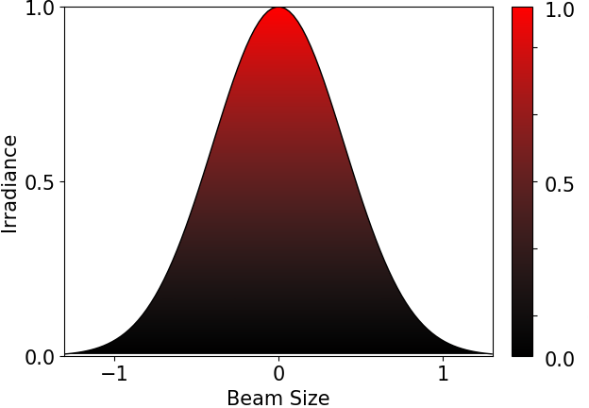
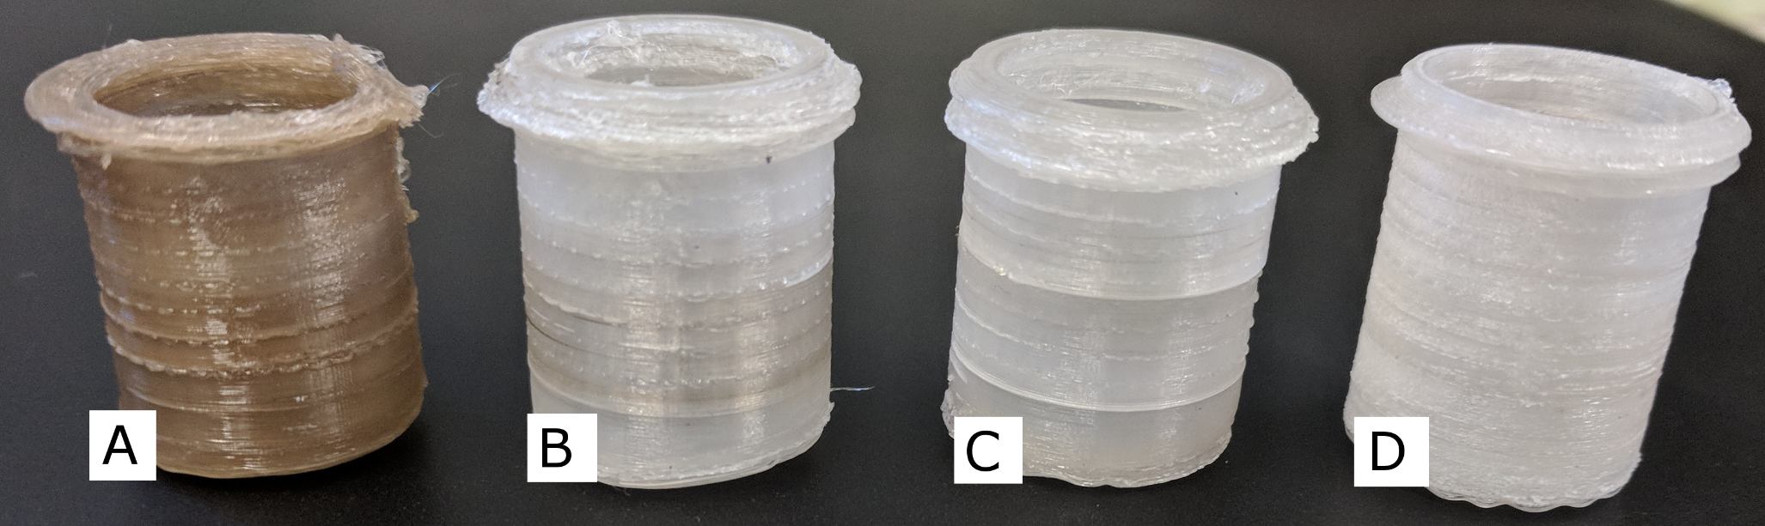
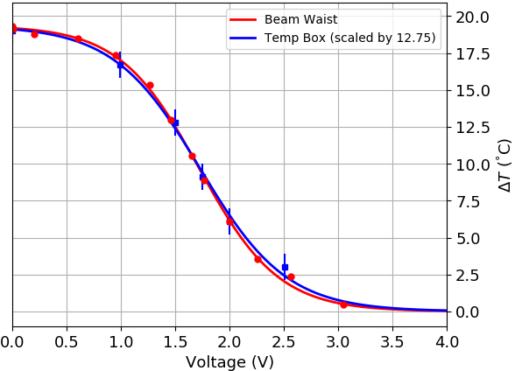
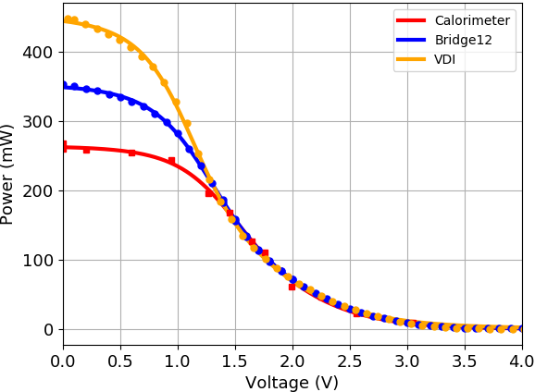
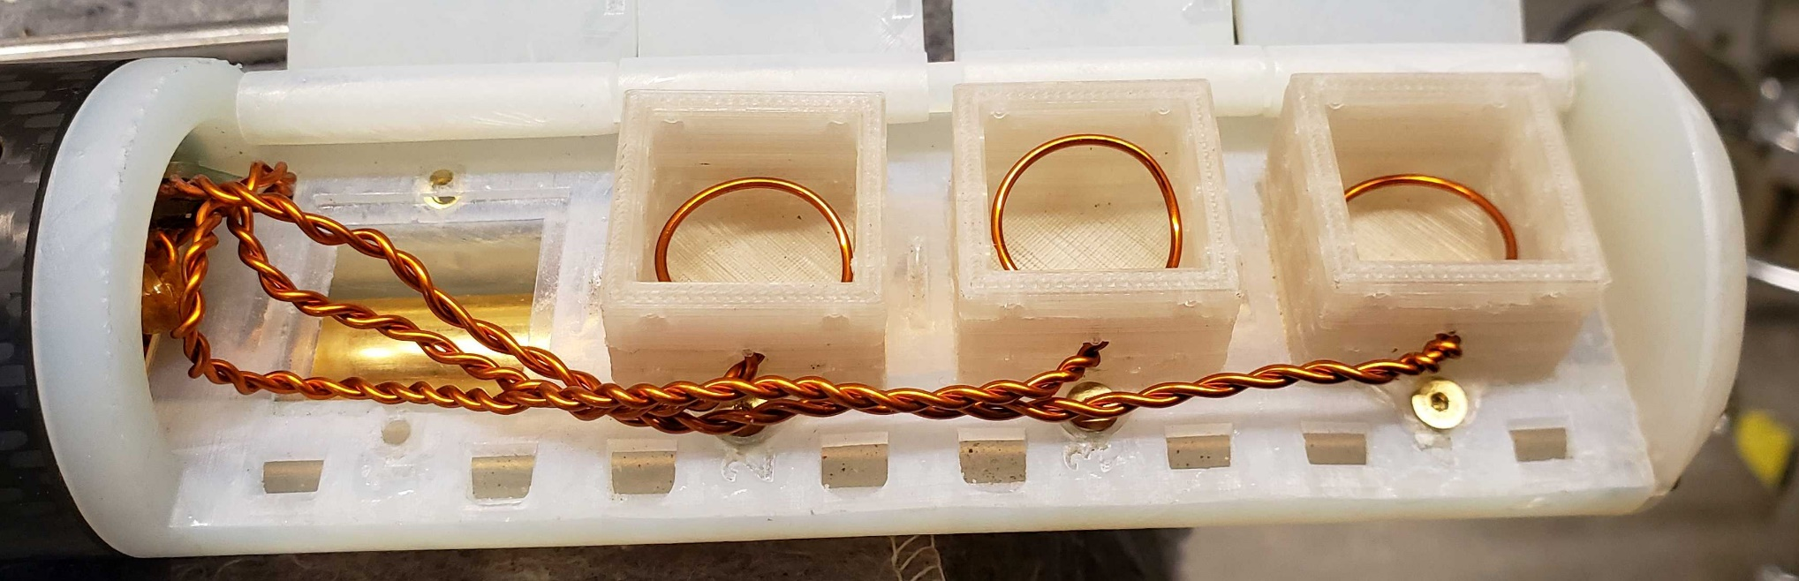
3D-Printed mm-Wave Lenses for DNP Target System
Kellie McGuire
Advisor: Prof. Elena Long
University of New Hampshire Physics
Background
The University of New Hampshire’s Long Lab¹ is at the forefront of 3D-printing innovation, developing new printing techniques and materials for nuclear physics experiments.
Included in this work is a method of 3D-printing with the fluoroplastic Kel-F® (PCTFE). This technology is being used to manufacture millimeter-wave lenses for a dynamic nuclear polarization (DNP) target system.
In DNP, a target material is placed in a strong magnetic field and exposed to mm-wave radiation, inducing electron-to-nucleon spin transfer. 3D-printed lenses could be used to evenly distribute the polarizing radiation and help drive up the degree of nucleon spin polarization.
This work is part of the UNH Nuclear Physics Group’s tensor-polarized target project.² To date, deuteron polarization of 15-20% has been achieved,³ and it is a central goal of the group to increase this to > 30%.
3D-Printing with Kel-F
3D-printing with Kel-F poses many challenges:
Small temperature window in which Kel-F can be processed before it crystalizes and turns brittle.
High processing temperature (~360 °C).
Self-lubricating; will not adhere directly to print bed.
High melt viscosity; must print at a slower speed than conventional materials.
Work is performed in a fume hood to minimize exposure to HF and HCl.
Kel-F Lenses and Power Loss
The polarizing radiation is in the form of a 140 GHz Gaussian beam incident on the Kel-F target cups. The beam is imaged using a custom calorimeter that features 25 thermally isolated “pixels” positioned inside a temperature-controlled box.
Printer filament is made in-house using a custom device, the “Filatizer.” Kel-F is thermally unstable and will decompose rapidly at high temperatures. To make quality filament, temperature, speed, processing volume, and cooling must all be carefully controlled.
Measurements from the calorimeter show Kel-F to be less transparent than expected, while better-performing than Formabs’ Durable resin, used in the target ladder design. Also shown is the mm-wave loss through a TEMPO-doped epoxy target, where absorption is desired.
Temperature-controlled box for imaging mm-wave radiation through Kel-F lenses.
“Filatizer” filament production system used to create Kel-F filament.
Motivation
Why Kel-F?
Suitable for use in dynamic nuclear polarization (DNP). Kel-F is ideal because:
It retains its plasticity at 1K, the temperature at which DNP is performed.
It is highly* transparent to the mm-wave radiation used in DNP.
It contains no free protons that could introduce noise in the NMR signal used to measure polarization.
Why 3D printing?
3D printing offers several benefits over machining:
Rapid prototyping.
Allows for complex geometries that are difficult or impossible to machine.
*Although not as transparent as expected, as this study reveals.
The lenses are printed with a layer thickness of 0.1 mm. They can be printed with hyperbolic or parabolic surfaces that would be difficult to machine.
Early results show significant power loss through the lenses due primarily to unexpected mm-wave absorption.
Results show that Kel-F is less transparent at 140 GHz than anticipated. This places limits on the practicality of designing lenses that can focus the radiation within the short distances necessary for the DNP target system.
MM-wave beam on calorimeter (left). The unobstructed beam has a Gaussian irradiance pattern (right). Kel-F lenses will be designed to evenly distribute the beam irradiance with minimal absorption.
Acknowledgments
This research was funded through grants from the U.S. Department of Energy and the University of New Hampshire’s Hamel Center for Undergraduate Research. I am especially grateful to Dr. Elena Long for her guidance and unwavering encouragement throughout this project.
DNP target cups. (A) was printed with over-processed filament; (B) and (C) show considerable color improvement but contain regions that are glassy and brittle; (D) was printed at a faster speed and the material retained its plasticity.
References
www.unhlonglab.com
https://nuclear.unh.edu/
3. W. Meyer, et al., Nucl. Instr. Meth. A 244, 574 (1986).
DNP target ladder with NMR coils and rectangular 3D-printed Kel-F cups after cooling to 1 K. The cup on the far left was removed to allow access to electronics.
Calorimeter performance compared with data from manufacturer (left); performance of calorimeter positioned before and after waveguide (right).
2019 UNH Undergraduate Research Conference

