Slide 1


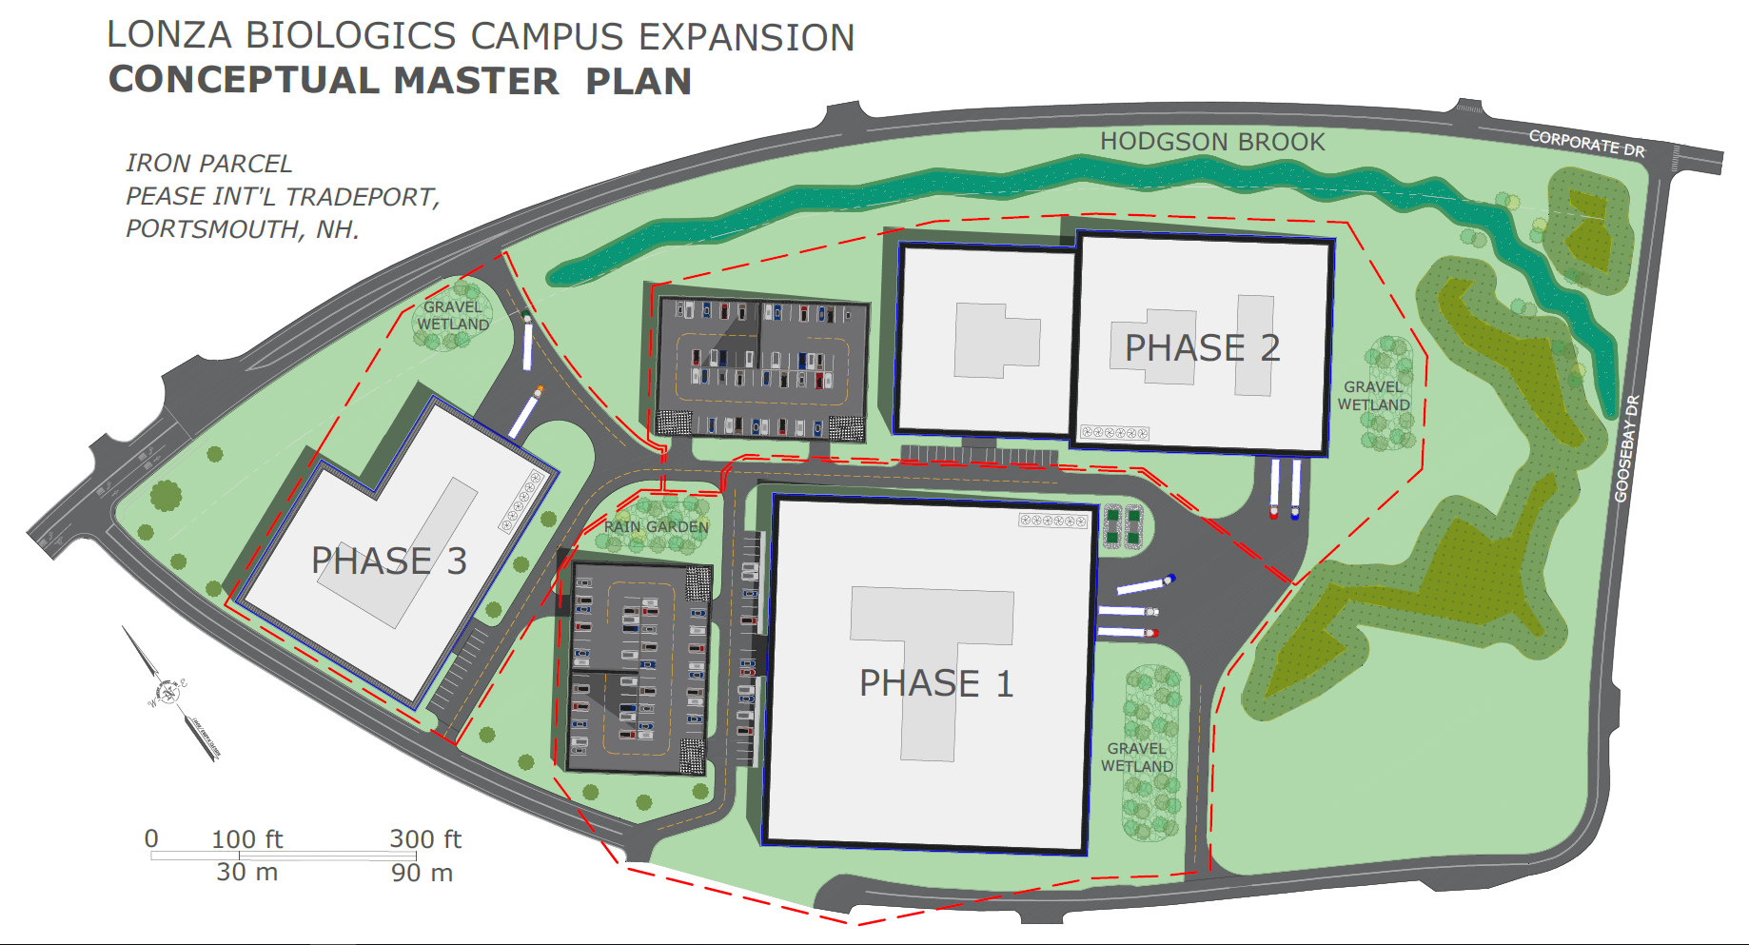
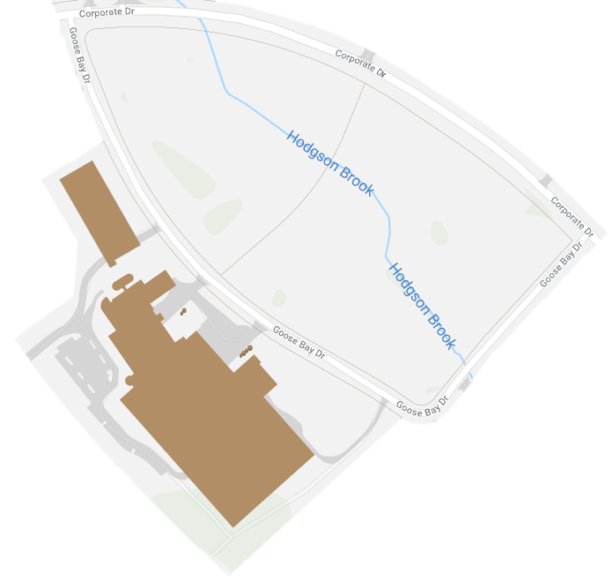
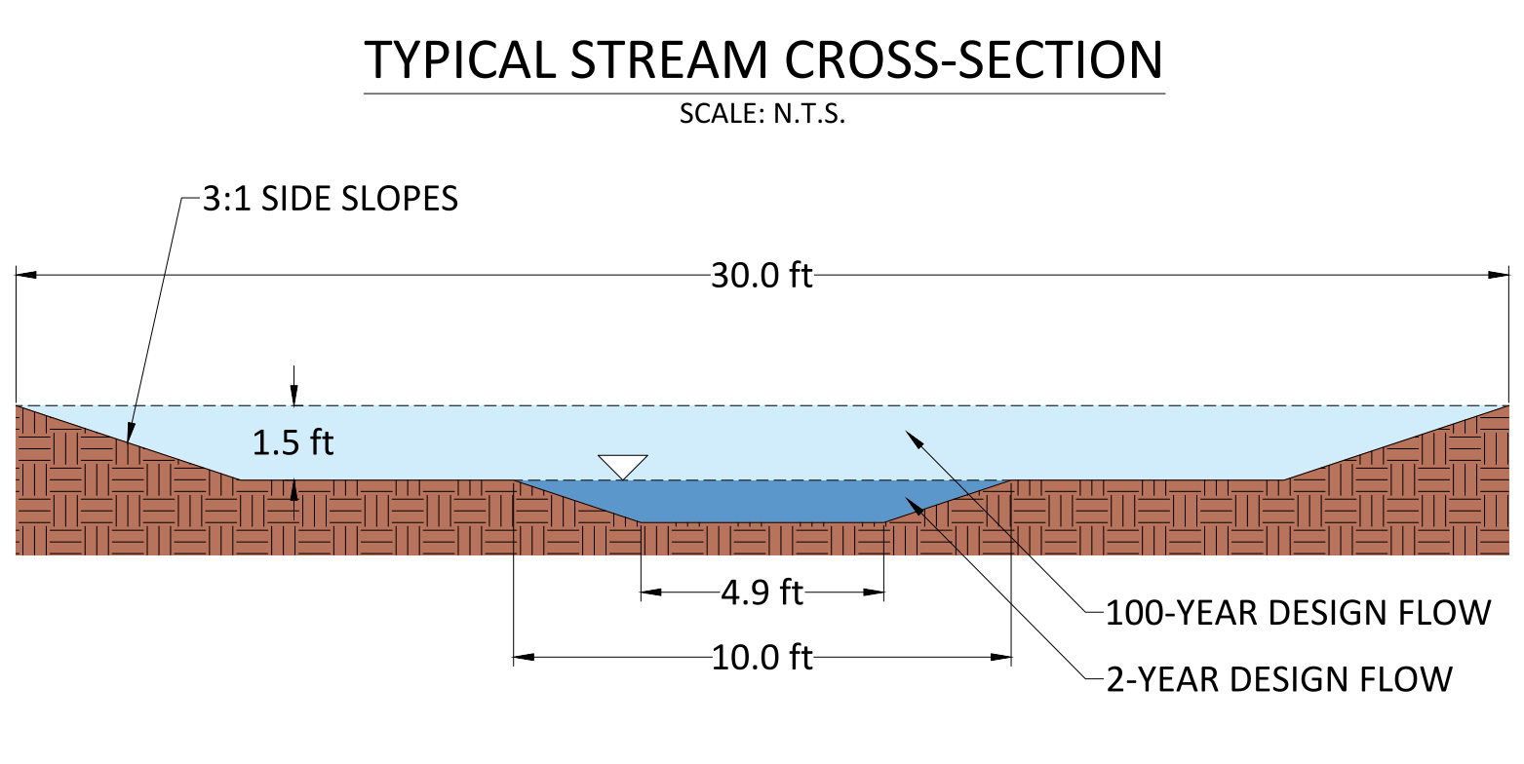
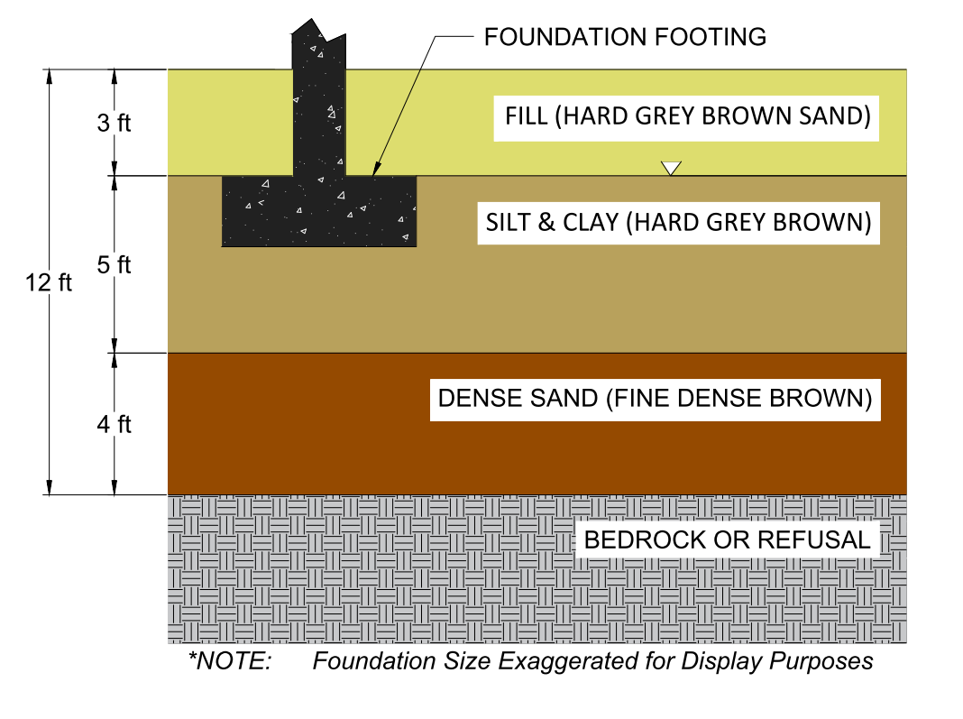
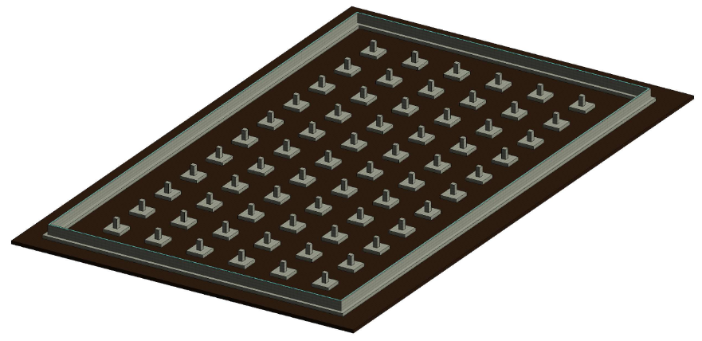
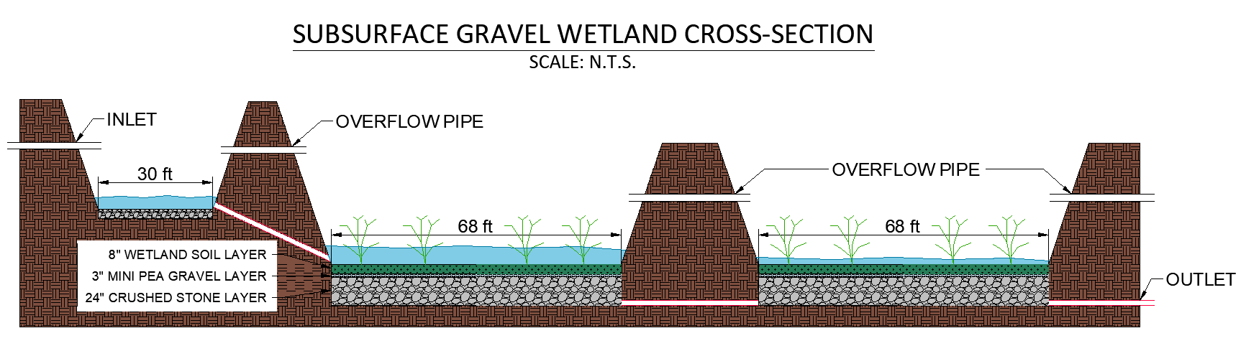
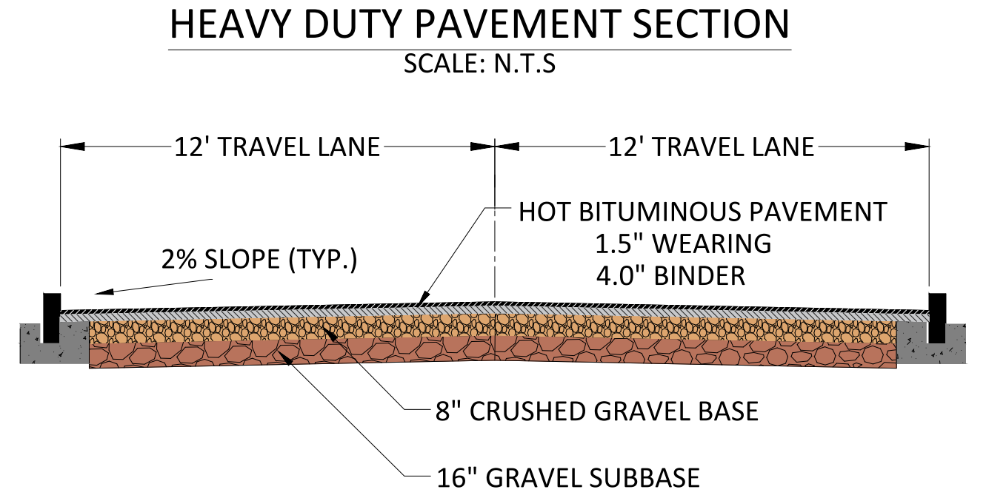
Lonza Biologics Campus Expansion, Portsmouth, NH
Allan Masison, Nicholas Francis, Owen Sweet, Philip McHenry (PM) & Rezwan Ali
Project Advisor: Anthony Puntin, P.E. | Project Sponsor: Patrick Crimmins, P.E.
Scope of Work
Existing Conditions
  Conceptual master plan for proposed campus expansion
    Building locations
    Traffic circulation
    Parking
  Stream restoration design
  Foundation & pavement recommendations
  LID stormwater management
  Environmental assessment
  23-acre site, the “Iron Parcel”
  Neighboring Lonza facilities
  Hodgson Brook flows under site in 48-inch concrete pipe
  1.73 acres of wetland area
  Large soil pile
  Chlordane contamination
  Historically served as housing for Pease Air Force Base
Program
  Merge Iron Parcel with existing campus to provide cohesion
  3 phases for development
  1-million ft² of industrial space
  1,000 future employees
  Minimum 667 parking spaces
  Minimize environmental impact
  Daylight Hodgson Brook
Stream Restoration
Foundations
Stormwater Management
40+ boring logs were provided
Refusal typically between 12-18 ft
Mostly fill, dense silty clay and dense sand layers
Frost line 3 feet below grade
Shallow foundations
(3D perspective)
  Subsurface gravel wetland for Phase 1
  Water Quality Volume (WQV) = 15,000 ft³ , 1-inch storm
  95% theoretical removal efficiency
Pavement
Wetland Impacts
  Mitigation is required by law when wetlands are impacted (NHDES)
  1.73 acres of wetlands; 0.93 acres impacted, 0.80 acres avoided
  $200k expected contribution to the Aquatic Resource Management (ARM) Fund for wetland impacts
Acknowledgements
  Special thanks to our sponsor, Patrick Crimmins from Tighe & Bond, our advisor, Anthony Puntin, and the help provided by Joel Ballestero, Prof. Tom Ballestero, Prof. Jo Sias, and the UNH Stormwater Center.
3
  2-year flow = 52.1 cfs ; 100-year flow = 175.9 cfs
  Drainage area = 131.8 acres

