Slide 1
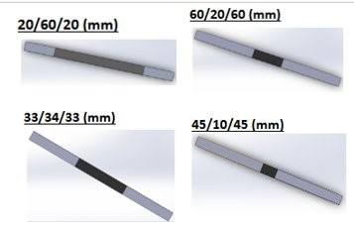
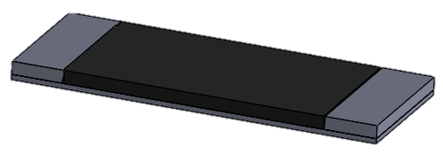
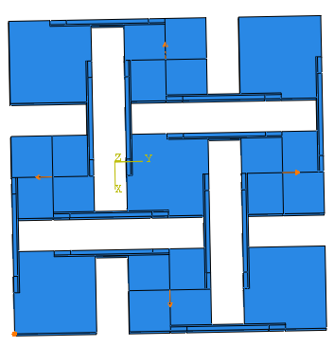
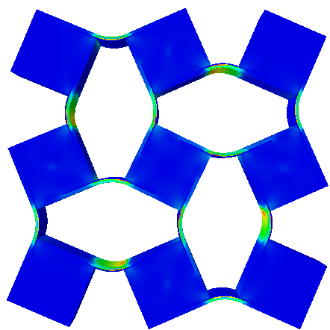
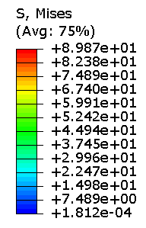
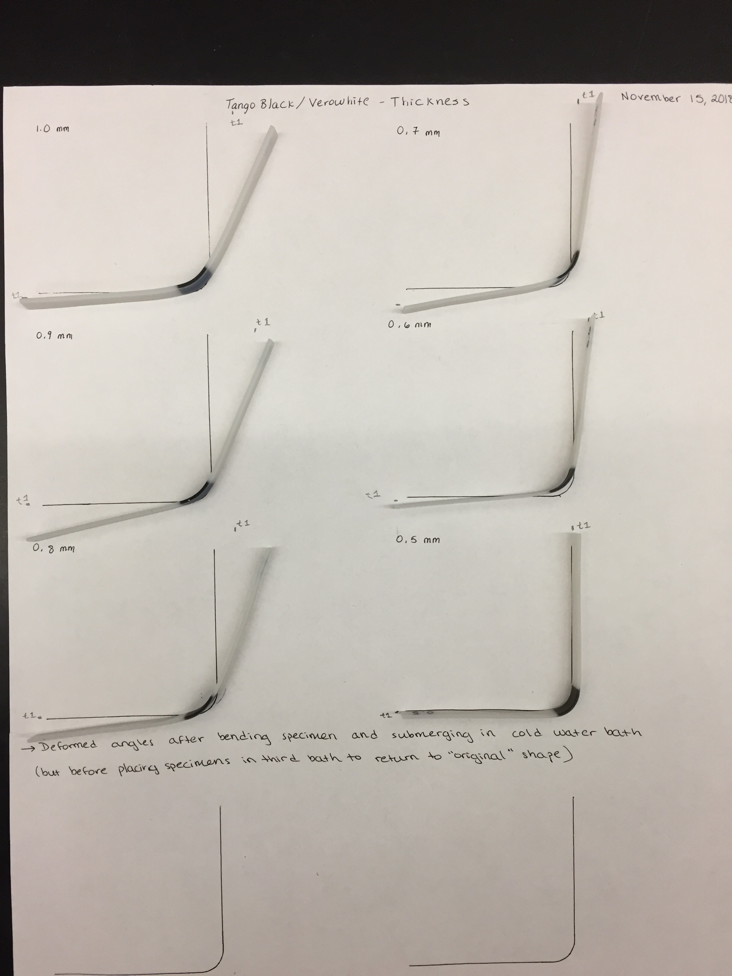
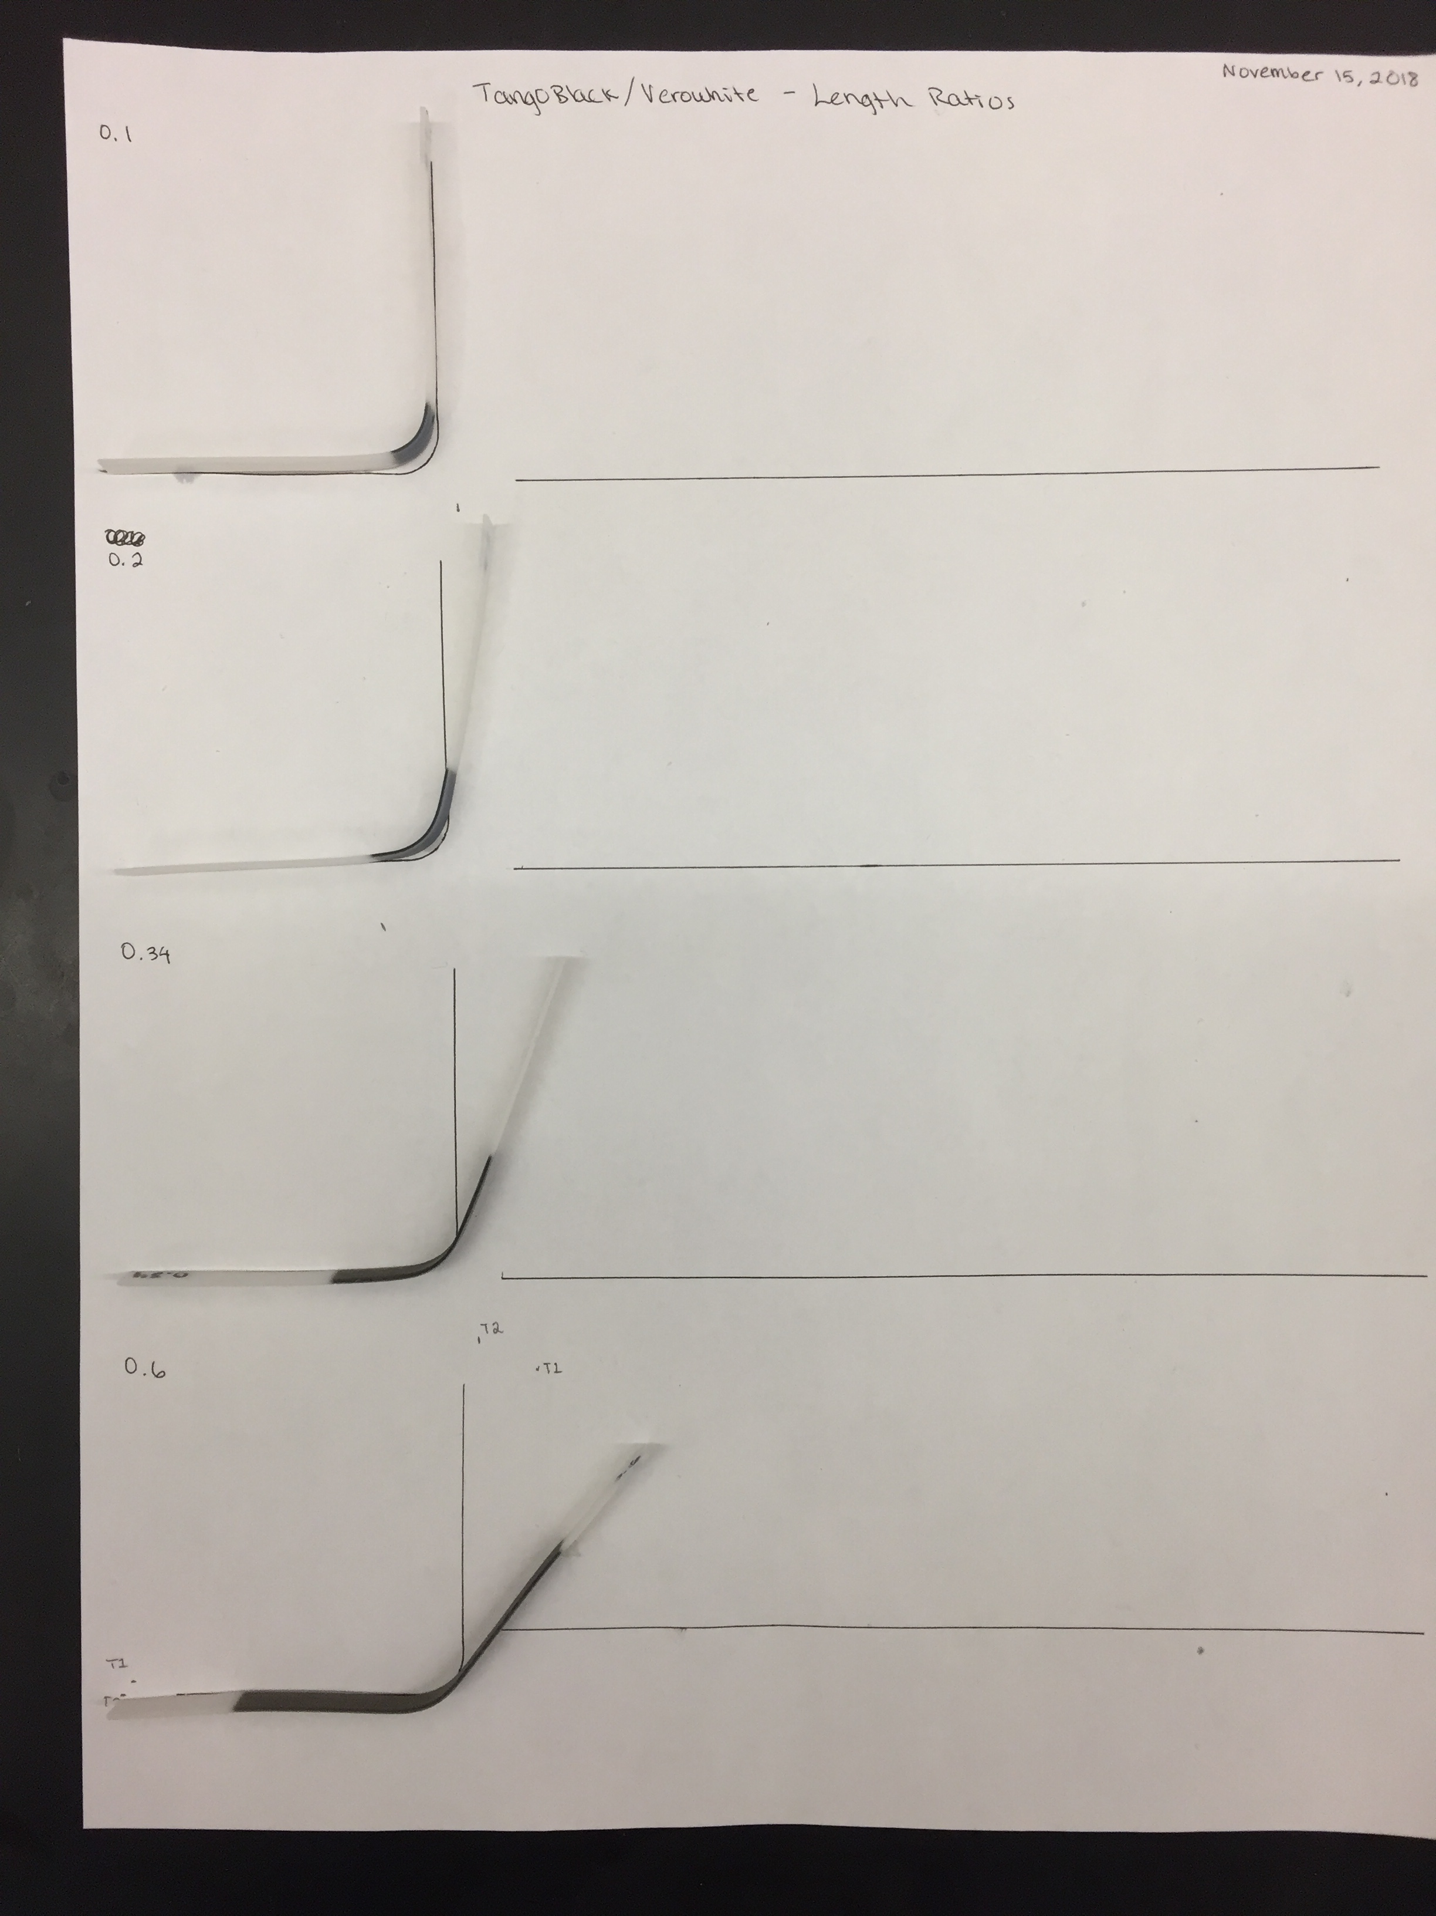
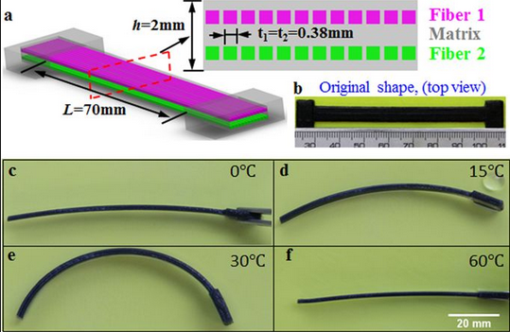
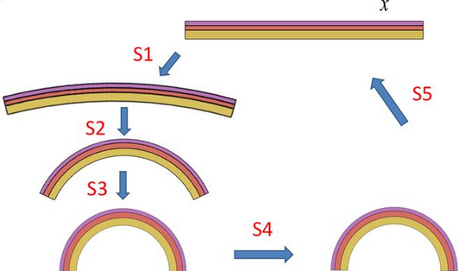
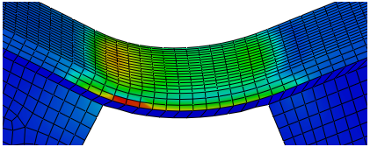
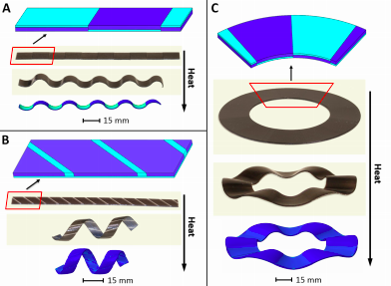
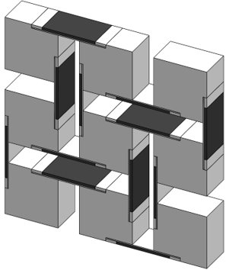
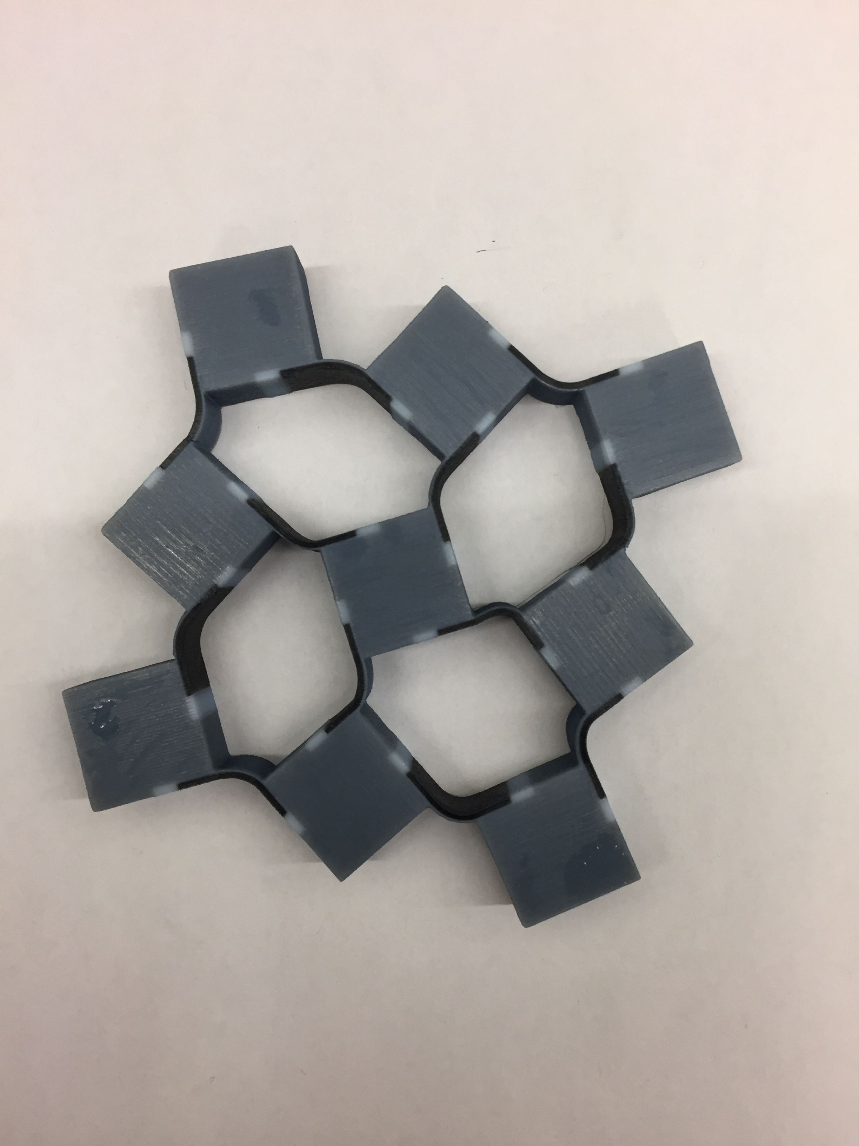
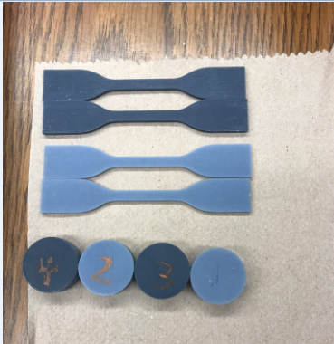
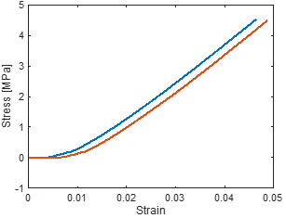
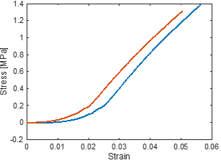
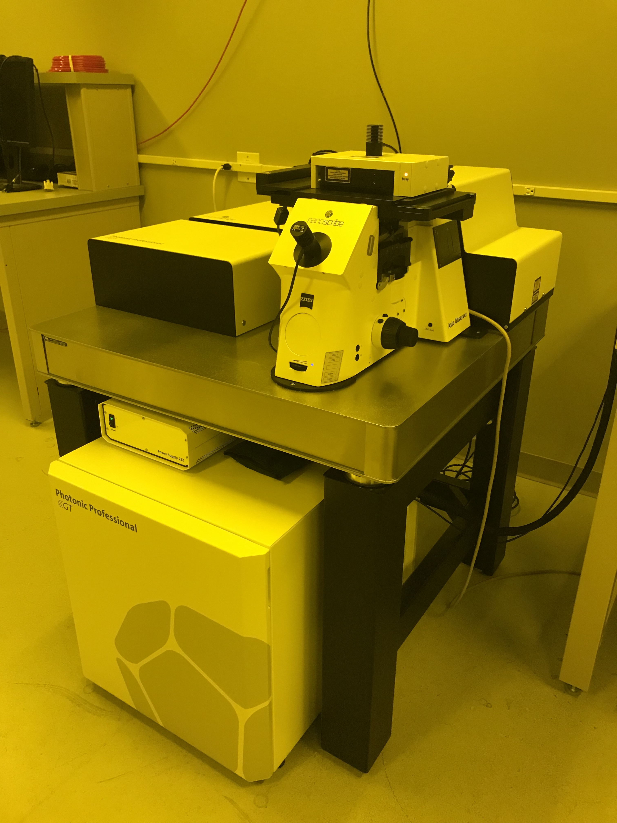
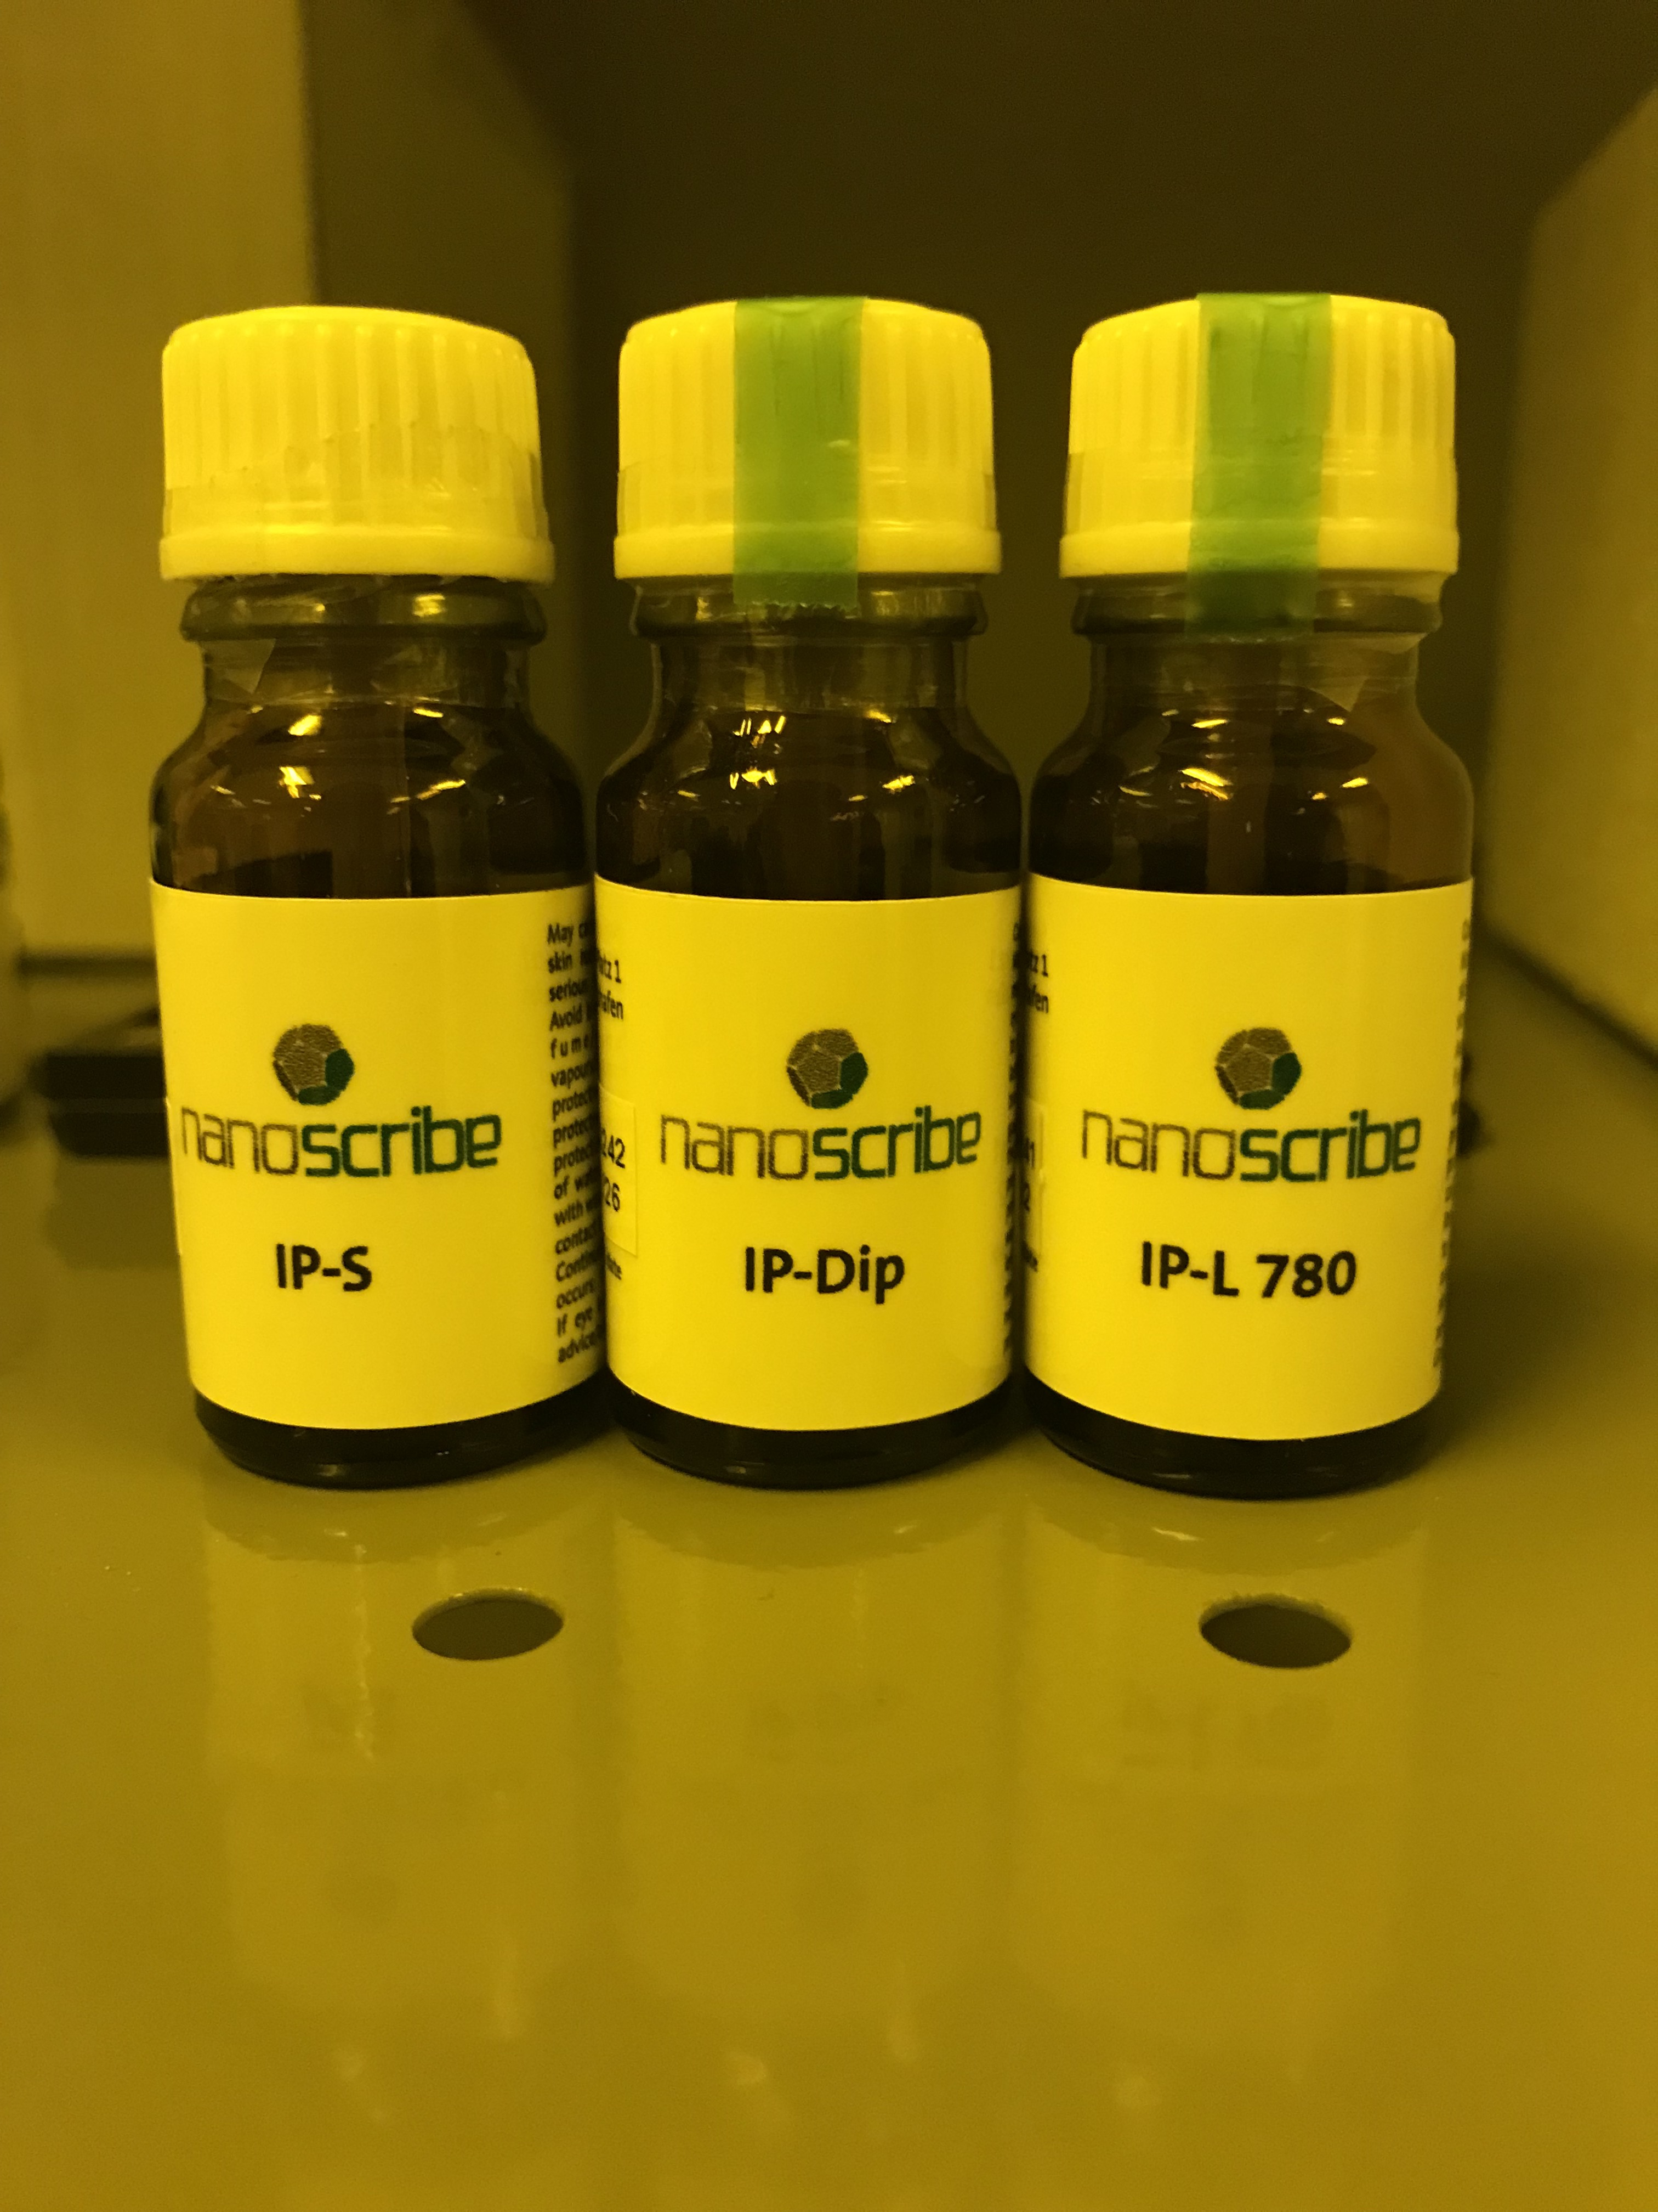
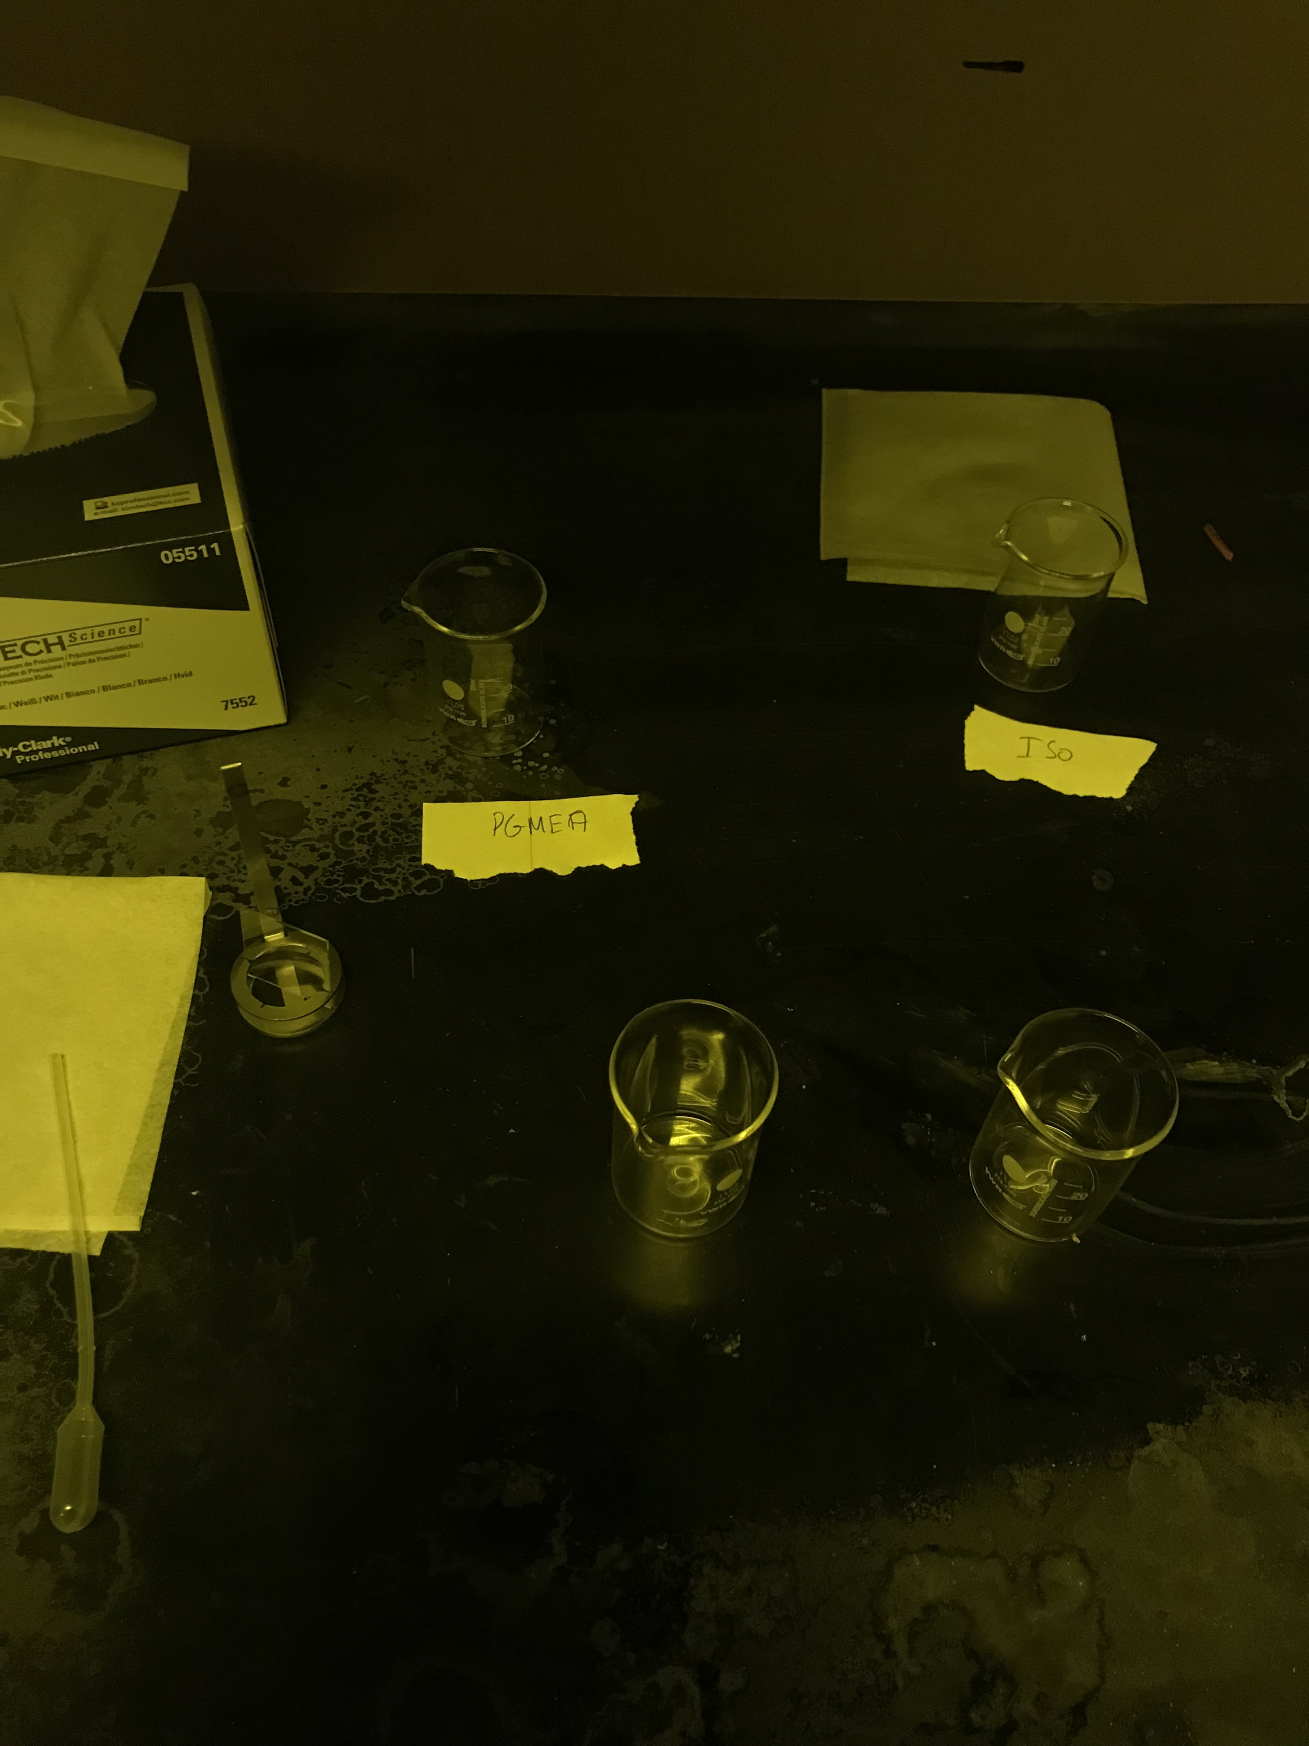
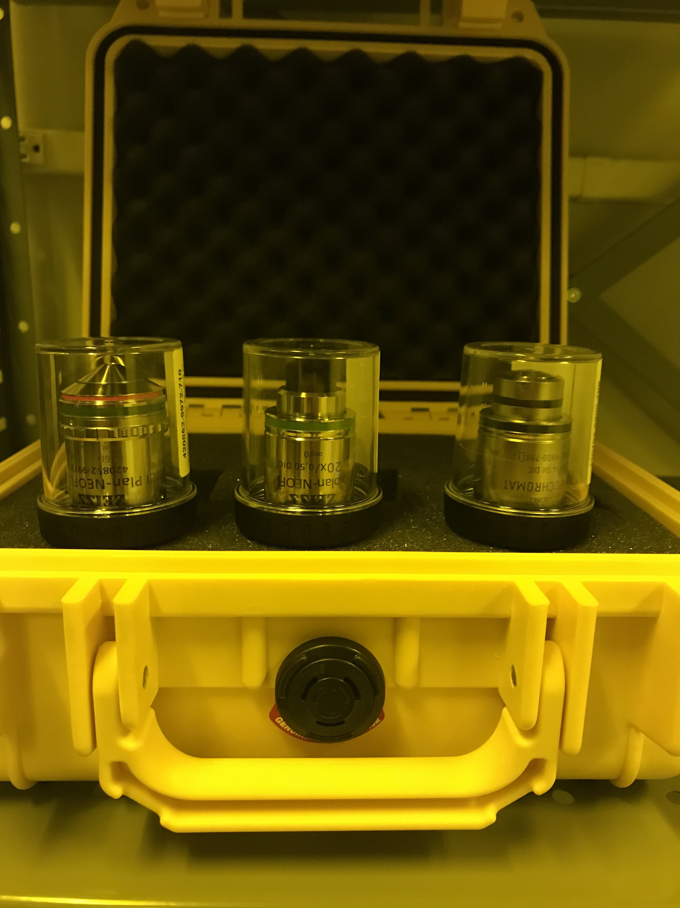
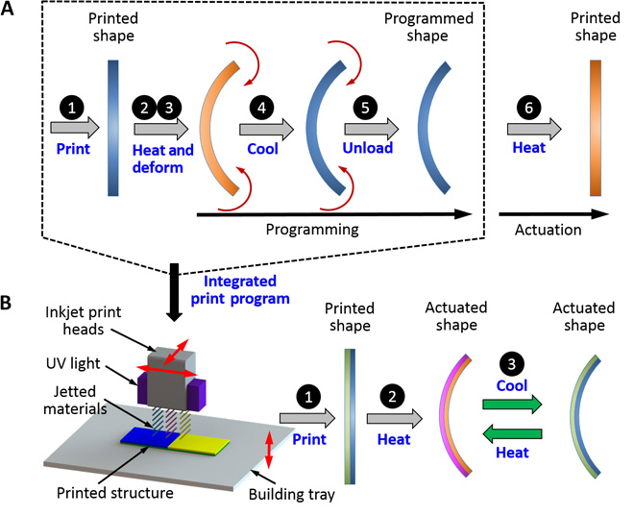
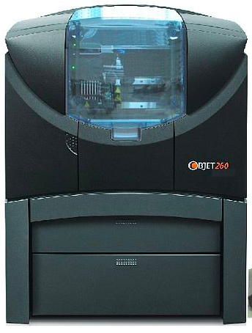
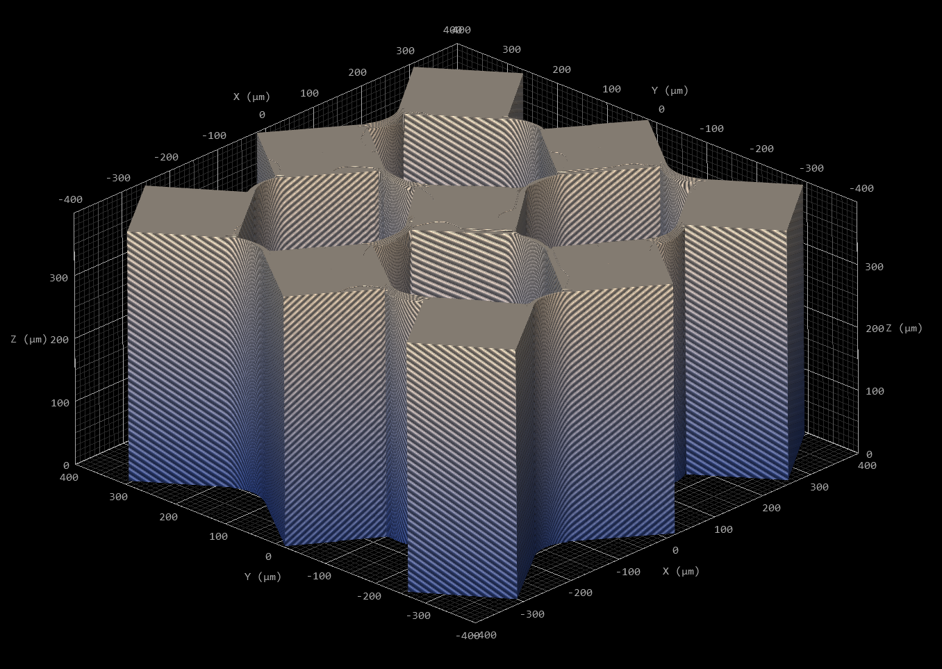
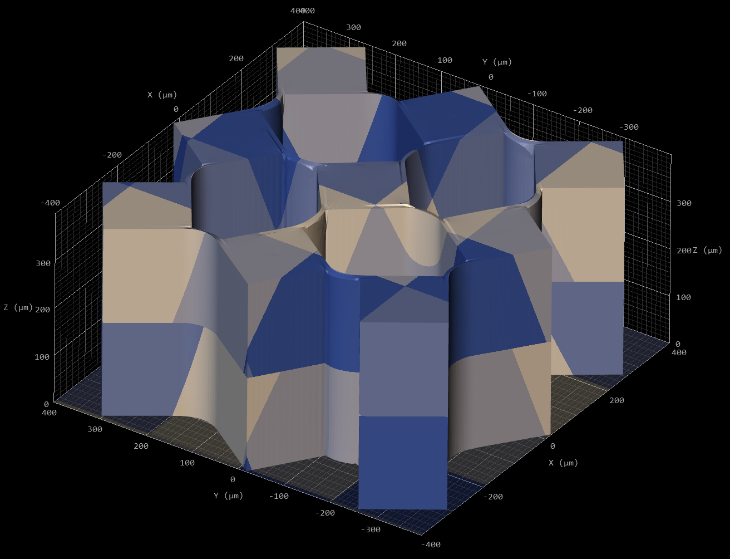
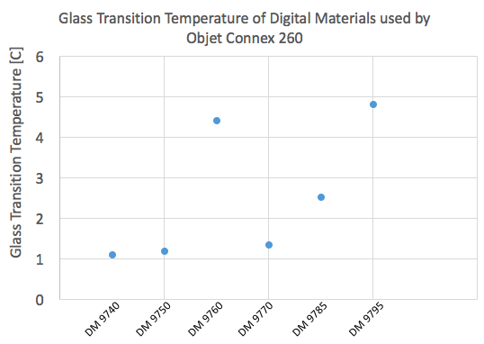
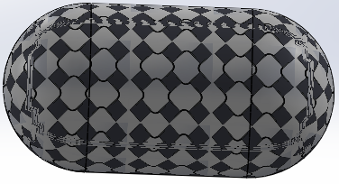
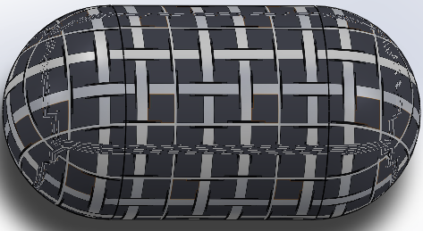
Characterizing and Analyzing 3D printed Smart Composites
Benjamin Andwood, Connor Byron, Dean Intonti, and Olivia Le Ray
Advisor: Dr. Yaning Li
Background & Motivation
Goal: Create self-folding simple geometry with real world applications
Shape memory polymers: materials that physically respond to external stimuli (i.e. thermal, electrical, optical, etc.)
Researched prior work from: Dr. Jerry Qi (professor at Georgia Tech), Jennifer Lewis, Jiangtao Wu who studied shape memory effects
Important material properties include: Modulus of Elasticity, Glass Transition Temperature, Thermal Expansion Coefficient
Applications include: biomedical drug delivery and tissue engineering
Design Criteria: Mechanical Experiments w/ Hinge Design
Finite Element Analysis
Mid-Block axial displacement applied
3 elements through hinge
Max displacement of 12.38 mm
Material Ratios:
VeroWhite to TangoBlack to VeroWhite
Thickness w/ 10% TB
→ 0.5 mm
Results
Experimental Analysis: Compression Test
Compression Test → Modulus of Elasticity
- 2 digital materials (DMs) printed from Connex 260
- Zwick Roell Uniaxial testing machine
Heat
Utilizing existing thermal expansion coefficients
→ object could be printed and deformed immediately without prior programming
Purple ~ TangoBlack
Blue ~ VeroWhite
15 mm
Heat
Nanoscribe
Highest resolution (X & Y: 150 nm and Z: 450 nm)
Utilizes Two-Photon polymerization of various UV-curable photoresists
Heat
Stress [MPa]
Stress [MPa]
15 mm
15 mm
Strain
Modulus of Elasticity
DM 8530, E = 115.1 MPa
DM 9895, E = 35.71 MPa
Strain
DM 8530 'Gray60'
DM 9895 'Shore95'
Experimental Analysis: Differential Scanning Calorimetry
Differential Scanning Calorimetry (DSC) → Glass Transition Temperature (T_{g})
- 6 digital materials printed from Connex 260
- DSC Q2000 machine
3D model of design to be printed by Nanoscribe
Total Length…
Left: ~500 um Right: ~ 1.6 mm
Glass Transition Temperature of Digital Materials used by
Objet Connex 260
Future Work
Research prior studies in Tissue Engineering and scaffold designs
Develop mock scaffold designs and perform finite element analysis to narrow down design features
3D print optimal design & perform mechanical tests to characterize structure
3D Printer: Connex 260
Jet layers of UV curable liquid photopolymer (capable of 6 materials at once)
30 – micron resolution for digital material (thinnest layer of 16 microns)
Utilizes Objet Studio 3D printing software
Glass Transition Temperature [ºC]
Project Scope
Develop a comprehensive understanding of pattern transformations through analyzing shape memory effects and smart-3D printing
Determine properties of materials being utilized
Perform parametric studies on simple geometric designs to determine optimal parameters/ features
References
[1] Wu, Jiangtao, et al. “Multi-Shape Active Composites by 3D Printing of Digital Shape Memory Polymers.” Scientific Reports, vol. 6, no. 1, 2016, doi:10.1038/srep24224
[2] Z. Ding, C. Yuan, X. Peng, T. Wang, H. J. Qi, M. L. Dunn, Direct 4D printing via active composite materials.Sci. Adv.3, e1602890 (2017)
[3] Robertson, J.M., Torbati, A.H., Rodriguez, E.D, Mao, Y., Baker, R.M., Qi, H.J., Mather, P.T., 2015. Mechanically Programmed Shape Change in Laminated Elastomeric Composites, Soft Matter, 11, 5754-5764.
Glass Transition Temperatures of 6 Digital Materials
T_{g} range: ~1 - 5ºC
Malleable at room temperature

